Slide 1

What caused it?
How to Isolate Program Effects on Improved Performance
Patti P. Phillips, Ph.D.
CEO, ROI Institute, Inc.

Slide 2
Upon completion of today’s session, you should be able to:
1
2
3
  Describe the importance of isolating the effects of programs.
  Apply at least three techniques to isolate the effects of programs.
  Determine when
  to use each of the techniques
  covered in this session.

Slide 3

Grab your calculator!
Notes:
This is a rapid fire chat.

Slide 4

What Caused it?
Second quarter earnings increased 8%; the CEO wants to know
“What caused it?” Executive team members respond as follows:
The Chief Commercialization Officer started the discussion by pointing
out that sales of products in the growth portfolio is the factor for
the increase.
He added that marketing efforts tailored to these products influenced both doctors
and patients.
The Chief Strategy Officer thought it was the result of strategic partnerships.
The General Council indicated that it was due to regulatory streamlining.
The Chief People Officer spoke up and said that the employee referral program is enabling the company to hire more of the right people.
The Chief Talent Officer argued that their new sales coaching for managers was the key. Managers were better supporting their team members and coaching them toward higher performance.
4

Slide 5

Is this situation typical?
5
Notes:
This is a rapid fire chat.

Slide 6
Multiple factors contribute to improvement.
External Factors
Management
Attention
Incentives
TOTAL
IMPROVEMENT
AFTER
PROGRAM
Systems/Procedures
Changes
Your
Program
EFFECT OF YOUR PROGRAM
Notes:
Multiple factors contribute to the improvement in measures.

Slide 7







The value chain provides evidence.
Inputs
Reaction
Learning
Application
Impact
ROI
Value Chain
Number of participants, budget, sessions completed, etc.
Reaction, perceived value, and buy-in
Learning, knowledge, skill, information, insight, capability, connections
Application of knowledge gained, behavior change, compliance, system support
Impact and consequences of applying knowledge/skill due to the program
Benefits compared to costs
©Copyright ROI Institute, Inc. 1983-2025. All Rights Reserved.
Notes:
The value chain provides evidence through the logical flow of results.

Slide 8
Impact Measures
Absenteeism |  |  |  | Turnover |  |  |  |  |  | Complaints |  |  |  |  |  | Recidivism |  |  |  |  |  | Visas processed |  |  |  |  |  |  | Customer satisfaction
Families fed |  |  | Hospital length of stay |  |  |  |  |  |  |  |  |  |  | Needle Sticks |  |  |  |  |  |  | Accolades |  |  |  |  | Bills passed |  |  |  |  |  |  | Votes
Contracts closed |  |  |  |  | Memberships renewed | Renewals |  |  |  |  |  | New customers |  |  | New customers |  |  |  |  |  | False rejects |  |  |  |  |  |  | Near misses |  |  |  |  |  | Rework
Rejects | Call escalations |  |  |  |  |  |  |  | New products |  |  |  |  |  |  |  |  |  | Carbon dioxide equivalents (CO2e) |  |  |  |  |  |  |  |  |  |  |  |  |  |  | Miles
Employee engagement |  |  |  |  |  |  |  | Stores sales |  |  |  |  |  | Awards |  |  |  |  | Customer net promoter score |  |  |  |  |  |  |  |  |  |  |  |  | Time to hire
Downtime |  | Overtime |  |  |  |  |  | Lost time accident |  |  |  |  |  |  | Traffic violations | Traffic violations | Traffic violations |  |  |  |  |  |  |  | Round-trip time |  |  |  |  | Number of investments |  | Investments
Churn rate |  | Average handle time |  |  |  |  |  |  |  |  | Slips and falls | Accidents | Accidents |  |  |  |  | Time to market |  |  |  |  |  | Inventory turnover |  |  |  |  |  |  |  | Conversions
Response time |  |  |  |  | New business licenses |  |  |  |  |  |  |  |  |  | Sales tax revenue |  |  |  |  |  |  |  | Cost per acquisition |  |  |  |  |  |  |  | Subscribers
Budget variance |  |  |  |  |  |  | Cycle time |  |  |  | Time in meetings |  |  |  |  |  |  |  |  | Job placements |  |  |  |  |  |  | Income |  |  | Kilowatt hours

Slide 9

The ROI Methodology Process Model
Designing for the Delivery of Business Results
PLAN THE EVALUATION
COLLECT DATA
ANALYZE DATA
Make it Credible:
Capture Costs of
Program
OPTIMIZE RESULTS
LEVEL 0: INPUT
LEVEL 1: REACTION AND PLANNED ACTION
LEVEL 3:
APPLICATION
Tell the Story:
Communicate
Results to Key
Stakeholders
Optimize
Results:
Use Black Box
Thinking to
Increase Funding
Start with Why:
Align Programs
With the
Business
Make it Feasible:
Select the Right
Solution
Expect
Success:
Plan for
Results
Make it Matter:
Design for Input,
Reaction and
Learning
Make it Stick:
Design for
Application
and Impact
Make it
Credible:
Isolate the
Effects of the
Program
Make it Credible:
Convert Data to
Monetary Value
Make it Credible:
Calculate ROI
LEVEL 5: ROI
LEVEL 2: LEARNING
LEVEL 4: IMPACT
Make it Credible:
Identify Intangible Measures
INTANGIBLE BENEFITS
©2025 ROI Institute Inc. All Rights Reserved.
9

Slide 10
The ROI Methodology Process Model
Designing for the Delivery of Business Results
PLAN THE EVALUATION
COLLECT DATA
ANALYZE DATA
Make it Credible:
Capture Costs of
Program
OPTIMIZE RESULTS
LEVEL 0: INPUT
LEVEL 1: REACTION AND PLANNED ACTION
LEVEL 3:
APPLICATION
Tell the Story:
Communicate
Results to Key
Stakeholders
Optimize
Results:
Use Black Box
Thinking to
Increase Funding
Start with Why:
Align Programs
With the
Business
Make it Feasible:
Select the Right
Solution
Expect
Success:
Plan for
Results
Make it Matter:
Design for Input,
Reaction and
Learning
Make it Stick:
Design for
Application
and Impact
Make it
Credible:
Isolate the
Effects of the
Program
Make it Credible:
Convert Data to
Monetary Value
Make it Credible:
Calculate ROI
LEVEL 5: ROI
LEVEL 2: LEARNING
LEVEL 4: IMPACT
Make it Credible:
Identify Intangible Measures
INTANGIBLE BENEFITS
©2025 ROI Institute Inc. All Rights Reserved.
10

Slide 11

Guiding Principles
When conducting a higher-level evaluation, collect data at lower levels.
When planning a higher-level evaluation, the previous level of evaluation is not required to be comprehensive.
When collecting and analyzing data, use only the most credible sources.
When analyzing data, select the most conservative alternatives for calculations.
Use at least one method to isolate the effects of the program or project.
If no improvement data are available for a population or from a specific source, assume that no improvement has occurred.
Adjust estimates of improvements for the potential error of the estimates.
Avoid use of extreme data items and unsupported claims when calculating ROI.
Use only the first year of annual benefits in the ROI analysis of short-term solutions.
Fully load all costs of the solution, project, or program when analyzing ROI.
Intangible measures are defined as measures that are purposely not converted to monetary values.
Communicate the results of the ROI Methodology to all key stakeholders.
11

Slide 12
Guiding Principles
When conducting a higher-level evaluation, collect data at lower levels.
When planning a higher-level evaluation, the previous level of evaluation is not required to be comprehensive.
When collecting and analyzing data, use only the most credible sources.
When analyzing data, select the most conservative alternatives for calculations.
Use at least one method to isolate the effects of the program or project.
If no improvement data are available for a population or from a specific source, assume that no improvement has occurred.
Adjust estimates of improvements for the potential error of the estimates.
Avoid use of extreme data items and unsupported claims when calculating ROI.
Use only the first year of annual benefits in the ROI analysis of short-term solutions.
Fully load all costs of the solution, project, or program when analyzing ROI.
Intangible measures are defined as measures that are purposely not converted to monetary values.
Communicate the results of the ROI Methodology to all key stakeholders.
12

Slide 13

Isolation Techniques
Use of a control group arrangement
Trend line analysis of performance data
Use of mathematical modeling
Participant’s estimate of impact (percent)
Significant other’s/Supervisor’s estimate of impact (percent)
Management’s estimate of impact (percent)
Use of experts/previous studies
Calculating/estimating the impact of other factors
Use of customer/client input

Slide 14
Frequency of Use of Isolation Techniques
*Survey of Users, N = 246
14

Slide 15

Frequency of Use of Isolation Techniques
*Survey of Users, N = 246
15

Slide 16
Today we will discuss three techniques.
*Survey of Users, N = 246
16

Slide 17
Control Group
17

Slide 18
What is the Difference in the
Change in Performance?
Experimental Group
Pre-Measure
Program
Post-Measure
Classic Control Group Design
Control Group
Pre-Measure
Post-Measure
18

Slide 19
What is the Difference in the
Change in Performance?
Experimental Group
Pre-Measure
Program
Post-Measure
40 hours
Classic Control Group Design
19
Notes:
The measure of interest in overtime hours.

Slide 20
What is the Difference in the
Change in Performance?
Experimental Group
Pre-Measure
Program
Post-Measure
40 hours
Classic Control Group Design
Control Group
Pre-Measure
Post-Measure
40 hours
20

Slide 21
What is the Difference in the
Change in Performance?
Experimental Group
Pre-Measure
Program
Post-Measure
40 hours
18 hours
Classic Control Group Design
Control Group
Pre-Measure
Post-Measure
40 hours
21
Notes:
Post program measures were taken for both groups. As you can see, there was a increase in both groups for some unknown reason. Here is your first math problem:

Slide 22
What is the Difference in the
Change in Performance?
Experimental Group
Pre-Measure
Program
Post-Measure
40 hours
18 hours
Classic Control Group Design
Control Group
Pre-Measure
Post-Measure
40 hours
28 hours
22
Notes:
Post program measures were taken for both groups. As you can see, there was a increase in both groups for some unknown reason. Here is your first math problem:

Slide 23
What is the Difference in the
Change in Performance?
Experimental Group
Pre-Measure
Program
Post-Measure
40 hours
18 hours
Classic Control Group Design
Control Group
Pre-Measure
Post-Measure
40 hours
28 hours
Rapid Fire Chat
What is the difference in the change in performance?
23
Notes:
Post program measures were taken for both groups. As you can see, there was a increase in both groups for some unknown reason.

Slide 24
What is the Difference in the
Change in Performance?
Experimental Group
Pre-Measure
Program
Post-Measure
40 hours
18 hours
Classic Control Group Design
Control Group
Pre-Measure
Post-Measure
40 hours
28 hours
Experimental: 40 - 18 = 22 Control: 40 - 28 = 12 ΔP = 10
24
Notes:
Experimental group… the difference in the change in performance is 10. Control group – 14. The difference in the change in performance is 11. So, you would then say that as a result of your program, you have increased the number of stops by 11 or 14% (10/40=25%)

Slide 25
What is the Difference?
Experimental Group
Program
Post-Measure
Post-Program Only Design
Control Group
Post-Measure
25
Notes:
Another design is post-program only design. Here you have two groups as in the previous example. However, you may or may not have a baseline comparison. Let’s look at the next example on page 4.

Slide 26
What is the Difference?
Experimental Group
Program
Post-Measure
3 hours
Post-Program Only Design
26
Notes:
In this example the measure of interest in hours spent in meetings per week. The goal is to reduce time in meetings by participating in training. So, the trained group should have less time in meetings than the control group. Again, it is important to match your two groups as closely as possible.
When is this useful? When the pre-data are not available, for example, if you have run a training program and now someone wants to see the impact of the program. You may not have collected the data during pre-work, so you are just asking your target audience to provide an estimate of the their time in meetings. Not ideal, but it happens.

Slide 27
What is the Difference?
Experimental Group
Program
Post-Measure
3 hours
Post-Program Only Design
Control Group
Post-Measure
8 hours
27
Notes:
In this example the measure of interest in hours spent in meetings per week. The goal is to reduce time in meetings by participating in training. So, the trained group should have less time in meetings than the control group. Again, it is important to match your two groups as closely as possible.
When is this useful? When the pre-data are not available, for example, if you have run a training program and now someone wants to see the impact of the program. You may not have collected the data during pre-work, so you are just asking your target audience to provide an estimate of the their time in meetings. Not ideal, but it happens.

Slide 28
What is the Difference?
Experimental Group
Program
Post-Measure
3 hours
Post-Program Only Design
Control Group
Post-Measure
8 hours
Rapid Fire Chat
What is the difference?
28
Notes:
In this example the measure of interest in hours spent in meetings per week. The goal is to reduce time in meetings by participating in training. So, the trained group should have less time in meetings than the control group. Again, it is important to match your two groups as closely as possible.
When is this useful? When the pre-data are not available, for example, if you have run a training program and now someone wants to see the impact of the program. You may not have collected the data during pre-work, so you are just asking your target audience to provide an estimate of the their time in meetings. Not ideal, but it happens.

Slide 29
What is the Difference?
Experimental Group
Program
Post-Measure
3 hours
Post-Program Only Design
Control Group
Post-Measure
8 hours
Experimental: 3 Control: 8 ΔP = 5
29
Notes:
The difference is 5. So as a result of the program, we have reduced time in meetings on average 5 hours per week. The difference is 63% or another way to put is that the experimental group results were 37% less than the control group.
3/8 = 37.5 or 5/8 = 62.5%

Slide 30
Trend Line Analysis
30

Slide 31
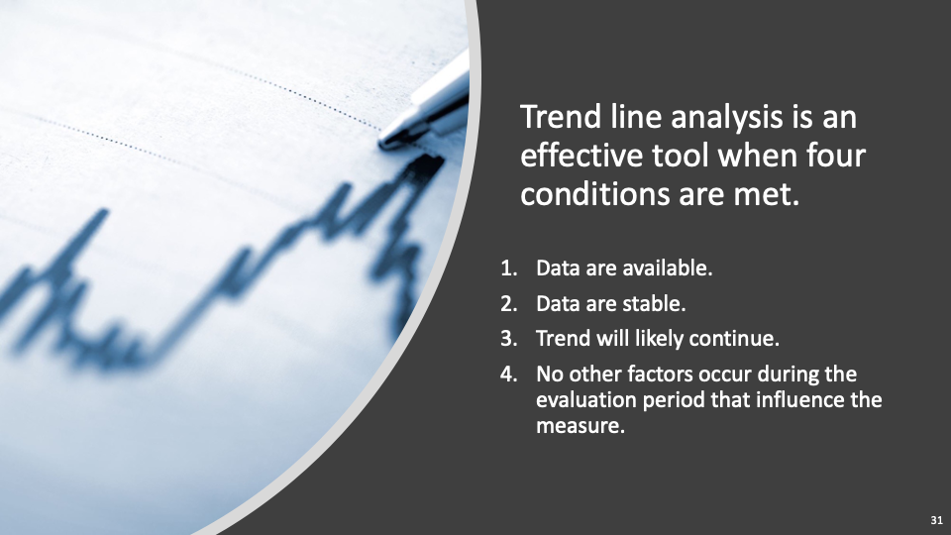

Slide 32
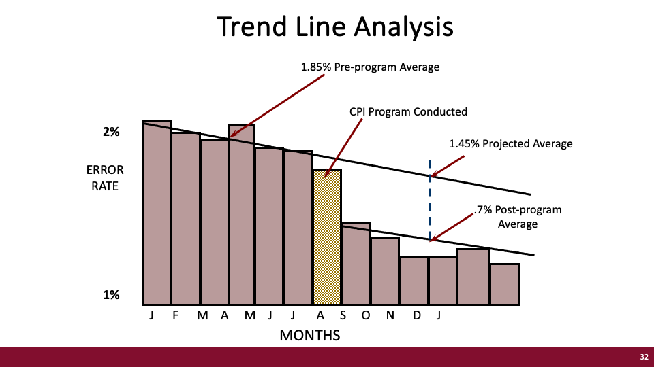
Notes:
Here we have error rate…… Talk them through this, then ask them what is the difference due to the program. (Rapid Fire Chat)

Slide 33
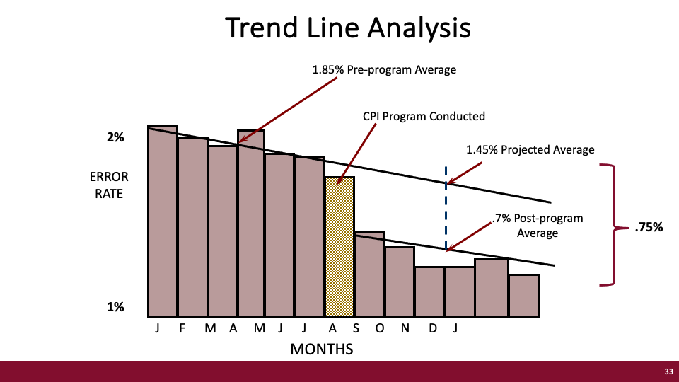
Notes:
The change in performance is .75 or a 51% decrease in error rate.

Slide 34
Estimations
34

Slide 35
Sales Increase: $1,537,690 (Fact)
Contributing Factors | Average Impact (%) | Average Confidence (%)
Account Manager | 19 | 87
Incentive Plan | 15 | 91
Marketing/Promo | 18 | 86
Managed Markets | 16 | 90
Sales Training | 14 | 69
Access to Provider | 10 | 94
Weekly Reporting | 8 | 94
 | 100%
Example of Estimation
35
Notes:
These are sales data for EGRIFTA when it was first developed by Theratechnologies (biopharma) . If you can share BMS sales data per month for a product, please do so that it is realistic. 11 Account Managers provided the estimates. 11 factors were identified. I will explain the process.

Slide 36
Sales Increase: $1,537,690 (Fact)
Contributing Factors | Average Impact (%) | Average Confidence (%)
Account Manager | 19 | 87
Incentive Plan | 15 | 91
Marketing/Promo | 18 | 86
Managed Markets | 16 | 90
Sales Training | 14 | 69
Access to Provider | 10 | 94
Weekly Reporting | 8 | 94
 | 100%
Example of Estimation
How much in sales is due to sales training?
36
Notes:
Have participants focus on sales training and ask them how much is due to sale training. Post in chat.

Slide 37
Influence | Fact | % Contrib. | Est. Impact | Confidence | Adjusted Impact
Sales Training | $1,537,690 | 14% | $215,276.60 | 69% | $148,540.85
Example of Estimation
37
Notes:
Walk them through what we are doing. There are a few slides that build after this.

Slide 38
Influence | Fact | % Contrib. | Est. Impact | Confidence | Adjusted Impact
Sales Training | $1,537,690 | 14% | $215,276.60 | 69% | $148,540.85
Fact: $1,537,690
% Contribution: 14%
Est. Impact: $215,276.60
Uncertainty: 31% (100% - 69%)
Margin of Error: +/- $66,735.75
Example of Estimation
38

Slide 39
Influence | Fact | % Contrib. | Est. Impact | Confidence | Adjusted Impact
Sales Training | $1,537,690 | 14% | $215,276.60 | 69% | $148,540.85
$215,276.60
Fact: $1,537,690
% Contribution: 14%
Est. Impact: $215,276.60
Uncertainty: 31% (100% - 69%)
Margin of Error: +/- $66,735.75
Example of Estimation
39

Slide 40
Influence | Fact | % Contrib. | Est. Impact | Confidence | Adjusted Impact
Sales Training | $1,537,690 | 14% | $215,276.60 | 69% | $148,540.85
$282,012.35
$215,276.60
Fact: $1,537,690
% Contribution: 14%
Est. Impact: $215,276.60
Uncertainty: 31% (100% - 69%)
Margin of Error: +/- $66,735.75
Example of Estimation
40

Slide 41
Influence | Fact | % Contrib. | Est. Impact | Confidence | Adjusted Impact
Sales Training | $1,537,690 | 14% | $215,276.60 | 69% | $148,540.85
$282,012.35
$215,276.60
$148,540.85
Fact: $1,537,690
% Contribution: 14%
Est. Impact: $215,276.60
Uncertainty: 31% (100% - 69%)
Margin of Error: +/- $66,735.75
Example of Estimation
41

Slide 42
Influence | Fact | % Contrib. | Est. Impact | Confidence | Adjusted Impact
Sales Training | $1,537,690 | 14% | $215,276.60 | 69% | $148,540.85
$282,012.35
$215,276.60
$148,540.85
Fact: $1,537,690
% Contribution: 14%
Est. Impact: $215,276.60
Uncertainty: 31% (100% - 69%)
Margin of Error: +/- $66,735.75
Example of Estimation
42

Slide 43
Influence | Fact | % Contrib. | Est. Impact | Confidence | Adjusted Impact
Sales Training | $1,537,690 | 14% | $215,276.60 | 69% | $148,540.85
$282,012.35
$215,276.60
$148,540.85
Fact: $1,537,690
% Contribution: 14%
Est. Impact: $215,276.60
Uncertainty: 31% (100% - 69%)
Margin of Error: +/- $66,735.75
Example of Estimation
43

Slide 44
Answers to three questions lead to credibility.
*This process was first introduced to learning and development in Jack J. Phillips’ 1983 Handbook of Training Evaluation and Measurement Methods (Houston, TX: Gulf Publishing). While the process leads to a conservative output and several organizations and learning evaluation platform providers have adopted it as a standard approach, ROI Institute recommends using estimates as a fallback technique. Experimental design is the gold standard, followed by trend line analysis, and mathematical modeling. But when all else fails, use the estimation process to isolate program effects.
44

Slide 45
Answers to three questions lead to credibility.
1. What are we doing?
  Isolating the effects of training’s contribution to the increase in sales.
*This process was first introduced to learning and development in Jack J. Phillips’ 1983 Handbook of Training Evaluation and Measurement Methods (Houston, TX: Gulf Publishing). While the process leads to a conservative output and several organizations and learning evaluation platform providers have adopted it as a standard approach, ROI Institute recommends using estimates as a fallback technique. Experimental design is the gold standard, followed by trend line analysis, and mathematical modeling. But when all else fails, use the estimation process to isolate program effects.
45

Slide 46
Answers to three questions lead to credibility.
1. What are we doing?
  Isolating the effects of training’s contribution to the increase in sales.
2. How are we doing it?
  We start with the fact that sales has increased.
  We identify the most credible sources of data to help us understand what caused it.
  We ask our sources of data three simple questions:
    Given the improvement in the measure, what factors caused it?
    As a percentage, how much of the improvement is due to each factor?
    As a percentage, how confident are you in your estimate?
*This process was first introduced to learning and development in Jack J. Phillips’ 1983 Handbook of Training Evaluation and Measurement Methods (Houston, TX: Gulf Publishing). While the process leads to a conservative output and several organizations and learning evaluation platform providers have adopted it as a standard approach, ROI Institute recommends using estimates as a fallback technique. Experimental design is the gold standard, followed by trend line analysis, and mathematical modeling. But when all else fails, use the estimation process to isolate program effects.
46

Slide 47
Answers to three questions lead to credibility.
1. What are we doing?
  Isolating the effects of training’s contribution to the increase in sales.
2. How are we doing it?
  We start with the fact that sales has increased.
  We identify the most credible sources of data to help us understand what caused it.
  We ask our sources of data three simple questions:
    Given the improvement in the measure, what factors caused it?
    As a percentage, how much of the improvement is due to each factor?
    As a percentage, how confident are you in your estimate?
3. Why did we do it that way?
  We always isolate the effects of the program (Guiding Principle #5) and in this case we could not use control group, trend line analysis, or forecasting models.
  We always go to the most credible sources when collecting data (Guiding Principle #3).
  When using estimates, we always adjust for error (Guiding Principle #7), which ensures we use the most conservative alternative (Guiding Principle #4).
*This process was first introduced to learning and development in Jack J. Phillips’ 1983 Handbook of Training Evaluation and Measurement Methods (Houston, TX: Gulf Publishing). While the process leads to a conservative output and several organizations and learning evaluation platform providers have adopted it as a standard approach, ROI Institute recommends using estimates as a fallback technique. Experimental design is the gold standard, followed by trend line analysis, and mathematical modeling. But when all else fails, use the estimation process to isolate program effects.
47

Slide 48

Credibility of output data is influenced by
Reputation of the source of the data
Reputation of the source of the study
Motives of the researchers
Personal bias of audience
Methodology of the study
Assumptions made in the analysis
Realism of the outcome data
Type of data
Scope of analysis

Slide 49




Questions?
Visit us Online
www.roiinstitute.net
Email Us
patti@roiinstitute.net
Connect with Us

Slide 50






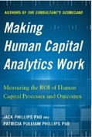

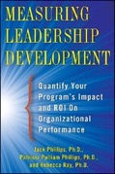

Patti P. Phillips, Ph.D.
Author, Educator, Consultant, Coach
CEO, ROI Institute, Inc.
Senior Advisor, The Conference Board
Chair, i4cp People Analytics Board
Member, International Federation of Training and Development Board
Vice Chair, UN Institute for Training and Research Board of Trustees
Board Member, International Society for Performance Improvement
Fellow, ATD Certified Professional in Talent Development
Author of these books and more.

Slide 51

The Wisdom of Crowds
Notes:
This is the video that if I think we have time to watch it we will. If we do, it will be show right after the estimation process example.

