Slide 1




Slide 2


Providing Results That Executives (and others) Will Love
Jack J. Phillips, Ph.D.
Chairman, ROI Institute, Inc.

Slide 3


Jack J. Phillips, Ph.D.
Jack J. Phillips, chairman of ROI Institute, Inc., is a world-renowned
expert on accountability, measurement, and evaluation. A former bank president and HR executive, Phillips consults for Fortune 500 companies and major global organizations. The author or editor of more than 75 books, including Show the Value of What You Do (Berrett-Kohler, 2022), he conducts workshops and presents at conferences throughout the world.
Jack has been recognized and awarded for his work in the field by numerous professional organizations, including receiving the 2022 Association of Talent Development (ATD) Thought Leader Award. SHRM presented Jack with its highest creativity award for an ROI study and awarded an ROI Institute book with a best book award. His work has been featured in the Wall Street Journal, BusinessWeek, and Fortune magazine, and he has been interviewed by several television programs, including CNN.

Slide 4

Session Objectives
After attending this session, participants should be able to:
Identify five levels of outcomes from any program or project.
Discuss the types of data that the senior executives want to see.
Explain how the data are collected, analyzed, and reported.
Plan the next steps to bring more accountability to your programs.

Slide 5

Papa Johns secret sauce to boosting frontline employee retention?
Free education benefits

Slide 6

ROI Methodology® Use
Used by 40 of the top 50 Best Managed Companies
Used by major foundations such as the Gates Foundation
Supported by over 75 books in 38 languages
Over 400 published case studies
Implemented in all 14 types of organizations, from businesses to government, nonprofits, and school systems.
Used in 22 professional fields ranging from learning and development to innovation and public relations.
6

Slide 7
ROI Methodology® Use
Implemented in over 70 countries
Most used evaluation system in the world
Endorsed by the United Nations with a UN General Assembly resolution in 2008
Endorsed by 30 federal governments
Used by over 300 healthcare systems
Used by over 150 colleges and universities
Used by three-fourths of Fortune 500 organizations
7

Slide 8
The Value Chain
 | LEVEL | ISSUE | MEASURES | TARGETS**
This is easy Always measured | 0 | Inputs | Volume, Hours, Convenience, Cost | 100%
This is easy Almost always measured | 1 | Reaction | *Relevance, Engaging, *Important, Useful, *New Content, *Intent to Use, *Recommend to Others | 100%
Not difficult Usually measured | 2 | Learning | Concepts, Trends, Facts, Contacts, Skills, Competencies | 90%
Possible Often measured | 3 | Application | Use of content, Frequency of Use, Success with Use, Barriers, Enablers | 30%
Not so difficult to connect Sometimes measured | 4 | Impact | Productivity, Time, Quality, Costs, Image, Reputation, Engagement, Compliance | 10%
Possible for many programs Rarely measured | 5 | ROI | Benefit Cost Ratio or Return on Investment, Expressed as a Percent | 5%
*Can predict
Must take a step to isolate the effects
Executives prefer
**Best Practice: Percent of programs evaluated at this level each year.
Notes:
What are the 2-3 main takeaways here? This slide is a bit dense and we found it to be easy to get lost in this

Slide 9

What CEOs Want
Measures | Currently Measure | Should Measure | Importance
Inputs | 94% | 86% | 6
Reaction | 53% | 22% | 7
Learning | 32% | 28% | 5
Application | 11% | 61% | 4
Impact | 8% | 96% | 1
ROI | 4% | 74% | 2
Awards | 40% | 44% | 3
ROI Institute and ATD research show that the data CEOs receive are not demonstrating what they want out of their talent investment. (N=96)

Slide 10







Cost of the program
Linkage of program to operational goals and issues
Characteristics of programs suitable for impact & ROI
Importance of program to strategic objectives
Top executive interest in the evaluation
Visibility of the program
Size of target audience
Investment of time required

Slide 11

The ROI Methodology Process Model
Designing for the Delivery of Business Results
EVALUATION PLANNING
DATA COLLECTION
DATA ANALYSIS
Make it Credible:
Tabulate Costs of
Program
OPTIMIZE RESULTS
LEVEL 0: INPUT
LEVEL 1: REACTION AND PLANNED ACTION
LEVEL 3:
APPLICATION
Start with Why:
Align Programs
With the
Business
Make it Credible:
Convert Data to
Monetary Value
Tell the Story:
Communicate
Results to Key
Stakeholders
Optimize
Results:
Use Black Box
Thinking to
Increase
Funding
Make it Feasible:
Select the Right
Solution
Expect
Success:
Plan for
Results
Make it Matter:
Design for Input,
Reaction and
Learning
Make it Stick:
Design for
Application
and Impact
Make it
Credible:
Isolate the
Effects
Make it Credible:
Calculate ROI
LEVEL 5: ROI
LEVEL 2: LEARNING
LEVEL 4: IMPACT
Make it Credible:
Identify Intangibles
INTANGIBLE BENEFITS
©2024 ROI Institute Inc. – No part of this document can be reproduced, stored in a retrieval system, or transmitted in any form without written permission from ROI Institute, Inc.

Slide 12

Start with why
Align programs with the business

Slide 13
How often do you align your programs to the business in the beginning?

Slide 14
Key Metrics to Examine
Talent retention
Talent attraction
Productivity
Performance
Quality of work
Unplanned absenteeism
Net promoter score
Engagement
Work experience
Burnout
Stress
Career satisfaction
Brand
Reputation
Work-life balance
Loyalty

Slide 15

Make it feasible
Select the right solution

Slide 16
Expect success
Design for results

Slide 17
Developing Objectives for Each Level
Levels | Focus
Level 1, Reaction | Defines specific measures of expected reaction to the program as it is revealed and communicated to the stakeholders
Level 2, Learning | Defines specific measures of improvement in knowledge, information, contacts, and skills as the participants and other stakeholders learn how to make the program successful
Level 3, Application | Defines specific measures of actions taken that define success with application and implementation of program
Level 4, Impact | Defines the specific impact measures that will change or improve as a consequence of the program’s implementation
Level 5, ROI | Defines the minimum return on investment from the program, comparing program costs with monetary benefits from the program

Slide 18

Rules for Objectives
Must be measurable and represent minimum acceptable performance.
Fewer objectives are better than many objectives.
Involve subject-matter experts and key stakeholders.
Keep them relevant to the situation, program, and key stakeholders.
Create stretch objectives, but make sure they are achievable.
Allow for the flexibility to change as conditions change.
Failure is OK; process improvement is the key.
Objectives are tools for progress, not weapons for performance review.
Most objectives should be time-bound.
Objectives provide the focus for design, development, implementation, and evaluation.

Slide 19

Make it matter
Design for input, reaction, and learning

Slide 20

Make it stick
Design for application and impact

Slide 21
Data Collection Methods
Benchmarking from Users
*Survey of Users, N = 246
21

Slide 22

Make it Credible
Measure Results and Calculate ROI
Isolating the effects of the program
Converting Impact data to money
Identifying intangible benefits
Tabulating cost of the program
Calculating ROI
22

Slide 23

Isolation Methods
Benchmarking from Users
*Survey of Users, N = 246

Slide 24
Data Conversion Methods
Benchmarking from Users
*Survey of Users, N = 246

Slide 25
Common Intangibles
Agility
Ambiguity
Alliances
Awards
Brand
Burnout
Capability
Capacity
Carbon emissions
Clarity
Collaboration
Communication
Compassion
Complexity
Compliance
Conflict
Corporate social responsibility
Creativity
Culture
Customer service
Decisiveness
Emotional intelligence
Employee attitudes
Engagement
Food security
Grit
Happiness
Human Life
Image
Intellectual capital
Job satisfaction
Leadership effectiveness
Loyalty
Mindfulness
Mindset
Net promoter score
Networking
Organizational commitment
Partnering
Patient satisfaction
Poverty
Reputation
Risk
Social Capital
Stress
Sustainability
Team effectiveness
Timeliness
Trust
Uncertainty
Volatility
Work/life balance

Slide 26
Tabulating Program Costs
Include all program costs direct and indirect

Slide 27

Program: EdAssist
Program Benefits = $22,440,000
Program Costs = $751,000
ROI Calculation Example:
Papa Johns
Calculate ROI

Slide 28

What is ROI?
Program Benefits
Program Costs
BCR =
Benefits - Costs
Program Costs
ROI =
X 100

Slide 29
What is ROI?
$22,440,000
$751,000
BCR =
=
30.12
$22,440,000 - $751,000
$751,000
ROI =
X 100 =
2,912%

Slide 30

Tell the story
Communicate results to key stakeholders

Slide 31

Optimize results
Use black-box thinking to increase funding

Slide 32
Do Your Executives See Your Programs as a Cost or Investment?

Slide 33


Costs Versus Investment Perception: The Reality
 | Perception |  | Actions |  | Consequences
 | It’s a cost |  | Control it Reduce it Eliminate it |  | Partnerships are rare Influence diminishes Support is lost Funding is curtailed
Executive Perception of Programs
 | It’s an investment |  | Maintain it Enhance it Protect it |  | Business partnerships flourish Client relationships improve A seat at the table is earned Funding is easier

Slide 34

The Payoff
Justify/defend budgets.
Align projects to business needs.
Show contributions of selected projects.
Earn respect of senior management/administrators.
Build staff morale.
Improve support for projects.
Enhance design and implementation processes.
Identify inefficient projects that need to be redesigned or eliminated.
Identify successful projects that can be implemented in other areas.
Earn a “seat at the table”.

Slide 35
2023 Dough & Degrees Review
Chad Jones
May 2024

Slide 36
Dough & Degrees Corporate User Feedback
Level 1 Feedback
67%
Believe Dough & Degrees positively impacts their job performance
4.8 / 5.0
User Satisfaction
29%
Have received a promotion after starting Dough & Degrees
76%
4.7 / 5.0
Likely to Recommend
Believe Dough & Degrees positively impacts Papa Johns culture
34%
Said education benefits weighed into their decision to join Papa Johns
Source: 2023 in-house survey
N=400
36

Slide 37
Dough & Degrees Return on investment
Papa Johns earned $30.12 value for every dollar invested in 2023
ROI Methodology was established in 1973 by The ROI Institute and reflects guiding principles and guidelines to ensure consistent application; accepted by ATD (The Association for Talent Development) as the standard for calculating learning financial measures.
ROI (%) = Net Benefits / Costs) x 100
Costs:
Tuition & Fees $ 730,000
Misc. Program Costs $21,000
Total Costs $ 751,000
Benefits
Turnover Reduction (34% Claim) $22,440,000 Annual Tax Credit $182,500
Total Benefits $ 22,622,500
Return on Investment : 2,912%
Benefits Cost Ratio: 30.12
Earned media value, soft skill development, engagement, productivity and customer impact not included in calculation.

Slide 38
Dough & Degrees Financial History
Average Tuition Reduced 5.8% with Bright Horizons Partnership
Tuition by Year
Avg. Cost / Student by Year

Slide 39

Be Proactive
Remember, when it comes to delivering results:
  Hope is not a strategy.
  Luck is not a factor.
  Doing nothing is not an option.
Change is inevitable.
Progress is optional.

Slide 40

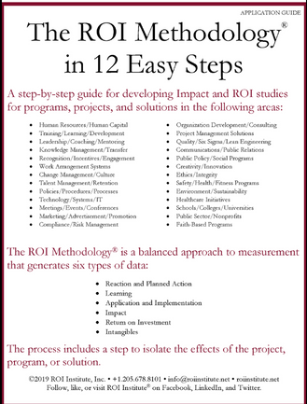

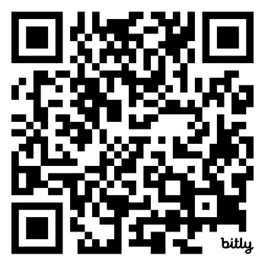

Resources

Slide 41
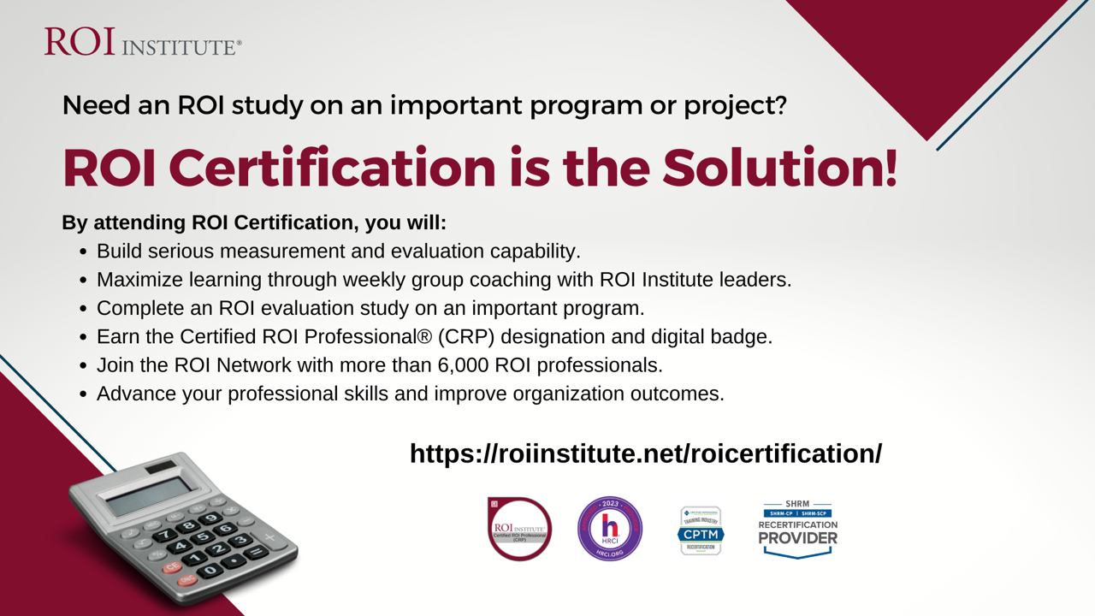


Slide 42
Questions

Slide 43




Learn more
Visit us online:
www.roiinstitute.net
Email:
Jack@roiinstitute.net
Connect with us on:
Thank you!

