Slide 1


Project Management ROI
Jack J. Phillips, Ph.D., Chairman, ROI Institute, Inc.

Slide 2


Jack J. Phillips, Ph.D.
Jack J. Phillips, chairman of ROI Institute, Inc., is a world-renowned
expert on accountability, measurement, and evaluation. A former bank president and HR executive, Phillips consults for Fortune 500 companies and major global organizations. The author or editor of more than 75 books, including Project Management ROI (Wiley), he conducts workshops and presents at conferences throughout the world.
Jack has been recognized and awarded for his work in the field by numerous professional organizations, including receiving the 2022 Association of Talent Development (ATD) Thought Leader Award. SHRM presented Jack with its highest creativity award for an ROI study and awarded an ROI Institute book with a best book award. His work has been featured in the Wall Street Journal, BusinessWeek, and Fortune magazine, and he has been interviewed by several television programs, including CNN.

Slide 3

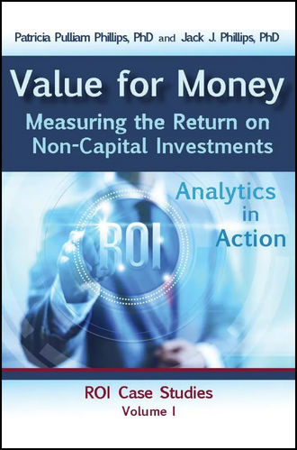
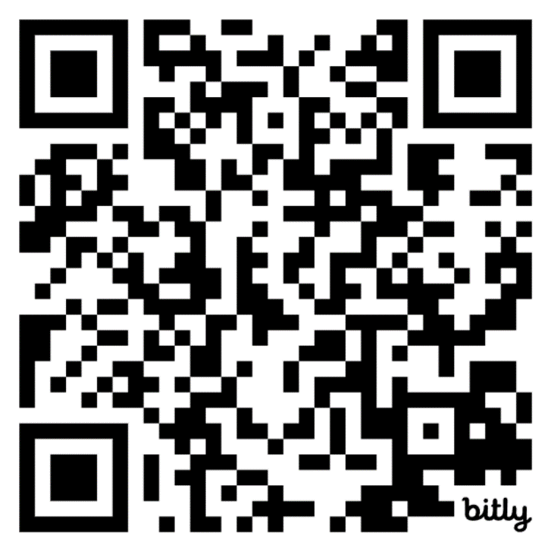
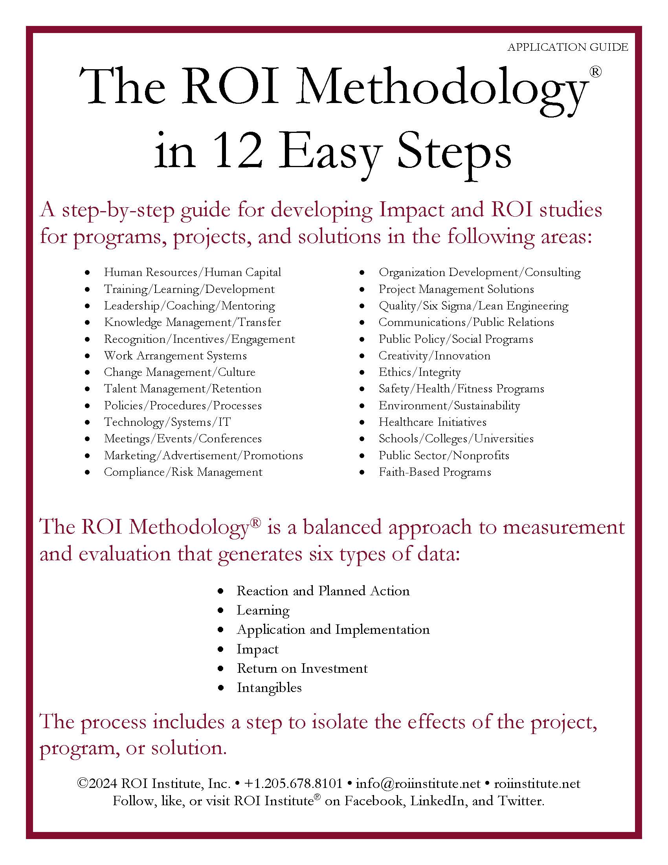
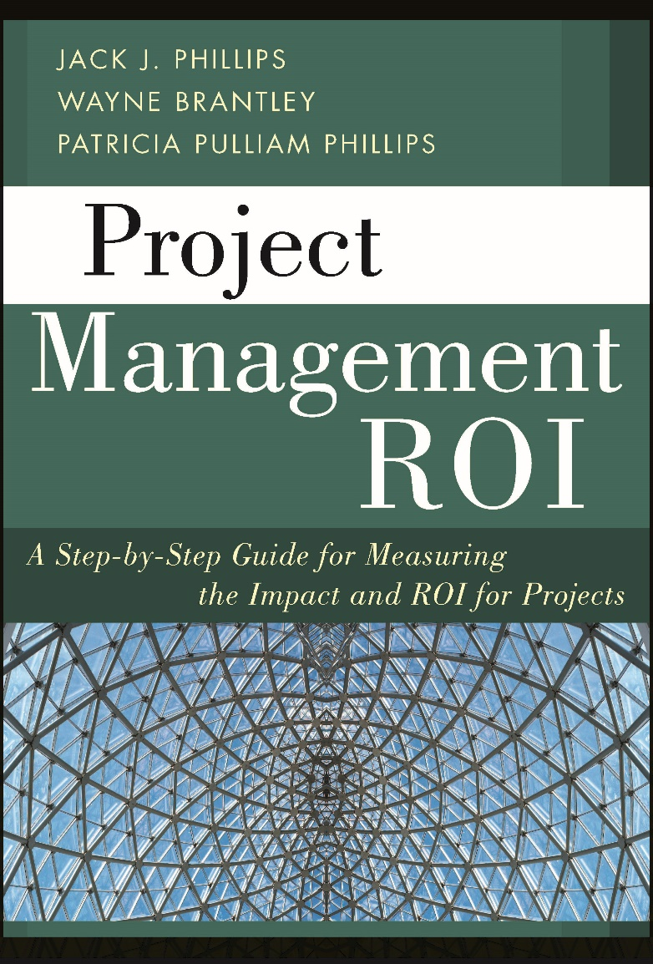
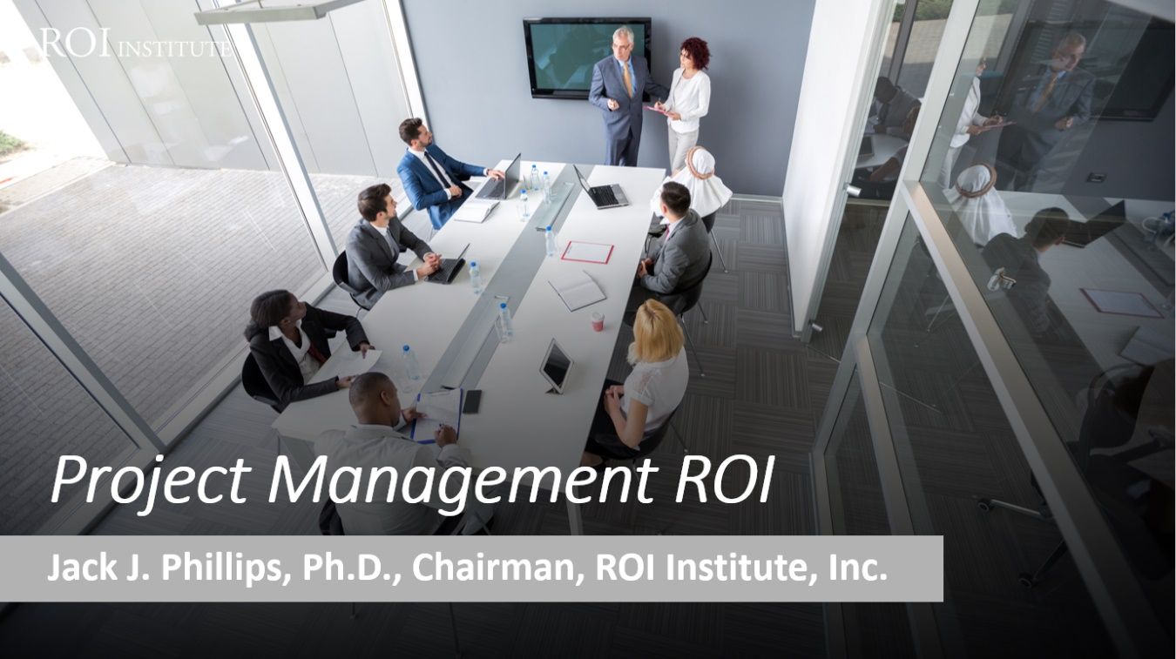
Resources
3

Slide 4
Objectives
After attending this session, participants should be able to:
List the data sets possible from projects, including ROI.
Identify the categories that are desired by top executives and other key stakeholders.
Explain how these measures are derived and developed.
Pursue a plan to measure and communicate the ROI for a project to different audiences.
4

Slide 5

What is your experience with ROI? (Select all that apply.)
No experience with it.
It’s been suggested, but no action has been taken.
I have attempted it.
I have conducted an ROI study.
I wish ROI would go away.
5

Slide 6

Project Managers have always had to stay within budget, on time, and deliver quality projects.
Now, some are asked to calculate the ROI.

Slide 7


To survive and thrive, organizations need growth and continuous process improvement.
All types of projects, programs, initiatives, events, systems, and processes must be implemented to drive improvement.
Growth & Progress Improvement
To Drive Growth
To Drive Process Improvement
An evaluation process is needed to focus on optimization and improvement.

Slide 8


According to Harvard Business Review, by 2027, some 88 million people around the world are likely to be working in project management, and the value of project-oriented economic activity will have reached $20 trillion.
But research shows that only 35% of the projects undertaken worldwide are successful—which means we’re wasting an extravagant amount of time, money, and opportunity.
Project Management Failures.
$611 billion dollars per year.

Slide 9



IT failures are expensive
$50bn - $150bn
PwC found that IT failures cost the US economy about $50 to $150 billion annually.

Slide 10


Organizations are facing many problems
Projects Falter
Systems Fail
Initiatives are unsuccessful
Innovation doesn't deliver

Slide 11




The Solution
Projects should be: Designed for impact
Projects should be: Delivered for success
Projects should be:
Evaluated for improvement
Projects should be:
Optimized to influence funding
The ROI Methodology tackles all four issues.

Slide 12


Human Resources/Human Capital
The ROI Methodology has been implemented in over 20 Professional Fields
Training/Learning/Development
Leadership/Coaching/Mentoring
Knowledge Management/Transfer
Recognition/Incentives/Engagement
Work Arrangement Systems
Change Management/Culture
Environment/Sustainability
Talent Management/Retention
Policies/Procedures/Processes
Project Management Solutions
Technology/Systems/IT
Quality/Six Sigma/Lean Engineering
Meetings/Events/Conferences
Communications/Public Relations
Marketing/Advertisement/Promotion
Public Policy/Social Programs
Compliance/Risk Management
Creativity/Innovation
Organization Development/Consulting
Ethics/Integrity
Healthcare Initiatives
Safety/Health/Fitness Programs
Faith-Based Programs

Slide 13


The ROI Methodology is Used in All Types of Organizations
Publicly traded businesses
Foundations
Privately held businesses
Charities
Nongovernment organizations
Healthcare organizations
Governments (federal, state, & local level)
Networks & alliances
Nonprofits
Associations
Universities
Religious organizations
Community colleges & technical institutes
K-12 school systems

Slide 14
The Value Chain
 | LEVEL | ISSUE | MEASURES | TARGETS**
This is easy Always measured | 0 | Inputs | Volume, Hours, Convenience, Cost | 100%
This is easy Almost always measured | 1 | Reaction | *Relevance, Engaging, *Important, Useful, *New Content, *Intent to Use, *Recommend to Others | 100%
Not difficult Usually measured | 2 | Learning | Concepts, Trends, Facts, Contacts, Skills, Competencies | 90%
Possible Often measured | 3 | Application | Use of content, Frequency of Use, Success with Use, Barriers, Enablers | 30%
Not so difficult to connect Sometimes measured | 4 | Impact | Productivity, Time, Quality, Costs, Image, Reputation, Engagement, Compliance | 10%
Possible for many programs Rarely measured | 5 | ROI | Benefit Cost Ratio or Return on Investment, Expressed as a Percent | 5%
*Can predict
Must take a step to isolate the effects
Executives prefer
**Best Practice: Percent of programs evaluated at this level each year.

Slide 15

In one word, what comes to mind when you think about ROI for your project?
ⓘ Start presenting to display the poll results on this slide.

Slide 16

POLL: Serious Performance Challenges?
Most projects are not successful.
The project outcome desired by executives is rarely measured.
Most project managers do not have data showing that they make a difference in the organization.
Most executives see project management as a cost and not an investment.
True
or
False?

Slide 17

What CEOs Want from Projects
Measures | Currently Measure | Should Measure | Importance
Inputs | 94% | 86% | 6
Reaction | 53% | 22% | 7
Learning | 32% | 28% | 5
Application | 11% | 61% | 4
Impact | 8% | 96% | 1
ROI | 4% | 74% | 2
Intangibles | 40% | 44% | 3

Slide 18
Measurement Targets
*Benchmarking Percentages
Level |  | Recommended % of Programs | **Benchmarking %
0 | Input | 100% | 100%
1 | Reaction | 100% | 80%
2 | Learning | 80-90% | 70%
3 | Application | 30% | 49%
4 | Impact | 10% | 37%
5 | ROI | 5% | 18%
*Percentage of programs evaluated at each level each year
**Benchmarking 2020
18
Notes:
SALLY

Slide 19







Cost of the program
Linkage of program to operational goals and issues
Characteristics of Programs Suitable for Impact & ROI
Importance of program to strategic objectives
Top executive interest in the evaluation
Visibility of the program
Size of target audience
Investment of time required

Slide 20
POLL: If you had a credible evaluation of your most important project, showing impact, and a very positive ROI, what would it mean to you?
(Check all that apply)
My project team would be happy
I will have more support for projects
This will help keep funding for projects
My relationship with the client will improve
I will know what worked and what didn’t work
Other (type in chat)

Slide 21

The ROI Methodology Process Model
Designing for the Delivery of Business Results
EVALUATION PLANNING
DATA COLLECTION
DATA ANALYSIS
Make it Credible:
Tabulate Costs of
Program
OPTIMIZE RESULTS
LEVEL 0: INPUT
LEVEL 1: REACTION AND PLANNED ACTION
LEVEL 3:
APPLICATION
Tell the Story:
Communicate
Results to Key
Stakeholders
Optimize
Results:
Use Black Box
Thinking to
Increase Funding
Start with Why:
Align Programs
With the
Business
Make it Feasible:
Select the Right
Solution
Expect
Success:
Plan for
Results
Make it Matter:
Design for Input,
Reaction and
Learning
Make it Stick:
Design for
Application
and Impact
Make it
Credible:
Isolate the
Effects
Make it Credible:
Convert Data to
Monetary Value
Make it Credible:
Calculate ROI
LEVEL 5: ROI
LEVEL 2: LEARNING
LEVEL 4: IMPACT
Make it Credible:
Identify Intangibles
INTANGIBLE BENEFITS
©2024 ROI Institute Inc. – No part of this document can be reproduced, stored in a retrieval system, or transmitted in any form without written permission from ROI Institute, Inc.

Slide 22

ROI Facts
Implemented in over 70 countries
Most used evaluation system in the world
Endorsed by the United Nations with a UN General Assembly resolution in 2008
Endorsed by 30 federal governments
Used by over 300 healthcare systems
Used by over 150 colleges and universities
Used by three-fourths of Fortune 500 organizations
22

Slide 23
ROI Facts
Used by 40 of the top 50 Best Managed Companies
Used by major foundations such as the Gates Foundation
Supported by over 75 books in 38 languages
Over 400 published case studies
Implemented in all 14 types of organizations, from businesses to government, nonprofits, and school systems.
Used in 22 professional fields ranging from learning and development to innovation and public relations.
23

Slide 24
Guiding Principles
When conducting a higher-level evaluation, collect data at lower levels.
When planning a higher-level evaluation, the previous level of evaluation is not required to be comprehensive.
When collecting and analyzing data, use only the most credible sources.
When analyzing data, select the most conservative alternative for calculations.
Use at least one method to isolate the effects of a project.
If no improvement data are available for a population or from a speciﬁc source, assume that little or no improvement has occurred.
Adjust estimates of improvement for potential errors of estimation.
Avoid use of extreme data items and unsupported claims when calculating ROI.
Use only the ﬁrst year of annual beneﬁts in ROI analysis of short-term solutions.
Fully load all costs of a solution, project, or program when analyzing ROI.
Intangible measures are deﬁned as measures that are purposely not converted to monetary values.
Communicate the results of ROI Methodology to all key stakeholders.
24

Slide 25

Start with Why
Align Programs with the Business
Design Thinking Principle 1
A problem-solving approach to handle problems on a systems levels

Slide 26

Alignment Model
Start Here
End Here
Payoff Needs
5
ROI Objectives
5
ROI
Why?
Business Needs
4
Impact Objectives
4
Impact
Performance Needs
3
Application Objectives
3
Application
Learning Needs
2
Learning Objectives
2
Learning
Initial
Analysis
Measurement and Evaluation
Preference Needs
1
Reaction Objectives
1
Reaction
Input Needs
0
Input Objectives
0
Input
Program Process Initiative
Alignment and Forecasting
The ROI Process Model

Slide 27

Make it Feasible
Select the Right Solution
Design Thinking Principle 2
A mind-set for curiosity and inquiry

Slide 28
Alignment Model
Start Here
End Here
Payoff Needs
5
ROI Objectives
5
ROI
Why?
Business Needs
4
Impact Objectives
4
Impact
Performance Needs
3
Application Objectives
3
Application
Feasible Solution
Learning Needs
2
Learning Objectives
2
Learning
Preference Needs
1
Reaction Objectives
1
Reaction
0
0
Program Process Initiative
Alignment and Forecasting
The ROI Process Model

Slide 29

Expect Success
Design for Results
Design Thinking Principle 3
A framework to balance
needs and feasibility

Slide 30
Developing Objectives for Each Level
Levels | Focus
Level 1, Reaction | Defines specific measures of expected reaction to the project as it is revealed and communicated to the stakeholders
Level 2, Learning | Defines specific measures of improvement in knowledge, information, contacts, and skills as the participants and other stakeholders learn how to make the project successful
Level 3, Application | Defines specific measures of actions taken that define success with application and implementation of the project
Level 4, Impact | Defines the specific impact measures that will change or improve as a consequence of the project’s implementation
Level 5, ROI | Defines the minimum return on investment from the project, comparing project costs with monetary benefits from the project

Slide 31

Rules for Objectives
Must be measurable and represent minimum acceptable performance.
Fewer objectives are better than many objectives.
Involve subject-matter experts and key stakeholders.
Keep them relevant to the situation, project, and key stakeholders.
Create stretch objectives, but make sure they are achievable.
Allow for the flexibility to change as conditions change.
Failure is OK; process improvement is the key.
Objectives are tools for progress, not weapons for performance review.
Most objectives should be time-bound.
Objectives provide the focus for design, development, implementation, and evaluation.

Slide 32
After completing this engagement, participants should:
Matching Evaluation Levels with Objectives
1. | Decrease complaints by 20% in one year.
2. | Use two or more of cost containment methods.
3. | Score an average of 70% or better on “How to Use Software.”
4. | Decrease the amount of time required to complete project.
5. | Perceive the project to be relevant to my job situation (4.5 out of 5).
6. | Achieve a 25% ROI one year after implementation of remote work project.
7. | Conduct a proper investigation using the seven-step process in 95% of complaint situations.
1 = Reaction 2 = Learning 3 = Application 4 = Impact 5 = ROI

Slide 33
After completing this engagement, participants should:
Matching Evaluation Levels with Objectives
1. | Decrease complaints by 20% in one year.
2. | Use two or more of cost containment methods.
3. | Score an average of 70% or better on “How to Use Software.”
4. | Decrease the amount of time required to complete project.
5. | Perceive the project to be relevant to my job situation (4.5 out of 5).
6. | Achieve a 25% ROI one year after implementation of remote work project.
7. | Conduct a proper investigation using the seven-step process in 95% of complaint situations.
4
3
2
4
1
5
3
1 = Reaction 2 = Learning 3 = Application 4 = Impact 5 = ROI

Slide 35

Make it Stick
Design for Application and Impact
Design Thinking Principle 5
A culture that fosters exploration
and experimentation

Slide 36
Data Collection Methods
*Survey of Users, N = 246
36

Slide 37

Make it Credible
Measure Results and Calculate ROI
Isolating the effects of the project
Converting Impact data to money
Identifying intangible benefits
Tabulating cost of the project
Calculating ROI
Design Thinking Principle
A fixed process and a tool kit
37

Slide 38

Isolation Methods
*Survey of Users, N = 246

Slide 39
Data Conversion Methods
*Survey of Users, N = 246

Slide 40
Common Intangibles
Agility
Ambiguity
Alliances
Awards
Brand
Burnout
Capability
Capacity
Carbon emissions
Clarity
Collaboration
Communication
Compassion
Complexity
Compliance
Conflict
Corporate social responsibility
Creativity
Culture
Customer service
Decisiveness
Emotional intelligence
Employee attitudes
Engagement
Food security
Grit
Happiness
Human Life
Image
Intellectual capital
Job satisfaction
Leadership effectiveness
Loyalty
Mindfulness
Mindset
Net promoter score
Networking
Organizational commitment
Partnering
Patient satisfaction
Poverty
Reputation
Risk
Social Capital
Stress
Sustainability
Team effectiveness
Timeliness
Trust
Uncertainty
Volatility
Work/life balance

Slide 41
Tabulating Program Costs Recommended Items
Project Cost Categories
Cost Item | Prorated | Expensed
Initial analysis and assessment | ✓
Development of solutions | ✓
Acquisition of solutions | ✓
Implementation and application
Salaries/benefits for program team time |  | ✓
Salaries/benefits for coordination time |  | ✓
Salaries/benefits for participant time (if appropriate) |  | ✓
Program materials |  | ✓
Hardware/software | ✓
Travel/lodging/meals |  | ✓
Use of facilities |  | ✓
Capital expenditures | ✓
Maintenance and monitoring |  | ✓
Administrative support and overhead | ✓
Evaluation and reporting |  | ✓

Slide 42

What is ROI?
Project Benefits
Project Costs
BCR =
Project Benefits – Project Costs
Project Costs
ROI =
X 100

Slide 43

A major project to offer 1,000 employees an opportunity to work at home.
Claims processers
Claims examiners
ROI Calculation Example
A room in the home or apartment would be modified to look,
feel, and function like the office at work.

Slide 44
Productivity
Office Cost Savings
Retention
Key Impact Measures

Slide 45
Monetary Benefits = $3,959,692
Office Cost Savings = $991,680
ROI = ?

Slide 46
Benefits
Costs
= $3,959,692
$991,680
BCR =
= 3.99
Benefits - Costs
Costs
$3,959,692 - $991,680
$991,680
X 100
= 299%
ROI =
=

Slide 47
ROI Objective =
ROI Forecast =
ROI Delivered =
Three ROIs
25%
165%
299%

Slide 48

Optimize Results
Use Black Box Thinking to Increase Funding
Design Thinking Principle 8
A new competitive logic of business strategy

Slide 49


Costs versus Investment Perception: The Reality
 | Perception |  | Actions |  | Consequences
 | It’s a cost |  | Control it Reduce it Eliminate it |  | Partnerships are rare Influence diminishes Support is lost Funding is curtailed
Executive Perception of Projects
 | It’s an investment |  | Maintain it Enhance it Protect it |  | Business partnerships flourish Client relationships improve A seat at the table is earned Funding is easier
Workbook Page 11-9

Slide 50

The Payoff
Justify/defend budgets.
Align projects to business needs.
Show contributions of selected projects.
Earn respect of senior management/administrators.
Build staff morale.
Improve support for projects.
Enhance design and implementation processes.
Identify inefficient projects that need to be redesigned or eliminated.
Identify successful projects that can be implemented in other areas.
Earn a “seat at the table”.

Slide 51

Be Proactive
Remember, when it comes to delivering results:
  Hope is not a strategy.
  Luck is not a factor.
  Doing nothing is not an option.
Change is inevitable.
Progress is optional.

Slide 52
Resources
52

Slide 53
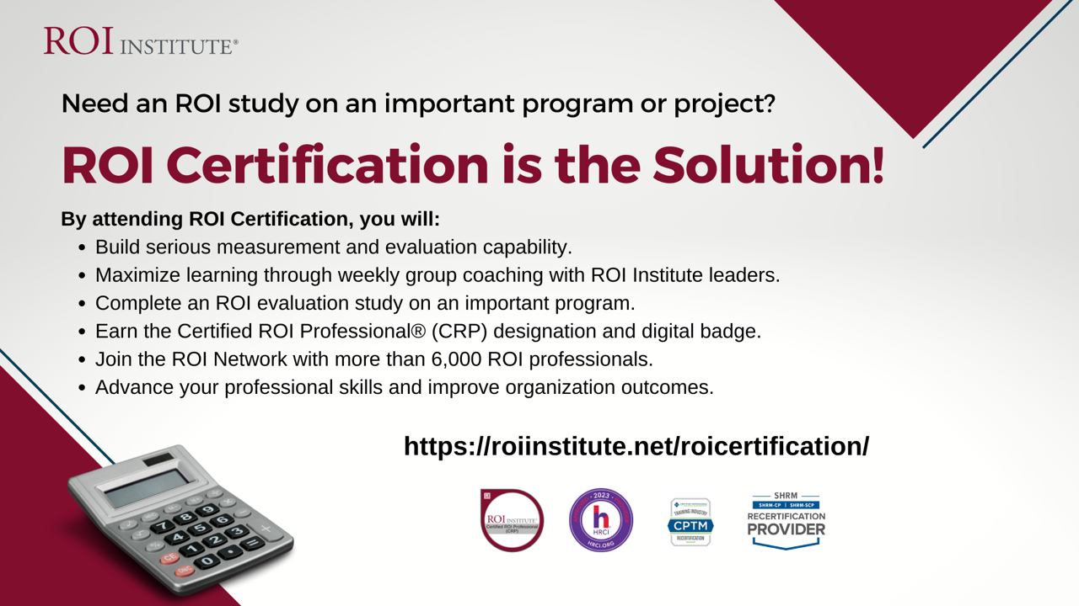
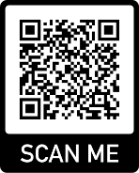

Slide 54




Questions?
Visit us Online
www.roiinstitute.net
Email Us
Jack@roiinstitute.net
Connect with Us

