Slide 1


ROI in Distance Learning:
Fact, Fad, or Fantasy

Slide 2

Objectives
After attending this session, participants should be able to:
Trace the use of ROI in learning.
Identify the five levels of outcomes from a distance learning program.
Describe the steps to measure the impact and ROI.
Cultivate an effective use of ROI.
2

Slide 3

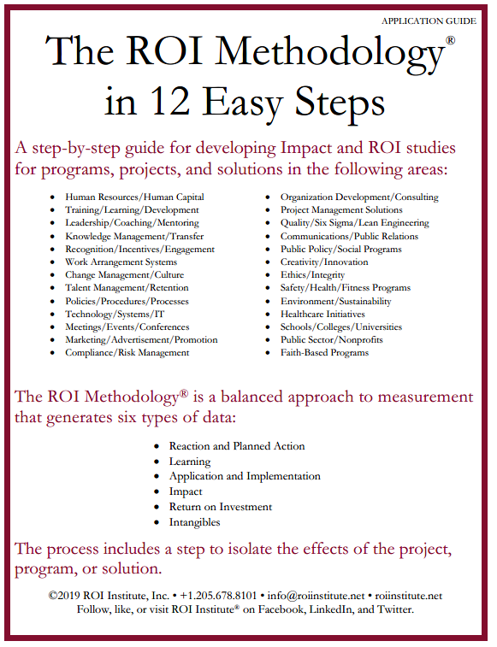
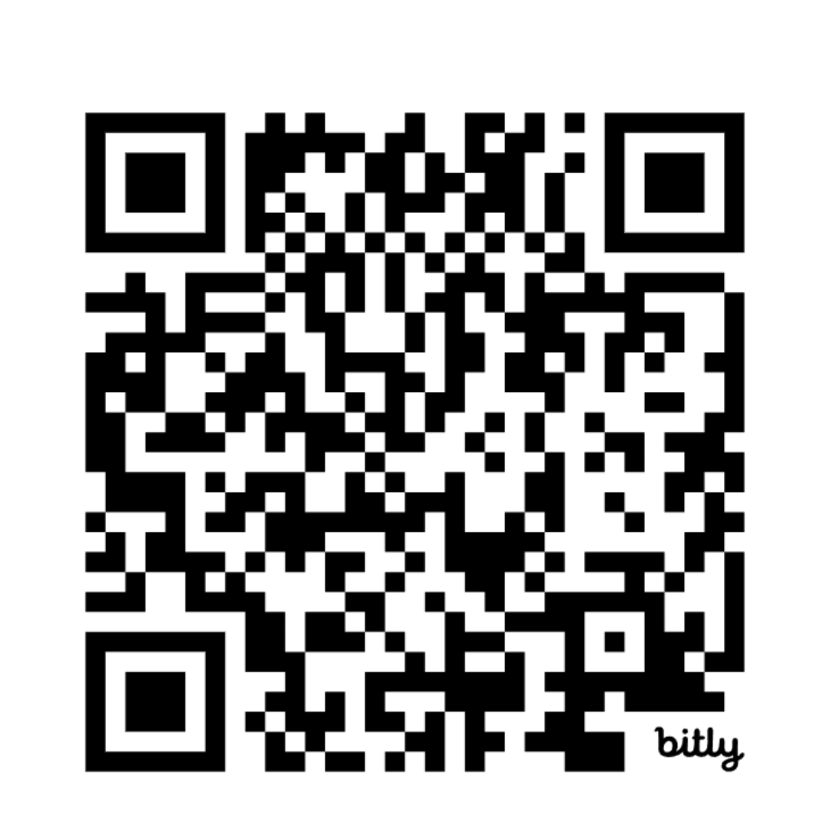

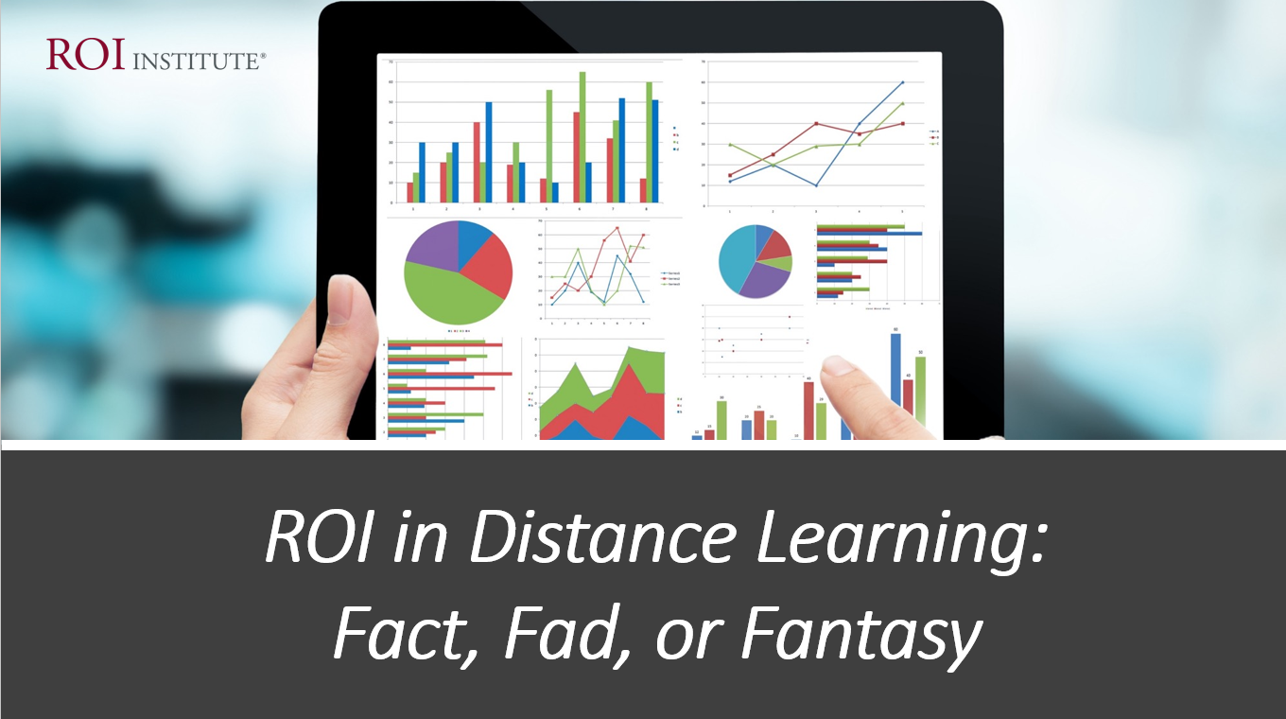
Resources
3

Slide 4

The Value Chain is Always There
 | LEVEL | ISSUE | MEASURES | TARGETS†
This is easy Always measured | 0 | Inputs | Volume, Hours, Convenience, Cost | 100%
This is easy Almost always measured | 1 | Reaction | *Relevance, Engaging, *Important, Useful, *New Content, *Intent to Use, *Recommend to Others | 100%
Not difficult Usually measured | 2 | Learning | Concepts, Trends, Facts, Contacts, Skills, Competencies | 90%
Possible Often measured | 3 | Application | Use of content, Frequency of Use, Success with Use, Barriers, Enablers | 30%
Not so difficult to connect Sometimes measured | 4 | Impact | Productivity, Time, Quality, Costs, Image, Reputation, Engagement, Compliance | 10%
Possible for many programs Rarely measured | 5 | ROI | Benefit-Cost Ratio or Return on Investment, Expressed as a Percent | 5%
*Can predict
Must take a step to isolate the effects
Executives prefer
† Best Practice: Percent of Programs Evaluated at this level each year.
©2024 ROI Institute Inc. All Rights Reserved.
4

Slide 5
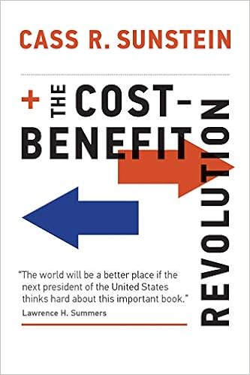
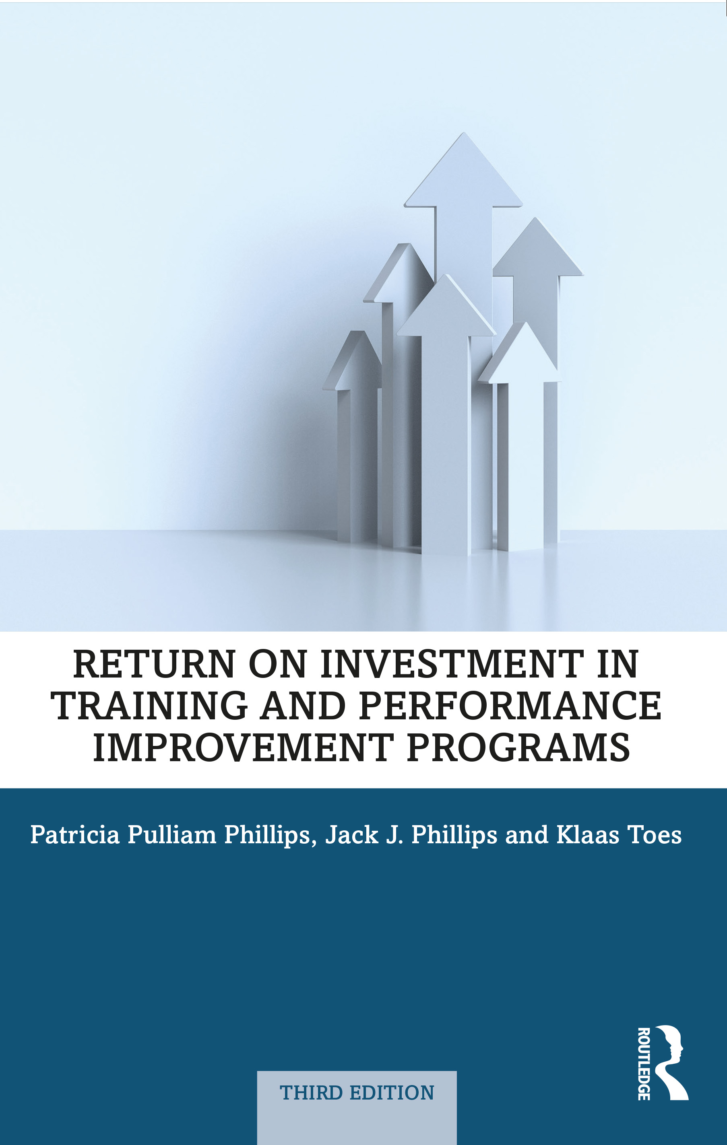
The Two Most Popular ROI Measures
Benefits Cost Ration (BCR)
Return on Investment (ROI)
BCR= Monetary Benefits
Program Costs
ROI= Monetary Benefits – Program Costs x 100
Program Costs

Slide 6

ROI Example
Benefits = $400,000
Costs = $300,000
BCR = ?
ROI = ?

Slide 7

BCR = $400,000 = 1.33 = 1
$300,000
ROI = $400,000 - $300,000 = 33% $300,000

Slide 8

The ROI Methodology Process Model
Designing for the Delivery of Business Results
PLAN THE EVALUATION
COLLECT DATA
ANALYZE DATA
Make it Credible:
Capture Costs of
Program
OPTIMIZE RESULTS
LEVEL 0: INPUT
LEVEL 1: REACTION AND PLANNED ACTION
LEVEL 3:
APPLICATION
Tell the Story:
Communicate
Results to Key
Stakeholders
Optimize
Results:
Use Black Box
Thinking to
Increase Funding
Start with Why:
Align Programs
With the
Business
Make it Feasible:
Select the Right
Solution
Expect
Success:
Plan for
Results
Make it Matter:
Design for Input,
Reaction and
Learning
Make it Stick:
Design for
Application
and Impact
Make it
Credible:
Isolate the
Effects
of the
Program
Make it Credible:
Convert Data to
Monetary Value
Make it Credible:
Calculate ROI
LEVEL 5: ROI
LEVEL 2: LEARNING
LEVEL 4: IMPACT
Make it Credible:
Identify Intangible Measures
INTANGIBLE BENEFITS
©2024 ROI Institute Inc. All Rights Reserved.

Slide 9

Fad
Misuse of “Return”
ROI (Information, intelligence, inspiration)
ROE (expectations, engagement, exhibit)
ROL (learning)
ROT (training, technology)
ROC (capability, capacity)
ROP (people)
ROR (resources)

Slide 10

Fantasy
“The Value of Learning is better.”
“My executives don’t want to see ROI.”
“I’m not measuring at ROI level until I’m forced to.”
“Return on inspiration (ROI) is ok.”
“Return on wows (ROW) is better.”
“Beyond ROI”
“ROI on soft skills is impossible.”
“Return on objectives (ROO) is ok.”

Slide 11

ROI Facts
Implemented in over 70 countries
Most used evaluation system in the world
Endorsed by the United Nations with a UN General Assembly resolution in 2008
Endorsed by 30 federal governments
Used by over 300 healthcare systems
Used by over 150 colleges and universities
Used by three-fourths of Fortune 500 organizations
11

Slide 12
ROI Facts
Used by 40 of the top 50 Best Managed Companies
Used by major foundations such as the Gates Foundation
Supported by over 75 books in 38 languages
Over 400 published case studies
Implemented in all 14 types of organizations, from businesses to government, nonprofits, and school systems.
Used in 22 professional fields ranging from learning and development to innovation and public relations.
12

Slide 13
Measurement Targets
*Benchmarking Percentages
Level |  | Recommended % of Programs | **Benchmarking %
0 | Input | 100% | 100%
1 | Reaction | 100% | 80%
2 | Learning | 80-90% | 70%
3 | Application | 30% | 49%
4 | Impact | 10% | 37%
5 | ROI | 5% | 18%
*Percentage of programs evaluated at each level each year
**Benchmarking 2020
13
Notes:
SALLY

Slide 14
ROI Must Be Credible
Data should come from credible sources.
Assumptions are transparent.
Assumptions are conservative.
The effects of the program should be isolated from other influences.
Missing impact data has no value.
Extreme data are omitted.
Unsupported claims are omitted.
All direct and indirect costs are included in the analysis.
Estimates are adjusted for potential errors in the estimate.

Slide 15
ROI Myths
No one is using ROI.
ROI takes too long.
ROI is too complicated.
ROI is too difficult.
ROI is inappropriate.
ROI is not needed.
ROI can be used with only 5% of programs.
ROI is too subjective.
ROI is for post-analysis only.

Slide 16

What CEOs Want
Measures | Currently Measure | Should Measure | Importance
Inputs and Indicators | 94% | 86% | 6
Efficiency | 78% | 82% | 7
Reaction | 53% | 22% | 8
Learning | 32% | 28% | 5
Application | 11% | 61% | 4
Impact | 8% | 96% | 1
ROI | 4% | 74% | 2
Awards | 40% | 44% | 3
This has changed
This will not change
ROI Institute and ATD research show that the data CEOs receive are not demonstrating what they want out of their talent investment. (N=96)

Slide 17

Can virtual learning be as effective as face-to-face learning?
Yes
No
Maybe

Slide 18

In-Person Learning Usually Delivers More Application and Impact than eLearning and Virtual Learning
But it doesn't have to.

Slide 19

What prevents virtual learning from delivering Impact and ROI?
19
Notes:
SLIDO is next. Do not remove

Slide 20
Attendance driven.
Multitasking inhibits learning.
Technology breaks down.
Content and experience focus versus performance focus.
Manager support is missing.
Facilitator is missing.
No real consequence.
Not designed to deliver impact.
20

Slide 21

Why Technology-Based Learning is Here to Stay
(The Four C's)
Convenience
Costs
Culture
Comfort

Slide 22
What Happens if Learning Doesn’t Deliver Impact?
You Have a CRISIS
Commitment Reduces
Respect Diminishes
Investment Disappears
Support Declines
Influence Deteriorates
Successful Client Relationships are Difficult to Develop

Slide 23

How do we design virtual learning to deliver application, impact, and ROI?
23

Slide 24

The ROI Methodology Process Model
Designing for the Delivery of Business Results
PLAN THE EVALUATION
COLLECT DATA
ANALYZE DATA
Make it Credible:
Capture Costs of
Program
OPTIMIZE RESULTS
LEVEL 0: INPUT
LEVEL 1: REACTION AND PLANNED ACTION
LEVEL 3:
APPLICATION
Tell the Story:
Communicate
Results to Key
Stakeholders
Optimize
Results:
Use Black Box
Thinking to
Increase Funding
Start with Why:
Align Programs
With the
Business
Make it Feasible:
Select the Right
Solution
Expect
Success:
Plan for
Results
Make it Matter:
Design for Input,
Reaction and
Learning
Make it Stick:
Design for
Application
and Impact
Make it
Credible:
Isolate the
Effects of the
Program
Make it Credible:
Convert Data to
Monetary Value
Make it Credible:
Calculate ROI
LEVEL 5: ROI
LEVEL 2: LEARNING
LEVEL 4: IMPACT
Make it Credible:
Identify Intangible Measures
INTANGIBLE BENEFITS
©2024 ROI Institute Inc. All Rights Reserved.
24

Slide 25
Design for Application and Impact
25

Slide 26


Key Actions BEFORE the Program
Develop application objectives for participants.
Have participants develop customized impact objectives.
Use performance contracts for application and impact.
Create an application guide to enable and support the application.
Create a job aid to use in the application.
Have manager create expectations before the program.
26
26

Slide 27

Key Actions DURING the Program
Use action plans to detail application steps.
Have action plans presented to the group to increase commitment.
Teach to application and impact.
Review Level 3 and Level 4 follow-up questionnaire in the last learning module.
27
27

Slide 28

Key Technology-Enabled Actions
Create coaching videos to use at appropriate times.
Use apps to encourage and enable the use of content.
Use social media groups to network for encouragement, support, and enablement.
Post-recorded content reviews.
Use automated reminders for application and impact.
28
28

Slide 29

Actions AFTER the Program
Organize a group coaching session after the program.
Collect action plans in a follow-up period.
Organize follow-up sessions to share results.
Use an on-the-job trainer to support the application.
Provide encouragement from the manager after the program.
Host a lessons-learned meeting after participants have used the content.
Share successes with other participants.
29
29

Slide 30

Rules for Objectives
Must be measurable and represent minimum acceptable performance.
Fewer objectives are better than many objectives.
Involve subject-matter experts and key stakeholders.
Keep them relevant to the situation, program, and key stakeholders.
Create stretch objectives, but make sure they are achievable.
Allow for the flexibility to change as conditions change.
Failure is OK; process improvement is the key.
Objectives are tools for progress, not weapons for performance review.
Most objectives should be time-bound.
Objectives provide the focus for design, development, implementation, and evaluation.
These rules are from a combination of publications:
J. J. Phillips and P. P. Phillips. Beyond Learning Objectives: Develop Measurable Objectives that Link to the Bottom Line. Alexandria, VA: ASTD Press. 2008.
P. P. Phillips and J. J. Phillips. 10 Steps to Successful Business Alignment. Alexandria, VA: ASTD Press. 2012.
J. Doerr. Measure What Matters: How Google, Bono, and the Gates Foundation Rock the World with OKRs. New York: Penguin. 2018.
Workbook page 11
30

Slide 31
Instructions: Indicate the level of evaluation at which the objective is aimed.
Exercise:
Matching Evaluation Levels with Objectives
Level 1: Reaction
Level 2: Learning
Level 3: Application
Level 4: Business Impact
Level 5: Return on Investment
Workbook page 11

Slide 32

The ROI Methodology Process Model
Designing for the Delivery of Business Results
PLAN THE EVALUATION
COLLECT DATA
ANALYZE DATA
Make it Credible:
Capture Costs of
Program
OPTIMIZE RESULTS
LEVEL 0: INPUT
LEVEL 1: REACTION AND PLANNED ACTION
LEVEL 3:
APPLICATION
Tell the Story:
Communicate
Results to Key
Stakeholders
Optimize
Results:
Use Black Box
Thinking to
Increase Funding
Start with Why:
Align Programs
With the
Business
Make it Feasible:
Select the Right
Solution
Expect
Success:
Plan for
Results
Make it Matter:
Design for Input,
Reaction and
Learning
Make it Stick:
Design for
Application
and Impact
Make it
Credible:
Isolate the
Effects of the
Program
Make it Credible:
Convert Data to
Monetary Value
Make it Credible:
Calculate ROI
LEVEL 5: ROI
LEVEL 2: LEARNING
LEVEL 4: IMPACT
Make it Credible:
Identify Intangible Measures
INTANGIBLE BENEFITS
©2024 ROI Institute Inc. All Rights Reserved.
32

Slide 33

Make it Credible
Measure Results and Calculate ROI
Design Thinking Principle 6
A fixed process and a tool kit
Isolating the effects of the program
Converting Impact data to money
Identifying intangible benefits
Tabulating cost of the program
Calculating ROI
33

Slide 34

Isolation Methods
*Survey of Users, N = 246

Slide 35
Data Conversion Methods
*Survey of Users, N = 246
35

Slide 36
Intangibles
Adaptability
Awards
Brand awareness
Career minded
Caring
Collaboration
Communication
Conflicts
Corporate social responsibility
Decisiveness
Engagement
Image
Innovation
Job satisfaction
Leadership
Networking
Organizational climate
Organizational commitment
Reputation
Stress
Talent
Teamwork
36

Slide 37


“When in doubt, put it in.”
Fully-Loaded Costs
The process should withstand even the closest scrutiny in terms of its credibility.
DIRECT
INDIRECT
Needs assessment (Prorated)
Program development (Prorated)
Participant time (salaries & benefits)
Administrative/overhead
Evaluation
Program materials
Facilitator/Organizer
Facilities
Travel, lodging, meals
37

Slide 38
The ROI Methodology Process Model
Designing for the Delivery of Business Results
PLAN THE EVALUATION
COLLECT DATA
ANALYZE DATA
Make it Credible:
Capture Costs of
Program
OPTIMIZE RESULTS
LEVEL 0: INPUT
LEVEL 1: REACTION AND PLANNED ACTION
LEVEL 3:
APPLICATION
Tell the Story:
Communicate
Results to Key
Stakeholders
Optimize
Results:
Use Black Box
Thinking to
Increase Funding
Start with Why:
Align Programs
With the
Business
Make it Feasible:
Select the Right
Solution
Expect
Success:
Plan for
Results
Make it Matter:
Design for Input,
Reaction and
Learning
Make it Stick:
Design for
Application
and Impact
Make it
Credible:
Isolate the
Effects of the
Program
Make it Credible:
Convert Data to
Monetary Value
Make it Credible:
Calculate ROI
LEVEL 5: ROI
LEVEL 2: LEARNING
LEVEL 4: IMPACT
Make it Credible:
Identify Intangible Measures
INTANGIBLE BENEFITS
©2024 ROI Institute Inc. All Rights Reserved.
38

Slide 39
Whose ROI?
Learner/Student
School/University
Organization/Employer
Government

Slide 40

Cost Savings ROI
When it’s difficult to convert impact to money
When a lower-cost option is available
When you want to know the ROI of the lower-cost option
Benefits = Cost Differential
Cost = Cost of New Option
ROI =
Benefits – Cost
Cost
x 100 = %

Slide 41
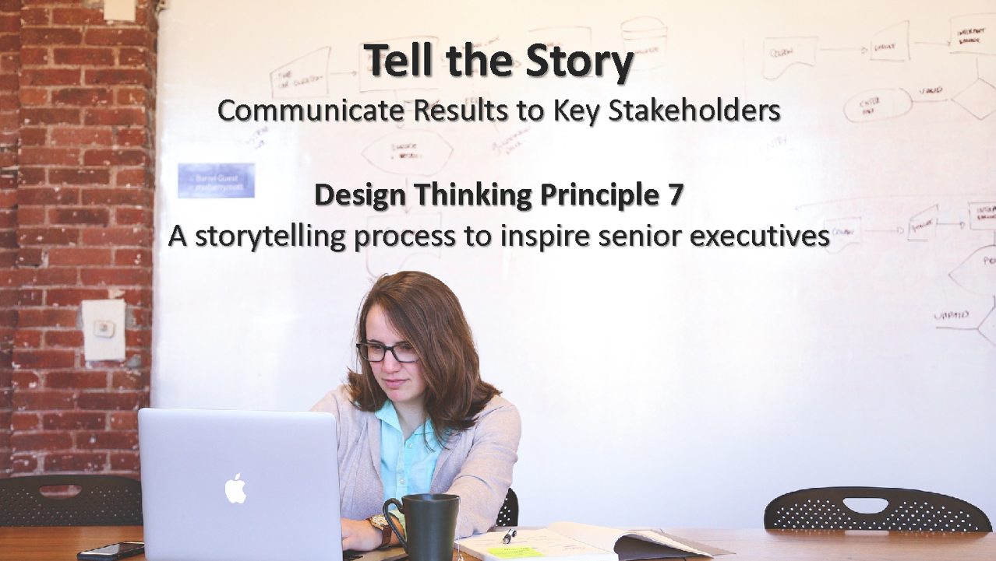
Tell the Story
Communicate Results to Key Stakeholders
Design Thinking Principle 7
A storytelling process to inspire senior executives
Define audience
Identify why they need it
Select method
Move quickly
Consider one-page summary
41

Slide 42

Optimize Results
Use Black Box Thinking to Increase Funding
Design Thinking Principle 8
A new competitive logic of business strategy
EVALUATION
OPTIMIZATION
ALLOCATION
Measure
Improve
Fund
42

Slide 43

General Accounting Program at Qassim University
What are the impact measures for this program?
How would you validate that these are correct?
How would you determine if this is the right solution?
Whose ROI should you pursue? The student’s ROI, the University’s ROI, the employer’s ROI, the government’s ROI? Explain.
43

Slide 44


Cost vs. Investment Perception: The Reality
 | Perception |  | Actions |  | Consequences
 | It’s a cost |  | Control it Reduce it Eliminate it |  | Partnerships are rare Influence diminishes Support is lost Funding is curtailed
Executive Perception of Projects
 | It’s an investment |  | Maintain it Enhance it Protect it |  | Business partnerships flourish Client relationships improve A seat at the table is earned Funding is easier
How do your leaders view your projects?
44

Slide 45

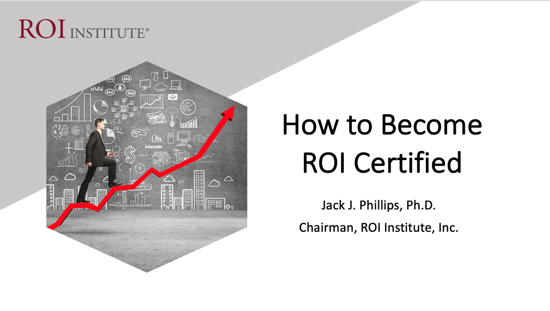
Scan the QR code or click here to access resources from today’s session.

Slide 46
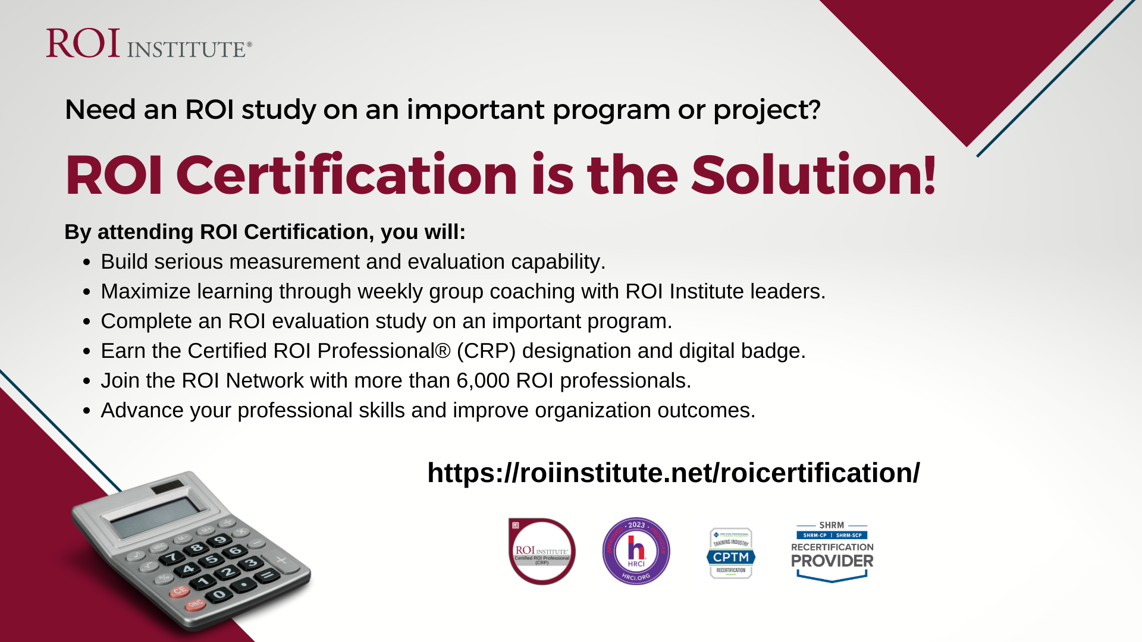

AEA Members
Use code
ROI10

Slide 47




Questions?
Visit us Online
www.roiinstitute.net
Email Us
info@roiinstitute.net
Connect with Us

