Slide 1



Delivering Results
That Executives
(and Others) Will Love
Jack J. Phillips, Ph.D.
Chairman, ROI Institute, Inc.

Slide 2


Jack J. Phillips, Ph.D.
Jack J. Phillips, chairman of ROI Institute, Inc., is a world-renowned
expert on accountability, measurement, and evaluation. A former bank president and HR executive, Phillips consults for Fortune 500 companies and major global organizations. The author or editor of more than 75 books, including Show the Value of What You Do (Berrett-Kohler, 2022), he conducts workshops and presents at conferences throughout the world.
Jack has been recognized and awarded for his work in the field by numerous professional organizations, including receiving the 2022 Association of Talent Development (ATD) Thought Leader Award. SHRM presented Jack with its highest creativity award for an ROI study and awarded an ROI Institute book with a best book award. His work has been featured in the Wall Street Journal, BusinessWeek, and Fortune magazine, and he has been interviewed by several television programs, including CNN.

Slide 3

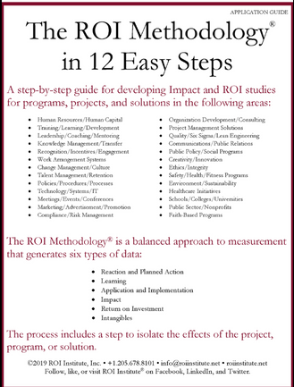
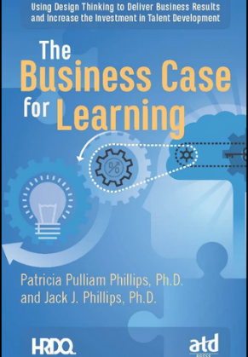
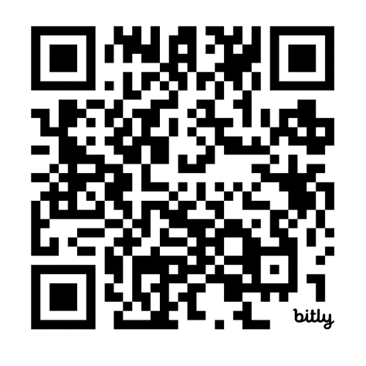

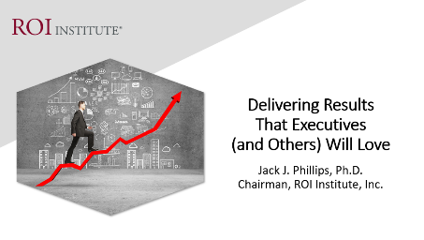
Resources

Slide 4

Session Objectives
After attending this session, participants should be able to:
List the data sets possible from learning and development programs by categories, including ROI.
Identify the categories that are desired by top executives and other key stakeholders.
Explain how these measures are derived and developed.
Pursue a plan to measure results and communicate results to different audiences.

Slide 5
In one word, what comes to mind when you think about ROI for learning and Development?
Enter your word in the chat.

Slide 6
The Value Chain
 | LEVEL | ISSUE | MEASURES | TARGETS**
This is easy Always measured | 0 | Inputs | Volume, Hours, Convenience, Cost | 100%
This is easy Almost always measured | 1 | Reaction | *Relevance, Engaging, *Important, Useful, *New Content, *Intent to Use, *Recommend to Others | 100%
Not difficult Usually measured | 2 | Learning | Concepts, Trends, Facts, Contacts, Skills, Competencies | 90%
Possible Often measured | 3 | Application | Use of content, Frequency of Use, Success with Use, Barriers, Enablers | 30%
Not so difficult to connect Sometimes measured | 4 | Impact | Productivity, Time, Quality, Costs, Image, Reputation, Engagement, Compliance | 10%
Possible for many programs Rarely measured | 5 | ROI | Benefit Cost Ratio or Return on Investment, Expressed as a Percent | 5%
*Can predict
Must take a step to isolate the effects
Executives prefer
**Best Practice: Percent of programs evaluated at this level each year.

Slide 7

Serious Performance Challenges
Most learning and development is not applied.
The learning outcome desired by executives is rarely measured.
Most learning providers do not have data showing that they make a difference in the organization.
Most executives see learning as a cost and not an investment.
Most executives view hard skills more valuable than soft skills.
True
or
False?

Slide 8
Serious Performance Challenges
Most learning and development is wasted (not used).
The learning outcome desired by executives in client organizations is rarely measured.
Most learning providers do not have data showing that they make a difference in the organization.
Most executives see learning as a cost and not an investment.
Most executives view hard skills more valuable than soft skills.
True
or
False?
It’s much worse for virtual.

Slide 9

What CEOs Want
Measures | Currently Measure | Should Measure | Importance
Inputs and Indicators | 94% | 86% | 6
Efficiency | 78% | 82% | 7
Reaction | 53% | 22% | 8
Learning | 32% | 28% | 5
Application | 11% | 61% | 4
Impact | 8% | 96% | 1
ROI | 4% | 74% | 2
Awards | 40% | 44% | 3
ROI Institute and ATD research show that the data CEOs receive are not demonstrating what they want out of their talent investment. (N=96)

Slide 10
Measurement Targets
*Benchmarking Percentages
Level |  | Recommended % of Programs | **Benchmarking %
0 | Input | 100% | 100%
1 | Reaction | 100% | 80%
2 | Learning | 80-90% | 70%
3 | Application | 30% | 49%
4 | Impact | 10% | 37%
5 | ROI | 5% | 18%
*Percentage of programs evaluated at each level each year
**Benchmarking 2020
10
Notes:
SALLY

Slide 11







Cost of the program
Linkage of program to operational goals and issues
Characteristics of Programs Suitable for Impact & ROI
Importance of program to strategic objectives
Top executive interest in the evaluation
Visibility of the program
Size of target audience
Investment of time required

Slide 12

ROI Facts
Implemented in over 70 countries
Most used evaluation system in the world
Endorsed by the United Nations with a UN General Assembly resolution in 2008
Endorsed by 30 federal governments
Used by over 300 healthcare systems
Used by over 150 colleges and universities
Used by three-fourths of Fortune 500 organizations
12

Slide 13
ROI Facts
Used by 40 of the top 50 Best Managed Companies
Used by major foundations such as the Gates Foundation
Supported by over 75 books in 38 languages
Over 400 published case studies
Implemented in all 14 types of organizations, from businesses to government, nonprofits, and school systems.
Used in 22 professional fields ranging from learning and development to innovation and public relations.
13

Slide 14

If you had a credible evaluation of your most important program/projects, showing reaction, learning, application, impact, and a positive ROI, what would it mean to you? (Check all that apply)
My team would be happy
I will have more support for this program
This will help keep funding for the program
My relationship with the sponsor will improve
I will know what worked and what didn’t work
Other (type in chat)

Slide 15

The ROI Methodology Process Model
Designing for the Delivery of Business Results
EVALUATION PLANNING
DATA COLLECTION
DATA ANALYSIS
Make it Credible:
Tabulate Costs of
Program
OPTIMIZE RESULTS
LEVEL 0: INPUT
LEVEL 1: REACTION AND PLANNED ACTION
LEVEL 3:
APPLICATION
Tell the Story:
Communicate
Results to Key
Stakeholders
Optimize
Results:
Use Black Box
Thinking to
Increase Funding
Start with Why:
Align Programs
With the
Business
Make it Feasible:
Select the Right
Solution
Expect
Success:
Plan for
Results
Make it Matter:
Design for Input,
Reaction and
Learning
Make it Stick:
Design for
Application
and Impact
Make it
Credible:
Isolate the
Effects
Make it Credible:
Convert Data to
Monetary Value
Make it Credible:
Calculate ROI
LEVEL 5: ROI
LEVEL 2: LEARNING
LEVEL 4: IMPACT
Make it Credible:
Identify Intangibles
INTANGIBLE BENEFITS
©2021 ROI Institute Inc. – No part of this document can be reproduced, stored in a retrieval system, or transmitted in any form without written permission from ROI Institute, Inc.

Slide 16
Guiding Principles
When conducting a higher-level evaluation, collect data at lower levels.
When planning a higher-level evaluation, the previous level of evaluation is not required to be comprehensive.
When collecting and analyzing data, use only the most credible sources.
When analyzing data, select the most conservative alternative for calculations.
Use at least one method to isolate the effects of a project.
If no improvement data are available for a population or from a speciﬁc source, assume that little or no improvement has occurred.
Adjust estimates of improvement for potential errors of estimation.
Avoid use of extreme data items and unsupported claims when calculating ROI.
Use only the ﬁrst year of annual beneﬁts in ROI analysis of short-term solutions.
Fully load all costs of a solution, project, or program when analyzing ROI.
Intangible measures are deﬁned as measures that are purposely not converted to monetary values.
Communicate the results of ROI Methodology to all key stakeholders.
16

Slide 17

Start with Why
Align Programs with the Business
Design Thinking Principle 1
A problem-solving approach to handle problems on a systems levels

Slide 18

Alignment Model
Start Here
End Here
Payoff Needs
5
ROI Objectives
5
ROI
Why?
Business Needs
4
Impact Objectives
4
Impact
Performance Needs
3
Application Objectives
3
Application
Learning Needs
2
Learning Objectives
2
Learning
Initial
Analysis
Measurement and Evaluation
Preference Needs
1
Reaction Objectives
1
Reaction
Input Needs
0
Input Objectives
0
Input
Program Process Initiative
Alignment and Forecasting
The ROI Process Model

Slide 19

Make it Feasible
Select the Right Solution
Design Thinking Principle 2
A mind-set for curiosity and inquiry

Slide 20
Alignment Model
Start Here
End Here
Payoff Needs
5
ROI Objectives
5
ROI
Why?
Business Needs
4
Impact Objectives
4
Impact
Performance Needs
3
Application Objectives
3
Application
Feasible Solution
Learning Needs
2
Learning Objectives
2
Learning
Preference Needs
1
Reaction Objectives
1
Reaction
0
0
Program Process Initiative
Alignment and Forecasting
The ROI Process Model

Slide 21

Expect Success
Design for Results
Design Thinking Principle 3
A framework to balance
needs and feasibility

Slide 22
Developing Objectives for Each Level
Levels | Focus
Level 1, Reaction | Defines specific measures of expected reaction to the program as it is revealed and communicated to the stakeholders
Level 2, Learning | Defines specific measures of improvement in knowledge, information, contacts, and skills as the participants and other stakeholders learn how to make the program successful
Level 3, Application | Defines specific measures of actions taken that define success with application and implementation of program
Level 4, Impact | Defines the specific impact measures that will change or improve as a consequence of the program’s implementation
Level 5, ROI | Defines the minimum return on investment from the program, comparing program costs with monetary benefits from the program

Slide 23

Rules for Objectives
Must be measurable and represent minimum acceptable performance.
Fewer objectives are better than many objectives.
Involve subject-matter experts and key stakeholders.
Keep them relevant to the situation, program, and key stakeholders.
Create stretch objectives, but make sure they are achievable.
Allow for the flexibility to change as conditions change.
Failure is OK; process improvement is the key.
Objectives are tools for progress, not weapons for performance review.
Most objectives should be time-bound.
Objectives provide the focus for design, development, implementation, and evaluation.

Slide 24
After completing this engagement, participants should:
Matching Evaluation Levels with Objectives
1. | Decrease complaints by 20% in one year.
2. | Use recognition skills to improve employee retention.
3. | Score an average of 70% or better on “How to Give Feedback.”
4. | Decrease the amount of time required to complete project.
5. | Perceive the program to be relevant to my job situation (4.5 out of 5).
6. | Achieve a 20% ROI one year after implementation of remote work.
7. | Conduct a proper investigation using the seven-step process in 95% of complaint situations.
4
3
2
4
1
5
3
1 = Reaction 2 = Learning 3 = Application 4 = Impact 5 = ROI

Slide 26

Make it Stick
Design for Application and Impact
Design Thinking Principle 5
A culture that fosters exploration
and experimentation

Slide 27
Data Collection Methods
*Survey of Users, N = 246
27

Slide 28

Make it Credible
Measure Results and Calculate ROI
Isolating the effects of the program
Converting Impact data to money
Identifying intangible benefits
Tabulating cost of the program
Calculating ROI
Design Thinking Principle
A fixed process and a tool kit
28

Slide 29

Isolation Methods
*Survey of Users, N = 246

Slide 30
Data Conversion Methods
*Survey of Users, N = 246

Slide 31
Common Intangibles
Agility
Ambiguity
Alliances
Awards
Brand
Burnout
Capability
Capacity
Carbon emissions
Clarity
Collaboration
Communication
Compassion
Complexity
Compliance
Conflict
Corporate social responsibility
Creativity
Culture
Customer service
Decisiveness
Emotional intelligence
Employee attitudes
Engagement
Food security
Grit
Happiness
Human Life
Image
Intellectual capital
Job satisfaction
Leadership effectiveness
Loyalty
Mindfulness
Mindset
Net promoter score
Networking
Organizational commitment
Partnering
Patient satisfaction
Poverty
Reputation
Risk
Social Capital
Stress
Sustainability
Team effectiveness
Timeliness
Trust
Uncertainty
Volatility
Work/life balance

Slide 32
Tabulating Program Costs Recommended Items
Project Cost Categories
Cost Item | Prorated | Expensed
Initial analysis and assessment | ✓
Development of solutions | ✓
Acquisition of solutions | ✓
Implementation and application
Salaries/benefits for program team time |  | ✓
Salaries/benefits for coordination time |  | ✓
Salaries/benefits for participant time (if appropriate) |  | ✓
Program materials |  | ✓
Hardware/software | ✓
Travel/lodging/meals |  | ✓
Use of facilities |  | ✓
Capital expenditures | ✓
Maintenance and monitoring |  | ✓
Administrative support and overhead | ✓
Evaluation and reporting |  | ✓

Slide 33

What is ROI?
Program Benefits
Program Costs
BCR =
Benefits - Costs
Program Costs
ROI =
X 100

Slide 34

Program: Emerging Leadership
Program Benefits = $2,016,290
Program Costs = $589,386
ROI Calculation Example
Data taken from an emerging leadership case study.

Slide 35
What is ROI?
$2,016,290
$589,386
BCR =
=
3.42
$2,016,290 - $589,386
$589,386
ROI =
242%
X 100 =

Slide 37

Optimize Results
Use Black Box Thinking to Increase Funding
Design Thinking Principle 8
A new competitive logic of business strategy

Slide 38


Costs versus Investment Perception: The Reality
 | Perception |  | Actions |  | Consequences
 | It’s a cost |  | Control it Reduce it Eliminate it |  | Partnerships are rare Influence diminishes Support is lost Funding is curtailed
Executive Perception of Programs
 | It’s an investment |  | Maintain it Enhance it Protect it |  | Business partnerships flourish Client relationships improve A seat at the table is earned Funding is easier
Workbook Page 11-9

Slide 39

The Payoff
Justify/defend budgets.
Align projects to business needs.
Show contributions of selected projects.
Earn respect of senior management/administrators.
Build staff morale.
Improve support for projects.
Enhance design and implementation processes.
Identify inefficient projects that need to be redesigned or eliminated.
Identify successful projects that can be implemented in other areas.
Earn a “seat at the table”.

Slide 40

Be Proactive
Remember, when it comes to delivering results:
  Hope is not a strategy.
  Luck is not a factor.
  Doing nothing is not an option.
Change is inevitable.
Progress is optional.

Slide 41
Resources

Slide 42
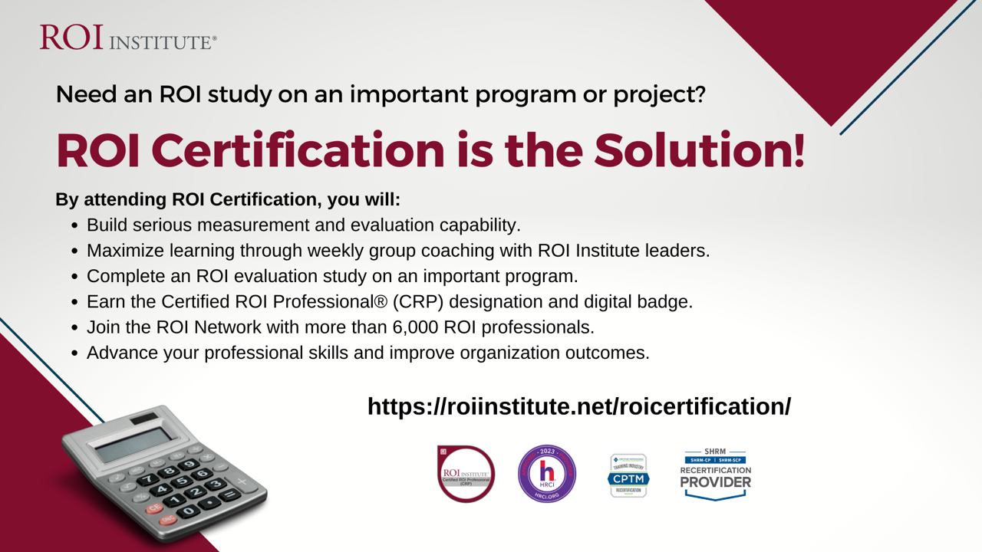


Slide 43




Questions?
Visit us online:
www.roiinstitute.net
Email:
Jack@roiinstitute.net
Connect with us on:

