Slide 1

Measuring the Impact & ROI for Learning & Development
Jack J. Phillips, Ph.D., Chairman, ROI Institute, Inc.

Slide 2


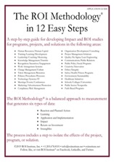


Resources

Slide 3
Module 1:
Introduction and Readiness to Learn
3
WB page 1

Slide 4
Workshop Components
Frequent short breaks
Networking
Participation and learning in small teams or groups
Learn by doing
Questions and sharing
Capture action items from consideration
Apply the evaluation planning process during the workshop
A great beginning
WB page 1

Slide 5
Reaction Objectives
After participating in this workshop, you should:
Perceive the workshop content to be relevant to your work.
Find it important to your success on the job.
Immediately apply it in your work.
Find the content to be new information.
WB page 1

Slide 6
Learning Objectives
Identify the drivers for ROI accountability.
Link program objectives to
business results.
Identify at least three ways to collect data.
Describe at least three ways to isolate the effects of a program.
Describe at least three ways to convert data to monetary values.
Identify all costs of a program.
Calculate ROI, given benefits and costs.
Identify intangible measures.
Plan a follow-up evaluation for one of your programs.
Describe the 12 steps in the
ROI Methodology®.
WB page 2

Slide 7
Application Objectives
When you return to your workplace, you should:
Develop an evaluation plan for a specific program within two weeks.
Revise/update internal policies on evaluation within 30 days.
Select appropriate data collection methods when conducting impact studies.
Use appropriate methods to isolate the effects of programs.
Use appropriate methods to convert data to monetary values.
Capture fully loaded costs when conducting an ROI study.
Calculate the return on investment for a simple ROI study.
WB page 2

Slide 8
Impact Objectives
Six months after completing this workshop, you should:
Improve the effectiveness of programs.
Expand the implementation of successful programs.
Redesign ineffective programs.
Improve satisfaction of your stakeholders.
Improve relationships with key managers and clients.
Maintain or increase funding for talent development.
WB page 3

Slide 9
Case Application: Reliance Insurance Organization
Is this situation typical? Explain.
What should Marge do? Explain.
What will Frank be expecting in the future?
How could this situation be avoided in the future?
WB page 4

Slide 10

What are the key factors in your
work setting that drive accountability?
10

Slide 11
Definition of Results-Based Programs
Programs are linked to business needs.
Performance issues are assessed.
Learning needs are assessed.
Objectives are defined at higher levels.
Expectations are created with stakeholders.
The transfer of learning is addressed early and often.
The level of evaluation is established for each program.
Partnerships are developed with
key managers.
The evaluation is completed, capturing a variety of data.
Results are communicated to the appropriate stakeholders.
WB page 6

Slide 12
Defining BCR and ROI
Program Benefits
Program Costs
Benefits/Cost Ratio
=
Program Benefits - Program Costs
Program Costs
ROI
=
x
100
WB page 6

Slide 13
Defining BCR and ROI: Example
ROI Calculation – Example
Program Benefits From Participants (1st year) $230,000
Costs per Program (25 participants) $88,000
Benefits/Cost Ratio =
ROI =
x
100
WB page 7

Slide 14
Defining BCR and ROI: Example
ROI Calculation – Example
Program Benefits From Participants (1st year) $230,000
Costs per Program (25 participants) $88,000
$230,000
$88,000
Benefits/Cost Ratio =
=
$230,000 - $88,000
$88,000
ROI =
x
100 =
WB page 7

Slide 15

Try it!
Reduce Safety Incidents (1st year) = $750,000
Program Cost (25 participants) = $425,000
BCR =
=
ROI =
x 100 =

Slide 16
Try it!
Reduce Safety Incidents (1st year) = $750,000
Program Cost (25 participants) = $425,000
$750,000
$425,000
BCR =
=
$750,000 - $425,000
$425,000
ROI =
x 100 =

Slide 17
ROI Target – Options
Set the value as with other investments, e.g., 15%
Set slightly above other investments, e.g., 25%
Set at break even: 0%
Set at client expectations
What value would be appropriate in your organization?
WB page 7

Slide 18
Module 2:
ROI Methodology®
18
WB page 8

Slide 19
Levels of Evaluation
Level | Measurement Focus
0. Input | Activities involved in the program
1. Reaction | Measures participant satisfaction with the program and captures planned action
2. Learning | Measures changes in knowledge, skills, and attitudes
3. Application | Measures changes in on-the-job behavior
4. Business Impact | Measures changes in business impact measures
5. Return on Investment | Compares program benefits to the costs
Intangibles | Impact data not converted to money
19
WB page 9

Slide 20
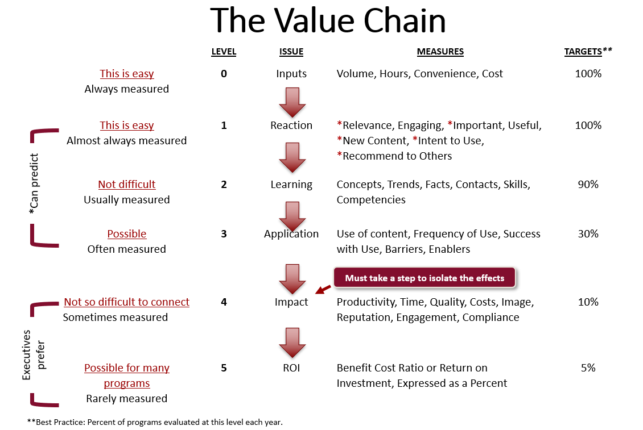
The Value Chain
WB page 11
20

Slide 21
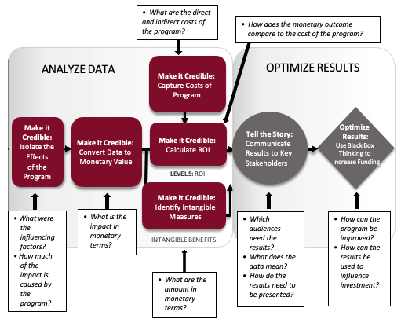
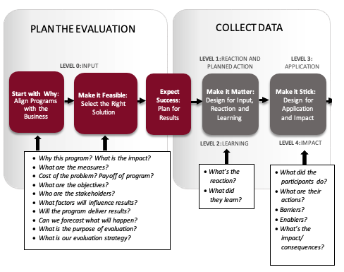
ROI Methodology® Process Model
21
WB page 12-13
©2024 ROI Institute, Inc. All Rights Reserved.

Slide 22
Twelve Guiding Principles
When conducting a higher-level evaluation, collect data at lower levels.
When planning a higher-level evaluation, the previous level of evaluation is not required to be comprehensive.
When collecting and analyzing data, use only the most credible sources.
When analyzing data, select the most conservative alternatives for calculations.
Use at least one method to isolate the effects of the program or project.
If no improvement data are available for a population or from a specific source, assume that no improvement has occurred.
Adjust estimates of improvements for the potential error of the estimates.
Avoid use of extreme data items and unsupported claims when calculating ROI.
Use only the first year of annual benefits in the ROI analysis of short-term solutions.
Fully load all costs of the solution, project, or program when analyzing ROI.
Define intangible measures as measures that are purposely not converted to monetary values.
Communicate the results of the ROI Methodology to all key stakeholders.
WB page 14-15

Slide 23
The Value Chain
Level | Measurement Category | Current Status | Recommended | Comments About Status
0 | Inputs/Indicators: Measures the number of programs, participants, audience, costs, and efficiencies |  | 100% | This is being accomplished now
1 | Reaction and Planned Action: Measures reaction to, and satisfaction with, the experience, contents, and value of program |  | 100% | Need more focus on content and perceived value
2 | Learning: Measures what participants learned in the program–information, knowledge, skills, and contacts (takeaways) |  | 80–90% | Must use simple learning measures
3 | Application: Measures progress after the program–the use of information, knowledge, skills, and contacts |  | 30–40% | Need more follow-up
4 | Business Impact: Measures changes in business impact variables such as output, quality, time, and costs linked to the program |  | 10–20% | This is the connection to business impact
5 | ROI: Compares the monetary benefits of the business impact measures to the costs of the program |  | 5–10% | The ultimate level of evaluation
23
*Recommended minimum percentage of programs evaluated at each level for the typical large organization.
WB page 16

Slide 24

What is your status?
Level | Measurement Category | Current Status | Recommended | Comments About Status
0 | Inputs/Indicators: Measures the number of programs, participants, audience, costs, and efficiencies |  | 100% | This is being accomplished now
1 | Reaction and Planned Action: Measures reaction to, and satisfaction with, the experience, contents, and value of program |  | 100% | Need more focus on content and perceived value
2 | Learning: Measures what participants learned in the program–information, knowledge, skills, and contacts (takeaways) |  | 80–90% | Must use simple learning measures
3 | Application: Measures progress after the program–the use of information, knowledge, skills, and contacts |  | 30–40% | Need more follow-up
4 | Business Impact: Measures changes in business impact variables such as output, quality, time, and costs linked to the program |  | 10–20% | This is the connection to business impact
5 | ROI: Compares the monetary benefits of the business impact measures to the costs of the program |  | 5–10% | The ultimate level of evaluation
24
*Recommended minimum percentage of programs evaluated at each level for the typical large organization compared to 2020 ROI Institute Benchmarking Study results..
WB page 16

Slide 25
What is your status?
Level | Measurement Category | Current Status | Recommended | 2020 Benchmarks*
0 | Inputs/Indicators: Measures the number of programs, participants, audience, costs, and efficiencies |  | 100% | 100%
1 | Reaction and Planned Action: Measures reaction to, and satisfaction with, the experience, contents, and value of program |  | 100% | 80%
2 | Learning: Measures what participants learned in the program–information, knowledge, skills, and contacts (takeaways) |  | 80–90% | 70%
3 | Application: Measures progress after the program–the use of information, knowledge, skills, and contacts |  | 30–40% | 49%
4 | Business Impact: Measures changes in business impact variables such as output, quality, time, and costs linked to the program |  | 10–20% | 37%
5 | ROI: Compares the monetary benefits of the business impact measures to the costs of the program |  | 5–10% | 18%
25
*Recommended minimum percentage of programs evaluated at each level for the typical large organization compared to 2020 ROI Institute Benchmarking Study results..
WB page 16

Slide 26
Criteria for Level 4 and Level 5 Evaluations
Expected life cycle of the program
The importance of the program in meeting the organization’s goals
The connection of the program to strategic objectives
Cost of the program
Visibility of the program
The size of the target audience
Extent of management interest
WB page 17

Slide 27
Payoff of the ROI Methodology
Justify/defend budgets.
Improve support for projects.
Enhance design and implementation processes.
Identify inefficient programs that need to be redesigned or eliminated.
Identify successful programs that can be implemented in other areas.
Align projects or programs to business needs.
Show contributions of selected programs.
Earn respect of senior management/administrators.
Build staff morale.
Earn a “seat at the table.”
WB page 17

Slide 28

Module 3:
Evaluation Planning
28
WB page 18

Slide 29

The ROI Methodology Process Model
PLAN THE EVALUATION
COLLECT DATA
ANALYZE DATA
Make it Credible:
Capture Costs of
Program
OPTIMIZE RESULTS
LEVEL 0: INPUT
LEVEL 1: REACTION AND PLANNED ACTION
LEVEL 3:
APPLICATION
Start With Why:
Align Programs
With the
Business
Make it Feasible:
Select the Right
Solution
Expect
Success:
Plan for
Results
Make it Matter:
Design for Input,
Reaction, and
Learning
Make it Stick:
Design for
Application
and Impact
Make it
Credible:
Isolate the
Effects
of the
Program
Make it Credible:
Convert Data to
Monetary Value
Make it Credible:
Calculate ROI
Optimize
Results:
Use Black Box
Thinking to
Increase
Funding
Tell the Story:
Communicate
Results to Key
Stakeholder
LEVEL 5: ROI
LEVEL 2: LEARNING
LEVEL 4: IMPACT
Make it Credible:
Identify Intangible Measures
INTANGIBLE BENEFITS
29
©2024 ROI Institute Inc. All Rights Reserved.

Slide 30
Four Major Categories of Hard Data
HARD DATA Typical Measures of Improvement
Output
Increases
Time
Savings
Cost
Savings
Quality
Improvement
30
WB page 19

Slide 31
Characteristics of Hard Data
Hard data are:
Easy to measure and quantify
Relatively easy to assign monetary values
Objectively based
Common measures of organizational performance
Very credible with management
Examples are:
Citizens vaccinated
Loans approved
Patients discharged
Length of stay
Repair time
Operating costs
Cost per day
WB page 19

Slide 32
Major Categories of Soft Data
SOFT DATA Typical Measures of Improvement
Initiative
Work Habits
Work Climate
Feelings/
Attitudes
New Skills
Development/
Advancement
32
WB page 20

Slide 33
Characteristics of Soft Data
Soft data are:
Difficult to measure and quantify directly
Difficult to assign dollar values
Subjectively based in many cases
Less credible as a performance measure
Usually behaviorally oriented
Examples are:
Teamwork
Decisiveness
Grievances
Employee Engagement
New ideas
Trademarks
Readiness
WB page 20

Slide 34
The ROI Methodology Process Model
PLAN THE EVALUATION
COLLECT DATA
ANALYZE DATA
Make it Credible:
Capture Costs of
Program
OPTIMIZE RESULTS
LEVEL 0: INPUT
LEVEL 1: REACTION AND PLANNED ACTION
LEVEL 3:
APPLICATION
Start With Why:
Align Programs
With the
Business
Make it Feasible:
Select the Right
Solution
Expect
Success:
Plan for
Results
Make it Matter:
Design for Input,
Reaction, and
Learning
Make it Stick:
Design for
Application
and Impact
Make it
Credible:
Isolate the
Effects
of the
Program
Make it Credible:
Convert Data to
Monetary Value
Make it Credible:
Calculate ROI
Optimize
Results:
Use Black Box
Thinking to
Increase
Funding
Tell the Story:
Communicate
Results to Key
Stakeholder
LEVEL 5: ROI
LEVEL 2: LEARNING
LEVEL 4: IMPACT
Make it Credible:
Identify Intangible Measures
INTANGIBLE BENEFITS
34

Slide 35
The Alignment Model (aka V-Model)
Start Here
End Here
Payoff Needs
5
ROI Objectives
5
ROI
Business Needs
4
Impact Objectives
4
Impact
Performance Needs
3
Application Objectives
3
Application
Learning Needs
2
Learning Objectives
2
Learning
Initial Analysis
Measurement and Evaluation
Preference Needs
1
Reaction Objectives
1
Reaction
Input Needs
0
Input Objectives
0
Input
Program Process Initiative
Alignment and Forecasting
The ROI Process Model
©2024 ROI Institute, Inc. All Rights Reserved.
WB page 21
35

Slide 36
The Alignment Model (aka V-Model)
Start Here
End Here
Payoff Needs
5
ROI Objectives
5
ROI
Start With Why
Business Needs
4
Impact Objectives
4
Impact
Performance Needs
3
Application Objectives
3
Application
Select a Feasible Solution
Learning Objectives
2
Learning Needs
2
Learning
Preference Needs
1
Reaction Objectives
1
Reaction
Input Needs
0
Input Objectives
0
Input
Program Process Initiative
Alignment and Forecasting
The ROI Process Model
©2024 ROI Institute, Inc. All Rights Reserved.
WB page 21
36

Slide 37
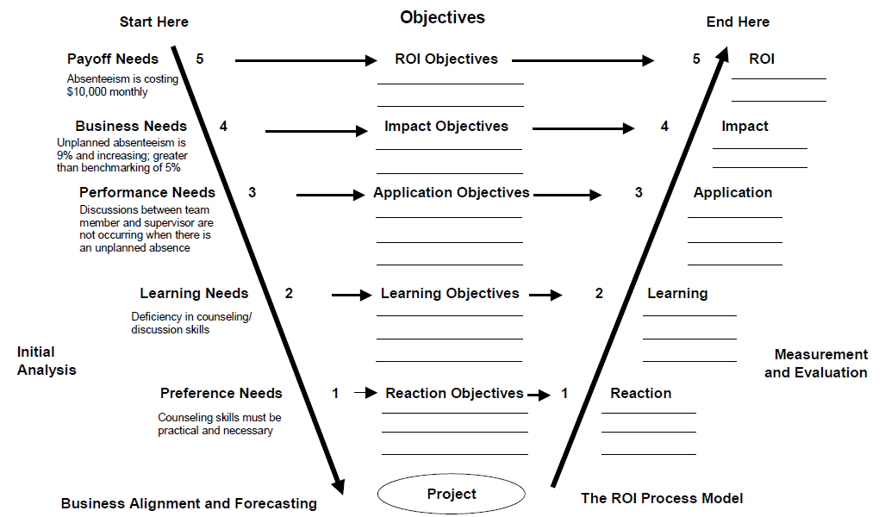
The Alignment Process
WB page 22
37

Slide 38
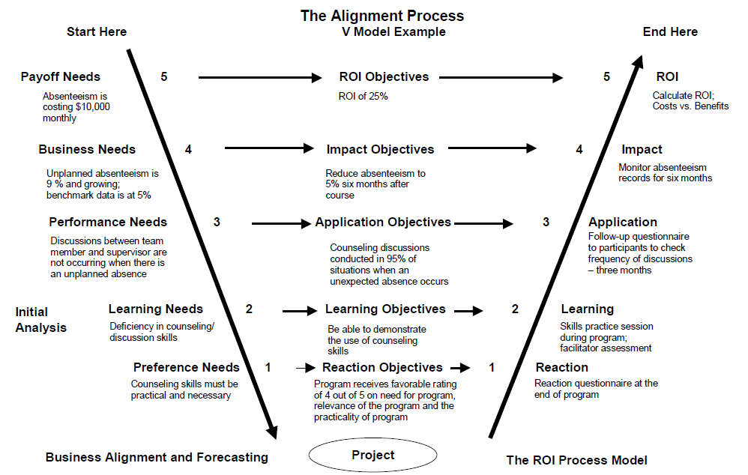
The Alignment Process — Example
WB page 23
38

Slide 39
The ROI Methodology Process Model
PLAN THE EVALUATION
COLLECT DATA
ANALYZE DATA
Make it Credible:
Capture Costs of
Program
OPTIMIZE RESULTS
LEVEL 0: INPUT
LEVEL 1: REACTION AND PLANNED ACTION
LEVEL 3:
APPLICATION
Start with Why:
Align Programs
With the
Business
Make it Feasible:
Select the Right
Solution
Expect
Success:
Plan for
Results
Make it Matter:
Design for Input,
Reaction, and
Learning
Make it Stick:
Design for
Application
and Impact
Make it
Credible:
Isolate the
Effects
of the
Program
Make it Credible:
Convert Data to
Monetary Value
Make it Credible:
Calculate ROI
Optimize
Results:
Use Black Box
Thinking to
Increase
Funding
Tell the Story:
Communicate
Results to Key
Stakeholder
LEVEL 5: ROI
LEVEL 2: LEARNING
LEVEL 4: IMPACT
Make it Credible:
Identify Intangible Measures
INTANGIBLE BENEFITS
39
©2024 ROI Institute Inc. All Rights Reserved.

Slide 40

Matching Evaluation Levels With Objectives
For each objective, indicate the level of evaluation at which the objective is aimed.
Level 1: Reaction
Level 2: Learning
Level 3: Application
Level 4: Impact
Level 5: Return on Investment
WB page 24-25
40

Slide 41
Developing Objectives for Each Level
Levels of Objectives | Focus of Objectives
Level 1, Reaction | Defines specific measures of expected reaction to the program as it is revealed and communicated to the stakeholders
Level 2, Learning | Defines specific measures of improvement in knowledge, information, contacts, and skills as the participants and other stakeholders learn how to make the program successful
Level 3, Application | Defines specific measures of actions taken that define success with application and implementation of the program
Level 4, Impact | Defines the specific impact measures that will change or improve as a consequence of the program’s implementation
Level 5, ROI | Defines the minimum return on investment from the program, comparing program costs with monetary benefits from the program
41
WB page 26

Slide 42
Rules for Objectives
Must be measurable and represent minimum acceptable performance.
Fewer objectives are better than many objectives.
Involve subject-matter experts and key stakeholders.
Keep objectives relevant to the situation, program, and key stakeholders.
Create stretch objectives, but make sure they are achievable.
Allow for the flexibility to change as conditions change.
Failure is OK; process improvement is the key.
Objectives are tools for progress, not weapons for performance review.
Most objectives should be time-bound.
Objectives provide the focus for design, development, implementation, and evaluation.
These rules are from a combination of publications:
J. J. Phillips and P. P. Phillips. Beyond Learning Objectives: Develop Measurable Objectives that Link to the Bottom Line. Alexandria, VA: ASTD Press. 2008.
P. P. Phillips and J. J. Phillips. 10 Steps to Successful Business Alignment. Alexandria, VA: ASTD Press. 2012.
J. Doerr. Measure What Matters: How Google, Bono, and the Gates Foundation Rock the World with OKRs. New York: Penguin. 2018.
WB page 27

Slide 43
Best Reaction Objectives
Identify issues that are important and measurable
Are attitude-based, clearly worded, and specific
Underscore the linkage between attitude and the success of the program
Represent a satisfaction index from key stakeholders
Have the capability to predict program success
Broad Objective | Measure
At the end of the course, participants will perceive program content as relevant to their jobs. | 80% of participants rate program relevance a 4.5 out of 5 on a Likert scale.
WB page 28

Slide 44
Best Learning Objectives
Describe behaviors or actions that are observable and measurable
Are outcome-based, clearly worded, and specific
Specify what the participant must do (not know or understand) as a result of the program
Have three components:
  Performance—what the participant will be able to do at the end of the program
  Condition—circumstances under which the participant will perform the task
  Criteria—degree or level of proficiency that is necessary to perform the job
WB page 29

Slide 45
Best Learning Objectives
Broad Objective | Measure
At the end of the program, participants will be able to implement Microsoft Word. | Within a 10-minute time period, participants will be able to demonstrate to the facilitator the following applications of Word with zero errors: File, Save as, Save as Web Page Formatting including font, paragraph, background, and themes Insert tables, add columns and rows, and delete columns and rows

Slide 46
Best Application Objectives
Identify behaviors and actions that are observable and measurable
Are outcome-based, clearly worded, and specific
Specify what the participant will change as a result of the program
WB page 30

Slide 47
Best Application Objectives
Broad Objective | Measure
Participants will use effective meeting behaviors. | Participants will develop a detailed agenda outlining the specific topics to be covered for 100% of meetings. Participants will establish meeting ground rules at the beginning of 100% of meetings. Participants will follow up on meeting action items within three days following 100% of meetings.

Slide 48
Best Impact Objectives
Must contain measures that are linked to the program
Describe measures that are easily available and collected
Are results-based, clearly worded, and specific
Specify the outcomes in the work unit or business unit as a result of the participant applying the content of the program
WB page 31

Slide 49
Best Impact Objectives
Level 4 Objective | Measure
Increase market share. | Increase market share of young professionals by 10% within 9 months of new ad launch.
Improve the quality of the X-1350. | Reduce the number of warranty claims on the X-1350 by 10% within six months after the program. Improve overall customer satisfaction with quality of the X-1350 by 10% as indicated by customer satisfaction survey taken six months after the program. Achieve top scores on product quality measures included in industry quality survey.

Slide 50
Defining BCR and ROI
Program Benefits
Program Costs
Benefits/Cost Ratio
=
Program Benefits - Program Costs
Program Costs
ROI
=
x
100
WB page 33

Slide 51
Defining BCR and ROI
$240,000
$80,000
Benefits/Cost Ratio
=
=
$240,000 - $80,000
$80,000
ROI
=
x
100 =
WB page 33

Slide 52
ROI Objectives
Set the value at the same level as other investments: 15 percent.
Set slightly above other estimates: 25 percent.
Set at breakeven: 0 percent.
Set at client expectations.
Private sector organizations usually go with option #2; public sector organizations prefer #3.
WB page 33

Slide 53
Data Collection Plan
Program:___________________________________________________ Responsibility: ________________________________________________________ Date:_____________________
Level | Broad Program Objective(s) | Measures | Data Collection Method/ Instruments | Data Sources | Timing | Responsibilities
1 | Reaction/Satisfaction and Planned Actions
2 | Learning
3 | Application/ Implementation
4 | Business Impact
5 | ROI | Comments:
53
WB page 34
Notes:
Facilitator delivers.
The first planning document is the data collection plan:
When planning data collection, you will answer five basic questions:
What do we ask? (objectives/measures)
How do we ask?
Who do we ask?
When do we ask?
Who does the asking?
We will address these questions in more detail next week.
Transition to next slide: the second planning document is the ROI Analysis plan

Slide 54
ROI Analysis Plan
Program:___________________________________________________ Responsibility: ________________________________________________________ Date:_____________________
Data Items (Usually Level 4) | Methods for Isolating the Effects of the Program/ Process | Methods of Converting Data to Monetary Values | Costs | Intangible Benefits | Communica-tion Targets for Final Report | Other Influences/ Issues During Application | Comments
54
WB page 35
Notes:
Facilitator delivers.
The first planning document is the data collection plan:
When planning data collection, you will answer five basic questions:
What do we ask? (objectives/measures)
How do we ask?
Who do we ask?
When do we ask?
Who does the asking?
We will address these questions in more detail next week.
Transition to next slide: the second planning document is the ROI Analysis plan

Slide 55
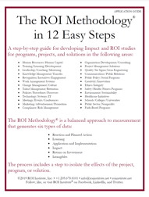
Time to Practice
Now is your time to practice planning an ROI study. You will read the case study titled Retail Merchandise in your Participant Workbook. Then with your team, answer the questions at the end of the case study.
You might also refer to the ROI Methodology fold out model the Application Guide as a reference.
WB page 36

Slide 56
Case Application: Retail Merchandise
Which types of data does the senior management team desire?
How should data be collected for application and business impact measurement?
Which method should be utilized to isolate the effects of the program?
How should the business impact data be converted to monetary values?
WB page 38

Slide 57
Program Profile
Title: Interactive Selling Skills
Target Group: Sales Associates in Electronics
Vendor Produced and Delivered
3 Days – (2 Days Plus 1 Day)
Significant Use of Skill Practices
3 Groups Trained (48 Participants From 3 Stores)
WB page 97

Slide 58
ROI Analysis Profile
Data Collection
  (L1) Reaction questionnaire – end of course
  (L2) Facilitator assessment/demonstration – during course
  (L3) Program follow-up session – 3 weeks
  (L3) Questionnaire – 3 months
  (L4) Performance Monitoring – 3 months
Isolation
  Control group arrangement
    Store size
    Store location
    Customer traffic levels
    Previous store performance
  Participant estimates (back-up)
Data Conversion
  Profit contribution (standard value)
58
WB page 91

Slide 59
Level 1 – Selected Data
Success With Objectives 4.3
Relevance of Material 4.4
Usefulness of Program 4.5
Exercises/Skill Practices 3.9
Overall Instructor Rating 4.1
Target 4.0 / 5.0
WB page 98

Slide 60
Level 2 – Selected Data
All participants demonstrated that they could use the skills successfully.
WB page 98

Slide 61
Level 3 – Selected Data
 | Strongly Agree | Agree | Neither Agree or Disagree | Disagree | Strongly Disagree
I utilize the skills taught in the program. | 78% | 22% | 0% | 0% | 0%
 | With Each Customer | Every Third Customer | Several Times Each Day | At Least Once Daily | At Least Once Weekly
Frequency of use of skills | 52% | 26% | 18% | 4% | 0%
Targets:
100% of participants indicate they use the skills taught in the program.
50% of participants indicate they use skills with everyone customer.
61
WB page 99

Slide 62
Level 4 – Average Weekly Sales
Weeks After Training | Trained Groups | Control Groups
1 | $9,723 | $9,698
2 | $9,978 | $9,720
3 | $10,424 | $9,812
13 | $13,960 | $11,572
14 | $11,491 | $9,683
15 | $11,044 | $10,092
Average for Weeks 13,14,15 | $12,075 | $10,449
62
WB page 99

Slide 63
Annualized Program Benefits
Average Weekly Sales per Employee — Trained Groups $12,075
Average Weekly Sales per Employee — Untrained Groups $10,449
Increase in sales $1,626
Profit Contribution is 2% of Store Sales ($1626 x .02) $32.50
Total Weekly Improvement ($32.50 x 46 participants) $1,495
Total Annual Benefits ($1,495 x 48 Weeks) $71,760
WB page 99

Slide 64
Cost Summary
Facilitation Fees: 3 courses @ $3750 $11,250
Program Materials: 48 @ $35/participant $ 1,680
Meals/Refreshments: 3 days @ $28/participant $ 4,032
Facilities: 9 days @ $120 $ 1,080
Participant Salaries Plus Benefits (35% factor) $12,442
Coordination/Evaluation $ 2,500
Total Costs $32,984
WB page 99

Slide 65
What Is the ROI?
Program Benefits
Program Costs
Benefits/Cost Ratio
=
=
Program Benefits – Program Costs
Program Costs
ROI =
x 100
=
WB page 100

Slide 66
What Is the ROI?
$71,760
$32,984
Benefits/Cost Ratio
=
=
$71,760 - $32,984
$32,984
ROI
=
x
100
=

Slide 67
Results
Capture Program Costs
$32,984
Collect Post Program Data
Isolate the Effects of the Program
Convert Data to Monetary Value
Calculate the Return on Investment
Follow-up session
Questionnaire
Performance Monitoring
Control groups
Participants’ estimates
Standard values
$71,760
118%
Identify Intangible Benefits
67

Slide 68
Module 4:
Data Collection
68
WB page 40

Slide 69
The ROI Methodology Process Model
PLAN THE EVALUATION
COLLECT DATA
ANALYZE DATA
Make it Credible:
Capture Costs of
Program
OPTIMIZE RESULTS
LEVEL 0: INPUT
LEVEL 1: REACTION AND PLANNED ACTION
LEVEL 3:
APPLICATION
Start With Why:
Align Programs
With the
Business
Make it Feasible:
Select the Right
Solution
Expect
Success:
Plan for
Results
Make it Matter:
Design for Input,
Reaction, and
Learning
Make it Stick:
Design for
Application
and Impact
Make it
Credible:
Isolate the
Effects
of the
Program
Make it Credible:
Convert Data to
Monetary Value
Make it Credible:
Calculate ROI
Optimize
Results:
Use Black Box
Thinking to
Increase
Funding
Tell the Story:
Communicate
Results to Key
Stakeholder
LEVEL 5: ROI
LEVEL 2: LEARNING
LEVEL 4: IMPACT
Make it Credible:
Identify Intangible Measures
INTANGIBLE BENEFITS
©2024 ROI Institute Inc. All Rights Reserved.
69

Slide 70
Methods of Collecting Follow-Up Data
 | Level 3 | Level 4
Follow-up surveys | X
Follow-up questionnaires | X | X
Observation on the job | X
Follow-up interviews | X
Follow-up focus groups | X
Action planning | X | X
Performance contracting | X | X
Program follow-up session | X | X
Performance records |  | X
WB page 41
70

Slide 71
Data Collection Methods
*2020 ROI Institute Benchmarking Study (n=246)
71

Slide 72
Matching Applications of Data Collection Instruments
Write the instrument’s letter in the box to the right of each item.
Survey
Test
Questionnaire
Interview
Focus Groups
Observation
Performance Records
Then indicate the level of evaluation pursued (1, 2, 3, or 4).
WB page 42
72

Slide 73
Follow-Up Questionnaire Content Checklist
Progress With Objectives
Action Plan Implementation
Relevance of Program
Perceived Value
Use of Materials, Guides, and Technology
Knowledge/Skill Enhancement
Skills Used, Tasks Followed
Changes With Work
Linkage with Output Measures
Other Benefits
Barriers
*optional
Enablers
Management Support
Other Solutions
Recommendations for Target Audience
Suggestions for Improvement
Other Comments
Improvements/Accomplishments*
Improvement Linked With Program*
Monetary Impact*
Confidence Level*
WB page 44
73

Slide 74
What other items might you include on a follow-up questionnaire?

Slide 75
Developing ROI With Action Planning
Before | Communicate the action plan requirement early. Have them select actions/measures in advance.
During | Describe the action planning process at the start of the program. Teach the action planning process. Allow time to develop the plan. Have the facilitator approve the action plan. Require participants to assign a monetary value for each proposed improvement. If possible, require action plans to be presented to the group. Explain the follow-up mechanism.
After | Require participants to provide improvement data. Ask participants to isolate the effects of the program. Ask participants to provide a level of confidence for estimates. Collect action plans at the pre-determined follow-up time. Summarize the data and calculate the ROI.
WB page 47
75

Slide 76
Module 5:
Data Analysis
WB page 48
76

Slide 77
The ROI Methodology Process Model
PLAN THE EVALUATION
COLLECT DATA
ANALYZE DATA
Make it Credible:
Capture Costs of
Program
OPTIMIZE RESULTS
LEVEL 0: INPUT
LEVEL 1: REACTION AND PLANNED ACTION
LEVEL 3:
APPLICATION
Start With Why:
Align Programs
With the
Business
Make it Feasible:
Select the Right
Solution
Expect
Success:
Plan for
Results
Make it Matter:
Design for Input,
Reaction, and
Learning
Make it Stick:
Design for
Application
and Impact
Make it
Credible:
Isolate the
Effects
of the
Program
Make it Credible:
Convert Data to
Monetary Value
Make it Credible:
Calculate ROI
Optimize
Results:
Use Black Box
Thinking to
Increase
Funding
Tell the Story:
Communicate
Results to Key
Stakeholder
LEVEL 5: ROI
LEVEL 2: LEARNING
LEVEL 4: IMPACT
Make it Credible:
Identify Intangible Measures
INTANGIBLE BENEFITS
©2024 ROI Institute Inc. All Rights Reserved.
77

Slide 78
Case Application: First Bank
Is this situation unusual? Please explain.
Should the CEO drop the issue?
What are some approaches to resolve this dilemma?
What would you do?
WB page 49-50

Slide 79
Techniques to Isolate the Effects of Programs
Use of a control group arrangement
Trend line analysis of performance data
Use of forecasting methods
Participant’s estimate of the program’s impact (percent)
Supervisor’s estimate of the program’s impact (percent)
Management’s estimate of the program’s impact (percent)
Use of experts/previous studies
Calculating/estimating the impact of
other factors
Use of customer input
WB page 51

Slide 80
Isolating the Effects of a Program
For each of the situations, please indicate the
method used to isolate the effects of
the program:
Control group
Trend line analysis
Forecasting
Participant’s estimate
Use of customer input
Expert’s estimate
WB page 51-53
80

Slide 81
Use of Control Groups Example
Sales and Customer Service Training
Six sites (dealer stores) chosen for program evaluation prior to roll-out to 130 stores
Experimental group of six stores received training (pilot), six stores in control group were not trained
Performance of both groups observed during same six-month period (sales and customer satisfaction)
Data collected on both groups during same timeframe
Neither group is aware of the control group arrangement
WB page 54

Slide 82
Control Groups
Classic Design
Experimental Group Control Group
Pre-Measure Program Post Measure Pre-Measure Post Measure
Post-Program Only Design
Experimental Group Control Group
Program Post Measure Post Measure
82

Slide 83
Case Application: Micro
Electronics, Inc.
WB page 55
83

Slide 84
Use of Trend Line Analysis Example:
Micro Electronics, Inc.
1.85% Pre-Program Six-Month Average
CPI Program Conducted
2%
1%
Projected Average— Using Pre-Data as a Base 1.45%
REJECT RATE
0.7% Post-Program Six-Month Average
J F M A M J J A S O N D J
MONTHS
WB page 55
84

Slide 85
Case Application: Micro Electronics, Inc.
Approximately what improvement in reject rate has resulted from the program?
How reliable is this process?
When can this process be used?
WB page 55

Slide 86
Case Application: National Bank
WB page 90
86

Slide 87
Case Application: National Bank
Monthly Increase in Credit Card Accounts: 175
Contributing Factors | Average Impact on Results | Average Confidence Level
Sales Training Program | 32% | 83%
Incentive Systems | 41% | 87%
Management Reinforcement/Management Emphasis | 14% | 62%
Marketing | 11% | 75%
Other | 2% | 91%
 | 100%
WB page 58
87

Slide 88
Here’s what we are doing.
Start With Facts: Increase in credit card accounts: 175 | Increase in credit card accounts 175
 | % Due to Program | Estimated Number of Credit Cards | % Confidence | Adjusted Number of Credit Cards
Sales Training | 32% | 56 | 83% | 46.48
 |  |  | 56
 |  |  | 46.48
WB page 58
88

Slide 89
Here’s what we are doing.
Start With Facts: Increase in credit card accounts: 175 | Increase in credit card accounts 175
 | % Due to Program | Estimated Number of Credit Cards | % Confidence | Adjusted Number of Credit Cards
Sales Training | 32% | 56 | 83% | 46.48
Participants “think” | 56 new credit cards
They are only | 83% confident |  | 56
Therefore, they are | 17% uncertain |  | 46.48
Basically, they think: | 56 new credit cards +/- 9.52
89

Slide 90
Here’s what we are doing.
Start With Facts: Increase in credit card accounts: 175 | Increase in credit card accounts 175
 | % Due to Program | Estimated Number of Credit Cards | % Confidence | Adjusted Number of Credit Cards
Sales Training | 32% | 56 | 83% | 46.48
Participants “think” | 56 new credit cards |  | 65.52 56 46.48
They are only | 83% confident |  | 56
Therefore, they are | 17% uncertain |  | 46.48
Basically, they think: | 56 new credit cards +/- 9.52
90

Slide 91
Here’s what we are doing.
Start With Facts: Increase in credit card accounts: 175 | Increase in credit card accounts 175
 | % Due to Program | Estimated Number of Credit Cards | % Confidence | Adjusted Number of Credit Cards
Sales Training | 32% | 56 | 83% | 46.48
Participants “think” | 56 new credit cards |  | 65.52 56 46.48
They are only | 83% confident |  | 56
Therefore, they are | 17% uncertain |  | 46.48
Basically, they think: | 56 new credit cards +/- 9.52
91

Slide 92

The Wisdom of Crowds
WB page 59
92

Slide 93


Slide 94
The ROI Methodology Process Model
PLAN THE EVALUATION
COLLECT DATA
ANALYZE DATA
Make it Credible:
Capture Costs of
Program
OPTIMIZE RESULTS
LEVEL 0: INPUT
LEVEL 1: REACTION AND PLANNED ACTION
LEVEL 3:
APPLICATION
Start With Why:
Align Programs
With the
Business
Make it Feasible:
Select the Right
Solution
Expect
Success:
Plan for
Results
Make it Matter:
Design for Input,
Reaction, and
Learning
Make it Stick:
Design for
Application
and Impact
Make it
Credible:
Isolate the
Effects
of the
Program
Make it Credible:
Convert Data to
Monetary Value
Make it Credible:
Calculate ROI
Optimize
Results:
Use Black Box
Thinking to
Increase
Funding
Tell the Story:
Communicate
Results to Key
Stakeholder
LEVEL 5: ROI
LEVEL 2: LEARNING
LEVEL 4: IMPACT
Make it Credible:
Identify Intangible Measures
INTANGIBLE BENEFITS
94
©2024 ROI Institute Inc. All Rights Reserved.

Slide 95

Defining BCR and ROI
Program Benefits
Program Costs
Benefits/Cost Ratio
=
=
Program Benefits – Program Costs
Program Costs
ROI =
x 100
=

Slide 96
Converting Data to Monetary Values
For each of these situations, please indicate the method used to convert data to money.
Profit/savings from output (standard value)
Cost of quality (standard value)
Employee time as compensation (standard value)
Historical costs/savings from records
Expert Input
External database
Link with other measures
Participant estimation
Management estimation
Estimation from staff
WB page 62-65
96

Slide 97
Methods of Converting Data to Monetary Values
Converting output to contribution-standard value (profit/savings)
Converting the cost of quality-
standard value
Converting employee’s time
(using compensation)
Using historical costs/savings
Using internal and external experts
Using data from external databases/studies
Linking with other measures
Using participants’ estimates
Using supervisors’ and
managers’ estimates
Using staff estimates
WB page 66
97

Slide 98
Calculating the Value of an Improvement
Step 1: Define and focus on a unit of measure
Step 2: Determine the value of each unit (V)
Step 3: Calculate the change in performance data (Δ P)
Step 4: Determine the annual amount of change in performance (A Δ P)
Step 5: Calculate total annual value of the improvement ( A Δ P X V)
WB page 67

Slide 99
Turnover Cost Summary
Job Type/Category | Turnover Cost Ranges
Entry Level — Hourly, Nonskilled, e.g., Fast Food Worker | 30–50%
Service/Production Workers—Hourly, e.g., Courier | 40–70%
Skilled Hourly, e.g., Machinist | 75–100%
Clerical/Administrative, e.g., Scheduler | 50–80%
Professional, e.g., Nurse, Accountant | 75–125%
Technical, e.g., Computer Technician | 100–150%
Engineers, e.g., Chemical Engineer | 200–300%
Specialists, e.g., Computer Software Designer | 200–400%
Supervisors/Team Leaders, e.g., Section Supervisor | 100–150%
Middle Managers, e.g., Department Manager | 125–200%
WB page 68
99

Slide 100
The ROI Methodology Process Model
PLAN THE EVALUATION
COLLECT DATA
ANALYZE DATA
Make it Credible:
Capture Costs of
Program
OPTIMIZE RESULTS
LEVEL 0: INPUT
LEVEL 1: REACTION AND PLANNED ACTION
LEVEL 3:
APPLICATION
Start With Why:
Align Programs
With the
Business
Make it Feasible:
Select the Right
Solution
Expect
Success:
Plan for
Results
Make it Matter:
Design for Input,
Reaction, and
Learning
Make it Stick:
Design for
Application
and Impact
Make it
Credible:
Isolate the
Effects
of the
Program
Make it Credible:
Convert Data to
Monetary Value
Make it Credible:
Calculate ROI
Optimize
Results:
Use Black Box
Thinking to
Increase
Funding
Tell the Story:
Communicate
Results to Key
Stakeholder
LEVEL 5: ROI
LEVEL 2: LEARNING
LEVEL 4: IMPACT
Make it Credible:
Identify Intangible Measures
INTANGIBLE BENEFITS
©2024 ROI Institute Inc. All Rights Reserved.
100

Slide 101
Defining BCR and ROI
Program Benefits
Program Costs
Benefits/Cost Ratio
=
=
Program Benefits – Program Costs
Program Costs
ROI =
x 100
=

Slide 102
Overview of Tabulating Costs
Cost Item | Prorated | Expensed
Needs Assessment | P
Design and Development | P
Acquisition (purchase) | P
Delivery Salaries/Benefits—Facilitators |  | P
Salaries/Benefits—Coordination |  | P
Program Materials and Fees |  | P
Travel/Lodging/Meals |  | P
Facilities |  | P
Participants Salaries/Benefits |  | P
Contact Time |  | P
Travel Time |  | P
Evaluation |  | P
Overheard | P | P
WB page 69
102

Slide 103
Prorated vs. Direct Costs
WB page 70
103

Slide 104
Prorated Development Cost
Development cost: $98,000
Program life cycle: 3 years
Participants over life of program: 1,000
Development cost per person: $98,000/1000 = $98
ROI study planned for one cohort: 25 participants
Prorated development cost: 25 x $98 = $2,450
104

Slide 105
The ROI Methodology Process Model
PLAN THE EVALUATION
COLLECT DATA
ANALYZE DATA
Make it Credible:
Capture Costs of
Program
OPTIMIZE RESULTS
LEVEL 0: INPUT
LEVEL 1: REACTION AND PLANNED ACTION
LEVEL 3:
APPLICATION
Start With Why:
Align Programs
With the
Business
Make it Feasible:
Select the Right
Solution
Expect
Success:
Plan for
Results
Make it Matter:
Design for Input,
Reaction, and
Learning
Make it Stick:
Design for
Application
and Impact
Make it
Credible:
Isolate the
Effects
of the
Program
Make it Credible:
Convert Data to
Monetary Value
Make it Credible:
Calculate ROI
Optimize
Results:
Use Black Box
Thinking to
Increase
Funding
Tell the Story:
Communicate
Results to Key
Stakeholder
LEVEL 5: ROI
LEVEL 2: LEARNING
LEVEL 4: IMPACT
Make it Credible:
Identify Intangible Measures
INTANGIBLE BENEFITS
©2024 ROI Institute Inc. All Rights Reserved.
105

Slide 106
Different Approaches to Measure the Financial Payoff of Learning
Cost Benefit Analysis
Return on Investment
Payback Period
Discounted Cash Flow
Internal Rate of Return
Utility Analysis
Consequences of Not Providing Learning Systems
Most
Common
WB page 122

Slide 107
Defining BCR and ROI
Program Benefits
Program Costs
Benefits/Cost Ratio
=
=
Program Benefits – Program Costs
Program Costs
ROI =
x 100 =
WB page 71

Slide 108
Defining BCR and ROI
Program Benefits = $71,760
Program Costs = $32,984
Program Benefits
Program Costs
Benefits/Cost Ratio
=
=
Program Benefits – Program Costs
Program Costs
ROI =
x 100 =
WB page 71

Slide 109
Defining BCR and ROI
Program Benefits = $71,760
Program Costs = $32,984
$71,760
$32,984
Benefits/Cost Ratio
=
=
$71,760 - $32,984
$32,984
ROI =
x 100 =

Slide 110
Defining the Payback Period
Total Investment = $32,984
Annual Savings = $71,760
Program Costs
Program Benefits
Payback Period =
x 12
WB page 72

Slide 111
Defining the Payback Period
Total Investment = $32,984
Annual Savings = $71,760
$32,984
$71,760
Payback Period =
x 12

Slide 112
A Rational Approach to ROI
Keep the process simple.
Use sampling for ROI calculations.
Always account for the influence of other factors.
Involve management in the process.
Educate the management team.
Communicate results carefully.
Give credit to participants and managers.
Plan for ROI calculations.
WB page 72

Slide 113
The ROI Methodology Process Model
PLAN THE EVALUATION
COLLECT DATA
ANALYZE DATA
Make it Credible:
Capture Costs of
Program
OPTIMIZE RESULTS
LEVEL 0: INPUT
LEVEL 1: REACTION AND PLANNED ACTION
LEVEL 3:
APPLICATION
Start With Why:
Align Programs
With the
Business
Make it Feasible:
Select the Right
Solution
Expect
Success:
Plan for
Results
Make it Matter:
Design for Input,
Reaction, and
Learning
Make it Stick:
Design for
Application
and Impact
Make it
Credible:
Isolate the
Effects
of the
Program
Make it Credible:
Convert Data to
Monetary Value
Make it Credible:
Calculate ROI
Optimize
Results:
Use Black Box
Thinking to
Increase
Funding
Tell the Story:
Communicate
Results to Key
Stakeholder
LEVEL 5: ROI
LEVEL 2: LEARNING
LEVEL 4: IMPACT
Make it Credible:
Identify Intangible Measures
INTANGIBLE BENEFITS
©2024 ROI Institute Inc. All Rights Reserved.
113

Slide 114
Common Intangibles Linked With Programs
Branding
Customer satisfaction
Poverty
Sustainability
Job satisfaction
Organizational commitment
Work climate
Employee complaints
Human life
Employee stress
Employee engagement
Leadership
Image
Citizen complaints
Reputation
Donor loyalty
Teamwork
Cooperation
Conflict
Decisiveness
Communication
Clarity
Caring
Capacity
Capability
Attention
Accountability
Alliances
WB page 73

Slide 115
Why Intangibles Are Important
WB page 73
115

Slide 116
Sources for Intangible Benefits
Identified during needs assessments
Identified during early planning (with no intention to convert to monetary value)
Clients identify intangibles
Participants identify intangibles
Managers identify intangibles
Customers identify intangibles
Intangibles are often identified when attempts at conversion are aborted
WB page 74

Slide 117
Module 6:
Reporting and Optimizing
WB page 76
117

Slide 118
The ROI Methodology Process Model
PLAN THE EVALUATION
COLLECT DATA
ANALYZE DATA
Make it Credible:
Capture Costs of
Program
OPTIMIZE RESULTS
LEVEL 0: INPUT
LEVEL 1: REACTION AND PLANNED ACTION
LEVEL 3:
APPLICATION
Start With Why:
Align Programs
With the
Business
Make it Feasible:
Select the Right
Solution
Expect
Success:
Plan for
Results
Make it Matter:
Design for Input,
Reaction, and
Learning
Make it Stick:
Design for
Application
and Impact
Make it
Credible:
Isolate the
Effects
of the
Program
Make it Credible:
Convert Data to
Monetary Value
Make it Credible:
Calculate ROI
Optimize
Results:
Use Black Box
Thinking to
Increase
Funding
Tell the Story:
Communicate
Results to Key
Stakeholder
LEVEL 5: ROI
LEVEL 2: LEARNING
LEVEL 4: IMPACT
Make it Credible:
Identify Intangible Measures
INTANGIBLE BENEFITS
©2024 ROI Institute Inc. All Rights Reserved.
118

Slide 119
Common Target Audiences
Audience | Reason for Communication
Top management* | Secure approval
All managers | Gain support/build credibility
Participants’ superiors* | Obtain commitment/build credibility
Potential participants | Create desire
Current participants* | Enhance reinforcement
Learning and Development staff* | Show importance
All employees | Stimulate interest
Stockholders | Secure endorsement
*Always consider providing a report for these audiences.
WB page 77
119

Slide 120
Methods of Communication
Meetings | Brief Reports | Mass Publications | Detailed Reports | Electronic Reporting
Executives Management Stakeholders Staff | Executive summary Slide overview One-page summary Brochure | Announcements Bulletins Newsletters Brief articles Press releases | Impact study Case study (internal) Case study (external) Major articles | Website Email Blog/social media Video
WB page 77
120

Slide 121
Sample Reports:
Impact Study Outline
One-Page Summary
WB page 79
121

Slide 122
Process Improvement Is the Key:
Black Box Thinking
EVALUATION
OPTIMIZATION
ALLOCATION
Measure
Improve
Fund
Compare and contrast the approach to mistakes in the aviation and healthcare industries. Why does this happen?
What is your approach to failure in programs?
WB page 82
122

Slide 123

Cost vs. Investment Perception: The Reality
Perception |  | Actions |  | Consequences
It’s a cost |  | Control it Reduce it Eliminate it |  | Partnerships are rare Influence diminishes Support is lost Funding is curtailed
It’s an investment |  | Maintain it Enhance it Protect it |  | Business partnerships flourish Client relationships improve A seat at the table is earned Funding is easier
Executive Perception of Programs
WB page 83
123

Slide 124
Module 7:
Implementation
WB page 84
124

Slide 125
Management Influence
Management commitment
Management support
Management reinforcement
Management involvement
WB page 85

Slide 126
ROI Dilemmas
If the CEO or other top executive is requiring ROI, it may be too late for the process.
The time to pursue ROI is when you do not have to pursue it.
The ROI process is not a quick fix.
If the learning and development staff does not see the need for ROI, it will usually fail.
Without the cooperation of participants, the ROI process will usually fail.
Without the support of management, the ROI process will usually fail.
The ROI process requires much education with a variety of groups.
WB page 85

Slide 127
Implementing a Comprehensive ROI Process
Assess your progress and readiness.
Develop a policy and philosophy statement on results-based approach.
Clarify roles:
  Staff
  Employees
  Supervision and management
Establish accountability.
Develop a transition plan.
Set targets for evaluation levels.
Develop guidelines.
Build staff skills.
Establish a management support system.
Enhance management commitment and support.
Communicate results to selective audiences.
Establish a quality review process.
WB page 86

Slide 128
Key Implementation Actions
Determine/establish responsibilities.
Develop skills/knowledge with ROI.
Develop transition/implementation plan.
Conduct ROI studies.
Prepare/revise evaluation, policy, procedures, and guidelines.
Train/brief managers on the ROI process.
Communicate progress/results.
WB page 86

Slide 129
Setting Evaluation Targets
Example From a Large Telecommunications Company
How would you set similar targets for evaluation in your organization?
Level | Target | Your Target
Level 1: Reaction | 100%
Level 2: Learning | 80%
Level 3: Application | 30%
Level 4: Business Impact | 6%
Level 5: ROI | 5%
WB page 88
129

Slide 130

What Have You Learned?
What is one thing you have learned in this workshop that you will immediately apply on the job?
What is one way in which you play to apply what you learn?
What is one barrier that could get in
your way?
What is one step you can take to overcome this barrier?

Slide 131

Scan the QR code to access resources from this session.
131

Slide 132
Thank you!

Slide 133




Questions?
Visit us Online
www.roiinstitute.net
Email Us
jack@roiinstitute.net
Connect with Us

Slide 134
