Slide 2

Patti P. Phillips, Ph.D. CEO, ROI Institute
Author, Educator, Consultant, Coach
CEO, ROI Institute, Inc.
Chair, i4cp People Analytics Board
Chair, Center for Talent Reporting Board
Senior Advisor, The Conference Board
Member, UN Institute for Training and Research Board of Trustees
Fellow, ATD Certified Professional in Talent Development
Recipient, ATD Thought Leader Award
2

Slide 3


ROI at Work: Planning an ROI Study
Patti P. Phillips, Ph.D., CEO, ROI Institute, Inc.

Slide 4

Objectives
After this session, we hope you will use what you learn to:
Describe how to use the ROI Methodology in evaluating talent development programs.
Determine when and how to use various approaches to collect and analyze data.
Plan next steps to conduct an ROI study.
4

Slide 5
Five-Level Evaluation Framework
Levels of Evaluation | Measurement Focus | Typical Measures
0 Inputs & Indicators | The input into the project in terms of scope, volume, efficiencies, costs | Participants, Hours, Costs, Timing
1 Reaction & Planned Action | Measures participant satisfaction and captures planned actions, if appropriate | Relevance, Importance, Usefulness, Appropriateness, Intent to use, Motivation to act
2 Learning & Confidence | Measures changes in knowledge, skills, and attitudes | Skills, Knowledge, Capacity, Competencies, Confidence, Contacts
3 Application & Implementation | Measures changes in behavior or actions | Extent of use, Task completion, Frequency of use, Actions completed, Success with use, Barriers to use, Enablers to use
4 Business Impact | Measures changes in business impact variables | Productivity, Revenue, Quality, Time, Efficiency, Customer satisfaction, Employee engagement
5 Return on Investment | Compares project benefits to the costs | Benefit-Cost Ratio (BCR), ROI%, Payback period
@Copyright 1983-2024. The five-level evaluation framework is a copyright of ROI Institute, Inc. All rights reserved
Katzell developed four steps of training evaluation; Kirkpatrick wrote about four steps of training evaluation; Phillips added economic theory and operationalized the framework by adding process and standards and applying it in practice.

Slide 6
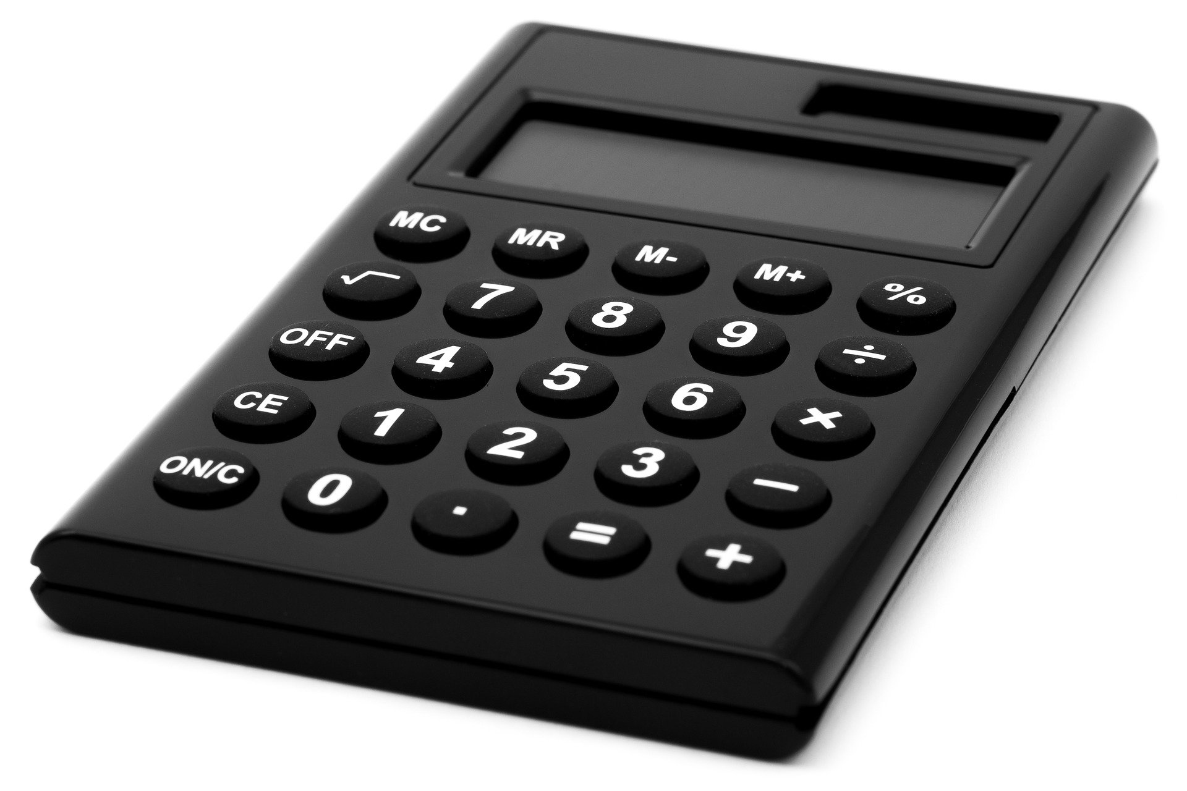
What is ROI?
Program Benefits
Program Costs
BCR =
Program Benefits – Program Costs
Program Costs
ROI =
x 100
6

Slide 7
What is ROI?
$750,000
$425,000
BCR =
$750,000 - $425,000
$425,000
ROI =
x 100
7

Slide 8

The ROI Methodology Process Model
Designing for the Delivery of Business Results
PLAN THE EVALUATION
COLLECT DATA
ANALYZE DATA
Make it Credible:
Tabulate Costs of
Program
OPTIMIZE RESULTS
LEVEL 0: INPUT
LEVEL 1: REACTION AND PLANNED ACTION
LEVEL 3:
APPLICATION
Start with Why:
Align Programs
With the
Business
Make it Feasible:
Select the Right
Solution
Expect
Success:
Plan for
Results
Make it Matter:
Design for Input,
Reaction and
Learning
Make it Stick:
Design for
Application
and Impact
Make it
Credible:
Isolate the
Effects
Make it Credible:
Convert Data to
Monetary Value
Make it Credible:
Calculate ROI
Optimize
Results:
Use Black Box
Thinking to
Increase
Funding
Tell the Story:
Communicate
Results to Key
Stakeholder
LEVEL 5: ROI
LEVEL 2: LEARNING
LEVEL 4: IMPACT
Make it Credible:
Identify Intangibles
INTANGIBLE BENEFITS
©2024 ROI Institute Inc. All Rights Reserved.
8

Slide 9
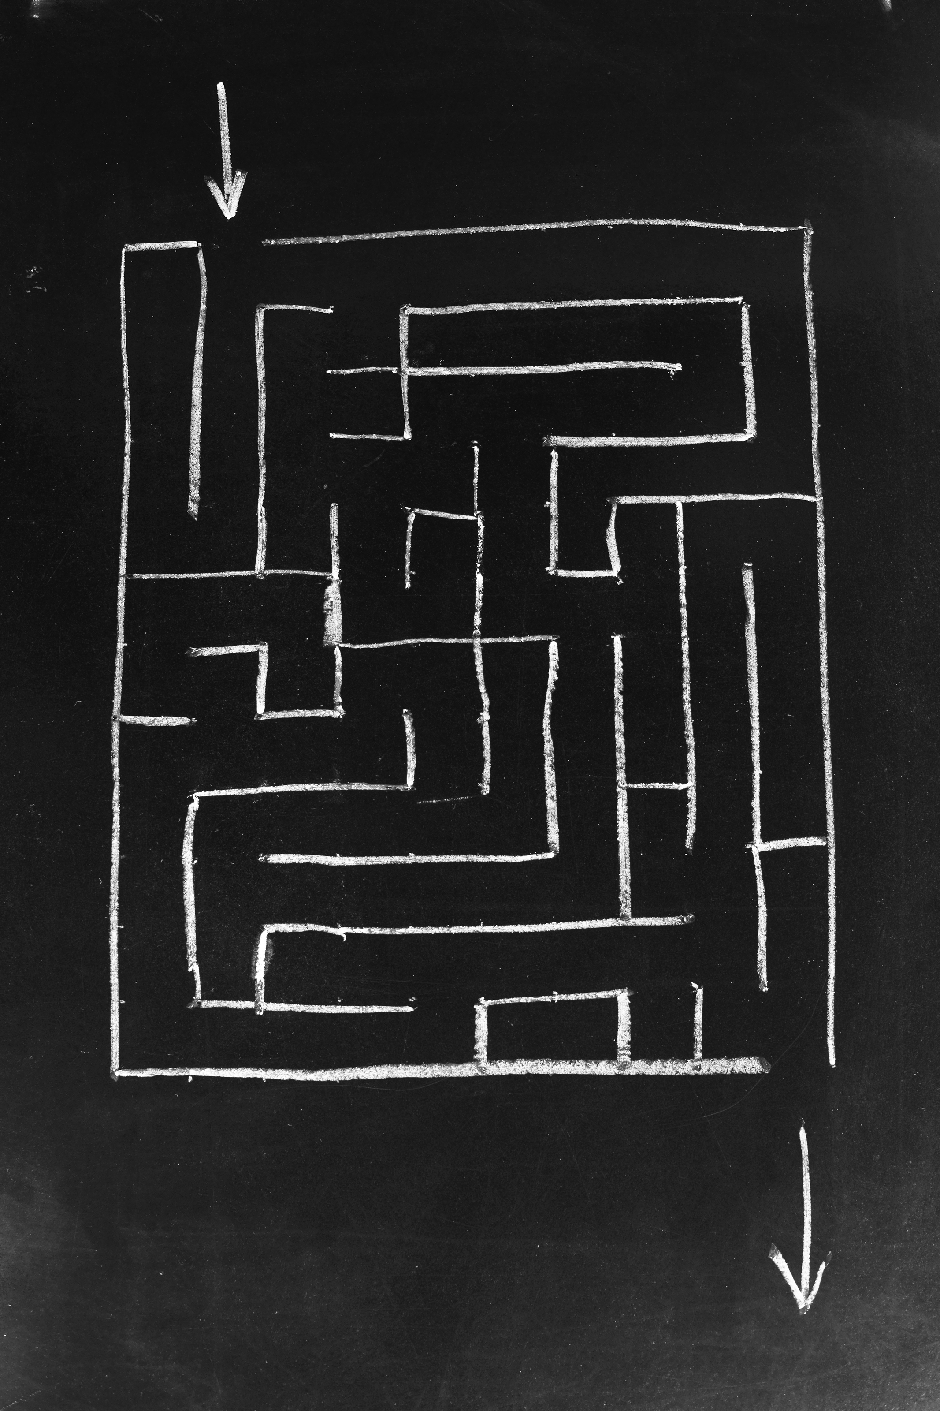
Guiding Principles
When conducting a higher-level evaluation, collect data at lower levels.
When planning a higher-level evaluation, the previous level of evaluation is not required to be comprehensive.
When collecting and analyzing data, use only the most credible sources.
When analyzing data, select the most conservative alternative for calculations.
Use at least one method to isolate the effects of a project.
If no improvement data are available for a population or from a speciﬁc source, assume that little or no improvement has occurred.
Adjust estimates of improvement for potential errors of estimation.
Avoid use of extreme data items and unsupported claims when calculating ROI.
Use only the ﬁrst year of annual beneﬁts in ROI analysis of short-term solutions.
Fully load all costs of a solution, project, or program when analyzing ROI.
Intangible measures are deﬁned as measures that are purposely not converted to monetary values.
Communicate the results of ROI Methodology to all key stakeholders.
9

Slide 10

Alignment Model
Start Here
End Here
Payoff Needs
5
ROI Objectives
5
ROI
Business Needs
4
Impact Objectives
4
Impact
Performance Needs
3
Application Objectives
3
Application
Learning Needs
2
Learning Objectives
2
Learning
Initial
Analysis
Measurement and Evaluation
Preference Needs
1
Reaction Objectives
1
Reaction
Input Needs
0
Input Objectives
0
Input
Program Process Initiative
Alignment and Forecasting
The ROI Process Model

Slide 11
After completing this program, participants should:
Matching Evaluation Levels with Objectives
1. | Decrease citizen complaints by 20% in one year.
2. | Explain rationale for system upgrade to customers using the five-step process.
3. | Be able to demonstrate the five steps to calm an upset customer.
4. | Rate the facilitator 4 out of 5 on presentation skills.
5. | Decrease the amount of time required to develop a proposal.
6. | Achieve a 20% ROI one year after program implementation of a sales incentive system.
7. | Perceive the content to be relevant to their actual situations (4.5 out of 5).
8. | Decrease security breaches by 25% in six months.
9. | Make the first sales call in five days after the training.
10. | Score an average of 75 or better on new strategy quiz.
11. | Demonstrate key features of system upgrade to customers during sales meetings.
12. | Use all 10 negotiation skills in at least 50% of negotiation situations.
11

Slide 12

Rules for Objectives
Must be measurable and represent minimum acceptable performance.
Fewer objectives are better than many objectives.
Involve subject-matter experts and key stakeholders.
Keep objectives relevant to the situation, program, and key stakeholders.
Create stretch objectives, but make sure they are achievable.
Allow for the flexibility to change as conditions change.
Failure is OK; process improvement is the key.
Objectives are tools for progress, not weapons for performance review.
Most objectives should be time-bound.
Objectives provide the focus for design, development, implementation, and evaluation.
These rules are from a combination of publications:
J. J. Phillips and P. P. Phillips. Beyond Learning Objectives: Develop Measurable Objectives that Link to the Bottom Line. Alexandria, VA: ASTD Press. 2008.
P. P. Phillips and J. J. Phillips. 10 Steps to Successful Business Alignment. Alexandria, VA: ASTD Press. 2012.
J. Doerr. Measure What Matters: How Google, Bono, and the Gates Foundation Rock the World with OKRs. New York: Penguin. 2018.

Slide 13

ROI Objectives
  Set the value at the same level as other investments: 15 percent.
  Set slightly above other estimates: 25 percent.
  Set at breakeven: 0 percent.
  Set at client expectations.
Private sector organizations usually go with option #2; public sector organizations prefer #3.
PW 62 / PDF 68

Slide 14
Examples: Broad Objectives versus Measures
 | Broad Objective | Measure
1 | Participants will perceive program content as relevant to their jobs. | 80% of participants rate program relevance a 4.5 out of 5 on agreement scale. 80% of participants rate intent to use 4.5 out of 5 on agreement scale.
2 | Participants will be able to: Identify the extent and cost of meetings Identity positives, negatives, and implications of basic meeting issues and dynamics Demonstrate use of effective meeting skills | Given cost guidelines, determine the cost of last three meetings From a list of 30 positive and negative meeting behaviors, correctly identify the implications of each behavior. Demonstrate appropriate responses to eight of ten active role play scenarios
3 | Participants will use effective meeting behaviors. Barriers to using effective meeting skills | 80% of participants indicate significant change or greater with the use of meeting behaviors. Five most frequently used meeting behaviors as identified by participants Top five barriers to using effective meeting skills as planned
4 | Shorter meetings Fewer meetings Few meeting participants Other benefits related to improvement in productivity | Reported difference time spent in meetings pre-post Reported difference in the number of meeting chaired pre-post Reported difference in the number of people in meetings Reported time savings, cost savings, output improvement, quality improvement, project turnaround
5 | ROI Target of 25% (based on conversation with client, Al Hudson)

Slide 15

Data Collection Plan
Program:___________________________________________________ Responsibility: ________________________________________________________ Date:_____________________
Level | Broad Program Objective(s) | Measures | Data Collection Method/ Instruments | Data Sources | Timing | Responsibilities
1 | Reaction/Satisfaction and Planned Actions
2 | Learning
3 | Application/ Implementation
4 | Business Impact
5 | ROI | Comments:
15
Notes:
Facilitator delivers.
The first planning document is the data collection plan:
When planning data collection, you will answer five basic questions:
What do we ask? (objectives/measures)
How do we ask?
Who do we ask?
When do we ask?
Who does the asking?
We will address these questions in more detail next week.
Transition to next slide: the second planning document is the ROI Analysis plan

Slide 16
Methods for Collecting Program Data
Method | Typical Levels
 | 1 | 2 | 3 | 4
Surveys | ✓ | ✓ | ✓
Questionnaires | ✓ | ✓ | ✓ | ✓
Observation |  | ✓ | ✓
Interviews | ✓ | ✓ | ✓
Focus Groups | ✓ | ✓ | ✓
Tests |  | ✓
Action Planning |  |  | ✓ | ✓
Performance Contracting |  |  | ✓ | ✓
Performance Monitoring |  |  |  | ✓

Slide 17


Program Design
Renew America Together: Civility Leadership Institute
12-month open-enrollment virtual program
12 months online
Monthly skill-building (first six months)
Special guest speakers (second six months)
Founder: General Wesley Clark
Executive Director: Mary-Lee Smith
Facilitator: Sharon Lovoy
Evaluation Team: ROI Institute
Sometimes a project requires data collection at multiple times for a long period of time. This can seem overwhelming The key is to build it into the process.
Data Collection
Application Process (Business Alignment)
Polling and chat each month during skill building
Questionnaire
  Three months into program
  Six-month skill building completion
  12-month end of program
Interviews

Slide 18
Leading in a Hybrid Work Environment: Program at A Glance
Assessment
Virtual Synchronous
Virtual Asynchronous
On-the-Job Application
AUGUST
15- 19
AUGUST
12-25
AUGUST
26
AUGUST 29 to
SEPTEMBER 2
SEPTEMBER 6-9
SEPTEMBER 12-16
SEPTEMBER 19-23
Set Conditions for Success
Cohort Formed
Pre-Program Assessment
Welcome
Module
Ice Breaker
Set up profiles
Program Kickoff
Program Overview
Set Intentions
Week 1
Coaching & Caring for a Hybrid Team
Week 2
Application
Week 3
Developing a Hybrid Team
Week 4
Application
Understand the talent responsibilities of leaders
Show empathy, coach to build trust and rapport
Conduct results-based coaching session
Coach by checking in
Use 4-step empathy in team member
conversation
Clarify expectations and manage accountability
Conduct positive performance conversations
Give real-time feedback to team members
Create a career dev plan for a team member
Define 30, 60, 90-day DEI plan
2
4
4
1
3
2
3
1
2
3
4
Live
1
2
3
4
Live
1
Live
Debrief
1 Hr.
Debrief
1 Hr.
30 Minutes
1 Hour
1 Hour
2 Hours
1 Hr.
2 Hours
1 Hr.
Analytics Dashboard
Analytics Dashboard
SEPTEMBER 26 - 30
OCTOBER 3 - 6
OCTOBER 7
OCTOBER 10 - 14
OCTOBER 18 - 19
TEAM
Celebrate
Measure and Report Impact
Week 5
Creating a Great Hybrid Work Place
Week 6
Application
Capstone
Synthesize learnings
Reflect on new behaviors
Post-Program Assessment
Conference
Panel Discussion
October
18-19
Create Employee Value Proposition
Improve employee experience
Conduct a “stay interview”
Develop EVP
Craft employee experience plan
2
4
1
2
3
4
1
3
Live
Live
Debrief
1 Hr.
2 Hours
1 Hr.
1.5 Hours
Analytics Insights Report
Analytics Dashboard
Copyright © 2022 Udemy/CorpU All rights reserved. Used with permission. www.business.udemy.com/cohort-learning

Slide 19
Considerations with Planning Data Collection
Selecting Data Collection Methods | Selecting Sources of Information
Time required for participants Time required for participant’s supervisor Costs of method Amount of disruption of normal activities Accuracy Utility Culture / Philosophy | Participants Supervisors of participants Direct reports of participants Peer group Internal team members External group Organizational performance records
Determining Timing of Follow-Up | Assigning Responsibilities
Availability of Data Ideal Time for Application (Level 3) Ideal Time for Business Impact (Level 4) Convenience of Collection Constraints on Collection | Availability to collect data Accountability for program Accountability for program evaluation

Slide 20
ROI Analysis Plan
Program:___________________________________________________ Responsibility: ________________________________________________________ Date:_____________________
Data Items (Usually Level 4) | Methods for Isolating the Effects of the Program/ Process | Methods of Converting Data to Monetary Values | Costs | Intangible Benefits | Communica-tion Targets for Final Report | Other Influences/ Issues During Application | Comments
Notes:
Facilitator delivers.
The first planning document is the data collection plan:
When planning data collection, you will answer five basic questions:
What do we ask? (objectives/measures)
How do we ask?
Who do we ask?
When do we ask?
Who does the asking?
We will address these questions in more detail next week.
Transition to next slide: the second planning document is the ROI Analysis plan

Slide 21
Multiple Factors Contribute to Changes in Performance
External Factors
Management
Attention
TOTAL
IMPROVEMENT
AFTER
PROGRAM
Incentives
Systems/Procedures
Changes
Your
Program
EFFECT OF YOUR PROGRAM

Slide 22
Techniques to Isolate the Effects
*Survey of Users, N = 246
22

Slide 23
What is the Difference in the
Change in Performance?
Experimental Group
Pre-Measure
Program
Post-Measure
Classic Control Group Design
Control Group
Pre-Measure
Post-Measure
23

Slide 24
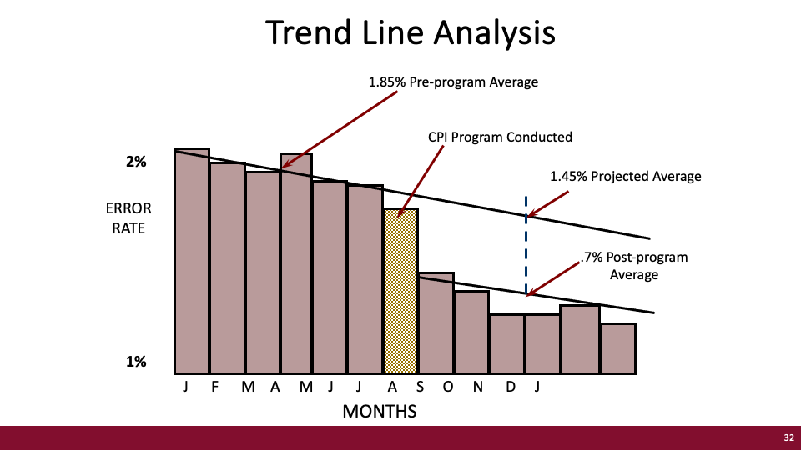
Notes:
Here we have error rate……

Slide 25
A Conservative Approach
to Estimates
Start with the fact in terms of the improvement in a business measure.
Identify the most credible sources of data to help us understand what
caused the improvement.
Ask the source(s) three simple questions:
  Given the improvement in the measure, what factors caused it?
  As a percentage, how much of the improvement is due to each factor?
  As a percentage, how confident are you in your estimate?
25
Notes:
But you need a process to ensure reliability – meaning, a process that will allow you to compare one estimate to another. Back in the 1970s when Jack first developed the ROI Methodology, he developed a very conservative approach to estimates, which has now become standard practice in many organizations.

Slide 26
Monthly decrease in missed pickups: 50 (fact)
Contributing Factors | Average Impact (%) | Average Confidence (%)
GPS Technology Update | 32% | 83%
Process Changes | 41% | 87%
Training | 14% | 62%
Incentives | 11% | 75%
Other _________ | 2% | 91%
 | 100%
Example of Estimation
How many missed pickups are attributable to the training program?
26

Slide 27

Methods to Convert Measures to Money
Converting output to contribution – standard value
Converting the cost of quality – standard value
Converting employee’s time – standard value
Using historical costs/existing data
Using internal and external experts
Using data from external databases
Linking with other measures
Using participants’ estimates
Using supervisors’ and managers’ estimates
Using staff estimates
27

Slide 28



“When in doubt, put it in.”
Fully Loaded Cost
The process should withstand even the closest scrutiny in terms of its credibility.
DIRECT
INDIRECT
Needs Assessment (Prorated)
Program Development (Prorated)
Participant Time (salaries & benefits)
Administrative/overhead
Evaluation
Program Materials
Instructor / facilitator
Facilities
Travel, lodging, meals
See also page 21 in AG

Slide 29


Typical Intangible Benefits
Image
Innovation
Job satisfaction
Leadership
Networking
Organizational climate
Organizational commitment
Sustainability
Stress
Talent
Teamwork
Adaptability
Awards
Agency brand
Career minded
Caring
Collaboration
Communication
Conflicts
Corporate social responsibility
Decisiveness
Engagement
29

Slide 30
Common Target Audiences
Audience | Reason for Communication
Top management* | Secure approval
All managers | Gain support/build credibility
Participants’ superiors* | Obtain commitment/build credibility
Potential participants | Create desire
Current participants* | Enhance reinforcement
Learning and Development staff* | Show importance
All employees | Stimulate interest
Stockholders | Secure endorsement
*Always consider providing a report for these audiences.

Slide 31

Remember, when it comes to demonstrating the ROI of your programs and projects:
  Hope is not a strategy.
  Luck is not a factor.
  Doing nothing is not an option.
Change is inevitable.
Progress is optional.
31

Slide 32

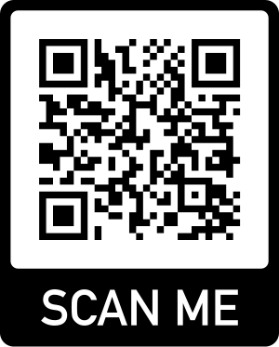
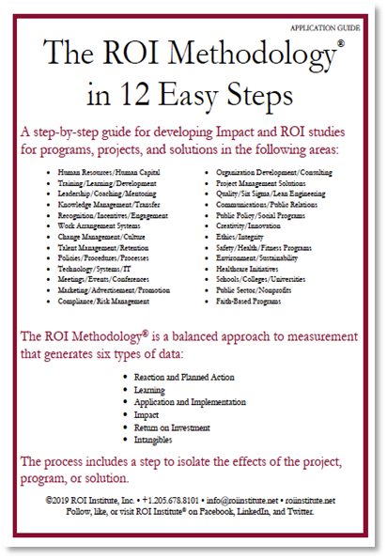
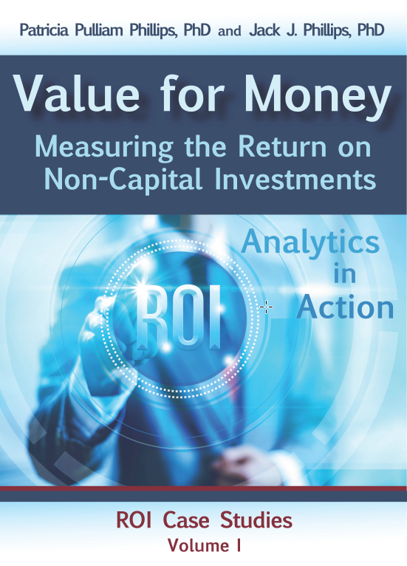
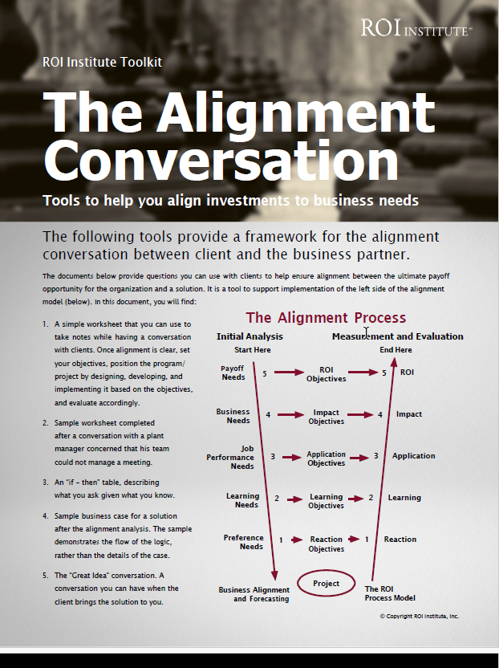

Scan the QR code to access resources from today’s session.

Slide 33
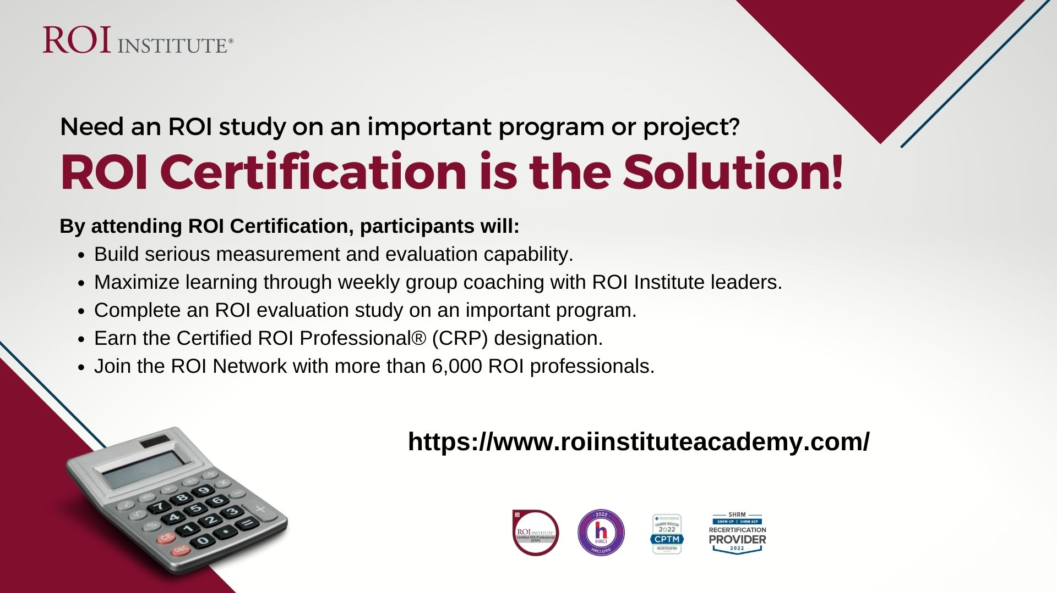
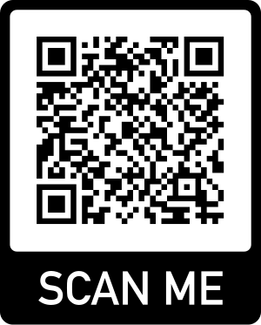
TMN Members Receive
10% Discount
Use code
ROITMN10

Slide 34


Slide 35
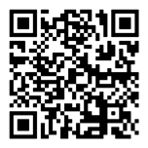
FEEDBACK COUNTS
Your feedback helps ATD continue to provide top-notch educational programs that help you stay on top of a changing profession.
The evaluation form for this session is available via
the mobile app, QR code and at the following link: techknowledge.td.org
35

