Slide 1

Measuring ROI in Human Resources, Learning & Development, and Performance Improvement
Patti P. Phillips, Ph.D., CEO, ROI Institute, Inc.

Slide 2
Module 1:
Introduction and Readiness to Learn
2
WB page 1

Slide 3
Workshop Components
Frequent short breaks
Networking
Participation and learning in small teams or groups
Learn by doing
Questions and sharing
Capture action items from consideration
Apply the evaluation planning process during the workshop
A great beginning
WB page 2

Slide 4
Reaction Objectives
After participating in this workshop, you should:
Perceive the workshop content to be relevant to your work.
Find it important to your success on the job.
Immediately apply it in your work.
Find the content to be new information.
WB page 2

Slide 5
Learning Objectives
Identify the drivers for ROI accountability.
Link program objectives to
business results.
Identify at least three ways to collect data.
Describe at least three ways to isolate the effects of a program.
Describe at least three ways to convert data to monetary values.
Identify all costs of a program.
Calculate ROI, given benefits and costs.
Identify intangible measures.
Plan a follow-up evaluation for one of your programs.
Describe the 12 steps in the
ROI Methodology®.
WB page 3

Slide 6
Application Objectives
When you return to your workplace, you should:
Develop an evaluation plan for a specific program within two weeks.
Revise/update internal policies on evaluation within 30 days.
Select appropriate data collection methods when conducting impact studies.
Use appropriate methods to isolate the effects of programs.
Use appropriate methods to convert data to monetary values.
Capture fully loaded costs when conducting an ROI study.
Calculate the return on investment for a simple ROI study.
WB page 3

Slide 7
Impact Objectives
Six months after completing this workshop, you should:
Improve the effectiveness of programs.
Expand the implementation of successful programs.
Redesign ineffective programs.
Improve satisfaction of your stakeholders.
Improve relationships with key managers and clients.
Maintain or increase funding for talent development.
WB page 4

Slide 8

What is the one key issue you hope we cover in this program?
8
WB page 4

Slide 9

Prework
Review of evaluation framework
Definition of ROI
Criteria for selecting programs for Level 4 (Impact) and Level 5 (ROI) evaluation
Evaluation Planning Worksheet
Data Collection Plan
ROI Analysis Plans
How many reviewed the prework?

Slide 10
Case Application: Reliance Insurance Organization
Is this situation typical? Explain.
What should Marge do? Explain.
What will Frank be expecting in the future?
How could this situation be avoided in the future?
WB page 5

Slide 11

What are the key factors in your
work setting that drive accountability?
11

Slide 12
Definition of Results-Based Programs
Programs are linked to business needs.
Performance issues are assessed.
Learning needs are assessed.
Objectives are defined at higher levels.
Expectations are created with stakeholders.
The transfer of learning is addressed early and often.
The level of evaluation is established for each program.
Partnerships are developed with
key managers.
The evaluation is completed, capturing a variety of data.
Results are communicated to the appropriate stakeholders.
WB page 7

Slide 13
Defining BCR and ROI
Program Benefits
Program Costs
Benefits/Cost Ratio
=
Program Benefits - Program Costs
Program Costs
ROI
=
x
100
WB page 7

Slide 14
Defining BCR and ROI: Example
ROI Calculation – Example
Program Benefits From Participants (1st year) $230,000
Costs per Program (25 participants) $88,000
Benefits/Cost Ratio =
ROI =
x
100
WB page 7

Slide 15
Defining BCR and ROI: Example
ROI Calculation – Example
Program Benefits From Participants (1st year) $230,000
Costs per Program (25 participants) $88,000
$230,000
$88,000
Benefits/Cost Ratio =
=
$230,000 - $88,000
$88,000
ROI =
x
100 =
WB page 7

Slide 16
Defining BCR and ROI: Example
ROI Calculation – Example
Program Benefits From Participants (1st year) $230,000
Costs per Program (25 participants) $88,000
$230,000
$88,000
Benefits/Cost Ratio =
= 2.61
$230,000 - $88,000
$88,000
ROI =
x
100 = 161%
WB page 7

Slide 17

Try it!
Reduce Safety Incidents (1st year) = $750,000
Program Cost (25 participants) = $425,000
BCR =
=
ROI =
x 100 =

Slide 18
Try it!
Reduce Safety Incidents (1st year) = $750,000
Program Cost (25 participants) = $425,000
$750,000
$425,000
BCR =
=
$750,000 - $425,000
$425,000
ROI =
x 100 =

Slide 19
Try it!
Reduce Safety Incidents (1st year) = $750,000
Program Cost (25 participants) = $425,000
$750,000
$425,000
BCR =
= 1.76:1
$750,000 - $425,000
$425,000
ROI =
x 100 = 76%

Slide 20
Sometimes we see this:
$750,000
BCR =
= 1.76:1 x 100 = 176%
$425,000
Reduce Safety Incidents (1st year) = $750,000
Program Cost (25 participants) = $425,000

Slide 21
Don’t do it.
$750,000
BCR =
= 1.76:1 x 100 = 176%
$425,000
Reduce Safety Incidents (1st year) = $750,000
Program Cost (25 participants) = $425,000

Slide 22
BCR and ROI are similar, yet different.
$750,000
BCR =
= 1.76:1
$425,000
$750,000 - $425,000
ROI =
x 100 = 76%
$425,000
Reduce Safety Incidents (1st year) = $750,000
Program Cost (25 participants) = $425,000

Slide 23
When sales in the impact measure:
BCR =
=
$425,000
ROI =
x 100 =
$425,000
Increase store sales (1st year) = $2,750,000
Gross profit on sales is 20%
Program Cost (25 participants) = $425,000

Slide 24
Sometimes we see this.
$2,750,000
BCR =
= 6.47:1
$425,000
$2,750,000 - $425,000
ROI =
x 100 = 547%
$425,000
Increase store sales (1st year) = $2,750,000
Gross profit on sales is 20%
Program Cost (25 participants) = $425,000

Slide 25
Don’t do it.
$2,750,000
BCR =
= 6.47:1
$425,000
$2,750,000 - $425,000
ROI =
x 100 = 547%
$425,000
Increase store sales (1st year) = $2,750,000
Gross profit on sales is 20%
Program Cost (25 participants) = $425,000

Slide 26
When sales is the benefit, convert sales to profit.
($2,750,000 x .20)
BCR =
= 1.29:1
$425,000
($2,750,000 x .20) - $425,000
ROI =
x 100 = 29%
$425,000
Increase store sales (1st year) = $2,750,000
Gross profit on sales is 20%
Program Cost (25 participants) = $425,000

Slide 27
ROI Target – Options
Set the value as with other investments, e.g., 15%
Set slightly above other investments, e.g., 25%
Set at break even: 0%
Set at client expectations
What value would be appropriate in your organization?
WB page 8

Slide 28
Module 2:
ROI Methodology®
28
WB page 9

Slide 29
Pieces of the Results-Based Puzzle
An Evaluation
Framework
Applications
and Practice
Implementation
Operating Standards and Philosophy
A Process
Model
WB page 10
29

Slide 30
Levels of Evaluation
Level | Measurement Focus
0. Input | Activities involved in the program
1. Reaction | Measures participant satisfaction with the program and captures planned action
2. Learning | Measures changes in knowledge, skills, and attitudes
3. Application | Measures changes in on-the-job behavior
4. Business Impact | Measures changes in business impact measures
5. Return on Investment | Compares program benefits to the costs
Intangibles | Impact data not converted to money
30
WB page 11

Slide 31
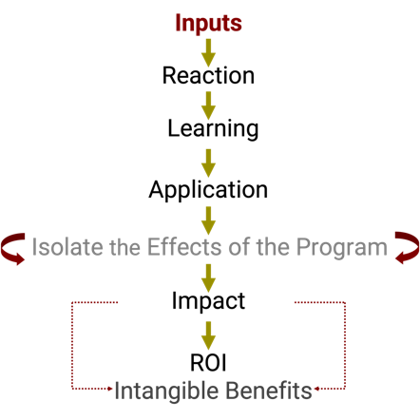
Chain of Impact
WB page 13
31

Slide 32
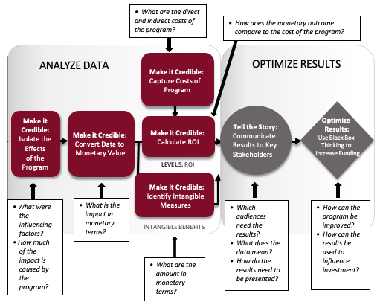
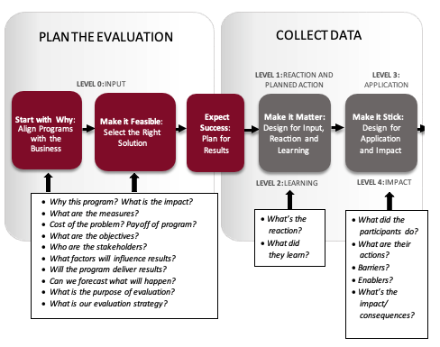
The ROI Methodology® Process Model
32
WB page 14
©2024 ROI Institute, Inc. All Rights Reserved.

Slide 33
Twelve Guiding Principles
When conducting a higher-level evaluation, collect data at lower levels.
When planning a higher-level evaluation, the previous level of evaluation is not required to be comprehensive.
When collecting and analyzing data, use only the most credible sources.
When analyzing data, select the most conservative alternatives for calculations.
Use at least one method to isolate the effects of the program or project.
If no improvement data are available for a population or from a specific source, assume that no improvement has occurred.
Adjust estimates of improvements for the potential error of the estimates.
Avoid use of extreme data items and unsupported claims when calculating ROI.
Use only the first year of annual benefits in the ROI analysis of short-term solutions.
Fully load all costs of the solution, project, or program when analyzing ROI.
Define intangible measures as measures that are purposely not converted to monetary values.
Communicate the results of the ROI Methodology to all key stakeholders.
WB page 16

Slide 34
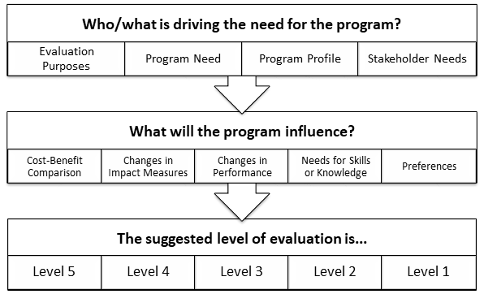
Not All Programs Are Evaluated at All Levels
WB page 18
34

Slide 35
Criteria for Level 4 and Level 5 Evaluations
Expected life cycle of the program
The importance of the program in meeting the organization’s goals
The connection of the program to strategic objectives
Cost of the program
Visibility of the program
The size of the target audience
Extent of management interest
WB page 18

Slide 36

Matching Evaluation Levels With Objectives
For each objective, indicate the level of evaluation at which the objective is aimed.
Level 1: Reaction
Level 2: Learning
Level 3: Application
Level 4: Impact
Level 5: Return on Investment
WB page 19
36

Slide 37
The Value Chain
Level | Measurement Category | Current Status | Recommended | Comments About Status
0 | Inputs/Indicators: Measures the number of programs, participants, audience, costs, and efficiencies |  | 100% | This is being accomplished now
1 | Reaction and Planned Action: Measures reaction to, and satisfaction with, the experience, contents, and value of program |  | 100% | Need more focus on content and perceived value
2 | Learning: Measures what participants learned in the program–information, knowledge, skills, and contacts (takeaways) |  | 80–90% | Must use simple learning measures
3 | Application: Measures progress after the program–the use of information, knowledge, skills, and contacts |  | 30–40% | Need more follow-up
4 | Business Impact: Measures changes in business impact variables such as output, quality, time, and costs linked to the program |  | 10–20% | This is the connection to business impact
5 | ROI: Compares the monetary benefits of the business impact measures to the costs of the program |  | 5–10% | The ultimate level of evaluation
37
*Recommended minimum percentage of programs evaluated at each level for the typical large organization.
WB page 20

Slide 38

What is your status?
Level | Measurement Category | Current Status | Recommended | Comments About Status
0 | Inputs/Indicators: Measures the number of programs, participants, audience, costs, and efficiencies |  | 100% | This is being accomplished now
1 | Reaction and Planned Action: Measures reaction to, and satisfaction with, the experience, contents, and value of program |  | 100% | Need more focus on content and perceived value
2 | Learning: Measures what participants learned in the program–information, knowledge, skills, and contacts (takeaways) |  | 80–90% | Must use simple learning measures
3 | Application: Measures progress after the program–the use of information, knowledge, skills, and contacts |  | 30–40% | Need more follow-up
4 | Business Impact: Measures changes in business impact variables such as output, quality, time, and costs linked to the program |  | 10–20% | This is the connection to business impact
5 | ROI: Compares the monetary benefits of the business impact measures to the costs of the program |  | 5–10% | The ultimate level of evaluation
38
*Recommended minimum percentage of programs evaluated at each level for the typical large organization compared to 2020 ROI Institute Benchmarking Study results..
WB page 20

Slide 39
What is your status?
Level | Measurement Category | Current Status | Recommended | 2020 Benchmarks*
0 | Inputs/Indicators: Measures the number of programs, participants, audience, costs, and efficiencies |  | 100% | 100%
1 | Reaction and Planned Action: Measures reaction to, and satisfaction with, the experience, contents, and value of program |  | 100% | 80%
2 | Learning: Measures what participants learned in the program–information, knowledge, skills, and contacts (takeaways) |  | 80–90% | 70%
3 | Application: Measures progress after the program–the use of information, knowledge, skills, and contacts |  | 30–40% | 49%
4 | Business Impact: Measures changes in business impact variables such as output, quality, time, and costs linked to the program |  | 10–20% | 37%
5 | ROI: Compares the monetary benefits of the business impact measures to the costs of the program |  | 5–10% | 18%
39
*Recommended minimum percentage of programs evaluated at each level for the typical large organization compared to 2020 ROI Institute Benchmarking Study results..
WB page 20

Slide 40
What Can You Do With the ROI Process?
Justify/defend budgets.
Improve support for projects.
Enhance design and implementation processes.
Identify inefficient programs that need to be redesigned or eliminated.
Identify successful programs that can be implemented in other areas.
Align projects or programs to business needs.
Show contributions of selected programs.
Earn respect of senior management/administrators.
Build staff morale.
Earn a “seat at the table.”
WB page 21

Slide 41
Characteristics of Evaluation Levels
Consumers are customers who are actively involved in the program/solution.
Clients are customers who fund, support, and approve the program/solution.
Chain of Value of Customer Frequency Difficulty of
Impact Information Focus of Use Assessment
Reaction Lowest Participants Frequent Easy
Learning
Application
Impact
ROI Highest Leadership/Execs Infrequent Difficult
41
WB page 22

Slide 42

Module 3:
Evaluation Planning
42
WB page 23

Slide 43

The ROI Methodology Process Model
PLAN THE EVALUATION
COLLECT DATA
ANALYZE DATA
Make it Credible:
Capture Costs of
Program
OPTIMIZE RESULTS
LEVEL 0: INPUT
LEVEL 1: REACTION AND PLANNED ACTION
LEVEL 3:
APPLICATION
Start With Why:
Align Programs
With the
Business
Make it Feasible:
Select the Right
Solution
Expect
Success:
Plan for
Results
Make it Matter:
Design for Input,
Reaction, and
Learning
Make it Stick:
Design for
Application
and Impact
Make it
Credible:
Isolate the
Effects
of the
Program
Make it Credible:
Convert Data to
Monetary Value
Make it Credible:
Calculate ROI
Optimize
Results:
Use Black Box
Thinking to
Increase
Funding
Tell the Story:
Communicate
Results to Key
Stakeholder
LEVEL 5: ROI
LEVEL 2: LEARNING
LEVEL 4: IMPACT
Make it Credible:
Identify Intangible Measures
INTANGIBLE BENEFITS
43
©2024 ROI Institute Inc. All Rights Reserved.

Slide 44
Four Major Categories of Hard Data
HARD DATA Typical Measures of Improvement
Output
Increases
Time
Savings
Cost
Savings
Quality
Improvement
44
WB page 27

Slide 45
Characteristics of Hard Data
Hard data are:
Easy to measure and quantify
Relatively easy to assign monetary values
Objectively based
Common measures of organizational performance
Very credible with management
Examples are:
Citizens vaccinated
Loans approved
Patients discharged
Length of stay
Repair time
Operating costs
Cost per day
WB page 27

Slide 46
Major Categories of Soft Data
SOFT DATA Typical Measures of Improvement
Initiative
Work Habits
Work Climate
Feelings/
Attitudes
New Skills
Development/
Advancement
46
WB page 30

Slide 47
Characteristics of Soft Data
Soft data are:
Difficult to measure and quantify directly
Difficult to assign dollar values
Subjectively based in many cases
Less credible as a performance measure
Usually behaviorally oriented
Examples are:
Teamwork
Decisiveness
Grievances
Employee Engagement
New ideas
Trademarks
Readiness
WB page 30

Slide 48
The ROI Methodology Process Model
PLAN THE EVALUATION
COLLECT DATA
ANALYZE DATA
Make it Credible:
Capture Costs of
Program
OPTIMIZE RESULTS
LEVEL 0: INPUT
LEVEL 1: REACTION AND PLANNED ACTION
LEVEL 3:
APPLICATION
Start With Why:
Align Programs
With the
Business
Make it Feasible:
Select the Right
Solution
Expect
Success:
Plan for
Results
Make it Matter:
Design for Input,
Reaction, and
Learning
Make it Stick:
Design for
Application
and Impact
Make it
Credible:
Isolate the
Effects
of the
Program
Make it Credible:
Convert Data to
Monetary Value
Make it Credible:
Calculate ROI
Optimize
Results:
Use Black Box
Thinking to
Increase
Funding
Tell the Story:
Communicate
Results to Key
Stakeholder
LEVEL 5: ROI
LEVEL 2: LEARNING
LEVEL 4: IMPACT
Make it Credible:
Identify Intangible Measures
INTANGIBLE BENEFITS
48

Slide 49
The Alignment Model (aka V-Model)
Start Here
End Here
Payoff Needs
5
ROI Objectives
5
ROI
Business Needs
4
Impact Objectives
4
Impact
Performance Needs
3
Application Objectives
3
Application
Learning Needs
2
Learning Objectives
2
Learning
Initial Analysis
Measurement and Evaluation
Preference Needs
1
Reaction Objectives
1
Reaction
Input Needs
0
Input Objectives
0
Input
Program Process Initiative
Alignment and Forecasting
The ROI Process Model
©2024 ROI Institute, Inc. All Rights Reserved.
WB page 33
49

Slide 50
The Alignment Model (aka V-Model)
Start Here
End Here
Payoff Needs
5
ROI Objectives
5
ROI
Start With Why
Business Needs
4
Impact Objectives
4
Impact
Performance Needs
3
Application Objectives
3
Application
Select a Feasible Solution
Learning Objectives
2
Learning Needs
2
Learning
Preference Needs
1
Reaction Objectives
1
Reaction
Input Needs
0
Input Objectives
0
Input
Program Process Initiative
Alignment and Forecasting
The ROI Process Model
©2024 ROI Institute, Inc. All Rights Reserved.
WB page 33
50

Slide 51
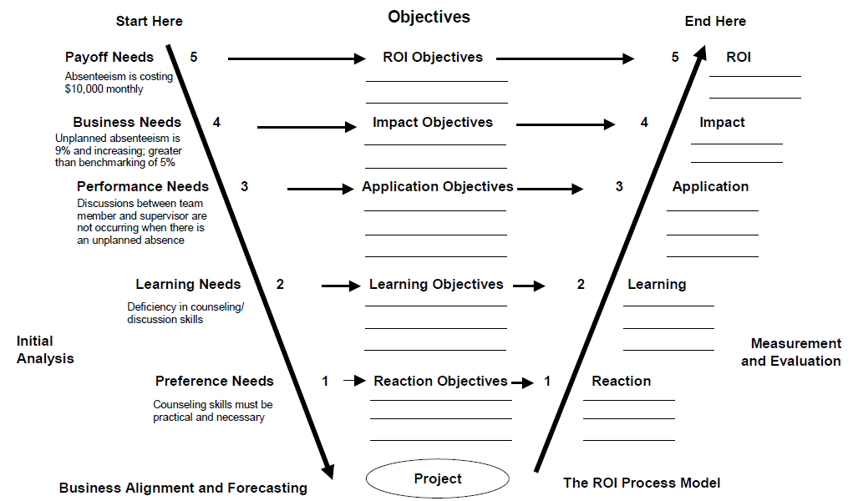
The Alignment Process
WB page 34
51

Slide 52
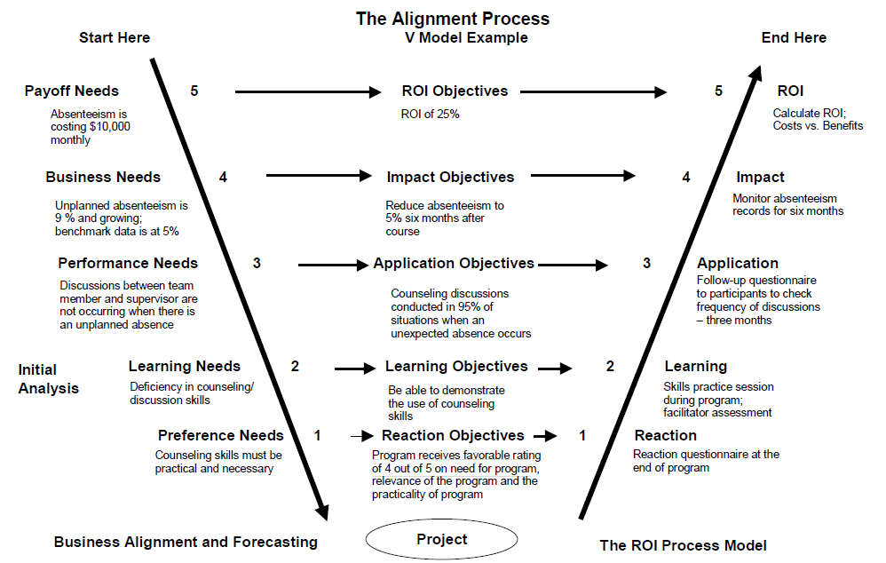
The Alignment Process — Example
WB page 35
52

Slide 53
Farmer Production Program
Level | Needs | Objectives | Evaluation | Level
5 | Country must produce food for citizens | Break-even (BCR = 1:1) | Program benefits compared to program costs | 5
4 | Farmer profits are negative Food produced is not to WFP standards Food not purchased by WFP | Farmer profit at ___ ___% of food meets WFP standards WFP purchase ____% of production | Farm records WFP records | 4
3 | Efficient farming methods not used Standards not followed Land not properly utilized | Farmers will: Follow standards Utilize land resources Sell food to WFP | Interviews Action plans Questionnaires | 3
2 | Operations Equipment Finance/accounting Management Technology | Farmers will demonstrate their knowledge of: Operations Equipment utilization Finance/accounting principles Operations management Technology | Simple quiz Checklists Demonstrations | 2
1 | Farmers must see program as: Feasible Important to their survival Relevant to their work Something they will use | Program receives favorable rating of 4 out of 5 on feasibility, importance, relevance, and usefulness Farmers commit to follow processes | Reaction questionnaire administered to farmers | 1

Slide 54
The ROI Methodology Process Model
PLAN THE EVALUATION
COLLECT DATA
ANALYZE DATA
Make it Credible:
Capture Costs of
Program
OPTIMIZE RESULTS
LEVEL 0: INPUT
LEVEL 1: REACTION AND PLANNED ACTION
LEVEL 3:
APPLICATION
Start with Why:
Align Programs
With the
Business
Make it Feasible:
Select the Right
Solution
Expect
Success:
Plan for
Results
Make it Matter:
Design for Input,
Reaction, and
Learning
Make it Stick:
Design for
Application
and Impact
Make it
Credible:
Isolate the
Effects
of the
Program
Make it Credible:
Convert Data to
Monetary Value
Make it Credible:
Calculate ROI
Optimize
Results:
Use Black Box
Thinking to
Increase
Funding
Tell the Story:
Communicate
Results to Key
Stakeholder
LEVEL 5: ROI
LEVEL 2: LEARNING
LEVEL 4: IMPACT
Make it Credible:
Identify Intangible Measures
INTANGIBLE BENEFITS
54
©2024 ROI Institute Inc. All Rights Reserved.

Slide 55
PCA, Inc.
PCA, a large printing company, has developed a three-day leadership workshop for supervisors and managers with the following objectives.
After attending this program, participants should be able to:
  Examine their own leadership style.
  Identify and discuss various leadership models and theories.
  Select the appropriate leadership style for a particular situation.
  Serve as a positive role model for appropriate leadership behavior.
WB page 36

Slide 56
API, Inc.
Your goal is to determine the levels at which to evaluate a program, the methods you would use, and the possibility of time-based objectives.
  Read the scenario in the Participant Workbook.
  Respond to the discussion questions.
  Be prepared to share your responses with the class.
WB page 37

Slide 57
API, Inc. Debrief
At what levels could you evaluate this program?
What methods would you use to evaluate at Levels 3 and 4?
Is it possible to have specific, time-based objectives for Level 4 evaluations?
WB page 38

Slide 58
Matching Evaluation Levels With Objectives
For each objective, indicate the level of evaluation at which the objective is aimed.
Level 1: Reaction
Level 2: Learning
Level 3: Application
Level 4: Impact
Level 5: Return on Investment
WB page 39
58

Slide 59
Developing Objectives for Each Level
Levels of Objectives | Focus of Objectives
Level 1, Reaction | Defines specific measures of expected reaction to the program as it is revealed and communicated to the stakeholders
Level 2, Learning | Defines specific measures of improvement in knowledge, information, contacts, and skills as the participants and other stakeholders learn how to make the program successful
Level 3, Application | Defines specific measures of actions taken that define success with application and implementation of the program
Level 4, Impact | Defines the specific impact measures that will change or improve as a consequence of the program’s implementation
Level 5, ROI | Defines the minimum return on investment from the program, comparing program costs with monetary benefits from the program
59
WB page 41

Slide 60
Rules for Objectives
Must be measurable and represent minimum acceptable performance.
Fewer objectives are better than many objectives.
Involve subject-matter experts and key stakeholders.
Keep objectives relevant to the situation, program, and key stakeholders.
Create stretch objectives, but make sure they are achievable.
Allow for the flexibility to change as conditions change.
Failure is OK; process improvement is the key.
Objectives are tools for progress, not weapons for performance review.
Most objectives should be time-bound.
Objectives provide the focus for design, development, implementation, and evaluation.
These rules are from a combination of publications:
J. J. Phillips and P. P. Phillips. Beyond Learning Objectives: Develop Measurable Objectives that Link to the Bottom Line. Alexandria, VA: ASTD Press. 2008.
P. P. Phillips and J. J. Phillips. 10 Steps to Successful Business Alignment. Alexandria, VA: ASTD Press. 2012.
J. Doerr. Measure What Matters: How Google, Bono, and the Gates Foundation Rock the World with OKRs. New York: Penguin. 2018.
WB page 42

Slide 61

Data Collection Plan
Program:___________________________________________________ Responsibility: ________________________________________________________ Date:_____________________
Level | Broad Program Objective(s) | Measures | Data Collection Method/ Instruments | Data Sources | Timing | Responsibilities
1 | Reaction/Satisfaction and Planned Actions
2 | Learning
3 | Application/ Implementation
4 | Business Impact
5 | ROI | Comments:
61
WB page 51

Slide 62
Best Reaction Objectives
Identify issues that are important and measurable
Are attitude-based, clearly worded, and specific
Underscore the linkage between attitude and the success of the program
Represent a satisfaction index from key stakeholders
Have the capability to predict program success
Broad Objective | Measure
At the end of the course, participants will perceive program content as relevant to their jobs. | 80% of participants rate program relevance a 4.5 out of 5 on a Likert scale.
WB page 43

Slide 63
Best Learning Objectives
Describe behaviors or actions that are observable and measurable
Are outcome-based, clearly worded, and specific
Specify what the participant must do (not know or understand) as a result of the program
Have three components:
  Performance—what the participant will be able to do at the end of the program
  Condition—circumstances under which the participant will perform the task
  Criteria—degree or level of proficiency that is necessary to perform the job
WB page 44

Slide 64
Best Learning Objectives
Broad Objective | Measure
At the end of the program, participants will be able to implement Microsoft Word. | Within a 10-minute time period, participants will be able to demonstrate to the facilitator the following applications of Word with zero errors: File, Save as, Save as Web Page Formatting including font, paragraph, background, and themes Insert tables, add columns and rows, and delete columns and rows

Slide 65
Best Application Objectives
Identify behaviors and actions that are observable and measurable
Are outcome-based, clearly worded, and specific
Specify what the participant will change as a result of the program
WB page 45

Slide 66
Best Application Objectives
Broad Objective | Measure
Participants will use effective meeting behaviors. | Participants will develop a detailed agenda outlining the specific topics to be covered for 100% of meetings. Participants will establish meeting ground rules at the beginning of 100% of meetings. Participants will follow up on meeting action items within three days following 100% of meetings.

Slide 67
Best Impact Objectives
Must contain measures that are linked to the program
Describe measures that are easily available and collected
Are results-based, clearly worded, and specific
Specify the outcomes in the work unit or business unit as a result of the participant applying the content of the program
WB page 46

Slide 68
Best Impact Objectives
Level 4 Objective | Measure
Increase market share. | Increase market share of young professionals by 10% within 9 months of new ad launch.
Improve the quality of the X-1350. | Reduce the number of warranty claims on the X-1350 by 10% within six months after the program. Improve overall customer satisfaction with quality of the X-1350 by 10% as indicated by customer satisfaction survey taken six months after the program. Achieve top scores on product quality measures included in industry quality survey.

Slide 69
Defining BCR and ROI
Program Benefits
Program Costs
Benefits/Cost Ratio
=
Program Benefits - Program Costs
Program Costs
ROI
=
x
100
WB page 48

Slide 70
Defining BCR and ROI
$240,000
$80,000
Benefits/Cost Ratio
=
=
$240,000 - $80,000
$80,000
ROI
=
x
100 =
WB page 48

Slide 71
Defining BCR and ROI—Answer
$240,000
$80,000
Benefits/Cost Ratio
=
= 3 or 3:1
$240,000 - $80,000
$80,000
ROI
=
x
100 = 200%

Slide 72
ROI Objectives
Set the value at the same level as other investments: 15 percent.
Set slightly above other estimates: 25 percent.
Set at breakeven: 0 percent.
Set at client expectations.
Private sector organizations usually go with option #2; public sector organizations prefer #3.
WB page 48

Slide 73
Collect Baseline Data
Ask the client:
  What do you (the client) want to change?
    What will it look like when it has changed?
    How does it look now?
    What direct measures reflect the change? (Output, Quality, Cost, Time)
    What indirect measures reflect the change?
    Who can provide information about the relationship between training and the business measures?
    What other factors will influence these business measures?
    What solutions have you tried?
WB page 49

Slide 74
Collect Baseline Data (continued)
Determine if baseline data is available from organization records.
If organization does not have baseline data, determine if it can be estimated by participants or others.
Determine the timing for the baseline data collection.
Collect baseline data as appropriate.
WB page 49

Slide 75
Factors to Consider When Developing an Evaluation Strategy
Location of participants
Duration of program
The importance of program in meeting organizational objectives
Relative investment in the program
The reason for program’s existence
Ability of participants to be involved
in evaluation
The level of management interest and involvement in the process
The content and nature of the program
Interest in evaluation by
senior management
The availability of business
results measures
WB page 50

Slide 76
Data Collection Plan
Program:___________________________________________________ Responsibility: ________________________________________________________ Date:_____________________
Level | Broad Program Objective(s) | Measures | Data Collection Method/ Instruments | Data Sources | Timing | Responsibilities
1 | Reaction/Satisfaction and Planned Actions
2 | Learning
3 | Application/ Implementation
4 | Business Impact
5 | ROI | Comments:
76
WB page 51
Notes:
Facilitator delivers.
The first planning document is the data collection plan:
When planning data collection, you will answer five basic questions:
What do we ask? (objectives/measures)
How do we ask?
Who do we ask?
When do we ask?
Who does the asking?
We will address these questions in more detail next week.
Transition to next slide: the second planning document is the ROI Analysis plan

Slide 77
ROI Analysis Plan
Program:___________________________________________________ Responsibility: ________________________________________________________ Date:_____________________
Data Items (Usually Level 4) | Methods for Isolating the Effects of the Program/ Process | Methods of Converting Data to Monetary Values | Costs | Intangible Benefits | Communica-tion Targets for Final Report | Other Influences/ Issues During Application | Comments
77
WB page 52
Notes:
Facilitator delivers.
The first planning document is the data collection plan:
When planning data collection, you will answer five basic questions:
What do we ask? (objectives/measures)
How do we ask?
Who do we ask?
When do we ask?
Who does the asking?
We will address these questions in more detail next week.
Transition to next slide: the second planning document is the ROI Analysis plan

Slide 78

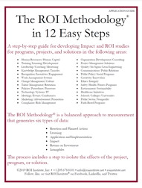
Time to Practice
Now is your time to practice planning an ROI study. You will read the case study titled Retail Merchandise in your Participant Workbook. Then with your team, answer the questions at the end of the case study.
You might also refer to the ROI Methodology fold out model the Application Guide as a reference.
WB page 53

Slide 79
Case Application: Retail Merchandise
Which types of data does the senior management team desire?
How should data be collected for application and business impact measurement?
Which method should be utilized to isolate the effects of the program?
How should the business impact data be converted to monetary values?
WB page 55

Slide 80
Program Profile
Title: Interactive Selling Skills
Target Group: Sales Associates in Electronics
Vendor Produced and Delivered
3 Days – (2 Days Plus 1 Day)
Significant Use of Skill Practices
3 Groups Trained (48 Participants From 3 Stores)
WB page 202

Slide 81
ROI Analysis Profile
Data Collection
  (L1) Reaction questionnaire – end of course
  (L2) Facilitator assessment/demonstration – during course
  (L3) Program follow-up session – 3 weeks
  (L3) Questionnaire – 3 months
  (L4) Performance Monitoring – 3 months
Isolation
  Control group arrangement
    Store size
    Store location
    Customer traffic levels
    Previous store performance
  Participant estimates (back-up)
Data Conversion
  Profit contribution (standard value)
81
WB page 202

Slide 82
Level 1 – Selected Data
Success With Objectives 4.3
Relevance of Material 4.4
Usefulness of Program 4.5
Exercises/Skill Practices 3.9
Overall Instructor Rating 4.1
Target 4.0 / 5.0
WB page 203

Slide 83
Level 2 – Selected Data
All participants demonstrated that they could use the skills successfully.
WB page 203

Slide 84
Level 3 – Selected Data
 | Strongly Agree | Agree | Neither Agree or Disagree | Disagree | Strongly Disagree
I utilize the skills taught in the program. | 78% | 22% | 0% | 0% | 0%
 | With Each Customer | Every Third Customer | Several Times Each Day | At Least Once Daily | At Least Once Weekly
Frequency of use of skills | 52% | 26% | 18% | 4% | 0%
Targets:
100% of participants indicate they use the skills taught in the program.
50% of participants indicate they use skills with everyone customer.
84
WB page 203

Slide 85
Level 4 – Average Weekly Sales
Weeks After Training | Trained Groups | Control Groups
1 | $9,723 | $9,698
2 | $9,978 | $9,720
3 | $10,424 | $9,812
13 | $13,960 | $11,572
14 | $11,491 | $9,683
15 | $11,044 | $10,092
Average for Weeks 13,14,15 | $12,075 | $10,449
85
WB page 204

Slide 86
Annualized Program Benefits
Average Weekly Sales per Employee — Trained Groups $12,075
Average Weekly Sales per Employee — Untrained Groups $10,449
Increase in sales $1,626
Profit Contribution is 2% of Store Sales ($1626 x .02) $32.50
Total Weekly Improvement ($32.50 x 46 participants) $1,495
Total Annual Benefits ($1,495 x 48 Weeks) $71,760
WB page 204

Slide 87
Cost Summary
Facilitation Fees: 3 courses @ $3750 $11,250
Program Materials: 48 @ $35/participant $ 1,680
Meals/Refreshments: 3 days @ $28/participant $ 4,032
Facilities: 9 days @ $120 $ 1,080
Participant Salaries Plus Benefits (35% factor) $12,442
Coordination/Evaluation $ 2,500
Total Costs $32,984
WB page 204

Slide 88
What Is the ROI?
Program Benefits
Program Costs
Benefits/Cost Ratio
=
=
Program Benefits – Program Costs
Program Costs
ROI =
x 100
=
WB page 205

Slide 89
What Is the ROI?
$71,760
$32,984
Benefits/Cost Ratio
=
=
$71,760 - $32,984
$32,984
ROI
=
x
100
=
WB page 205

Slide 90
What Is the ROI?
$71,760
$32,984
Benefits/Cost Ratio
=
=
2.18
$71,760 - $32,984
$32,984
ROI
=
x
100
=
118%
WB page 205

Slide 91
Results
Capture Program Costs
$32,984
Collect Post Program Data
Isolate the Effects of the Program
Convert Data to Monetary Value
Calculate the Return on Investment
Follow-up session
Questionnaire
Performance Monitoring
Control groups
Participants’ estimates
Standard values
$71,760
118%
Identify Intangible Benefits
91

Slide 92
Module 4:
Data Collection
92
WB page 57

Slide 93
The ROI Methodology Process Model
PLAN THE EVALUATION
COLLECT DATA
ANALYZE DATA
Make it Credible:
Capture Costs of
Program
OPTIMIZE RESULTS
LEVEL 0: INPUT
LEVEL 1: REACTION AND PLANNED ACTION
LEVEL 3:
APPLICATION
Start With Why:
Align Programs
With the
Business
Make it Feasible:
Select the Right
Solution
Expect
Success:
Plan for
Results
Make it Matter:
Design for Input,
Reaction, and
Learning
Make it Stick:
Design for
Application
and Impact
Make it
Credible:
Isolate the
Effects
of the
Program
Make it Credible:
Convert Data to
Monetary Value
Make it Credible:
Calculate ROI
Optimize
Results:
Use Black Box
Thinking to
Increase
Funding
Tell the Story:
Communicate
Results to Key
Stakeholder
LEVEL 5: ROI
LEVEL 2: LEARNING
LEVEL 4: IMPACT
Make it Credible:
Identify Intangible Measures
INTANGIBLE BENEFITS
©2024 ROI Institute Inc. All Rights Reserved.
93

Slide 94
The ROI Methodology Process Model
PLAN THE EVALUATION
COLLECT DATA
ANALYZE DATA
Make it Credible:
Capture Costs of
Program
OPTIMIZE RESULTS
LEVEL 0: INPUT
LEVEL 1: REACTION AND PLANNED ACTION
LEVEL 3:
APPLICATION
Start With Why:
Align Programs
With the
Business
Make it Feasible:
Select the Right
Solution
Expect
Success:
Plan for
Results
Make it Matter:
Design for Input,
Reaction, and
Learning
Make it Stick:
Design for
Application
and Impact
Make it
Credible:
Isolate the
Effects
of the
Program
Make it Credible:
Convert Data to
Monetary Value
Make it Credible:
Calculate ROI
Optimize
Results:
Use Black Box
Thinking to
Increase
Funding
Tell the Story:
Communicate
Results to Key
Stakeholder
LEVEL 5: ROI
LEVEL 2: LEARNING
LEVEL 4: IMPACT
Make it Credible:
Identify Intangible Measures
INTANGIBLE BENEFITS
94

Slide 95
Level 1 Target Areas
Relevance of program content
Importance to my success
Amount of new information
Would recommend to others
Instructional materials
Out-of-class assignments
Method of delivery
Instructor/facilitator performance
Facilities/learning environment
Overall evaluation
Planned application/ improvements
WB page 58
95

Slide 96
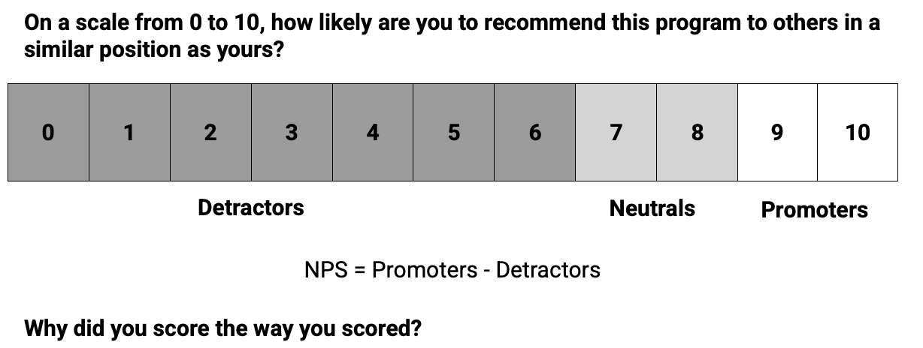
Net Promoter Score
*NPS was created by Fred Reichheld and Bain and Company. It was developed to measure and manage customer loyalty. It predicts overall company growth and customer lifetime value. For talent development programs, the relationship between NPS and application and impact has not yet been shown to the same extent. However, it can be a useful measure.
WB page 58
96

Slide 97
Improving Level 1 Evaluation
Consider an ongoing evaluation
Try quantifying course ratings
Allow ample time for providing feedback
Use the data in constructive ways
Collect information related to improvement
Specifically, what will you do to improve Level 1 evaluation in your organization?
WB page 59

Slide 98
Common Uses of Level 1 Data
Determine participant satisfaction level with the program.
Identify the strengths and weaknesses of the programs.
Evaluate facilitator’s performance.
Determine participant needs.
Develop norms and standards.
Obtain quantitative data that can be communicated to management.
Analyze quantitative data that can be used to establish performance standards for future programs.
Evaluate planned improvements.
Link with follow-up data.
Decide who should participate in future programs.
How is reaction information used in your organization?
WB page 59

Slide 99
Planned Improvement Questions for Feedback Questionnaires
As a result of this program, what do you estimate to be the increase in your personal effectiveness expressed as a percent?
Please indicate what you will achieve as a result of this program (please be specific).
As a result of any change in your thinking, new ideas, or planned actions, please estimate (in monetary values) the benefit to your organization (i.e., reduced errors, reduced cycle time, increased productivity, reduced costs, etc.).
  What is the annual monetary value?
  What is the basis of this estimate?
  What confidence, expressed as a percentage, can you put in your estimate? (0%=No Confidence; 100%=Certainty)
WB page 60

Slide 100
Techniques for Measuring Learning
Commonly Used Techniques
Formal Testing | Simulation | Less Structured
Objective testing Criterion-referenced testing Performance testing | Electrical/mechanical simulation Task simulation Business games In-basket Case studies Role playing Assessment center method | Exercises/activities Self-assessment Team assessment Consultant/facilitator assessment
WB page 61
100

Slide 101
Common Uses of Level 2 Data
Providing individual feedback to build confidence
Ensuring that learning has been acquired
Improving programs
Evaluating instructors/facilitators
How is Level 2 data used in your organization?
WB page 61

Slide 102
The ROI Methodology Process Model
PLAN THE EVALUATION
COLLECT DATA
ANALYZE DATA
Make it Credible:
Capture Costs of
Program
OPTIMIZE RESULTS
LEVEL 0: INPUT
LEVEL 1: REACTION AND PLANNED ACTION
LEVEL 3:
APPLICATION
Start With Why:
Align Programs
With the
Business
Make it Feasible:
Select the Right
Solution
Expect
Success:
Plan for
Results
Make it Matter:
Design for Input,
Reaction, and
Learning
Make it Stick:
Design for
Application
and Impact
Make it
Credible:
Isolate the
Effects
of the
Program
Make it Credible:
Convert Data to
Monetary Value
Make it Credible:
Calculate ROI
Optimize
Results:
Use Black Box
Thinking to
Increase
Funding
Tell the Story:
Communicate
Results to Key
Stakeholder
LEVEL 5: ROI
LEVEL 2: LEARNING
LEVEL 4: IMPACT
Make it Credible:
Identify Intangible Measures
INTANGIBLE BENEFITS
102

Slide 103
Matching Applications of Data Collection Instruments
Write the instrument’s letter in the box to the right of each item.
Survey
Test
Questionnaire
Interview
Focus Groups
Observation
Performance Records
Then indicate the level of evaluation pursued (1, 2, 3, or 4).
WB page 62
103

Slide 104
Methods of Collecting Follow-Up Data
 | Level 3 | Level 4
Follow-up surveys | X
Follow-up questionnaires | X | X
Observation on the job | X
Follow-up interviews | X
Follow-up focus groups | X
Action planning | X | X
Performance contracting | X | X
Program follow-up session | X | X
Performance records |  | X
WB page 64
104

Slide 105
Data Collection Methods
*2020 ROI Institute Benchmarking Study (n=246)
105

Slide 106
Follow-Up Questionnaire Content Checklist
Progress With Objectives
Action Plan Implementation
Relevance of Program
Perceived Value
Use of Materials, Guides, and Technology
Knowledge/Skill Enhancement
Skills Used, Tasks Followed
Changes With Work
Linkage with Output Measures
Other Benefits
Barriers
*optional
Enablers
Management Support
Other Solutions
Recommendations for Target Audience
Suggestions for Improvement
Other Comments
Improvements/Accomplishments*
Improvement Linked With Program*
Monetary Impact*
Confidence Level*
WB page 65
106

Slide 107
Questionnaire Item Example:
Cyber International
WB page 66
107

Slide 108
What would you do to ensure high response on the questionnaire?
Before the Evaluation
During the Evaluation Period
After the Evaluation

Slide 109
Developing ROI With Action Planning
Before | Communicate the action plan requirement early. Have them select actions/measures in advance.
During | Describe the action planning process at the start of the program. Teach the action planning process. Allow time to develop the plan. Have the facilitator approve the action plan. Require participants to assign a monetary value for each proposed improvement. If possible, require action plans to be presented to the group. Explain the follow-up mechanism.
After | Require participants to provide improvement data. Ask participants to isolate the effects of the program. Ask participants to provide a level of confidence for estimates. Collect action plans at the pre-determined follow-up time. Summarize the data and calculate the ROI.
WB page 78
109

Slide 110
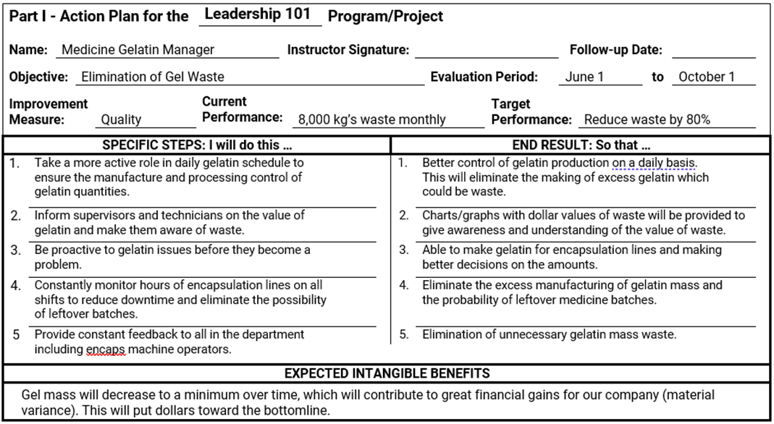

Slide 111
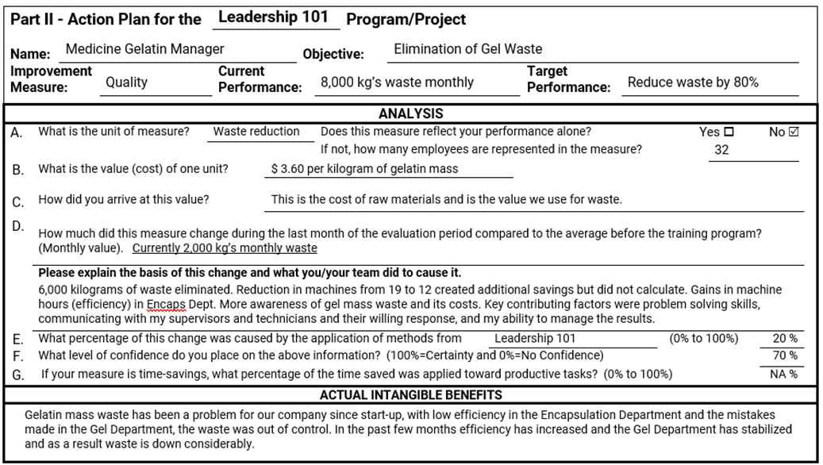

Slide 112
Considerations with Planning Data Collection
Selecting Data Collection Methods | Selecting Sources of Information
Time required for participants Time required for participant’s supervisor Costs of method Amount of disruption of normal activities Accuracy Utility Culture / Philosophy | Participants Supervisors of participants Direct reports of participants Peer group Internal team members External group Organizational performance records
Determining Timing of Follow-Up | Assigning Responsibilities
Availability of Data Ideal Time for Application (Level 3) Ideal Time for Business Impact (Level 4) Convenience of Collection Constraints on Collection | Availability to collect data Accountability for program Accountability for program evaluation
112

Slide 113
Data Collection Plan
Program:___________________________________________________ Responsibility: ________________________________________________________ Date:_____________________
Level | Broad Program Objective(s) | Measures | Data Collection Method/ Instruments | Data Sources | Timing | Responsibilities
1 | Reaction/Satisfaction and Planned Actions
2 | Learning
3 | Application/ Implementation
4 | Business Impact
5 | ROI | Comments:
113
WB page 51
Notes:
Facilitator delivers.
The first planning document is the data collection plan:
When planning data collection, you will answer five basic questions:
What do we ask? (objectives/measures)
How do we ask?
Who do we ask?
When do we ask?
Who does the asking?
We will address these questions in more detail next week.
Transition to next slide: the second planning document is the ROI Analysis plan

Slide 114
Module 5:
Data Analysis
WB page 81
114

Slide 115
The ROI Methodology Process Model
PLAN THE EVALUATION
COLLECT DATA
ANALYZE DATA
Make it Credible:
Capture Costs of
Program
OPTIMIZE RESULTS
LEVEL 0: INPUT
LEVEL 1: REACTION AND PLANNED ACTION
LEVEL 3:
APPLICATION
Start With Why:
Align Programs
With the
Business
Make it Feasible:
Select the Right
Solution
Expect
Success:
Plan for
Results
Make it Matter:
Design for Input,
Reaction, and
Learning
Make it Stick:
Design for
Application
and Impact
Make it
Credible:
Isolate the
Effects
of the
Program
Make it Credible:
Convert Data to
Monetary Value
Make it Credible:
Calculate ROI
Optimize
Results:
Use Black Box
Thinking to
Increase
Funding
Tell the Story:
Communicate
Results to Key
Stakeholder
LEVEL 5: ROI
LEVEL 2: LEARNING
LEVEL 4: IMPACT
Make it Credible:
Identify Intangible Measures
INTANGIBLE BENEFITS
©2024 ROI Institute Inc. All Rights Reserved.
115

Slide 116
The ROI Methodology Process Model
PLAN THE EVALUATION
COLLECT DATA
ANALYZE DATA
Make it Credible:
Capture Costs of
Program
OPTIMIZE RESULTS
LEVEL 0: INPUT
LEVEL 1: REACTION AND PLANNED ACTION
LEVEL 3:
APPLICATION
Start With Why:
Align Programs
With the
Business
Make it Feasible:
Select the Right
Solution
Expect
Success:
Plan for
Results
Make it Matter:
Design for Input,
Reaction, and
Learning
Make it Stick:
Design for
Application
and Impact
Make it
Credible:
Isolate the
Effects
of the
Program
Make it Credible:
Convert Data to
Monetary Value
Make it Credible:
Calculate ROI
Optimize
Results:
Use Black Box
Thinking to
Increase
Funding
Tell the Story:
Communicate
Results to Key
Stakeholder
LEVEL 5: ROI
LEVEL 2: LEARNING
LEVEL 4: IMPACT
Make it Credible:
Identify Intangible Measures
INTANGIBLE BENEFITS
©2024 ROI Institute Inc. All Rights Reserved.
116

Slide 117
Case Application: First Bank
Is this situation unusual? Please explain.
Should the CEO drop the issue?
What are some approaches to resolve this dilemma?
What would you do?
WB page 82

Slide 118
Several Factors Contribute to an Improvement After a Program Is Conducted
External Factors
Management
Attention
TOTAL
IMPROVEMENT
AFTER
PROGRAM
Incentives
Systems/Procedures
Changes
Programs
EFFECT OF PROGRAM ON IMPROVEMENT
WB page 84
118

Slide 119
Techniques to Isolate the Effects of Programs
Use of a control group arrangement
Trend line analysis of performance data
Use of forecasting methods
Participant’s estimate of the program’s impact (percent)
Supervisor’s estimate of the program’s impact (percent)
Management’s estimate of the program’s impact (percent)
Use of experts/previous studies
Calculating/estimating the impact of
other factors
Use of customer input
WB page 85

Slide 120
Isolating the Effects of a Program
For each of the situations, please indicate the
method used to isolate the effects of
the program:
Control group
Trend line analysis
Forecasting
Participant’s estimate
Use of customer input
Expert’s estimate
WB page 85
120

Slide 121
Use of Control Groups Example
Sales and Customer Service Training
Six sites (dealer stores) chosen for program evaluation prior to roll-out to 130 stores
Experimental group of six stores received training (pilot), six stores in control group were not trained
Performance of both groups observed during same six-month period (sales and customer satisfaction)
Data collected on both groups during same timeframe
Neither group is aware of the control group arrangement
WB page 88

Slide 122
Control Groups
Classic Design
Experimental Group Control Group
Pre-Measure Program Post Measure Pre-Measure Post Measure
Post-Program Only Design
Experimental Group Control Group
Program Post Measure Post Measure
122

Slide 123
Case Application: Micro
Electronics, Inc.
WB page 89
123

Slide 124
Use of Trend Line Analysis Example:
Micro Electronics, Inc.
1.85% Pre-Program Six-Month Average
CPI Program Conducted
2%
1%
Projected Average— Using Pre-Data as a Base 1.45%
REJECT RATE
0.7% Post-Program Six-Month Average
J F M A M J J A S O N D J
MONTHS
WB page 89
124

Slide 125
Case Application: Micro Electronics, Inc.
Approximately what improvement in reject rate has resulted from the program?
How reliable is this process?
When can this process be used?
WB page 89

Slide 126
Case Application: National Bank
WB page 90
126

Slide 127
Case Application: National Bank
Monthly Increase in Credit Card Accounts: 175
Contributing Factors | Average Impact on Results | Average Confidence Level
Sales Training Program | 32% | 83%
Incentive Systems | 41% | 87%
Management Reinforcement/Management Emphasis | 14% | 62%
Marketing | 11% | 75%
Other | 2% | 91%
 | 100%
WB page 90
127

Slide 128
Here’s what we are doing.
Start With Facts: Increase in credit card accounts: 175 | Increase in credit card accounts 175
 | % Due to Program | Estimated Number of Credit Cards | % Confidence | Adjusted Number of Credit Cards
Sales Training | 32% | 56 | 83% | 46.48
 |  |  | 56
 |  |  | 46.48
WB page 92
128

Slide 129
Here’s what we are doing.
Start With Facts: Increase in credit card accounts: 175 | Increase in credit card accounts 175
 | % Due to Program | Estimated Number of Credit Cards | % Confidence | Adjusted Number of Credit Cards
Sales Training | 32% | 56 | 83% | 46.48
Participants “think” | 56 new credit cards
They are only | 83% confident |  | 56
Therefore, they are | 17% uncertain |  | 46.48
Basically, they think: | 56 new credit cards +/- 9.52
WB page 92
129

Slide 130
Here’s what we are doing.
Start With Facts: Increase in credit card accounts: 175 | Increase in credit card accounts 175
 | % Due to Program | Estimated Number of Credit Cards | % Confidence | Adjusted Number of Credit Cards
Sales Training | 32% | 56 | 83% | 46.48
Participants “think” | 56 new credit cards |  | 65.52 56 46.48
They are only | 83% confident |  | 56
Therefore, they are | 17% uncertain |  | 46.48
Basically, they think: | 56 new credit cards +/- 9.52
WB page 92
130

Slide 131
Here’s what we are doing.
Start With Facts: Increase in credit card accounts: 175 | Increase in credit card accounts 175
 | % Due to Program | Estimated Number of Credit Cards | % Confidence | Adjusted Number of Credit Cards
Sales Training | 32% | 56 | 83% | 46.48
Participants “think” | 56 new credit cards |  | 65.52 56 46.48
They are only | 83% confident |  | 56
Therefore, they are | 17% uncertain |  | 46.48
Basically, they think: | 56 new credit cards +/- 9.52
WB page 92
131

Slide 132

The Wisdom of Crowds
WB page 92
132

Slide 133


Slide 134
Steps in Determining Which Method(s) to Use
Step | Example
Step 1. Define the measure. | Step 1. Quality (waste due to errors)
Step 2. What time frame should be used to monitor progress and collect the data to determine any change in the measure? | Step 2. Collect baseline data for three-to-four-month period prior to learning solution. Collect improvement data at four months after the training.
Step 3. During the established time frame, what are the internal and external factors (other than the learning solution) that will influence the measure? | Step 3. Change in raw materials. Change in production process. Change in team personnel. Supervisor or team leader provides on-job-training. Changes in run time.
Step 4. Which method(s) is most feasible to use (control group, trend line, other sources)? If control group or trend line cannot be used, then who/what are the best sources to provide data or estimates that address changes in the measure? Who is in the best position to know about influences? | Step 4. Is control group possible? If so, establish control group criteria. If not, is trend analysis feasible? If not, good sources may be participants, participants’ supervisor, and quality supervisor. If you are using estimates from participants or others, determine how you will structure the isolation question.
Step 5. Select the isolation method(s) to be used to determine the effects of the influencing factors. | Step 5. Select the most credible method(s) that can be accomplished in the performance environment.
WB page 96
134

Slide 135
Credibility of Data
Rank the items listed here from 1 to 7, (1 = most credible, 7 = least credible).
 | Rank
The cumulative expenditures on child sex abuse claims in the USA for the Roman Catholic Church is $1.5 billion.
Vulcan Materials Company produced 321 million tons of crushed stone last year.
Pharmaceutical Firm in Ireland receives -42% ROI (negative) in a management learning program.
Wells Fargo Bank receives 932% ROI in a learning program for relationship managers.
Annual cost of absenteeism and diminished productivity resulting from employee depression is $23.8 billion.
The annual value of the market for wildlife trafficking—the second largest illegal trade in the world after drugs—is $10 billion.
Presenteeism (working while sick) is costing employers $15 billion a year.
WB page 97
135

Slide 136
Credibility of Outcome Data
Reputation of the source of the data
Reputation of the source of the study
Motives of the researchers
Bias of the audience
Methodology of the study
Assumptions made in the analysis
Realism of the outcome data
Type of data
Scope of analysis
WB page 98

Slide 137
The ROI Methodology Process Model
PLAN THE EVALUATION
COLLECT DATA
ANALYZE DATA
Make it Credible:
Capture Costs of
Program
OPTIMIZE RESULTS
LEVEL 0: INPUT
LEVEL 1: REACTION AND PLANNED ACTION
LEVEL 3:
APPLICATION
Start With Why:
Align Programs
With the
Business
Make it Feasible:
Select the Right
Solution
Expect
Success:
Plan for
Results
Make it Matter:
Design for Input,
Reaction, and
Learning
Make it Stick:
Design for
Application
and Impact
Make it
Credible:
Isolate the
Effects
of the
Program
Make it Credible:
Convert Data to
Monetary Value
Make it Credible:
Calculate ROI
Optimize
Results:
Use Black Box
Thinking to
Increase
Funding
Tell the Story:
Communicate
Results to Key
Stakeholder
LEVEL 5: ROI
LEVEL 2: LEARNING
LEVEL 4: IMPACT
Make it Credible:
Identify Intangible Measures
INTANGIBLE BENEFITS
137
©2024 ROI Institute Inc. All Rights Reserved.

Slide 138

Defining BCR and ROI
Program Benefits
Program Costs
Benefits/Cost Ratio
=
=
Program Benefits – Program Costs
Program Costs
ROI =
x 100
=

Slide 139
Converting Data to Monetary Values
For each of these situations, please indicate the method used to convert data to money.
Profit/savings from output (standard value)
Cost of quality (standard value)
Employee time as compensation (standard value)
Historical costs/savings from records
Expert Input
External database
Link with other measures
Participant estimation
Management estimation
Estimation from staff
WB page 99
139

Slide 140
Methods of Converting Data to Monetary Values
Converting output to contribution-standard value (profit/savings)
Converting the cost of quality-
standard value
Converting employee’s time
(using compensation)
Using historical costs/savings
Using internal and external experts
Using data from external databases/studies
Linking with other measures
Using participants’ estimates
Using supervisors’ and
managers’ estimates
Using staff estimates
WB page 103
140

Slide 141
Calculating the Value of an Improvement
Step 1: Define and focus on a unit of measure
Step 2: Determine the value of each unit (V)
Step 3: Calculate the change in performance data (Δ P)
Step 4: Determine the annual amount of change in performance (A Δ P)
Step 5: Calculate total annual value of the improvement ( A Δ P X V)
WB page 104

Slide 142

Turnover of Middle Managers
WB page 105
142

Slide 143
Turnover of Middle Managers: A Word Problem
Your organization is experiencing a high level of turnover of middle managers who are paid $75,000 per year (fully-loaded). To capture the value of turnover for this group, you rely on a database. The database provides you with various job groups and a range for the cost of turnover for each group.
A program was implemented to reduce the turnover. One year after the program, you found that turnover decreased by 10 for the year – a direct result of the program.
Using your five steps, the guiding principles, and the Turnover Cost Summary, calculate the annual monetary value of the reduction in turnover of middle managers who are paid $75,000 per year.
WB page 105

Slide 144
Turnover Cost Summary
Job Type/Category | Turnover Cost Ranges
Entry Level — Hourly, Nonskilled, e.g., Fast Food Worker | 30–50%
Service/Production Workers—Hourly, e.g., Courier | 40–70%
Skilled Hourly, e.g., Machinist | 75–100%
Clerical/Administrative, e.g., Scheduler | 50–80%
Professional, e.g., Nurse, Accountant | 75–125%
Technical, e.g., Computer Technician | 100–150%
Engineers, e.g., Chemical Engineer | 200–300%
Specialists, e.g., Computer Software Designer | 200–400%
Supervisors/Team Leaders, e.g., Section Supervisor | 100–150%
Middle Managers, e.g., Department Manager | 125–200%
WB page 106
144

Slide 145
Calculating the Value of an Improvement
Step 1: Define and focus on a unit of measure.
Step 2: Determine the value of each unit (V).
Step 3: Calculate the change in performance data (Δ P).
Step 4: Determine the annual amount of change in performance (A Δ P).
Step 5: Calculate the total annual value of the improvement ( A Δ P X V).
145

Slide 146
Calculating the Value of Improving Turnover
Step 1: Define and focus on a unit of measure.
  1 turnover of middle managers paid $75,000 per year
Step 2: Determine the value of each unit (V).
Step 3: Calculate the change in performance data (Δ P).
Step 4: Determine the annual amount of change in performance (A Δ P).
Step 5: Calculate the total annual value of the improvement ( A Δ P X V).
146

Slide 147
Calculating the Value of Improving Turnover
Step 1: Define and focus on a unit of measure.
  1 turnover of middle managers paid $75,000 per year
Step 2: Determine the value of each unit (V).
  125% of annual (external database) = 1.25 x $75,000 = $93,750
Step 3: Calculate the change in performance data (Δ P).
Step 4: Determine the annual amount of change in performance (A Δ P).
Step 5: Calculate the total annual value of the improvement ( A Δ P X V).
147

Slide 148
Calculating the Value of Improving Turnover
Step 1: Define and focus on a unit of measure.
  1 turnover of middle managers paid $75,000 per year
Step 2: Determine the value of each unit (V).
  125% of annual (external database) = 1.25 x $75,000 = $93,750
Step 3: Calculate the change in performance data (Δ P).
  10 per year
Step 4: Determine the annual amount of change in performance (A Δ P).
Step 5: Calculate the total annual value of the improvement ( A Δ P X V).
148

Slide 149
Calculating the Value of Improving Turnover
Step 1: Define and focus on a unit of measure.
  1 turnover of middle managers paid $75,000 per year
Step 2: Determine the value of each unit (V).
  125% of annual (external database) = 1.25 x $75,000 = $93,750
Step 3: Calculate the change in performance data (Δ P).
  10 per year
Step 4: Determine the annual amount of change in performance (A Δ P).
  10 per year
Step 5: Calculate the total annual value of the improvement ( A Δ P X V).
149

Slide 150
Calculating the Value of Improving Turnover
Step 1: Define and focus on a unit of measure.
  1 turnover of middle managers paid $75,000 per year
Step 2: Determine the value of each unit (V).
  125% of annual (external database) = 1.25 x $75,000 = $93,750
Step 3: Calculate the change in performance data (Δ P).
  10 per year
Step 4: Determine the annual amount of change in performance (A Δ P).
  10 per year
Step 5: Calculate the total annual value of the improvement ( A Δ P X V).
  $937,500
150

Slide 151

Package Delivery Co.
WB page 108
151

Slide 152
Remember our five steps:
Step 1: Define and focus on a unit of measure.
Step 2: Determine the value of each unit (V).
Step 3: Calculate the change in performance data (Δ P).
Step 4: Determine the annual amount of change in performance (A Δ P).
Step 5: Calculate the total annual value of the improvement ( A Δ P X V).
152

Slide 153
Calculating the Value of Absenteeism Reduction (Approach 1)
Step 1: Define and focus on a unit of measure.
  1 absence
Step 2: Determine the value of each unit (V).
  $81 per absence (manager estimates)
Step 3: Calculate the change in performance data (Δ P).
  .07-.04 = .03 x .40 = 0.012 or 1.2%
Step 4: Determine the annual amount of change in performance (A Δ P).
  .012 x 120 x 240 = 345.6 absences
Step 5: Calculate the total annual value of the improvement ( A Δ P X V).
  345.6 x $81 = $27,993.60
153

Slide 154
Calculating the Value of Absenteeism Reduction (Approach 2)
Step 1: Define and focus on a unit of measure.
  1 absence
Step 2: Determine the value of each unit (V).
  $81 per absence (manager estimates)
Step 3: Calculate the change in performance data (Δ P).
  [(.07 x 120) – (0.04 x 120)] x .40 =
  (8.4 – 4.8) x .40 =
  3.6 x .40 = 1.44 per day
Step 4: Determine the annual amount of change in performance (A Δ P).
  1.44 x 240 = 345.6 absences
Step 5: Calculate the total annual value of the improvement ( A Δ P X V).
  345.6 x $81 = $27,993.60
154

Slide 155
To Convert or Not to Convert
Is there a standard value?
Is there a method to get there?
Move to intangible benefits
No
No
Yes
Yes
Add to numerator
Can we get there with minimum resources?
Move to intangible benefits
No
Yes
Can we convince our executive in 2 minutes that the value is credible?
Move to intangible benefits
No
Yes
Convert data and add to numerator
WB page 109
155

Slide 156
Leadership 101
WB page 110
156

Slide 157
ROI Application: Leadership 101
You have been asked to calculate the ROI from action plans used in a leadership program. The plans are being collected and the results analyzed four months after the training is completed. Most of the plans have been received, analyzed, isolated, and annualized. The results from 28 participants and the cost of the program for the 30 participants are:
Thirty participants completed the program and were asked to submit action plans.
Data from 18 participants has been analyzed, isolated, and annualized; total monetary benefit influenced by the training is $54,109.
Ten participants did not provide data.
WB page 110
157

Slide 158
ROI Application Exercise: Leadership 101
You must analyze the remaining two plans and determine the benefits and calculate the ROI from results of 30 participants.
30 participants completed the program and were asked to complete action plans.
Data from 18 participants has been analyzed, isolated, and annualized; total monetary benefit influenced by the training is $54,109.
10 participants did not provide data.
Two additional action plans remain to be analyzed:
  Medicine Gelatin Manager (See last pages of activity.)
  Bill Burgess (See last pages of activity.)
WB page 110
158

Slide 159
Document your results in this table and calculate the ROI.
Benefits From Leadership Program | Your Answer | Actual Answer
Medicine Gelatin Manager
Bill Burgess
18 other participants (isolated and annualized) |  | $54,109
10 other participants
Total Benefits From Leadership Program
Leadership 101 costs: $60,000
WB page 111
159

Slide 160

Medicine Gelatin Manager: Quality
WB page 112
160

Slide 161
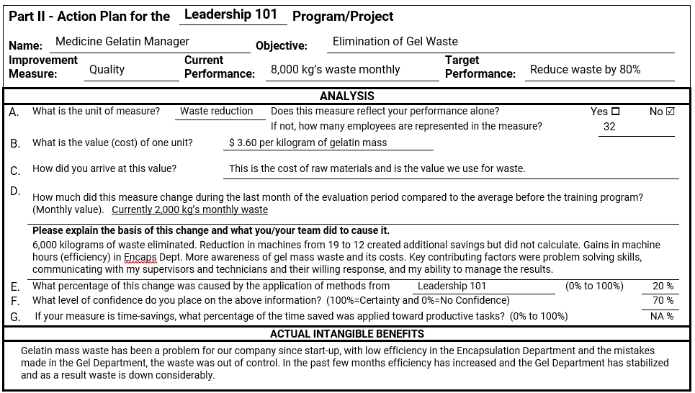
Medicine Gelatin Manager: Quality
WB page 113
161

Slide 162
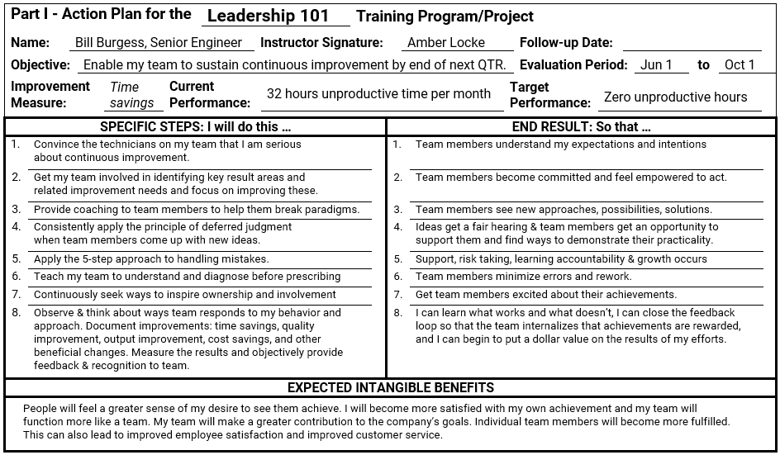
Bill Burgess: Unproductive Time
WB page 114
162

Slide 163
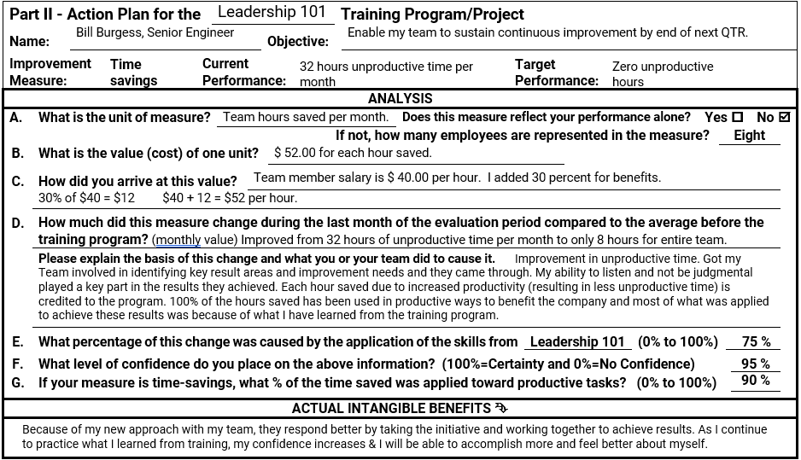
Bill Burgess: Unproductive Time
WB page 115
163

Slide 164
Worksheet to Calculate Monetary Benefits for Medicine Gelatin Manager and Bill Burgess
Steps | Medicine Gelatin Manager | Bill Burgess
Unit of Measure
Value of Each Unit (V)
Change in Performance Data (Δ P)
Annual Change in Performance (A Δ P)
Total Monetary Benefit (A Δ P x V)*
*Move your totals to Table 5-7 on page 111 and complete the ROI calculation.
WB page 116
164

Slide 165
Worksheet to Calculate Monetary Benefits for Medicine Gelatin Manager and Bill Burgess
Steps | Medicine Gelatin Manager | Bill Burgess
Unit of Measure | 1 kg waste
Value of Each Unit (V) | $3.60 per kg (standard value)
Change in Performance Data (Δ P) | 8,000 – 2,000 = 6,000 6,000 x .20 x .70 = 840 per month
Annual Change in Performance (A Δ P) | 840 x 12 = 10,080 kg
Total Monetary Benefit (A Δ P x V)* | 10,080 x $3.60 = $36,288
*Move your totals to Table 5-9 and complete the ROI calculation.
WB page 116
165

Slide 166
Worksheet to Calculate Monetary Benefits for Medicine Gelatin Manager and Bill Burgess
Steps | Medicine Gelatin Manager | Bill Burgess
Unit of Measure | 1 kg waste | 1 hour unproductive time
Value of Each Unit (V) | $3.60 per kg (standard value) | $52 per hour (standard value)
Change in Performance Data (Δ P) | 8,000 – 2,000 = 6,000 6,000 x .20 x .70 = 840 per month | 32 – 8 = 24 24 x .75 x .95 x .90 = 15.39 per month
Annual Change in Performance (A Δ P) | 840 x 12 = 10,080 kg | 15.39 x 12 = 184.68 hours
Total Monetary Benefit (A Δ P x V)* | 10,080 x $3.60 = $36,288 | 184.58 x $52 = $9,603.36
*Move your totals to Table 5-9 and complete the ROI calculation.
WB page 113
166

Slide 167
ROI Application Exercise
Review the sample action plans and the information on this slide and calculate the ROI.
Benefits From Leadership Program | Actual Answer
Medicine Gelatin Manager
Bill Burgess
18 other participants (isolated and annualized) | $54,109
10 other participants | 0
Total Benefits From Leadership Program
Total Fully Loaded Costs of Leadership Program | $60,000
ROI =
167

Slide 168
ROI Application Exercise
Review the sample action plans and the information on this slide and calculate the ROI.
Benefits From Leadership Program | Actual Answer
Medicine Gelatin Manager | $36,288
Bill Burgess | $9,603.36
18 other participants (isolated and annualized) | $54,109
10 other participants | 0
Total Benefits From Leadership Program | $100,000.36
Total Fully Loaded Costs of Leadership Program | $60,000
ROI = | 67%
168

Slide 169
The ROI Methodology Process Model
PLAN THE EVALUATION
COLLECT DATA
ANALYZE DATA
Make it Credible:
Capture Costs of
Program
OPTIMIZE RESULTS
LEVEL 0: INPUT
LEVEL 1: REACTION AND PLANNED ACTION
LEVEL 3:
APPLICATION
Start With Why:
Align Programs
With the
Business
Make it Feasible:
Select the Right
Solution
Expect
Success:
Plan for
Results
Make it Matter:
Design for Input,
Reaction, and
Learning
Make it Stick:
Design for
Application
and Impact
Make it
Credible:
Isolate the
Effects
of the
Program
Make it Credible:
Convert Data to
Monetary Value
Make it Credible:
Calculate ROI
Optimize
Results:
Use Black Box
Thinking to
Increase
Funding
Tell the Story:
Communicate
Results to Key
Stakeholder
LEVEL 5: ROI
LEVEL 2: LEARNING
LEVEL 4: IMPACT
Make it Credible:
Identify Intangible Measures
INTANGIBLE BENEFITS
©2024 ROI Institute Inc. All Rights Reserved.
169

Slide 170
Defining BCR and ROI
Program Benefits
Program Costs
Benefits/Cost Ratio
=
=
Program Benefits – Program Costs
Program Costs
ROI =
x 100
=

Slide 171
Overview of Tabulating Costs
Cost Item | Prorated | Expensed
Needs Assessment | P
Design and Development | P
Acquisition (purchase) | P
Delivery Salaries/Benefits—Facilitators |  | P
Salaries/Benefits—Coordination |  | P
Program Materials and Fees |  | P
Travel/Lodging/Meals |  | P
Facilities |  | P
Participants Salaries/Benefits |  | P
Contact Time |  | P
Travel Time |  | P
Evaluation |  | P
Overheard | P | P
WB page 117
171

Slide 172
Prorated vs. Direct Costs
WB page 118
172

Slide 173
Prorated Development Cost
Development cost: $98,000
Program life cycle: 3 years
Participants over life of program: 1,000
Development cost per person: $98,000/1000 = $98
ROI study planned for one cohort: 25 participants
Prorated development cost: 25 x $98 = $2,450
173

Slide 174
The ROI Methodology Process Model
PLAN THE EVALUATION
COLLECT DATA
ANALYZE DATA
Make it Credible:
Capture Costs of
Program
OPTIMIZE RESULTS
LEVEL 0: INPUT
LEVEL 1: REACTION AND PLANNED ACTION
LEVEL 3:
APPLICATION
Start With Why:
Align Programs
With the
Business
Make it Feasible:
Select the Right
Solution
Expect
Success:
Plan for
Results
Make it Matter:
Design for Input,
Reaction, and
Learning
Make it Stick:
Design for
Application
and Impact
Make it
Credible:
Isolate the
Effects
of the
Program
Make it Credible:
Convert Data to
Monetary Value
Make it Credible:
Calculate ROI
Optimize
Results:
Use Black Box
Thinking to
Increase
Funding
Tell the Story:
Communicate
Results to Key
Stakeholder
LEVEL 5: ROI
LEVEL 2: LEARNING
LEVEL 4: IMPACT
Make it Credible:
Identify Intangible Measures
INTANGIBLE BENEFITS
©2024 ROI Institute Inc. All Rights Reserved.
174

Slide 175
Different Approaches to Measure the Financial Payoff of Learning
Cost Benefit Analysis
Return on Investment
Payback Period
Discounted Cash Flow
Internal Rate of Return
Utility Analysis
Consequences of Not Providing Learning Systems
Most
Common
WB page 122

Slide 176
Defining BCR and ROI
Program Benefits
Program Costs
Benefits/Cost Ratio
=
=
Program Benefits – Program Costs
Program Costs
ROI =
x 100 =
WB page 122

Slide 177
Defining BCR and ROI
Program Benefits = $71,760
Program Costs = $32,984
Program Benefits
Program Costs
Benefits/Cost Ratio
=
=
Program Benefits – Program Costs
Program Costs
ROI =
x 100 =
WB page 122

Slide 178
Defining BCR and ROI
Program Benefits = $71,760
Program Costs = $32,984
$71,760
$32,984
Benefits/Cost Ratio
=
=
$71,760 - $32,984
$32,984
ROI =
x 100 =
WB page 122

Slide 179
Defining BCR and ROI
Program Benefits = $71,760
Program Costs = $32,984
$71,760
$32,984
Benefits/Cost Ratio
=
= 2.17
$71,760 - $32,984
$32,984
ROI =
x 100 = 117%
WB page 122

Slide 180
Defining the Payback Period
Total Investment = $32,984
Annual Savings = $71,760
Program Costs
Program Benefits
Payback Period =
x 12
WB page 123

Slide 181
Defining the Payback Period
Total Investment = $32,984
Annual Savings = $71,760
$32,984
$71,760
Payback Period =
x 12
WB page 123

Slide 182
Defining the Payback Period
Total Investment = $32,984
Annual Savings = $71,760
$32,984
$71,760
Payback Period =
x 12 = 5.51
WB page 123

Slide 183
A Rational Approach to ROI
Keep the process simple.
Use sampling for ROI calculations.
Always account for the influence of other factors.
Involve management in the process.
Educate the management team.
Communicate results carefully.
Give credit to participants and managers.
Plan for ROI calculations.
WB page 123

Slide 184
The ROI Methodology Process Model
PLAN THE EVALUATION
COLLECT DATA
ANALYZE DATA
Make it Credible:
Capture Costs of
Program
OPTIMIZE RESULTS
LEVEL 0: INPUT
LEVEL 1: REACTION AND PLANNED ACTION
LEVEL 3:
APPLICATION
Start With Why:
Align Programs
With the
Business
Make it Feasible:
Select the Right
Solution
Expect
Success:
Plan for
Results
Make it Matter:
Design for Input,
Reaction, and
Learning
Make it Stick:
Design for
Application
and Impact
Make it
Credible:
Isolate the
Effects
of the
Program
Make it Credible:
Convert Data to
Monetary Value
Make it Credible:
Calculate ROI
Optimize
Results:
Use Black Box
Thinking to
Increase
Funding
Tell the Story:
Communicate
Results to Key
Stakeholder
LEVEL 5: ROI
LEVEL 2: LEARNING
LEVEL 4: IMPACT
Make it Credible:
Identify Intangible Measures
INTANGIBLE BENEFITS
©2024 ROI Institute Inc. All Rights Reserved.
184

Slide 185
Common Intangibles Linked With Programs
Branding
Customer satisfaction
Poverty
Sustainability
Job satisfaction
Organizational commitment
Work climate
Employee complaints
Human life
Employee stress
Employee engagement
Leadership
Image
Citizen complaints
Reputation
Donor loyalty
Teamwork
Cooperation
Conflict
Decisiveness
Communication
Clarity
Caring
Capacity
Capability
Attention
Accountability
Alliances
WB page 124

Slide 186
Why Intangibles Are Important
WB page 124
186

Slide 187
Sources for Intangible Benefits
Identified during needs assessments
Identified during early planning (with no intention to convert to monetary value)
Clients identify intangibles
Participants identify intangibles
Managers identify intangibles
Customers identify intangibles
Intangibles are often identified when attempts at conversion are aborted
WB page 125

Slide 188
Module 6:
Reporting and Optimizing
WB page 127
188

Slide 189
The ROI Methodology Process Model
PLAN THE EVALUATION
COLLECT DATA
ANALYZE DATA
Make it Credible:
Capture Costs of
Program
OPTIMIZE RESULTS
LEVEL 0: INPUT
LEVEL 1: REACTION AND PLANNED ACTION
LEVEL 3:
APPLICATION
Start With Why:
Align Programs
With the
Business
Make it Feasible:
Select the Right
Solution
Expect
Success:
Plan for
Results
Make it Matter:
Design for Input,
Reaction, and
Learning
Make it Stick:
Design for
Application
and Impact
Make it
Credible:
Isolate the
Effects
of the
Program
Make it Credible:
Convert Data to
Monetary Value
Make it Credible:
Calculate ROI
Optimize
Results:
Use Black Box
Thinking to
Increase
Funding
Tell the Story:
Communicate
Results to Key
Stakeholder
LEVEL 5: ROI
LEVEL 2: LEARNING
LEVEL 4: IMPACT
Make it Credible:
Identify Intangible Measures
INTANGIBLE BENEFITS
©2024 ROI Institute Inc. All Rights Reserved.
189

Slide 190
Case Application:
Utility Services Company
WB page 128
190

Slide 191
ROI Example:
Utility Services Company
Capture Program Costs
$54,300
Collect Post Program Data
Isolate the Effects of the Program
Convert Data to Monetary Value
Calculate the Return on Investment
Questionnaire
Performance Monitoring
Participants’ estimates
Standard values
$408,500
652%
Identify Intangible Benefits
WB page 133
191

Slide 192
Common Target Audiences
Audience | Reason for Communication
Top management* | Secure approval
All managers | Gain support/build credibility
Participants’ superiors* | Obtain commitment/build credibility
Potential participants | Create desire
Current participants* | Enhance reinforcement
Learning and Development staff* | Show importance
All employees | Stimulate interest
Stockholders | Secure endorsement
*Always consider providing a report for these audiences.
WB page 135
192

Slide 193
Methods of Communication
Meetings | Brief Reports | Mass Publications | Detailed Reports | Electronic Reporting
Executives Management Stakeholders Staff | Executive summary Slide overview One-page summary Brochure | Announcements Bulletins Newsletters Brief articles Press releases | Impact study Case study (internal) Case study (external) Major articles | Website Email Blog/social media Video
WB page 135
193

Slide 194
Sample Reports: Impact
Study Outline One-Page
Summary Scorecard
WB page 137
194

Slide 195
Use of Evaluation Data
Use of Evaluation Data | Appropriate Level of Data
 | 1 | 2 | 3 | 4 | 5
Adjust Program Design | ✓ | ✓
Improve Program Delivery | ✓ | ✓
Influence Application and Impact |  |  | ✓ | ✓
Enhance Reinforcement |  |  | ✓
Improve Management Support |  |  | ✓ | ✓
WB page 142
195

Slide 196
Use of Evaluation Data (continued)
Use of Evaluation Data | Appropriate Level of Data
 | 1 | 2 | 3 | 4 | 5
Improve Stakeholder Satisfaction |  |  | ✓ | ✓ | ✓
Recognize and Reward Participants |  | ✓ | ✓ | ✓
Justify or Enhance Budget |  |  |  | ✓ | ✓
Develop Norms and Standards | ✓ | ✓ | ✓
Reduce Costs |  | ✓ | ✓ | ✓ | ✓
Market Talent Development Programs | ✓ |  | ✓ | ✓ | ✓
Expand Implementation to Other Areas |  |  |  | ✓ | ✓
WB page 142
196

Slide 197
Delivering Bad News
Never fail to recognize the power to learn and improve with a negative study.
Look for red flags along the way.
Lower outcome expectations with key stakeholders along the way.
Look for data everywhere.
Never alter the standards.
Remain objective throughout the process.
Prepare the team for the bad news.
Consider different scenarios.
Find out what went wrong.
Say: “Now we have data that shows how to make this program more successful.” This becomes a positive spin on less-than-positive data.
Drive improvement.
WB page 143

Slide 198
Process Improvement Is the Key:
Black Box Thinking
EVALUATION
OPTIMIZATION
ALLOCATION
Measure
Improve
Fund
Compare and contrast the approach to mistakes in the aviation and healthcare industries. Why does this happen?
What is your approach to failure in programs?
WB page 144
198

Slide 199

Cost vs. Investment Perception: The Reality
Perception |  | Actions |  | Consequences
It’s a cost |  | Control it Reduce it Eliminate it |  | Partnerships are rare Influence diminishes Support is lost Funding is curtailed
It’s an investment |  | Maintain it Enhance it Protect it |  | Business partnerships flourish Client relationships improve A seat at the table is earned Funding is easier
Executive Perception of Programs
WB page 145
199

Slide 200
Module 7:
Implementation
WB page 147
200

Slide 201
Management Influence
Management commitment
Management support
Management reinforcement
Management involvement
WB page 148

Slide 202
ROI Dilemmas
If the CEO or other top executive is requiring ROI, it may be too late for the process.
The time to pursue ROI is when you do not have to pursue it.
The ROI process is not a quick fix.
If the learning and development staff does not see the need for ROI, it will usually fail.
Without the cooperation of participants, the ROI process will usually fail.
Without the support of management, the ROI process will usually fail.
The ROI process requires much education with a variety of groups.
WB page 148

Slide 203
Implementation Concerns
Resources (staffing/budget)
Leadership (individual, group, cross-functional team)
Timing (urgency, activities)
Communication (various audiences)
Commitment (staff, managers, top executives)
WB page 149

Slide 204
Cost-Savings Approaches to ROI
Plan for evaluation early in the process.
Build evaluation into the learning process.
Share the responsibilities for evaluation.
Require participants to conduct major steps.
Use sampling to select the most appropriate programs for ROI analysis.
Use estimates in the collection and analysis of data.
Develop internal capability to implement the ROI process.
Use web-based software to reduce time.
Streamline the reporting process.
WB page 149

Slide 205
Implementing a Comprehensive ROI Process
Assess your progress and readiness.
Develop a policy and philosophy statement on results-based approach.
Clarify roles:
  Staff
  Employees
  Supervision and management
Establish accountability.
Develop a transition plan.
Set targets for evaluation levels.
Develop guidelines.
Build staff skills.
Establish a management support system.
Enhance management commitment and support.
Communicate results to selective audiences.
Establish a quality review process.
WB page 150

Slide 206
Key Implementation Actions
Determine/establish responsibilities.
Develop skills/knowledge with ROI.
Develop transition/implementation plan.
Conduct ROI studies.
Prepare/revise evaluation, policy, procedures, and guidelines.
Train/brief managers on the ROI process.
Communicate progress/results.
WB page 150

Slide 207
Setting Evaluation Targets
Example From a Large Telecommunications Company
How would you set similar targets for evaluation in your organization?
Level | Target | Your Target
Level 1: Reaction | 100%
Level 2: Learning | 80%
Level 3: Application | 30%
Level 4: Business Impact | 6%
Level 5: ROI | 5%
WB page 152
207

Slide 208

What Have You Learned?
What is one thing you have learned in this workshop that you will immediately apply on the job?
What is one way in which you play to apply what you learn?
What is one barrier that could get in
your way?
What is one step you can take to overcome this barrier?

Slide 209
Thank you!

Slide 210




Questions?
Visit us Online
www.roiinstitute.net
Email Us
patti@roiinstitute.net
Connect with Us

Slide 211



Slide 212
