Slide 1

The First Standard for L&D Metrics is Here!
CLO Webinar
January 11, 2024
Presented by: David Vance

Slide 2
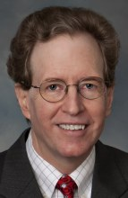
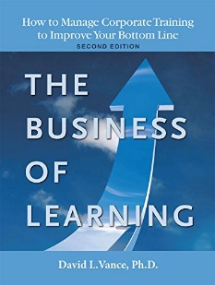

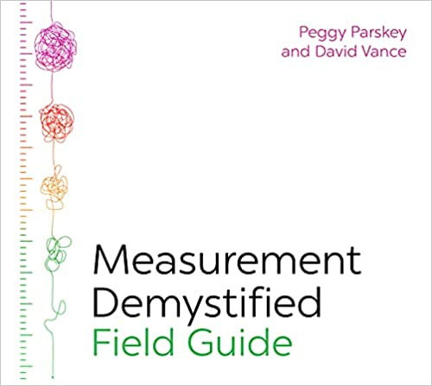
Introduction
Founder and Former Executive Director, Center for Talent Reporting
Founder and Former President, Caterpillar University
  2005 1st Place in ATD BEST Awards
  2006 CLO of the Year
Former Chief Economist, Caterpillar Inc.
  Ph.D. in Economics, Masters in Business Administration
Author, The Business of Learning (second edition), and Measurement Demystified (2021) & Measurement Demystified Field Guide (2022) with Peggy Parskey (ATD Press)
Adjunct Professor in Human Capital Development
  Bellevue University (PhD program)
  George Mason University (Executive Education program)
Member, ISO Working Group on Metrics

Slide 3

Today’s Discussion
Introduction to the New Standard
The Process of Creating the Standard
Key Components
The Recommended Metrics
How to use the standard
Conclusion
Notes:
POLL #1: What is your HR Function (check all that apply)
Learning & Development
Leadership Development
Capability Development (career planning and progression)
Talent Acquisition
Other

Slide 4
The New ISO Standard on L&D Metrics
ISO TS30437 Human resource development – Learning and development metrics is the name of the standard
  ISO is the International Organization for Standardization
  The “TS” denotes a Technical Specification which will be reviewed every three years
  “30437” is the number of this standard
Created to support ISO 30422 – Human resource management – Learning and development published in 2022
The result of two years work by ISO Technical Committee (TC) 260 on Human Resource Development, Working Group 2 Metrics
  Members from many countries including US, Canada, UK, and Australia

Slide 5
The ISO 30422-Learning and Development process
Highlights three types of measures
  Efficiency
  Effectiveness
  Outcome

Slide 6
ISO TS30437 Highlights
52 metrics recommendations for large organizations
19 metrics recommended for small/medium organizations
Recommendations made by type of user and type of metric
  For example, eight effectiveness metrics for the head of learning for a large organization
Recommendations also made for formal and informal learning metrics
Definitions provided for all 52 metrics
  Examples of use in a table provided for many
Sample reports using the recommended metrics

Slide 7
The Steps to Create This Technical Specification
New work item proposal written in May 2021 and circulated globally to TC260 members for comment and approval
Subgroup within Working Group 2 formed to draft the standard
  First draft created
  Numerous meetings held to incorporate feedback and suggestions
Draft presented to full Working Group 2
  Feedback incorporated
Committee draft circulated to TC260 members for comments and approval
  24 pages of comments received – all of which had to be addressed
Changes made and approved by Working Group 2
Final draft sent to ISO editors in December 2022. Published June 2023

Slide 8
About ISO Standards
ISO standards are recommendations from experts in their fields and represent the best thinking on the topic
  The standard creation process ensures input from the global community
The published standards are for voluntary adoption by organizations and countries
  This contrasts with Securities and Exchange Commission (SEC) rules in the US or laws passed by Congress which are legally binding mandates
  Some countries do adopt ISO standards as law
  The US does not (at least not yet for human capital)

Slide 9
ISO TS30437 Key Components
The framework (based on TDRP)
  Five categories of users
  Four broad reasons to measure
  Three types of measures
  Four types of reports
Recommendation of metrics by user, type of metric, and size of organization
Definitions with examples of usage
Sample reports using the recommend metrics

Slide 10
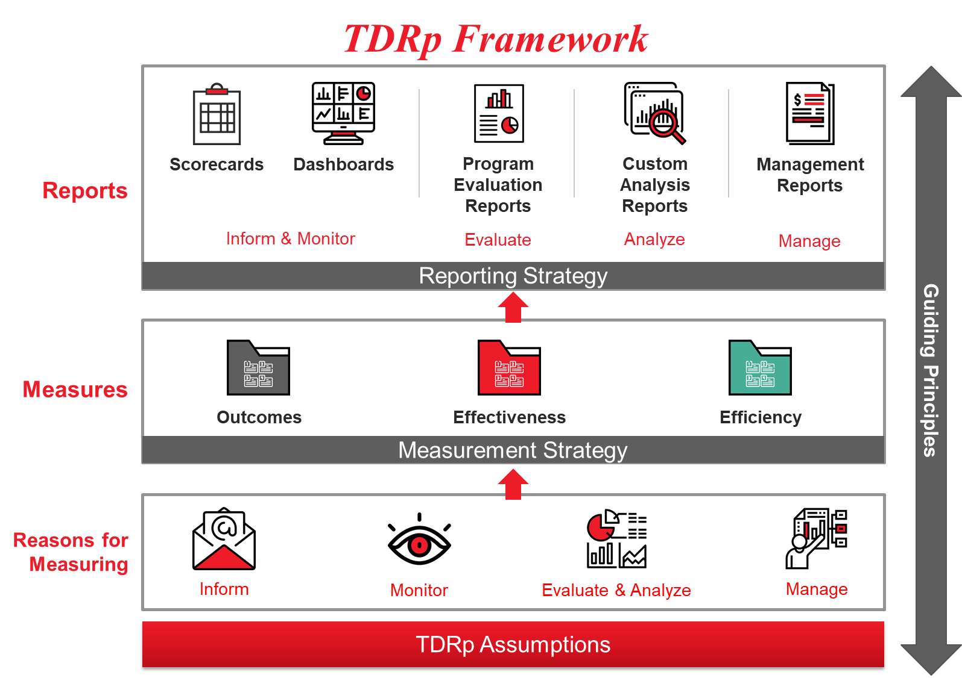

Slide 11
The Framework: Five Types of Users
Senior organization leader (for example, CEO, CFO, board of governors)
Group or team leader (for example, business unit or department head)
Head of learning (CLO or VP of Training, or person designated provide leadership to learning)
Program manager (L&D professional or other person responsible for learning program)
Learner
Start by knowing who your users are and why they are interested in metrics.

Slide 12
The Framework: Four Broad Reasons to Measure
Inform: Answer questions and identify trends
Monitor: Ensure that a value remains above (or below) a historic threshold
Evaluate: Determine the efficiency, effectiveness and impact of a learning program
Manage: Set targets to improve and actively manage to deliver the planned targets
Understand your user’s reasons for measuring. This will dictate the frequency of measurement and the most appropriate report.

Slide 13
The Framework: Three Types of Metrics*
Efficiency metrics: Measures quantity (Level 0: activity, cost, utilization metrics)
Effectiveness metrics: Measures quality (Levels 1, 2, 3, and 5)
Outcome metrics: Measures the impact of learning on organization goals (Level 4)
Helps organize the almost 200 L&D metrics we have. Your measurement strategy should always include a balance of efficiency and effectiveness metrics. Add an outcome metric whenever learning can support a high-level organization goal.
* Note: Also recommended by various authors including Adelsberg and Trolley (Running Training like a Business, 1999), Boudreau and Ramstad (Beyond HR: The New Science of Human Capital, 2007), Mattox, Parskey and Hall (Learning Analytics: Using Talent Data to Improve Business Outcomes, second edition, 2020), and Vance and Parskey (Measurement Demystified: Creating Your L&D Measurement, Analytics, and Reporting Strategy, 2021, as well as numerous whitepapers on TDRP from 2011 on)

Slide 14
The Framework: The Four Types of Reports
The recommended report depends on the reason for measuring.
Scorecards: Tables where the rows are metrics and the columns are time periods. Contains only historical data. Used to inform or monitor
Dashboards: Visually appealing displays of data employing graphs and bar charts as well as some monthly and year-to-date (YTD) data. Usually contains only historical data. Used to inform or monitor
Program evaluation reports: PowerPoint or word document that shares the results of a learning program. Used to share evaluation results
Management reports: Reports that contain plan (target), YTD data, YTD comparison to plan, forecast, and forecast compared to plan for metrics to be managed. Used to manage

Slide 15
Typical Scorecard – Purpose: Inform

Slide 16
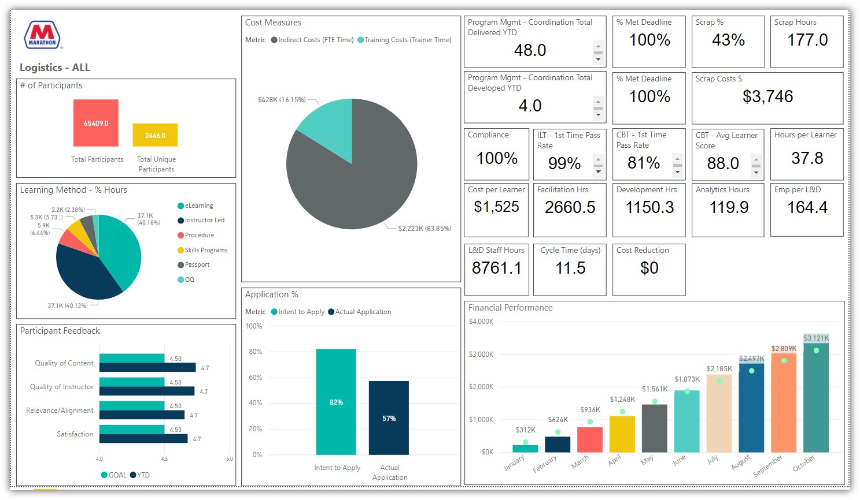
Typical Dashboard - Purpose: Inform

Slide 17
Typical Dashboard - Purpose: Monitor
Notes:
This is another view with color coding based on a rubric for performance

Slide 18
Program Evaluation Report - Purpose: Share evaluation results
One-off report
For sharing evaluation results of a program or initiative
The following elements are recommended:
  Goal or need to be addressed with context or background. Goal owner
  The proposed program with targets for key measures
  Results
  Lessons learned and opportunities for improvement

Slide 19
Sample Program Report for L&D - Purpose: Manage programs

Slide 20
Recommended Metrics
Recommendations consider the size of the organization, the needs of the
users, and best practice
By design, the recommendations are not customized for any one organization
  Consequently, the recommendations should be considered a starting point for consideration
  Individual circumstances, including priorities and measurement resources, will dictate the specific measures selected
The list of 19 metrics recommended for small/medium–sized organizations is a good place to start for all organizations.
  Larger organizations that already measure for the 19 can then proceed to the fuller list
The most metrics will always be recommended for the head of learning who has the greatest need

Slide 21
19 Metrics Are Recommended for Small/Medium -Sized Organizations
By user
  Senior leader: 8 metrics
  Group leader: 5 metrics
  Head of learning: 13 metrics
  Program manager: 7 metrics
  Learner: 4 metrics
By type of metric
  Outcome metrics: 0
  Efficiency metrics: 15
    All learning: 6
    Formal learning: 9
    Informal learning: 0
  Effectiveness metrics: 4
    Formal learning: 4
    Informal learning: 0

Slide 22
52 Metrics Are Recommended for Large Organizations
By user
  Senior leader: 19 metrics
  Group leader: 12 metrics
  Head of learning: 47 metrics
  Program manager: 11 metrics
  Learner: 12 metrics
By type of metric
  Outcome metrics: 3
  Efficiency metrics: 40
    All learning: 6
    Formal learning: 22
    Informal learning: 12
  Effectiveness metrics: 9
    Formal learning: 6
    Informal learning: 3

Slide 23
Example: Metrics Recommended for a Senior Leader in a Small/Medium – Sized Organization
Efficiency metrics
  Unique participants
  Total participants
  Percentage of employees reached by learning
  Percentage of employees with development plans
  Total cost of learning
  Average formal training hours
  Percentage of employees who have completed training on compliance and ethics
Effectiveness metrics
  Participant reaction

Slide 24
The Recommended Metrics for Large and Small/Medium – sized Organizations

Slide 25
ISO TS30437 Definitions
Definitions provided for all metrics, including formulas where needed
and often an example of their use
For example:

Slide 26
ISO TS30437 Sample Reports
Sample reports are provided for each user
For example:

Slide 27
Use the ISO Standard to Create Your Own Measurement and Reporting Strategy
Use the standard to establish a common language and framework in your department for metrics and reports
Begin to use the five types of users and four reasons to measure to identify the needs of the users. Share sample report formats with them so they can choose how they would like the data shared
Begin to use the metrics framework and selection guidance to recommend the most appropriate metrics for each user and for the department. Choose a balance of efficiency and effectiveness metrics. Add outcome metrics as appropriate
Begin to use the reporting framework and selection guidance to create the most appropriate reports for each user.

Slide 28
Summary
ISO TS30437 provides a framework for measurement and reporting as well as recommended metrics by user, type of metric, and size of organization
The standard also provides definitions, examples, and sample reports.
The hope is that this technical specification will provide the guidance and standardization necessary for organizations to significantly improve their L&D measurement and reporting.
Published in June 2023. Forty pages.
  Available at https://www.iso.org/standard/68714.html for CHF166 (about USD195)

Slide 29

Questions?
  Contact: Dave Vance, dave@roiinstitute.net
Resources
Click the link below or scan the QR code to access the PowerPoint from today’s session.
https://roiinstitute.net/the-first-standard-for-ld-metrics-is-here/

Slide 30
