Slide 1

L&D Value Creation: Quantifying the ROI in L&D Programs
Patti P. Phillips, Ph.D., CEO, ROI Institute, Inc.

Slide 2

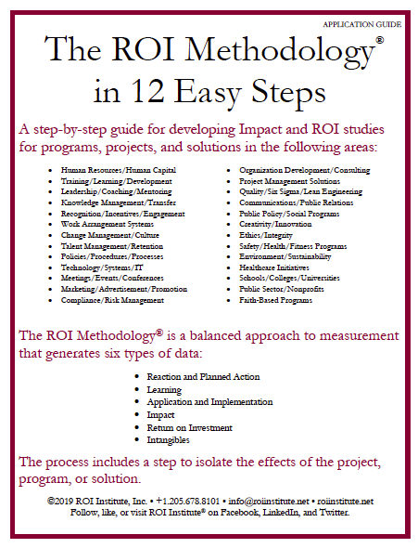
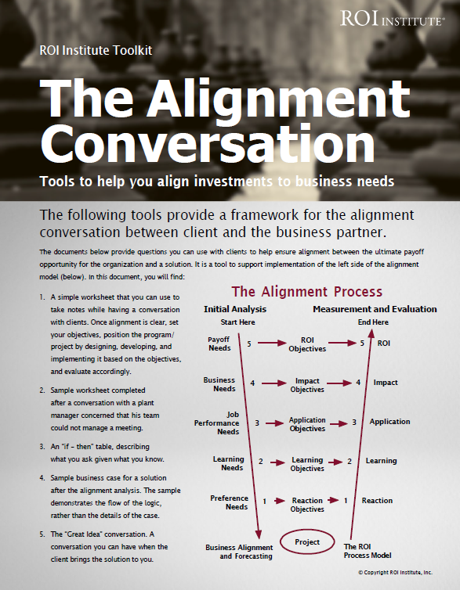



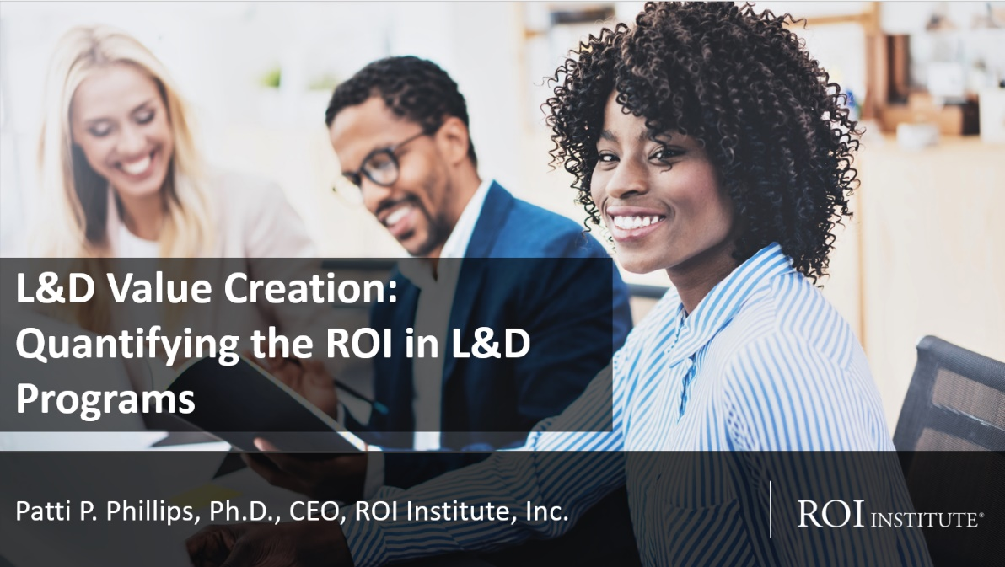
Resources
2

Slide 3





The Value of Chaplaincy
Approach
Action 01
*Skills required of a chaplain:
Excellent listening, communication and interpersonal skills in order to build and develop relationships with the people you are helping.
An understanding and willingness to engage with people of all cultures
*from prospects.ac.uk
Aligned chaplaincy with the needs of the business.
Action 02
Positioned chaplaincy integration in the ICU for success by developing clear objectives
Action 03
Business Needs
Results
Ensured buy-in and knowledge of process from ICU medical team, patient, and patient’s family
Length of stay (LOS) of patients in high-cost units such as the intensive care unit (ICU)
Patient satisfaction including that of the patient’s family members
Cost savings to hospital in one year due to the program $251,640
Ensured patient care
Improved family care
Secured future funding
Cost of solution: $33,800
ROI: 644%
Action 04
Collected data along the way. Compared LOS in ICU with chaplain integration to LOS in similar ICU settings without chaplain integration
3
Source: Doug Stewart, Chief Chaplain at Memorial Regional Health System in Belleville, Illinois. Featured in Phillips, P. P. and Phillips, J. J. (2023) Show the Value of What You Do. Oakland, CA: Berrett-Koehler Publishing.

Slide 4

If chaplains can create and demonstrate value for the work they do in terms that resonate with senior leaders, including ROI, what prevents L&D from doing the same?
4

Slide 5
Organizations that create and demonstrate value, begin with a framework of measures.
Levels of Evaluation | Measurement Focus | Typical Measures
0. Inputs & Indicators | The input into the project in terms of scope, volume, efficiencies, costs | Participants, Hours, Costs, Timing
1. Reaction & Planned Action | Measures participant satisfaction and captures planned actions, if appropriate | Relevance, Importance, Usefulness, Appropriateness, Intent to use, Motivation to take action
2. Learning & Confidence | Measures changes in knowledge, skills, and attitudes | Skills, Knowledge, Insight, Capacity, Competencies, Confidence, Contacts
3. Application & Implementation | Measures changes in behavior or actions | Extent of use, Task completion, Frequency of use, Actions completed, Success with use, Barriers to use, Enablers to use
4. Business Impact | Measures changes in business impact variables | Productivity, Revenue, Quality, Time, Efficiency, Customer satisfaction, Employee engagement, Carbon emissions, Social impact
5. Return on Investment | Compares project benefits to the costs | Benefit-Cost Ratio (BCR), ROI%, Payback period
@Phillips Five-Level Evaluation Framework. Copyright 1983-2023. All Rights Reserved.
Katzell developed four steps of training evaluation; Kirkpatrick wrote about four steps of training evaluation; Phillips added economic theory and operationalized the framework by adding process and standards and applying it in practice.
5

Slide 6
Use Impact and ROI selectively.
Level |  | Recommended % of Programs* | Benchmarking %**
0 | Input | 100% | 100%
1 | Reaction | 100% | 80%
2 | Learning | 80-90% | 70%
3 | Application | 30% | 49%
4 | Impact | 10% | 37%
5 | ROI | 5% | 18%
*Percentage of programs evaluated at each level each year
**Benchmarking 2020
6

Slide 7
Use Impact and ROI selectively.
Level |  | Recommended % of Programs* | Benchmarking %**
0 | Input | 100% | 100%
1 | Reaction | 100% | 80%
2 | Learning | 80-90% | 70%
3 | Application | 30% | 49%
4 | Impact | 10% | 37%
5 | ROI | 5% | 18%
*Percentage of programs evaluated at each level each year
**Benchmarking 2020
7

Slide 8
What is ROI?
ROI measures the amount of return relative to an investment.
It indicates the extent to which an organization uses its resources efficiently.
Program Benefits
Program Costs
BCR =
Program Benefits – Program Costs
Program Costs
ROI =
x 100
8

Slide 9

ROI Formula
$89,900
$75,600
BCR =
$89,900 - $75,600
$75,600
ROI =
x 100
9

Slide 10
ROI Formula
$89,900
$75,600
BCR =
= 1.19
$89,900 - $425,000
$75,600
ROI =
x 100 = 19%
10

Slide 11
Organizations that create and demonstrate value, begin with a framework of measures.
Levels of Evaluation | Measurement Focus | Typical Measures
0. Inputs & Indicators | The input into the project in terms of scope, volume, efficiencies, costs | Participants, Hours, Costs, Timing
1. Reaction & Planned Action | Measures participant satisfaction and captures planned actions, if appropriate | Relevance, Importance, Usefulness, Appropriateness, Intent to use, Motivation to take action
2. Learning & Confidence | Measures changes in knowledge, skills, and attitudes | Skills, Knowledge, Insight, Capacity, Competencies, Confidence, Contacts
3. Application & Implementation | Measures changes in behavior or actions | Extent of use, Task completion, Frequency of use, Actions completed, Success with use, Barriers to use, Enablers to use
4. Business Impact | Measures changes in business impact variables | Productivity, Revenue, Quality, Time, Efficiency, Customer satisfaction, Employee engagement
5. Return on Investment | Compares project benefits to the costs | Benefit-Cost Ratio (BCR), ROI%, Payback period
@Phillips Five-Level Evaluation Framework. Copyright 1983-2023. All Rights Reserved.
Katzell developed four steps of training evaluation; Kirkpatrick wrote about four steps of training evaluation; Phillips added economic theory and operationalized the framework by adding process and standards and applying it in practice.
11

Slide 12

Alignment Model
Start Here
End Here
Payoff Needs
5
ROI Objectives
5
ROI
Business Needs
4
Impact Objectives
4
Impact
Performance Needs
3
Application Objectives
3
Application
Learning Needs
2
Learning Objectives
2
Learning
Initial Analysis
Measurement and Evaluation
Preference Needs
1
Reaction Objectives
1
Reaction
0
0
Program Process Initiative
Alignment and Forecasting
The ROI Process Model

Slide 13
Alignment Model
Start Here
End Here
Payoff Needs
5
ROI Objectives
5
ROI
Why?
Business Needs
4
Impact Objectives
4
Impact
Performance Needs
3
Application Objectives
3
Application
Learning Needs
2
Learning Objectives
2
Learning
Initial Analysis
Measurement and Evaluation
Preference Needs
1
Reaction Objectives
1
Reaction
0
0
Program Process Initiative
Alignment and Forecasting
The ROI Process Model

Slide 14
Alignment Model
Start Here
End Here
Payoff Needs
5
ROI Objectives
5
ROI
Why?
Business Needs
4
Impact Objectives
4
Impact
Performance Needs
3
Application Objectives
3
Application
Feasible Solution
Learning Needs
2
Learning Objectives
2
Learning
Preference Needs
1
Reaction Objectives
1
Reaction
0
0
Program Process Initiative
Alignment and Forecasting
The ROI Process Model
14

Slide 15

The ROI Methodology Process Model
PLAN THE EVALUATION
COLLECT DATA
ANALYZE DATA
Make it Credible:
Capture Costs of
Program
OPTIMIZE RESULTS
LEVEL 0: INPUT
LEVEL 1: REACTION AND PLANNED ACTION
LEVEL 3:
APPLICATION
Start with Why:
Align Programs
With the
Business
Make it Feasible:
Select the Right
Solution
Expect
Success:
Plan for
Results
Make it Matter:
Design for Input,
Reaction and
Learning
Make it Stick:
Design for
Application
and Impact
Make it
Credible:
Isolate the
Effects of the Program
Make it Credible:
Convert Data to
Monetary Value
Make it Credible:
Calculate ROI
Optimize
Results:
Use Black Box
Thinking to
Increase
Funding
Tell the Story:
Communicate
Results to Key
Stakeholder
LEVEL 5: ROI
LEVEL 2: LEARNING
LEVEL 4: IMPACT
Make it Credible:
Identify Intangible Measures
INTANGIBLE BENEFITS
©2023 ROI Institute Inc. All Rights Reserved.
15

Slide 16
The ROI Methodology Process Model
PLAN THE EVALUATION
COLLECT DATA
ANALYZE DATA
Make it Credible:
Capture Costs of
Program
OPTIMIZE RESULTS
LEVEL 0: INPUT
LEVEL 1: REACTION AND PLANNED ACTION
LEVEL 3:
APPLICATION
Start with Why:
Align Programs
With the
Business
Make it Feasible:
Select the Right
Solution
Expect
Success:
Plan for
Results
Make it Matter:
Design for Input,
Reaction and
Learning
Make it Stick:
Design for
Application
and Impact
Make it
Credible:
Isolate the
Effects of the Program
Make it Credible:
Convert Data to
Monetary Value
Make it Credible:
Calculate ROI
Optimize
Results:
Use Black Box
Thinking to
Increase
Funding
Tell the Story:
Communicate
Results to Key
Stakeholder
LEVEL 5: ROI
LEVEL 2: LEARNING
LEVEL 4: IMPACT
Make it Credible:
Identify Intangible Measures
INTANGIBLE BENEFITS
©2023 ROI Institute Inc. All Rights Reserved.
16

Slide 17
The ROI Methodology Process Model
PLAN THE EVALUATION
COLLECT DATA
ANALYZE DATA
Make it Credible:
Capture Costs of
Program
OPTIMIZE RESULTS
LEVEL 0: INPUT
LEVEL 1: REACTION AND PLANNED ACTION
LEVEL 3:
APPLICATION
Start with Why:
Align Programs
With the
Business
Make it Feasible:
Select the Right
Solution
Expect
Success:
Plan for
Results
Make it Matter:
Design for Input,
Reaction and
Learning
Make it Stick:
Design for
Application
and Impact
Make it
Credible:
Isolate the
Effects of the Program
Make it Credible:
Convert Data to
Monetary Value
Make it Credible:
Calculate ROI
Optimize
Results:
Use Black Box
Thinking to
Increase
Funding
Tell the Story:
Communicate
Results to Key
Stakeholder
LEVEL 5: ROI
LEVEL 2: LEARNING
LEVEL 4: IMPACT
Make it Credible:
Identify Intangible Measures
INTANGIBLE BENEFITS
©2023 ROI Institute Inc. All Rights Reserved.
17

Slide 18


Collect Data Along the Way
Six-week virtual leadership development
Pre-program assessment including targeted business measures
Application data collected throughout
  System data
  Built in questionnaire (Qualtrics)
  Facilitator/moderator feedback
Post-program data collection
ROI Forecast 310%
Download the report: https://roiinstitute.net/report/

Slide 19
The ROI Methodology Process Model
PLAN THE EVALUATION
COLLECT DATA
ANALYZE DATA
Make it Credible:
Capture Costs of
Program
OPTIMIZE RESULTS
LEVEL 0: INPUT
LEVEL 1: REACTION AND PLANNED ACTION
LEVEL 3:
APPLICATION
Start with Why:
Align Programs
With the
Business
Make it Feasible:
Select the Right
Solution
Expect
Success:
Plan for
Results
Make it Matter:
Design for Input,
Reaction and
Learning
Make it Stick:
Design for
Application
and Impact
Make it
Credible:
Isolate the
Effects of the Program
Make it Credible:
Convert Data to
Monetary Value
Make it Credible:
Calculate ROI
Optimize
Results:
Use Black Box
Thinking to
Increase
Funding
Tell the Story:
Communicate
Results to Key
Stakeholder
LEVEL 5: ROI
LEVEL 2: LEARNING
LEVEL 4: IMPACT
Make it Credible:
Identify Intangible Measures
INTANGIBLE BENEFITS
©2023 ROI Institute Inc. All Rights Reserved.
19

Slide 20
The ROI Methodology Process Model
PLAN THE EVALUATION
COLLECT DATA
ANALYZE DATA
Make it Credible:
Capture Costs of
Program
OPTIMIZE RESULTS
LEVEL 0: INPUT
LEVEL 1: REACTION AND PLANNED ACTION
LEVEL 3:
APPLICATION
Start with Why:
Align Programs
With the
Business
Make it Feasible:
Select the Right
Solution
Expect
Success:
Plan for
Results
Make it Matter:
Design for Input,
Reaction and
Learning
Make it Stick:
Design for
Application
and Impact
Make it
Credible:
Isolate the
Effects of the Program
Make it Credible:
Convert Data to
Monetary Value
Make it Credible:
Calculate ROI
Optimize
Results:
Use Black Box
Thinking to
Increase
Funding
Tell the Story:
Communicate
Results to Key
Stakeholder
LEVEL 5: ROI
LEVEL 2: LEARNING
LEVEL 4: IMPACT
Make it Credible:
Identify Intangible Measures
INTANGIBLE BENEFITS
©2023 ROI Institute Inc. All Rights Reserved.
20

Slide 21
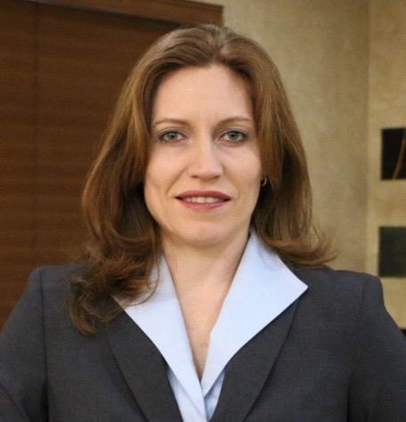
With more than 20 years of experience in the learning & development industry, Kaycee Buckley is Director for Global Commerical Talent. She works with organizational leaders to define talent development, strategies, develop and deploy learning events, and measure the business impact for these training initiatives.
Just wanted to let you know that I presented the Coaching ROI results to my DVP and the Area Commercial Directors last Thursday. It was AMAZING! They were surprised and not surprised by the results. That is, they were not surprised that the ROI was negative because they are all aware that the Sales Managers are not coaching and agreed with the barriers as I had outlined in the study. They were surprised at what a negative impact “not applying Coaching” was making to the business, which sparked a very productive conversation as to what to do to fix it.
Wow...such positive outcomes from my stakeholders...and with a negative ROI!
Tell your story. Optimize results.
21

Slide 22

Six Steps to Create and Demonstrate the Value of What You Do
Start with why
Select the right solution
Expect success with objectives
Collect data along the way
Analyze the data
Optimize the results

Slide 23

Remember, when it comes to showing value:
  Hope is not a strategy.
  Luck is not a factor.
  Doing nothing is not an option.
Change is inevitable.
Progress is optional.
23

Slide 24
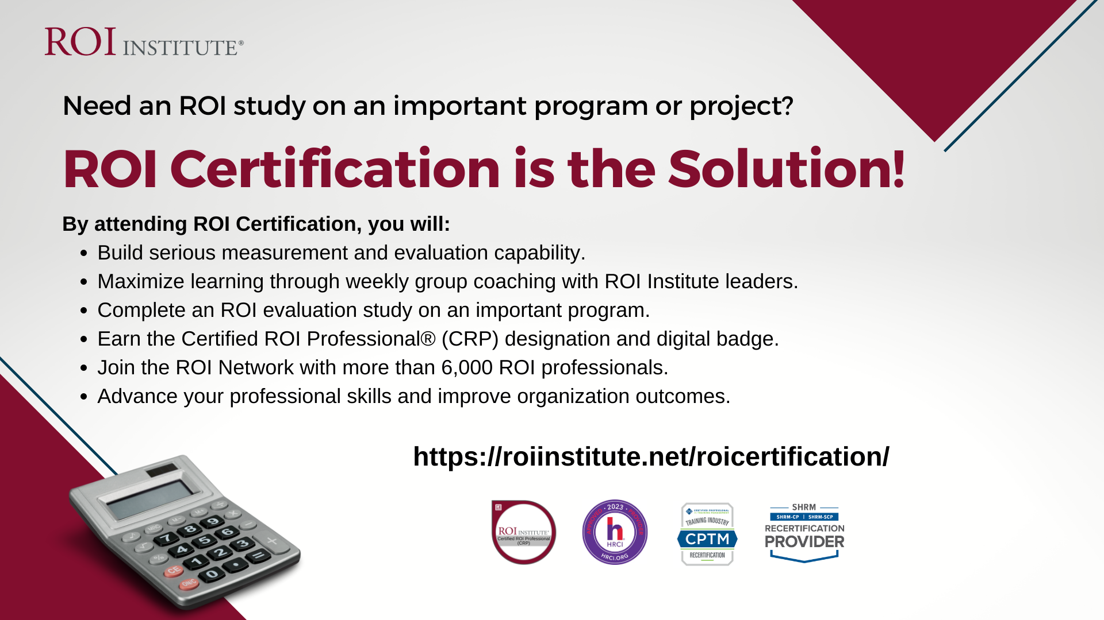


Slide 25




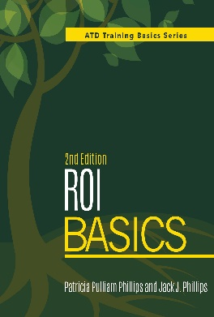



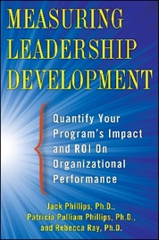

Patti P. Phillips, Ph.D.
Author, Educator, Consultant, Coach
CEO, ROI Institute, Inc.
Senior Advisor, The Conference Board
Chair, i4cp People Analytics Board
Member, International Federation of Training and Development Board
Vice Chair, UN Institute for Training and Research Board of Trustees
Chair, Center for Talent Reporting Board
Fellow, ATD Certified Professional in Talent Development
Author of these books and more.
https://www.linkedin.com/in/pattipphillips/

Slide 26

How Much?
Collect Data Along the Way
26

Slide 27
*Survey of Users, N = 246
Data Collection Methods
27

Slide 28

What’s it worth?
Analyze the Data
28

Slide 29

*Survey of Users, N = 246
Isolate Program Effects
29

Slide 30
*Survey of Users, N = 246
Convert Impact Measures to Money
30

Slide 31

Adaptability
Awards
Belonging
Brand awareness
Career-minded
Caring
Collaboration
Communication
Conflict
Corporate social
responsibility
Decisiveness
Engagement
Image
Innovation
Job satisfaction
Leadership
Networking
Organizational climate
Organizational commitment
Reputation
Stress
Talent
Teamwork
Report Intangible Benefits

Slide 32

Account for Fully-Loaded Costs
“When in doubt, put it in.”
The process should withstand even the closest scrutiny in terms of its credibility.
DIRECT
INDIRECT
Program materials
Instructor/facilitator
Facilities
Travel, lodging, meals
Needs assessment (Prorated)
Program development (Prorated)
Participant time (salaries & benefits)
Administrative/overhead
Evaluation
32

