Slide 1


Value for Money:
How the ROI Methodology Shows the Impact and ROI for all Types of Projects and Programs
Presented by Jack J. Phillips, Ph.D., Chairman, ROI Institute, Inc.

Slide 2

Objectives
After attending this session, participants should be able to:
Explain the need for an improved logic model.
Identify the key characteristics of the ROI Methodology.
Explain why and how the ROI Methodology was developed.
List the advantages of using the ROI Methodology.
Describe different applications of the ROI Methodology.

Slide 3

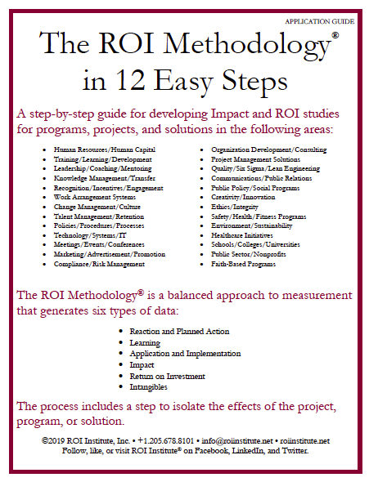

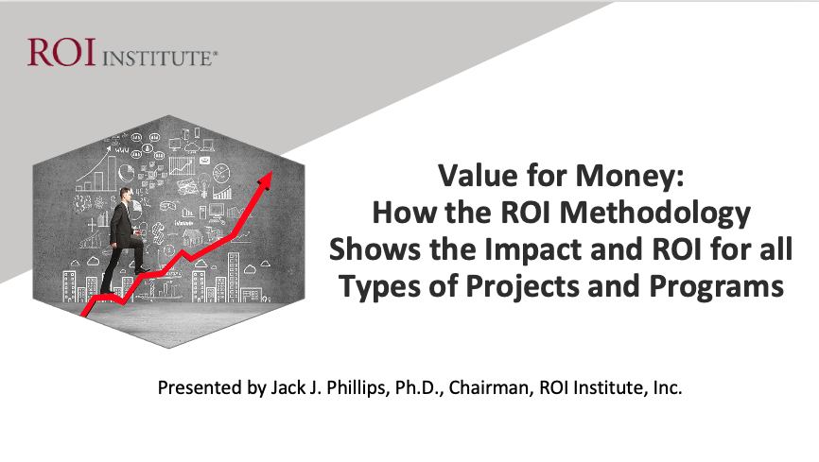
Resources

Slide 4


Organizations are Facing Many Problems
Projects Falter
Systems Fail
Programs are disappointing
Initiatives are unsuccessful
Events miss the mark
Innovation doesn't deliver

Slide 5



IT Failures are Expensive
$50bn - $150bn
PwC found that IT failures cost the US economy about $50 to $150 billion annually.

Slide 6

According to Harvard Business Review, by 2027, some 88 million people worldwide will likely be working in project management, and the value of project-oriented economic activity will have reached $20 trillion.
But research shows that only 35% of the projects undertaken worldwide are successful—which means we’re wasting an extravagant amount of time, money, and opportunity.
Project Management Failures
$611 billion dollars per year.

Slide 7



According to a study by the Future Foundation and reported in Inc. Magazine, the US is devoting $105 billion a year to correcting problems associated with poor hiring and people management practices. This shortfall is worth about 1% of the total US GDP.
$105 Billion per year
HR Failures Are Expensive.
$611 billion dollars per year.
The reason for this failure is that businesses waste the talent and potential of their workforces and fail to match the right people to the right jobs.

Slide 8




The Solution
Projects must be: Designed for impact
Projects must be: Delivered for success
Projects must be:
Evaluated for improvement
Projects must be:
Optimized to influence funding
The ROI Methodology tackles all four issues.

Slide 9
The Value Chain is Always There!
 | LEVEL | ISSUE | MEASURES | TARGETS†
This is easy Always measured | 0 | Inputs | Volume, Hours, Convenience, Cost | 100%
This is easy Almost always measured | 1 | Reaction | *Relevance, Engaging, *Important, Useful, *New Content, *Intent to Use, *Recommend to Others | 100%
Not difficult Usually measured | 2 | Learning | Concepts, Trends, Facts, Contacts, Skills, Competencies | 90%
Possible Often measured | 3 | Application | Use of content, Frequency of Use, Success with Use, Barriers, Enablers | 30%
Not so difficult to connect Sometimes measured | 4 | Impact | Productivity, Time, Quality, Costs, Image, Reputation, Engagement, Compliance | 10%
Possible for many programs Rarely measured | 5 | ROI | Benefit Cost Ratio or Return on Investment, Expressed as a Percent | 5%
*Can predict
Must take a step to isolate the effects
Executives prefer
† Best Practice: Percent of Programs Evaluated at this level each year.
9

Slide 10

What is ROI?
Program Benefits
Costs
BCR =
Benefits - Costs
Costs
ROI =
x 100
10

Slide 11

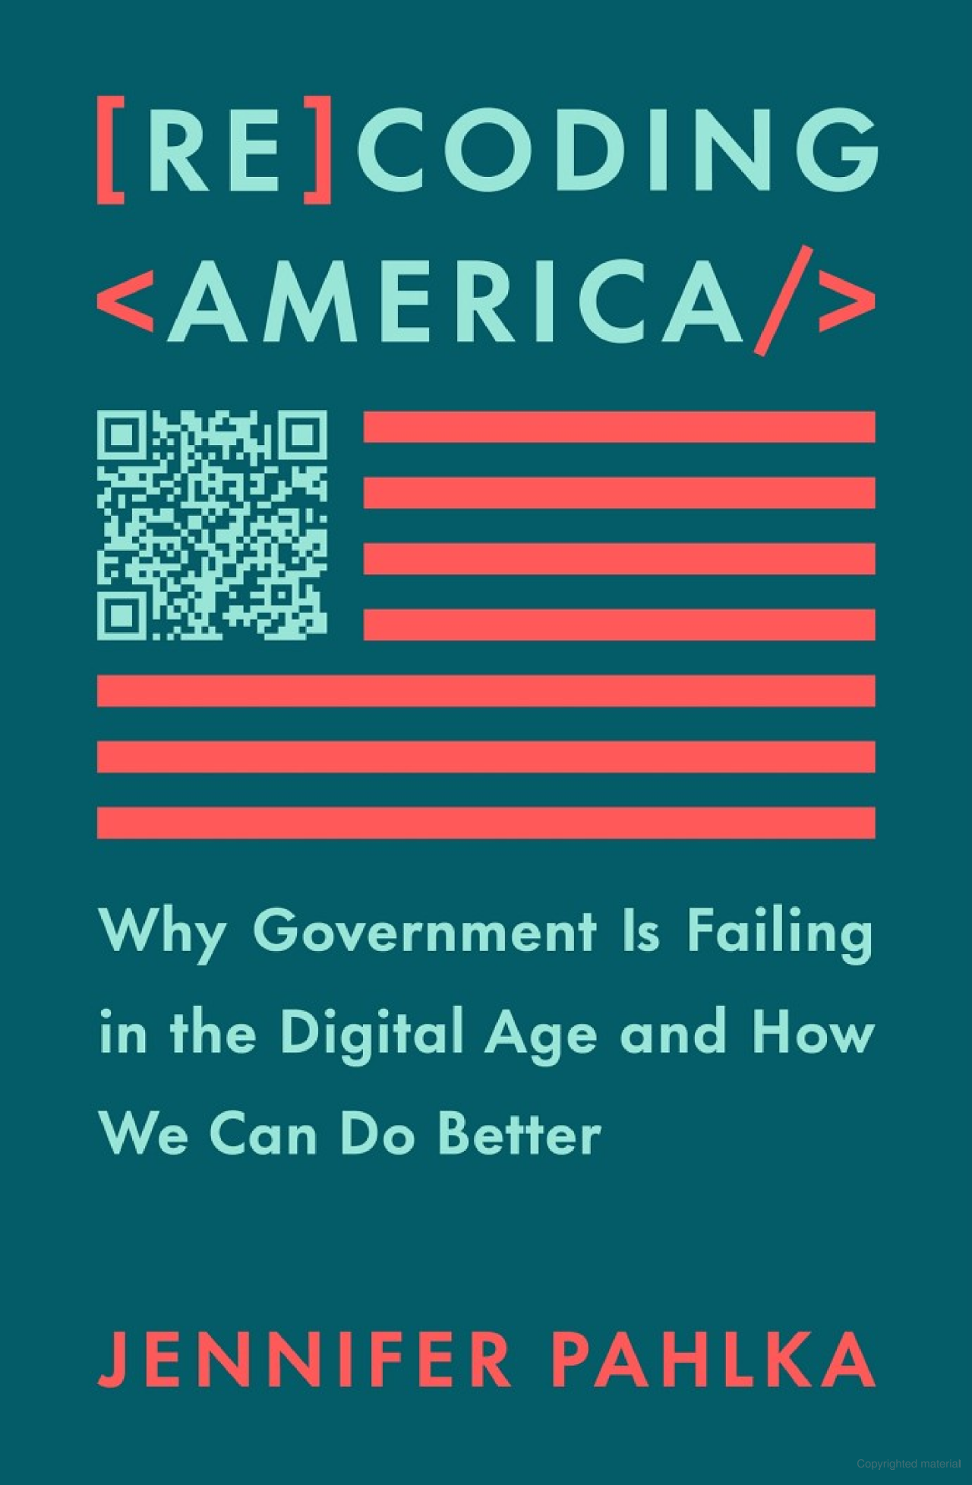
Pressures Facing the Public Sector Today
Budget constraints
Need to do more with less
Need process improvements (effectiveness and efficiency)
Need to show value of projects and programs
Need for public accountability and transparency
11
11

Slide 12

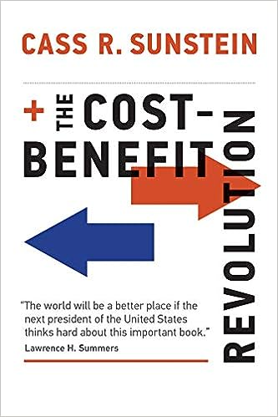
Issues — Real or Imagined?
No profits — no ROI? Lack of alignment Absence of hard data Too much politics Programs are necessary Multiple ROI Perspectives

Slide 13

Concerns about Current Models
Lack of Focus on Benefit-Cost Analysis
Lack of Emphasis on Attribution
Unclear Timing of Data Collection
Not CEO- and CFO-Friendly (Top Executive)
Lack of Focus on Process Improvement
The Inability to Influence Investment

Slide 14
The ROI Methodology® Process Model
Designing for the Delivery of Business Results
PLAN THE EVALUATION
COLLECT DATA
ANALYZE DATA
Make it Credible:
Capture Costs of
Program
OPTIMIZE RESULTS
LEVEL 0: INPUT
LEVEL 1: REACTION AND PLANNED ACTION
LEVEL 3:
APPLICATION
Optimize Results:
Use Black Box
Thinking to
Increase Funding
Start with Why:
Align Programs
with the
Business
Make it Feasible:
Select the Right
Solution
Expect
Success:
Plan for
Results
Make it Matter:
Design for Input,
Reaction and
Learning
Make it Stick:
Design for
Application
and Impact
Make it
Credible:
Isolate the
Effects
of the
Program
Make it Credible:
Convert Data to
Monetary Value
Tell the Story:
Communicate
Results to Key
Stakeholders
Make it Credible:
Calculate ROI
LEVEL 5: ROI
LEVEL 2: LEARNING
LEVEL 4: IMPACT
Make it Credible:
Identify Intangible Measures
INTANGIBLE BENEFITS
©1995-2023 ROI Institute Inc. All Rights Reserved.
14

Slide 15

What is your experience with measuring ROI?
(Select all that apply.)
No experience with it.
It has been suggested, but no action has been taken.
I have attempted it.
I have successfully conducted an ROI study.
I have successfully conducted many ROI studies.
I wish ROI would go away.
15

Slide 16

Application of This Methodology
Publicly traded businesses Privately held businesses Governments (federal, state, and local level) Nongovernment organizations Nonprofits Universities Community colleges and technical institutes | K-12 school systems Foundations Charities Healthcare organizations Networks and alliances Associations Religious organizations
16
16

Slide 17

Twelve Guiding Principles of ROI
When conducting a higher-level evaluation, collect data at lower levels.
When planning a higher-level evaluation, the previous level of evaluation is not required to be comprehensive.
When collecting and analyzing data, use only the most credible sources.
When analyzing data, select the most conservative alternative for calculations.
Use at least one method to isolate the effects of a project.
If no improvement data are available for a population or from a speciﬁc source, assume that little or no improvement has occurred.
Adjust estimates of improvement for potential errors of estimation.
Avoid use of extreme data items and unsupported claims when calculating ROI.
Use only the ﬁrst year of annual beneﬁts in ROI analysis of short-term solutions.
Fully load all costs of a solution, project, or program when analyzing ROI.
Intangible measures are deﬁned as measures that are purposely not converted to monetary values.
Communicate the results of ROI Methodology to all key stakeholders.
17

Slide 18
Measurement Targets
Level |  | Recommended % of Programs | **Benchmarking %
0 | Input | 100% | 100%
1 | Reaction | 100% | 80%
2 | Learning | 80-90% | 70%
3 | Application | 30% | 49%
4 | Impact | 10% | 37%
5 | ROI | 5% | 18%
*Percentage of programs evaluated at each level each year
**Benchmarking 2020
What is your status?
18
Notes:
SALLY

Slide 19







Cost of the program
Linkage of program to operational goals and issues
Characteristics of Programs Suitable for Impact & ROI
Importance of program to strategic objectives
Top executive interest in the evaluation
Visibility of the program
Size of target audience
Investment of time required
19

Slide 20
A Sample of ROI Studies
The British Columbia Interior Health System calculated the ROI for a new procedure for colorectal surgery.
The Ministry of Education in Dubai calculated ROI for implementing a model classroom program.
Memorial Regional Hospital System measured the ROI on using chaplains in the intensive care unit.
A major U.S. city calculated the ROI for investing in housing to reduce the number of homeless citizens.
The Australian Capital Territory Community Care agency forecasted the ROI for implementing a client relationship management system.
The Healthy Living Group in Alberta’s healthcare system developed the ROI for a smoking cessation program for citizens under the age of 35.

Slide 21
A Sample of ROI Studies Continued
Intermountain Health Services conducted an ROI study on workplace violence reduction programs.
An NGO has developed the impact and ROI for a new law to make domestic violence illegal in Kazakhstan.
The National Security Agency calculated the ROI for a master’s degree offered to high-potential employees.
The United Nations Security Department calculated the ROI for providing police training in Malaysia.
The U.S. Air Force calculated the ROI for implementing procedures to prevent an intrusion into a database.
The U.S. Veterans Administration uses the ROI Methodology process to measure the success and impact of dozens of training and educational programs.

Slide 22

This Methodology is Documented
in over 75 book and 300 articles

Slide 23

Start with Why
Align Programs with the Business
Design Thinking Principle 1
A problem-solving approach to handle problems on a systems levels
Alignment is the key.
Is it a problem or opportunity?
Need specific business measures.
23

Slide 24
The Alignment Process: V-Model
Start Here
End Here
Payoff Needs
5
ROI Objectives
5
ROI
Business Needs
4
Impact Objectives
4
Impact
Performance Needs
3
Application Objectives
3
Application
Learning Needs
2
Learning Objectives
2
Learning
Preference Needs
1
Reaction Objectives
1
Reaction
Input Needs
0
Input Objectives
0
Inputs
Program Process Initiative
Alignment and Forecasting
The ROI Process Model
24

Slide 25

Make It Feasible
Select the Right Solution
Design Thinking Principle 2
A mind-set for curiosity and inquiry
  What are we doing (or not doing) that’s influencing the business measure?
  How can we achieve this performance?
25

Slide 26

Is it the Right Solution?
Examine the data and records.
Initiate the discussion.
Reference a case study.
Use benchmarking from similar solutions.
Use evaluation as the hook.
Involve others in the discussion.
Discuss disasters in other places.
Conduct an analysis of problem.
26

Slide 27

Expect Success
Design for Results
Design Thinking Principle 3
A framework to balance needs and feasibility
  Set objectives at multiple levels
  Redefine success of program
  Expand responsibilities
27

Slide 28

Rules for Objectives
Must be measurable and represent minimum acceptable performance.
Fewer objectives are better than many objectives.
Involve subject-matter experts and key stakeholders.
Keep them relevant to the situation, program, and key stakeholders.
Create stretch objectives, but make sure they are achievable.
Allow for the flexibility to change as conditions change.
Failure is OK; process improvement is the key.
Objectives are tools for progress, not weapons for performance review.
Most objectives should be time-bound.
Objectives provide the focus for design, development, implementation, and evaluation.
These rules are from a combination of publications:
J. J. Phillips and P. P. Phillips. Beyond Learning Objectives: Develop Measurable Objectives that Link to the Bottom Line. Alexandria, VA: ASTD Press. 2008.
P. P. Phillips and J. J. Phillips. 10 Steps to Successful Business Alignment. Alexandria, VA: ASTD Press. 2012.
J. Doerr. Measure What Matters: How Google, Bono, and the Gates Foundation Rock the World with OKRs. New York: Penguin. 2018.
28

Slide 29
After completing this program, participants should:
Matching Evaluation Levels with Objectives
1. | Decrease citizen complaints by 20% in one year.
2. | Use problem-solving skills to uncover causes of problems.
3. | Be able to demonstrate the five steps to determine if there is a food security issue.
4. | Rate the facilitator 4 out of 5 on presentation skills.
5. | Decrease the amount of time required to develop a proposal by 25%.
6. | Achieve a 20% ROI one year after program implementation.
7. | Perceive the Crime Prevention Program to be relevant to the community (4.5 out of 5).
8. | Decrease security breaches by 25% in six months.
9. | Conduct a proper investigation using the seven-step process in 95% of complaint situations.
10. | Score an average of 20 or better on AIDS Awareness quiz.
11. | Complete a conflict-of-interest questionnaire each year as part of the new ethics policy.
12. | Use all 10 negotiation skills in at least 50% of negotiation situations.
1 = Reaction 2 = Learning 3 = Application 4 = Impact 5 = ROI
29

Slide 30

Focus on the objectives
Think about the definition of success
Make it relevant
Make it important
Make it action-oriented
Make it Matter
Design for Input, Reaction,
and Learning
Design Thinking Principle 4
A way to take on design challenges by applying empathy

Slide 31

Make it Stick
Design for Application and Impact
Design Thinking Principle 5
A culture that fosters exploration
and experimentation
Collect data
Focus on objectives
Ensure transfer to the workplace
Design for application

Slide 32

Make it Credible
Measure Results and Calculate ROI
Design Thinking Principle 6
A fixed process and a tool kit
Isolating the effects of the program
Converting Impact data to money
Identifying intangible benefits
Tabulating cost of the program
Calculating ROI
32

Slide 33

Isolation Methods
*Survey of Users, N = 246

Slide 34
Data Conversion Methods
*Survey of Users, N = 246
34

Slide 35
Common Intangibles
Agility
Ambiguity
Alliances
Awards
Brand
Burnout
Capability
Capacity
Carbon emissions
Clarity
Collaboration
Communication
Compassion
Happiness
Human Life
Image
Intellectual capital
Job satisfaction
Leadership effectiveness
Loyalty
Mindfulness
Mindset
Net promoter score
Networking
Organizational commitment
Partnering
Complexity
Compliance
Conflict
Corporate social responsibility
Creativity
Culture
Customer service
Decisiveness
Emotional intelligence
Employee attitudes
Engagement
Food security
Grit
Patient satisfaction
Poverty
Reputation
Risk
Social Capital
Stress
Sustainability
Team Effectiveness
Timeliness
Trust
Uncertainty
Volatility
Work/life balance

Slide 36


“When in doubt, put it in.”
Fully-Loaded Costs
The process should withstand even the closest scrutiny in terms of its credibility.
DIRECT
INDIRECT
Project materials
Facilitator
Facilities
Travel, lodging, meals
Needs assessment (Prorated)
Program development (Prorated)
Participant time (salaries & benefits)
Administrative/overhead
Evaluation
36

Slide 37
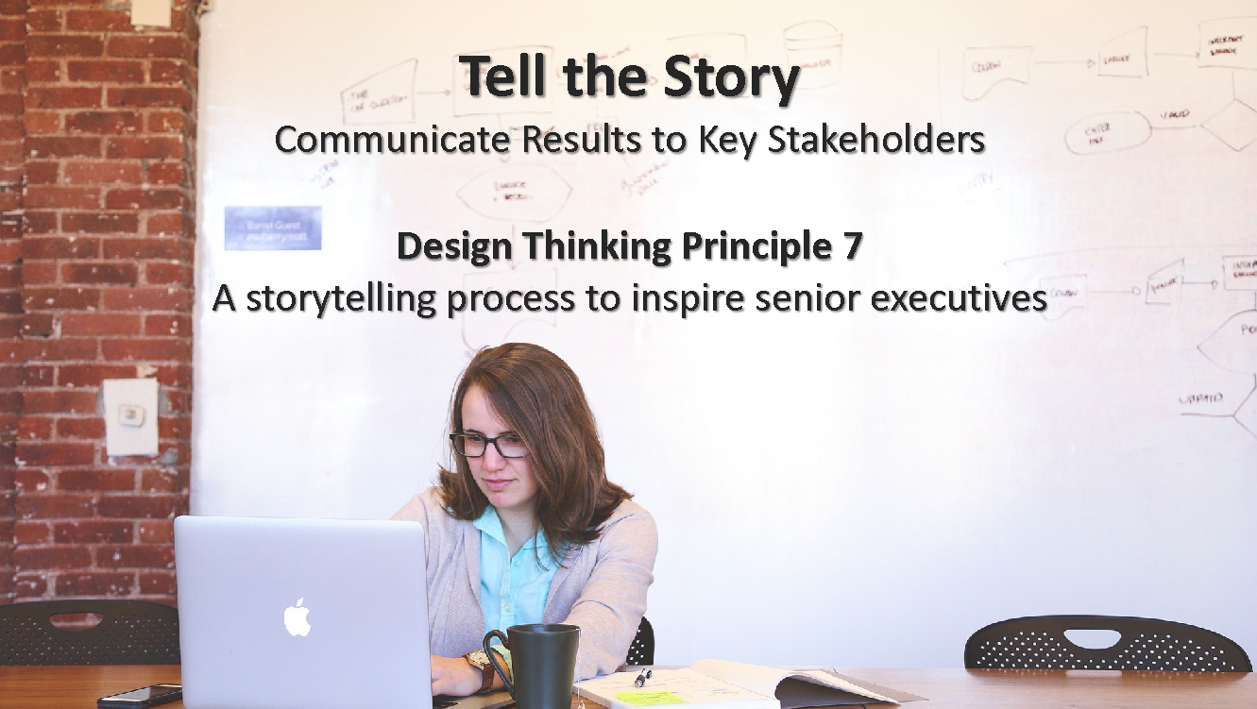
Tell the Story
Communicate Results to Key Stakeholders
Design Thinking Principle 7
A storytelling process to inspire senior executives
Define audience
Identify why they need it
Select method
Move quickly
Consider one-page summary
37

Slide 38

Optimize Results
Use Black Box Thinking to Increase Funding
Design Thinking Principle 8
A new competitive logic of business strategy
EVALUATION
OPTIMIZATION
ALLOCATION
Measure
Improve
Fund
38

Slide 39
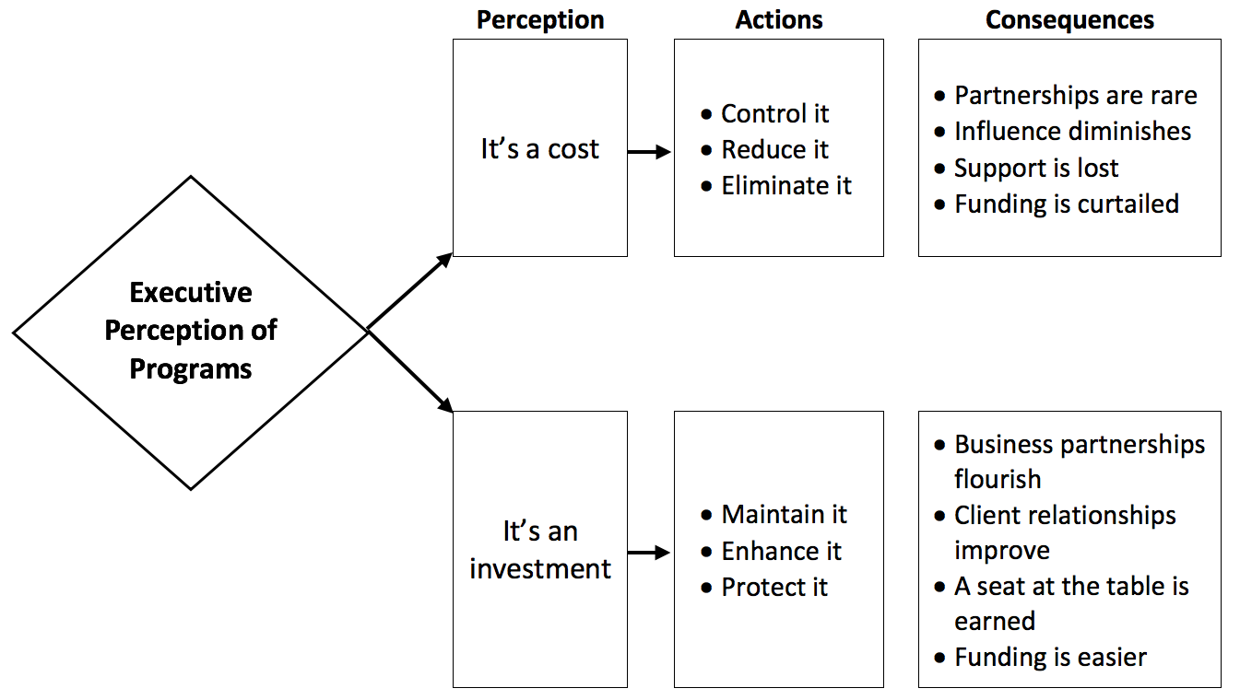
Cost vs. Investment Perception: The Reality
How do your leaders view your programs? Costs or investments?
39

Slide 40

What are your concerns about measuring ROI?
(Select all that apply.)
It’s too difficult.
It takes took much time.
No one is asking for this.
It will kill my programs.
I wish It would go away.
40

Slide 41

The Payoff
Justify/defend budgets.
Align projects to business needs.
Show contributions of selected projects.
Earn respect of senior management/administrators.
Build staff morale.
Improve support for projects.
Enhance design and implementation processes.
Identify inefficient projects that need to be redesigned or eliminated.
Identify successful projects that can be implemented in other areas.
Earn a “seat at the table”.

Slide 42

Be Proactive
Remember, when it comes to delivering results:
  Hope is not a strategy.
  Luck is not a factor.
  Doing nothing is not an option.
Change is inevitable.
Progress is optional.
42

Slide 43

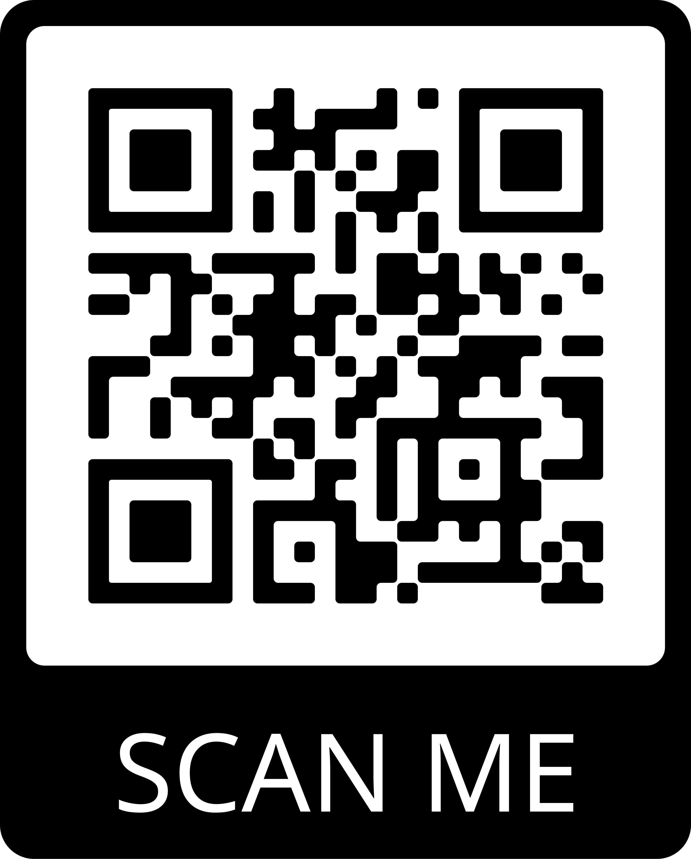
Click the link below or scan the QR code to receive resources from today’s session.
https://roiinstitute.net/mitre-value-for-money/

Slide 44




Questions?
Visit us online:
www.roiinstitute.net
Email:
Jack@roiinstitute.net
Connect with Us

