Slide 1



Demonstrating the Impact of Capacity Development
Katinka Koke, Specialist, Planning, Performance Monitoring and Evaluation Unit, Division for Strategic Planning and Performance
Patti P. Phillips, Ph.D.
CEO, ROI Institute, Inc.

Slide 2

UNEG Interest Group on Evaluating Capacity Development (CDIG) Guidance Documents
Individual dimension relates to the people in the concerned development sector in terms of: knowledge, skill levels (technical and managerial), competencies, attitudes, behaviours and values that can be addressed through facilitation, training and competency development.
Organizational dimension relates to public and private organizations, civil society organizations, and networks of organizations involved in the concerned development sector in terms of: i) strategic management functions, structures and relationships; ii) operational capacity (processes, systems, procedures, sanctions, incentives and values); iii) human and financial resources (policies, deployment and performance); iv) knowledge and information resources; and v) infrastructure.
Enabling environment dimension refers to the context in which individuals and organizations work, including the political commitment and vision; policy, legal and economic frameworks and institutional set-up in the country; national public sector budget allocations and processes; governance and power structures; incentives and social norms; power structures and dynamics.
Source: FAO: Capacity development dimensions (FAO Strategy on CD, 2010):
2

Slide 3
Some Context
In 2019, the UNEG Interest Group on Evaluating Capacity Development was created following FAO’s and UNITAR’s interest.
The main output of the group: Guidance document for Evaluating Capacity Development;
2020 EPE session on Evaluating Capacity Development;
In 2023 the group was incorporated into the UNEG Methods Working Group;
3

Slide 4
Capacity Development Defined
Capacity Development Level | Sample Evaluation Questions
Individual | To what extent did the constituents display improvements in capacities (increased knowledge, skills, and practices)
Organisational | To what extent did capacity development reach sufficient constituents to enable institutional change?
Enabling Environment | To what extent did the organization deliver on its capacity development plan? To what extent did the capacity development reinforce the ability of constituents to use the results of the programme/project?
Source: ILO Guidance Note 3.4: Evaluation of Capacity Developing in ILO Programmes and Projects
4

Slide 5

Objectives
During this session, we will discuss:
  Five components of the evaluation puzzle.
  Twelve steps in the ROI Methodology®.
  How organizations apply the ROI Methodology to capacity-development interventions.
  How to use results to influence the enabling environment that supports successful capacity-development implementation.
5

Slide 6

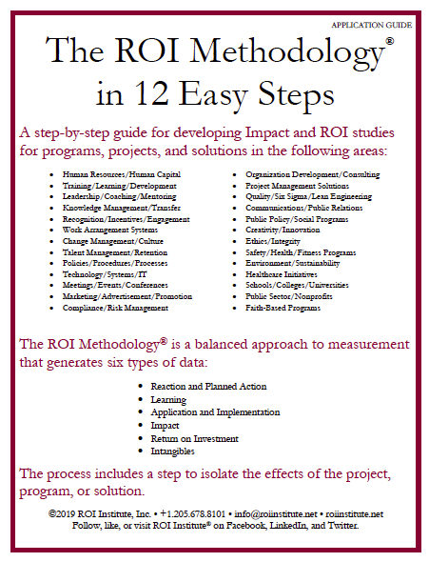
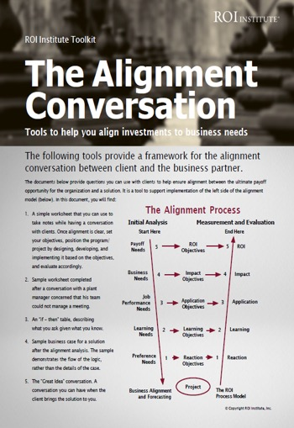


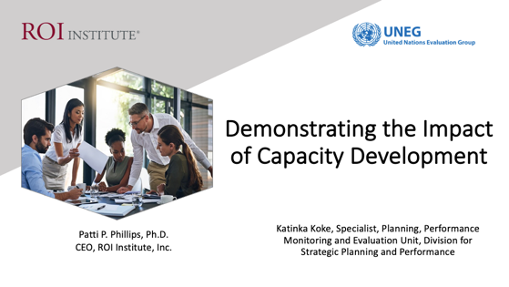
Resources
Participants in today’s webinar will receive a copy of the book, Value for Money. Scan the QR code for details.
6

Slide 7

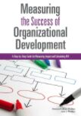

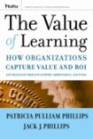




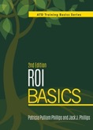











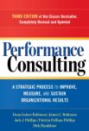
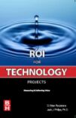


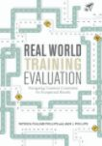
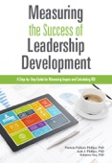

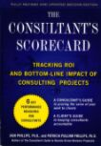
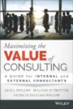
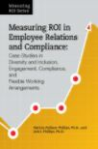





Case studies describing the use of the ROI Methodology in capacity development efforts and other interventions are available in a variety of books.
There are more than 75 publications to support the ROI Methodology.
7

Slide 8
Why is there interest in demonstrating the impact in capacity development interventions?
Enter Your Response in Chat
Possible responses:
Executives or donors require it. My office/organization must pursue this.
My office/organization will need to demonstrate more value beyond learning outcomes in the future.
My office/organization wants to show increased accountability for our expenditures.
My office/organization wants to explore new techniques to measure program success.
*Intervention can also be a:
Solution
Programme
Thematic programme
Country programme
8
8

Slide 9
Evaluation Framework
Levels of Evaluation | Measurement Focus | Typical Measures
0. Inputs | The input into the intervention in terms of scope, volume, efficiencies, costs | Participants, Hours, Costs, Timing
1. Reaction & Planned Action | Measures participant satisfaction and captures planned actions, if appropriate | Relevance, Importance, Usefulness, Appropriateness, Intent to use, Motivation to act
2. Learning | Measures changes in knowledge, skills, insights and attitudes | Skills, Knowledge, Capacity, Competencies, Confidence, Contacts
3. Application & Implementation | Measures changes in behavior or actions | Extent of use, Task completion, Frequency of use, Actions completed, Success with use, Barriers to use, Enablers to use
4. Impact | Measures changes in impact variables | Productivity, Quality, Time, Efficiency, Cost Savings, Beneficiary Satisfaction, Community Health and Development, Recovery Rate
5. ROI | Compares intervention benefits to the costs | Benefit-Cost Ratio (BCR), ROI%, Payback Period
Raymond Katzell developed four steps of training evaluation; Donald Kirkpatrick wrote about four steps of training evaluation; Jack J. Phillips changed the focus of Level 3 to include other measures of application and implementation along with enabling factors, changed Level 4 to include a focus on attribution, and added economic theory leading to Level 5 ROI. More importantly, he operationalized the framework by adding process and standards and applying it in practice.
9

Slide 10

BCR and ROI Formula
Intervention Benefits
Intervention Costs
Benefit Cost Ratio =
=
Intervention Benefits – Intervention Costs
Intervention Costs
ROI =
x 100 =
*Intervention might be a single event or other solution, programme, thematic programme, or country programme.
10

Slide 11

ROI Example
$750,000
$425,000
Benefit Cost Ratio =
=
$750,000 - $425,000
$425,000
ROI =
x 100 =
Reduce Safety Incidents (1st year) = $750,000
Program Cost (25 participants) = $425,000
11

Slide 12
ROI Example
$750,000
$425,000
Benefit Cost Ratio =
= 1.76
$750,000 - $425,000
$425,000
ROI =
x 100 = 76%
Reduce Safety Incidents (1st year) = $750,000
Program Cost (25 participants) = $425,000
12

Slide 13
To what level do you evaluate capacity development interventions*?
Chat Your Response
Inputs and Activities
Reaction
Learning
Application
Impact
BCR and ROI
*Intervention can also be a:
Solution
Programme
Thematic programme
Country programme
13
13

Slide 14
The Value Chain
 | LEVEL | ISSUE | MEASURES | TARGETS*
This is easy Always measured | 0 | Inputs | Volume, Hours, Convenience, Cost | 100%
This is easy Almost always measured | 1 | Reaction | *Relevance, Engaging, *Important, Useful, *New Content, *Intent to Use, *Recommend to others | 100%
Not difficult Usually measured | 2 | Learning | Concepts, Trends, Facts, Contacts, Skills, Competencies | 90%
Possible Often measured | 3 | Application | Use of content, Frequency of use, Success with use, Actions taken, Policies implemented, Barriers, Enablers | 30%
Not so difficult to connect Sometimes measured | 4 | Impact | Productivity, Time, Quality, Costs, Image, Reputation, Engagement, Compliance, False rejects, Rework, Health, Safety incidents | 10%
Possible for many interventions Rarely measured | 5 | ROI | Benefit-Cost ratio or Return on Investment, expressed as a percent | 5%
*Can Predict
Must take a step to isolate the effects
Executives prefer
*Best practice targets.
14
14

Slide 15
Characteristics
of Investments Suitable for
Impact & ROI
Life cycle of the intervention
Linkage of intervention to operational goals
Importance of intervention to strategic objectives
Top administrator interest in the evaluation
Cost of the intervention
Visibility of the intervention
Size of target audience
Investment of time required
15

Slide 16
The framework is the first piece of the evaluation puzzle.
An Evaluation
Framework
Case Applications
and Practices
Implementation
Operating Standards and Philosophy
A Process
Model
16

Slide 17

The ROI Methodology Process Model
Designing for the Delivery of Business Results
PLAN THE EVALUATION
COLLECT DATA
ANALYZE DATA
Make it Credible:
Capture Costs of
Program
OPTIMIZE RESULTS
LEVEL 0: INPUT
LEVEL 1: REACTION AND PLANNED ACTION
LEVEL 3:
APPLICATION
Start with Why:
Align Programs
With the
Business
Make it Feasible:
Select the Right
Solution
Expect
Success:
Plan for
Results
Make it Matter:
Design for Input,
Reaction and
Learning
Make it Stick:
Design for
Application
and Impact
Make it
Credible:
Isolate the
Effects
of the
Program
Make it Credible:
Convert Data to
Monetary Value
Make it Credible:
Calculate ROI
Optimize
Results:
Use Black Box
Thinking to
Increase
Funding
Tell the Story:
Communicate
Results to Key
Stakeholder
LEVEL 5: ROI
LEVEL 2: LEARNING
LEVEL 4: IMPACT
Make it Credible:
Identify Intangible Measures
INTANGIBLE BENEFITS
©2023 ROI Institute Inc. All Rights Reserved.
17

Slide 18
The ROI Methodology Process Model
Designing for the Delivery of Business Results
PLAN THE EVALUATION
COLLECT DATA
ANALYZE DATA
Make it Credible:
Capture Costs of
Program
OPTIMIZE RESULTS
LEVEL 0: INPUT
LEVEL 1: REACTION AND PLANNED ACTION
LEVEL 3:
APPLICATION
Start with Why:
Align Programs
With the
Business
Make it Feasible:
Select the Right
Solution
Expect
Success:
Plan for
Results
Make it Matter:
Design for Input,
Reaction and
Learning
Make it Stick:
Design for
Application
and Impact
Make it
Credible:
Isolate the
Effects
of the
Program
Make it Credible:
Convert Data to
Monetary Value
Make it Credible:
Calculate ROI
Optimize
Results:
Use Black Box
Thinking to
Increase
Funding
Tell the Story:
Communicate
Results to Key
Stakeholder
LEVEL 5: ROI
LEVEL 2: LEARNING
LEVEL 4: IMPACT
Make it Credible:
Identify Intangible Measures
INTANGIBLE BENEFITS
©2023 ROI Institute Inc. All Rights Reserved.
18

Slide 19

Alignment Model
Start Here
End Here
Payoff Needs
5
ROI Objectives
5
ROI
Business Needs
4
Impact Objectives
4
Impact
Performance Needs
3
Application Objectives
3
Application
Learning Needs
2
Learning Objectives
2
Learning
Initial Analysis
Measurement and Evaluation
Preference Needs
1
Reaction Objectives
1
Reaction
0
0
Program Process Initiative
Alignment and Forecasting
The ROI Process Model

Slide 20
Alignment Model
Start Here
End Here
Payoff Needs
5
ROI Objectives
5
ROI
Why?
Business Needs
4
Impact Objectives
4
Impact
Performance Needs
3
Application Objectives
3
Application
Learning Needs
2
Learning Objectives
2
Learning
Initial Analysis
Measurement and Evaluation
Preference Needs
1
Reaction Objectives
1
Reaction
0
0
Program Process Initiative
Alignment and Forecasting
The ROI Process Model

Slide 21
Alignment Model
Start Here
End Here
Payoff Needs
5
ROI Objectives
5
ROI
Why?
Business Needs
4
Impact Objectives
4
Impact
Performance Needs
3
Application Objectives
3
Application
Feasible Solution
Learning Needs
2
Learning Objectives
2
Learning
Preference Needs
1
Reaction Objectives
1
Reaction
0
0
Program Process Initiative
Alignment and Forecasting
The ROI Process Model
21

Slide 22
The ROI Methodology Process Model
Designing for the Delivery of Business Results
PLAN THE EVALUATION
COLLECT DATA
ANALYZE DATA
Make it Credible:
Capture Costs of
Program
OPTIMIZE RESULTS
LEVEL 0: INPUT
LEVEL 1: REACTION AND PLANNED ACTION
LEVEL 3:
APPLICATION
Start with Why:
Align Programs
With the
Business
Make it Feasible:
Select the Right
Solution
Expect
Success:
Plan for
Results
Make it Matter:
Design for Input,
Reaction and Learning
Make it Stick:
Design for
Application
and Impact
Make it
Credible:
Isolate the
Effects
of the
Program
Make it Credible:
Convert Data to
Monetary Value
Make it Credible:
Calculate ROI
Optimize
Results:
Use Black Box
Thinking to
Increase
Funding
Tell the Story:
Communicate
Results to Key
Stakeholder
LEVEL 5: ROI
LEVEL 2: LEARNING
LEVEL 4: IMPACT
Make it Credible:
Identify Intangible Measures
INTANGIBLE BENEFITS
©2023 ROI Institute Inc. All Rights Reserved.
22

Slide 23
Data Collection Methods
Method | Level
 | 1 | 2 | 3 | 4
Surveys | ✓ | ✓ | ✓
Questionnaires | ✓ | ✓ | ✓ | ✓
Observation | ✓ | ✓ | ✓
Interviews | ✓ | ✓ | ✓
Focus Groups | ✓ | ✓ | ✓
Tests/Quizzes |  | ✓
Demonstrations |  | ✓
Simulations |  | ✓
Action planning/improvement plans |  |  | ✓ | ✓
Performance contracting |  |  | ✓ | ✓
Performance monitoring |  |  |  | ✓
23

Slide 24
Data Collection Methods
*Sample of selected users n = 246
24

Slide 25
The ROI Methodology Process Model
Designing for the Delivery of Business Results
PLAN THE EVALUATION
COLLECT DATA
ANALYZE DATA
Make it Credible:
Capture Costs of
Program
OPTIMIZE RESULTS
LEVEL 0: INPUT
LEVEL 1: REACTION AND PLANNED ACTION
LEVEL 3:
APPLICATION
Start with Why:
Align Programs
With the
Business
Make it Feasible:
Select the Right
Solution
Expect
Success:
Plan for
Results
Make it Matter:
Design for Input,
Reaction and
Learning
Make it Stick:
Design for
Application
and Impact
Make it
Credible:
Isolate the
Effects
of the
Program
Make it Credible:
Convert Data to
Monetary Value
Make it Credible:
Calculate ROI
Optimize
Results:
Use Black Box
Thinking to
Increase
Funding
Tell the Story:
Communicate
Results to Key
Stakeholder
LEVEL 5: ROI
LEVEL 2: LEARNING
LEVEL 4: IMPACT
Make it Credible:
Identify Intangible Measures
INTANGIBLE BENEFITS
©2023 ROI Institute Inc. All Rights Reserved.
25

Slide 26
Accounting for Other Factors
External Factors
Management
Attention
TOTAL
IMPROVEMENT
AFTER
INTERVENTION
Incentives
Systems/Procedures
Changes
Your
Intervention
EFFECT OF YOUR INTERVENTION
26

Slide 27

Isolation Methods
*Survey of Users, N = 246

Slide 28
Data Conversion Methods
*Sample of selected users n = 246
28

Slide 29

Tabulating Fully-Loaded Costs
Assessment Costs (Prorated)
Development Costs (Prorated)
Intervention Materials
Instructor/Facilitator/ Intervention Lead Costs
Facilities Costs
Travel/Lodging/Meals
Participant Salaries and Benefits
Administrative/Overhead Costs
Evaluation Costs
29

Slide 30
BCR and ROI Formula
Intervention Benefits
Intervention Costs
BCR =
Intervention Benefits – Intervention Costs
Intervention Costs
ROI =
x 100
*Intervention might be a single event or other solution, programme, thematic programme, or country programme.
30

Slide 31
Intangible Benefits
Adaptability
Awards
Brand awareness
Career minded
Caring
Collaboration
Communication
Commitment
Conflicts
Cooperation
Corporate social responsibility
Creativity
Culture
Customer complaints
Customer response time
Customer satisfaction
Decisiveness
Employee complaints
Engagement
Execution
Image
Innovation
Job satisfaction
Leadership
Networking
Organizational climate
Organizational commitment
Partnering
Reputation
Resilience
Stress
Talent
Teamwork
31

Slide 32
The ROI Methodology Process Model
Designing for the Delivery of Business Results
PLAN THE EVALUATION
COLLECT DATA
ANALYZE DATA
Make it Credible:
Tabulate Costs of
Program
OPTIMIZE RESULTS
LEVEL 0: INPUT
LEVEL 1: REACTION AND PLANNED ACTION
LEVEL 3:
APPLICATION
Start with Why:
Align Programs
With the
Business
Make it Feasible:
Select the Right
Solution
Expect
Success:
Plan for
Results
Make it Matter:
Design for Input,
Reaction and
Learning
Make it Stick:
Design for
Application
and Impact
Make it
Credible:
Isolate the
Effects
Make it Credible:
Convert Data to
Monetary Value
Make it Credible:
Calculate ROI
Optimize
Results:
Use Black Box
Thinking to
Increase
Funding
Tell the Story:
Communicate
Results to Key
Stakeholder
LEVEL 5: ROI
LEVEL 2: LEARNING
LEVEL 4: IMPACT
Make it Credible:
Identify Intangible Measures
INTANGIBLE BENEFITS
©2023 ROI Institute Inc. All Rights Reserved.
32

Slide 33

Twelve Guiding Principles
When conducting a higher-level evaluation, collect data at lower levels.
When planning a higher-level evaluation, the previous level of evaluation is not required to be comprehensive.
When collecting and analyzing data, use only the most credible sources.
When analyzing data, select the most conservative alternative for calculations.
Use at least one method to isolate the effects of a project.
If no improvement data are available for a population or from a speciﬁc source, assume that little or no improvement has occurred.
Adjust estimates of improvement for potential errors of estimation.
Avoid use of extreme data items and unsupported claims when calculating ROI.
Use only the ﬁrst year of annual beneﬁts in ROI analysis of short-term solutions.
Fully load all costs of a solution, project, or program when analyzing ROI.
Intangible measures are deﬁned as measures that are purposely not converted to monetary values.
Communicate the results of ROI Methodology to all key stakeholders.
33

Slide 34
Inputs
The
Value Chain
Reaction
Learning
Application
Isolate the Effects of the Program
Impact
ROI
Intangible Benefits
34

Slide 35
Sample List in the UN Context
Sample List of Agencies
Sample Applications
FAO IFAD IMF UNDPKO UNEP UNESCO UNHCR UNITAR UNODC | UNON UNSOA UN Secretariat UN Security UN System Staff College UN Women WFP World Bank
Air Safety and Security Training Collaborative Negotiations HIV Prevention/Care Leadership Development Management Development Centre Microfinancing Performance Management Police Training Project Management | SMART Leadership Programme SMART Leadership Programme II Statelessness Project Technical Writing Others
Courses for UN System Staff College, including:
Evaluation and Impact Assessment (based on ROI Institute’s ROI Certification Program)
Measurement for Results-Based Management

Slide 36
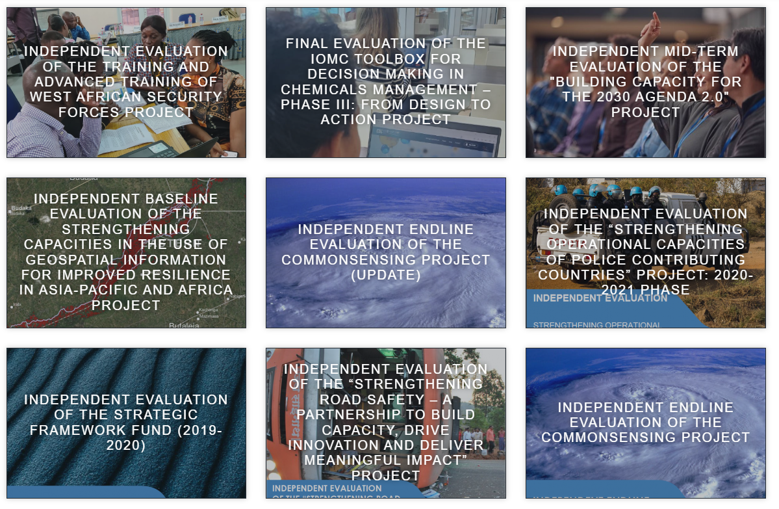
CD
CD
CD
CD
CD
CD
CD
CD
CD
Notes:
Evaluation | UNITAR put this on chat

Slide 37
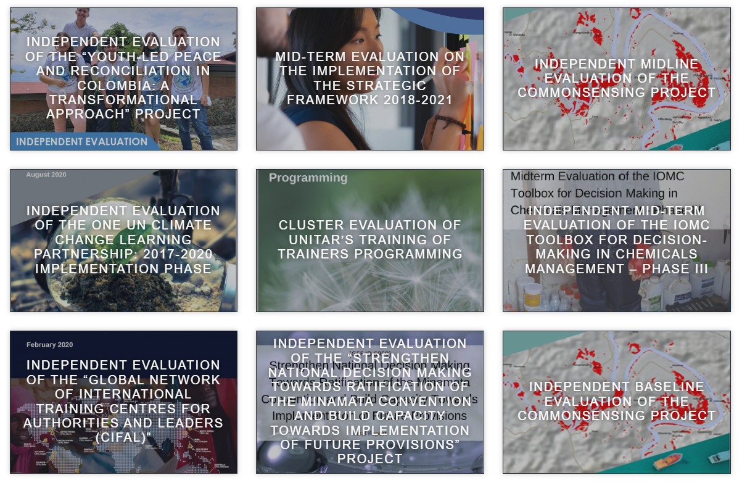
CD
CD
CD
CD
CD
CD
CD
CD
CD

Slide 38
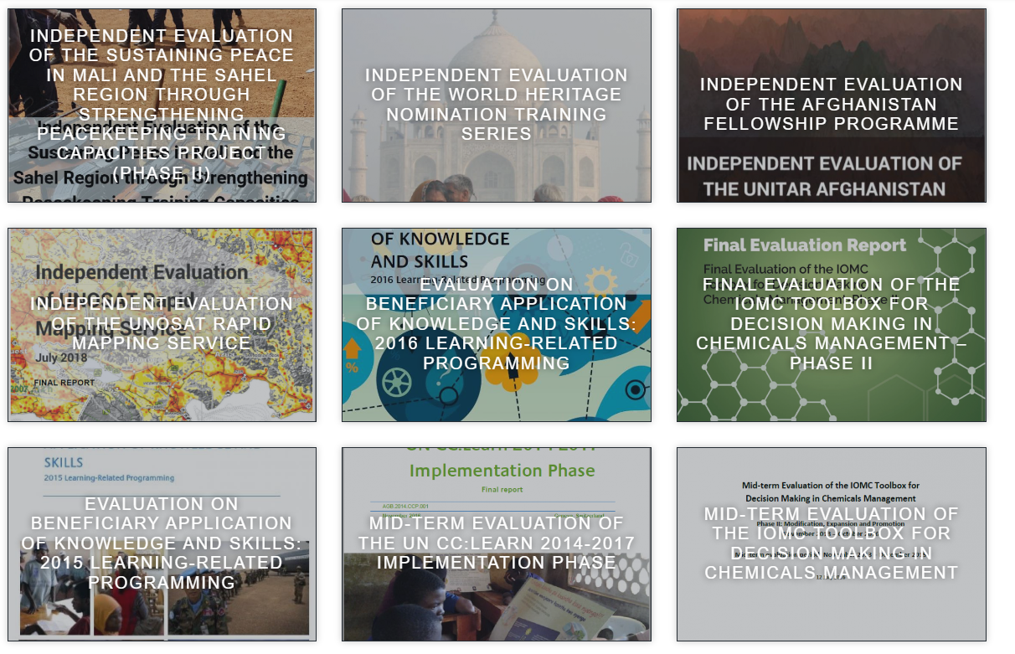
CD
CD
CD
CD
CD
CD
CD
CD

Slide 39


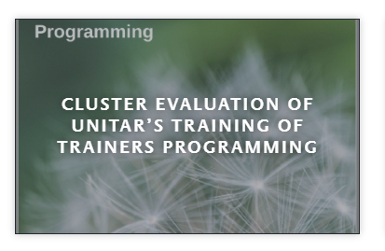
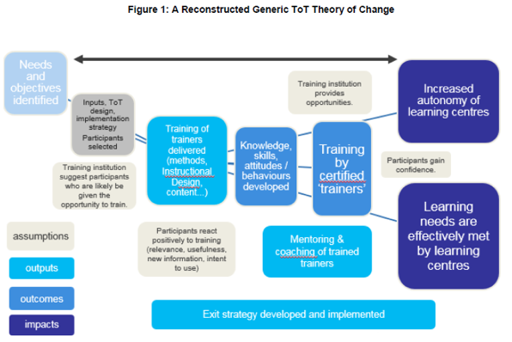
Evaluations including Capacity Development
Broad (participants, academia, private sector, UN, government) stakeholder
analysis and consultation through survey, focus groups and interviews
Global, regional and national level, individual & institutional dimension
Level 3 and 4 including frequency, factors, confidence, attribution
Most Significant Change technique
Analysis of certification/assessment results
Case studies by Region
Large sampling > 5,000
Use of three languages
Disaggregated survey results analysis
Construction of a generic Theory of Change
Surveys to trained trainers and participants
from training by trainers
Interviews with partner institutions/employers
Level 3
Cluster nature of the evaluation allowed
focus on ToT element and dive deeper

Slide 40

Challenges
Missing baselines which require reconstructing baseline information retroperspectively
Difficult finding consultants having the experience and focus on evaluating capacity development
Too often evaluation is reduced to looking at participants’ reaction and learning alone
At the time of the evaluation it is often too early to see long term results, behaviour changes and impact
Missing results frameworks, theories of change in project design
Insufficient self-evaluation/monitoring data available (e.g. no Level 1 and Level 2 data)
Missing contacts particularly in situations where the security situation is challenging. No access to supervisors, to deployed personnel or performance evaluations.
Connecting individual capacities with a contribution to supporting countries implementing the SDGs
Scale does often not always allow for robust methodologies including the comparison groups/counterfactual

Slide 41

Methodological take-away messages
Dare the unknown – reconstruct your baseline, assess the most significant change, try Level 4 Impact evaluation or ROI
Surveys and focus groups can be a great tool to reach out to larger groups – often survey respondents are pleased to share their learning experience and follow-up actions with the evaluation team and other participants
Be humble about the attribution vs contribution debate and always include a question regarding attribution
Workshops on outcome harvesting / outcome evidencing / After action review / Theory of change review can help understand unintended outcomes which are common in the area of capacity development initiatives
Provide sufficient time for application of knowledge/skills and changed behaviour in your evaluation timeframe
Move from individual changes to institutional changes. More effort needs to be placed on understanding the relationships between individual capacities and organizational/institutional capacities
…….

Slide 42

Remember, when it comes to delivering results:
  Hope is not a strategy.
  Luck is not a factor.
  Doing nothing is not an option.
Change is inevitable.
Progress is optional.
42

Slide 43


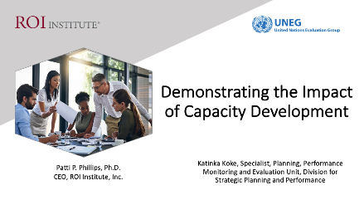
Click the link below or scan the QR code to receive resources from today’s session.
https://roiinstitute.net/uneg-demonstrating-the-impact-of-capacity-development-2/

Slide 44




Questions?
Visit us Online
www.roiinstitute.net
Email Us
patti@roiinstitute.net
Connect with Us

Slide 45
