Slide 1


ROI in Training: Fact, Fad, or Fantasy
Jack J. Phillips, Ph.D., Chairman, ROI Institute, Inc.

Slide 2

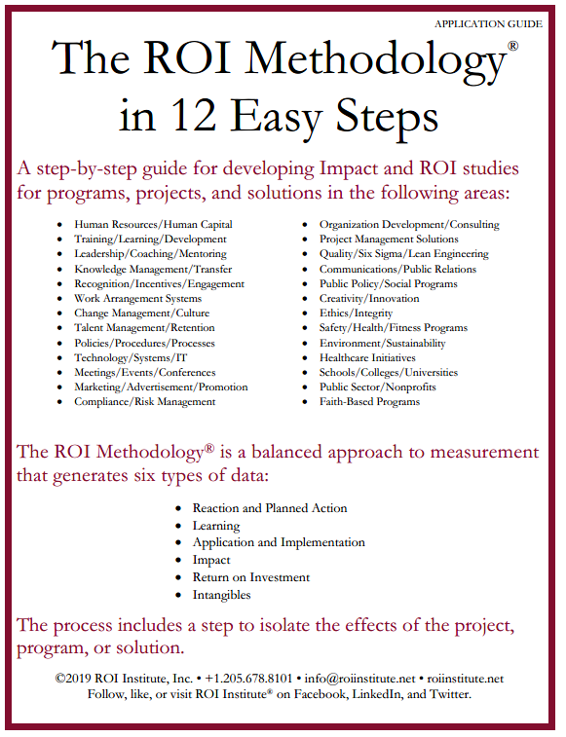
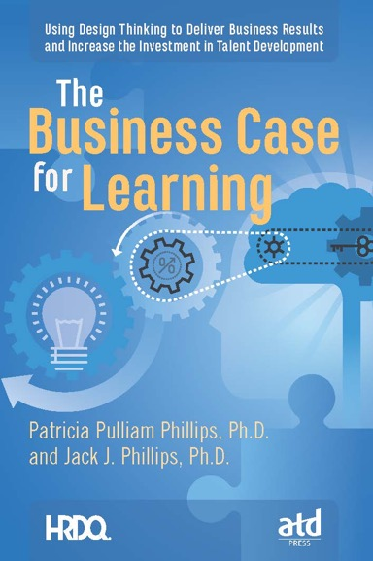
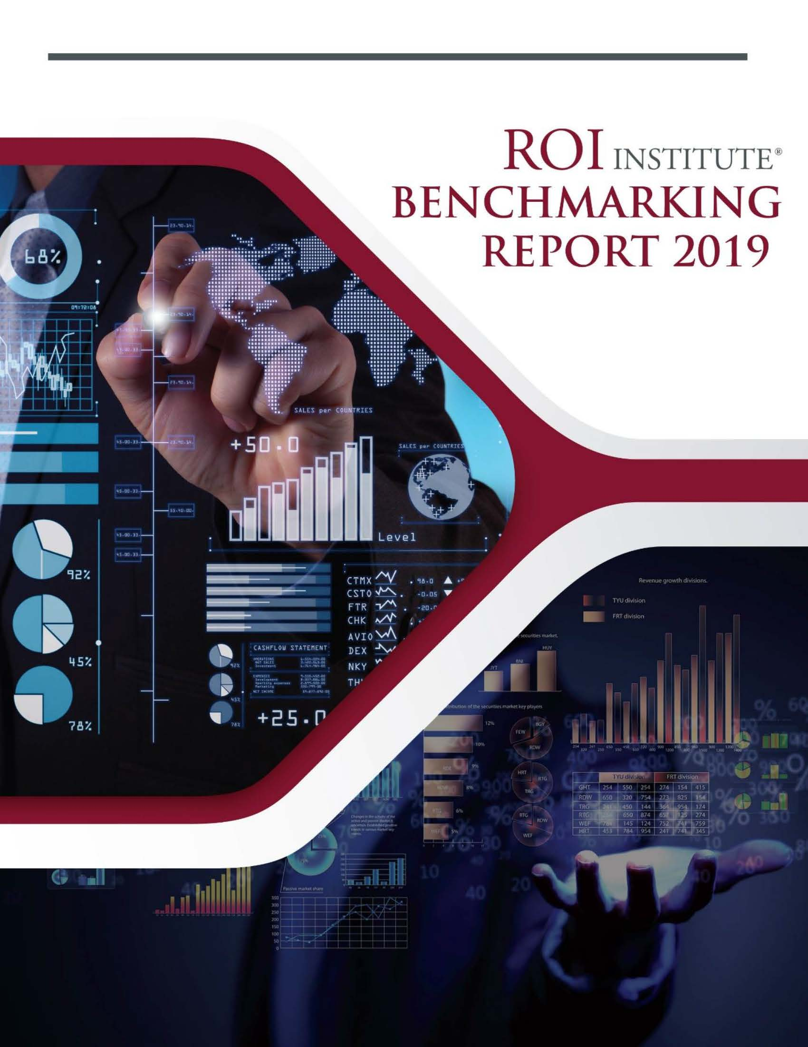
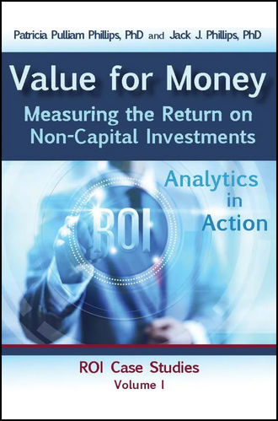
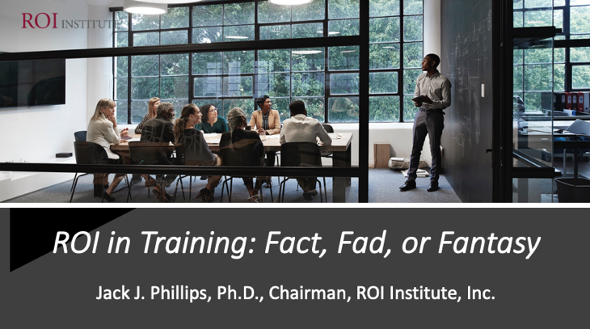
Resources

Slide 3

Objectives
After completing this session, participants should be able to:
  Trace the use of ROI in learning and development.
  Identify the five levels of outcomes from a learning and development program.
  Describe the steps to measure the impact and ROI.
  Cultivate an effective use of ROI.
3

Slide 4

Which of these issues do you currently face? (Select all that apply.)
A. Budget constraints
B. Need to do more with less
C. Need process improvements (effectiveness and efficiency)
D. Need to show the value of programs
E. Need for public accountability and transparency
4

Slide 5
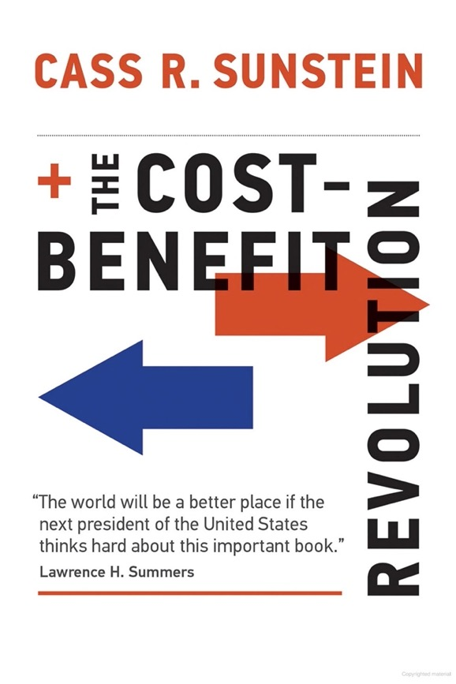
Issues —
Real or Imagined?
No profits — no ROI?
Lack of alignment
Absence of hard data
Too much politics
Multiple ROI perspectives
5

Slide 6
The Chain of Value is Always There
 | LEVEL | ISSUE | MEASURES | TARGETS†
This is easy Always measured | 0 | Inputs | Volume, Hours, Convenience, Cost | 100%
This is easy Almost always measured | 1 | Reaction | *Relevance, Engaging, *Important, Useful, *New Content, *Intent to Use, *Recommend to Others | 100%
Not difficult Usually measured | 2 | Learning | Concepts, Trends, Facts, Contacts, Skills, Competencies | 90%
Possible Often measured | 3 | Application | Use of content, Frequency of Use, Success with Use, Barriers, Enablers | 30%
Not so difficult to connect Sometimes measured | 4 | Impact | Productivity, Time, Quality, Costs, Image, Reputation, Engagement, Compliance | 10%
Possible for many programs Rarely measured | 5 | ROI | Benefit Cost Ratio or Return on Investment, Expressed as a Percent | 5%
*Can predict
Must take a step to isolate the effects
Executives prefer
† Best Practice: Percent of Programs Evaluated at this level each year.
6

Slide 7

True or
False?
Serious Performance Challenges
Most of the learning and development is wasted (not used).
The learning outcomes desired by executives in client organizations are rarely measured.
Most learning providers do not have data showing they make a difference in the organization.
Most executives see learning as a cost and not an investment.
Most executives view hard skills as more valuable than soft skills.
7

Slide 8

ROI Myths
No one is using ROI.
ROI is too complex for most users.
ROI is too expensive,
ROI consumes too many resources.
If senior management doesn’t require it, there is no need to pursue it.
ROI is not appropriate for the Public Sector.
ROI is a passing fad.
ROI can be used with only 5% of programs.
ROI is too subjective.
ROI is for post-analysis only.
8

Slide 9

What CEOs Want
ROI Institute and ATD research show that the data CEOs receive are not demonstrating what they want out of their talent investment. (N=96)
Measures | Currently Measure | Should Measure | Importance
Inputs and Indicators | 94% | 86% | 6
Efficiency | 78% | 82% | 7
Reaction | 53% | 22% | 8
Learning | 32% | 28% | 5
Application | 11% | 61% | 4
Impact | 8% | 96% | 1
ROI | 4% | 74% | 2
Awards | 40% | 44% | 3
9

Slide 10
CLOs Use or Plan to Use ROI
35.6%
21.6%
22.6%
9.7%
17.3%
(N=335)
Use business data to demonstrate the impact of the training organization on the broader enterprise.
Use ROI for that purpose.
Plan to implement ROI within twelve months.
Plan implementation in twelve to twenty-four months.
Plan implementation with no time frame.
71.2%
2015 Measurement and Metrics Study by CLO Magazine
10

Slide 11

“Ultimately, the success of any program is based on whether it improves business results.”
— Training Top 10 Hall of Fame – May 2017

Slide 12

A 2020 benchmarking report indicates that 37% of programs are evaluated at the impact level and 18% at the ROI level.
— ROI Institute User Survey

Slide 13

What Gets in the Way
  Fear of the outcome
  Lack of business alignment
  Inappropriate solution
  Lack of focus
  Not designed for impact
13

Slide 14
Why ROI is Important – Now
It is the ultimate business case.
Shows the efficient use of funds.
Validates that an expenditure is an investment—not a cost.
It’s a way to keep score.
Helps to set priorities.
14

Slide 15
Top ROI Studies: Which are you implementing?
(Select all that apply.)
A. Leadership Development
B. Coaching/Consulting
C. Engagement/Work Experience
D. Talent Retention
E. Manager\ Supervisor Skills
F. Remote (Hybrid Work)
G. Onboarding
H. Diversity, Equity, & Inclusion
I. Empowerment
J. Communication
15

Slide 16

The ROI Methodology®
Implemented in over 70 countries
Most used evaluation system in the world
Endorsed by United Nations with a UN General Assembly resolution in 2008
Endorsed by 28 federal governments
Used by over 300 health care systems
Used by over 150 colleges and universities
Used by three-fourths of Fortune 500 organizations
Used by major foundations such as the Gates Foundation
Supported by over 75 books in 38 languages
16

Slide 17
Credible Evaluation System
An Evaluation
Framework
Applications
and Practice
Implementation
Operating Standards and Philosophy
A Process Model
17

Slide 18

The ROI Methodology® Process Model
Designing for the Delivery of Business Results
PLAN THE EVALUATION
COLLECT DATA
ANALYZE DATA
Make it Credible:
Capture Costs of
Program
OPTIMIZE RESULTS
LEVEL 0: INPUT
LEVEL 1: REACTION AND PLANNED ACTION
LEVEL 3:
APPLICATION
Optimize Results:
Use Black Box
Thinking to
Increase Funding
Start with Why:
Align Programs
with the
Business
Make it Feasible:
Select the Right
Solution
Expect
Success:
Plan for
Results
Make it Matter:
Design for Input,
Reaction and
Learning
Make it Stick:
Design for
Application
and Impact
Make it
Credible:
Isolate the
Effects of the
Program
Make it Credible:
Convert Data to
Monetary Value
Tell the Story:
Communicate
Results to Key
Stakeholders
Make it Credible:
Calculate ROI
LEVEL 5: ROI
LEVEL 2: LEARNING
LEVEL 4: IMPACT
Make it Credible:
Identify Intangible Measures
INTANGIBLE BENEFITS
Copyright 1995-2023 ROI Institute Inc. All Rights Reserved.
18

Slide 19







Cost of the program
Linkage of program to operational goals and issues
Characteristics of Programs Suitable for Impact & ROI
Importance of program to strategic objectives
Top executive interest in the evaluation
Visibility of the program
Size of target audience
Investment of time required
19

Slide 20

Challenge #1 Alignment
Start Here
End Here
Payoff Needs
5
ROI Objectives
5
ROI
Business Needs
4
Impact Objectives
4
Impact
Performance Needs
3
Application Objectives
3
Application
Learning Needs
2
Learning Objectives
2
Learning
Initial Analysis
Measurement and Evaluation
Preference Needs
1
Reaction Objectives
1
Reaction
Input Needs
0
Input Objectives
0
Input
Program Process Initiative
Alignment and Forecasting
The ROI Process Model
20

Slide 21

Challenge #2 Post Program Data Collection
Method | Level | 1 | 2 | 3 | 4
Surveys
Questionnaires
Observation
Interviews
Focus groups
Tests/Quizzes
Demonstrations
Simulations
Action plan/Improvement plan
Performance contracting
Performance monitoring
21

Slide 22
Challenge #3 Isolating the Effects of Program
When isolating the effects of programs on improvement in key measures, what percentage of the time do you use the following techniques?
n = 246
22

Slide 23
Challenge #4 Converting Data to Money
When converting data to money, what percentage of the time do you use the following techniques?
23

Slide 24

Implementation Strategies
Brief, train, educate
Involve the staff – early and often
Emphasize process improvement
Explain why – routinely
Build it into projects – not add it on
Provide resources
Use the results appropriately
Recognize and celebrate
24

Slide 25

What are your concerns about measuring ROI?
(Select all that apply.)
A. It’s too difficult.
B. It takes took much time.
C. No one is asking for this.
D. It will kill my programs.
E. I wish It would go away.
25
25

Slide 26

Benefits of This Approach
Connects to organizational outcomes (business alignment)
Secures funding (protect budget)
Improves programs (process improvement)
Enhance image of LD (builds respect)
Improves support (stakeholder satisfaction)
Builds productive relationships (business partnerships)

Slide 27


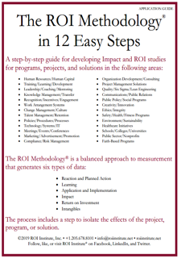

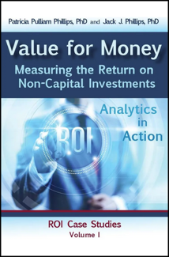

Scan the QR code or click the link below to receive resources from today’s session.
https://roiinstitute.net/dcloc-fact-fad-or-fantasy/

Slide 28
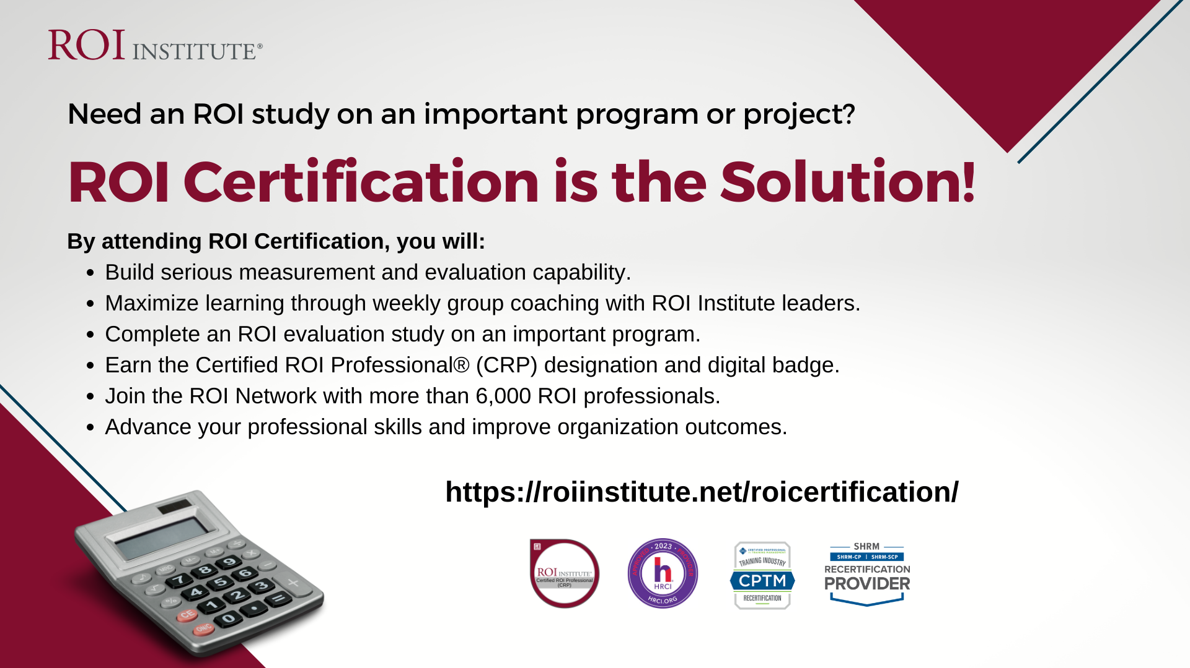


Slide 29




Questions?
Visit us Online
www.roiinstitute.net
Email Us
Jack@roiinstitute.net
Connect with Us

