Slide 1


Measuring the Success of Sales Training
Patti P. Phillips, Ph.D., CEO, ROI Institute, Inc.

Slide 2

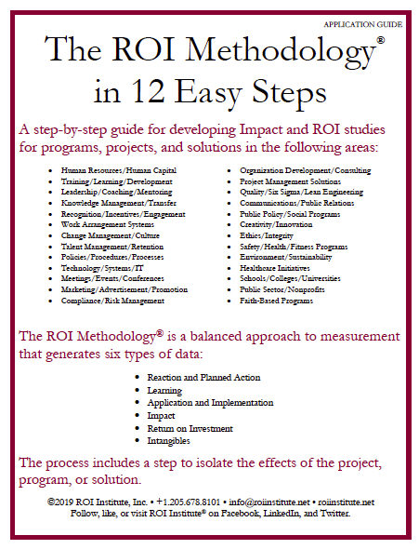
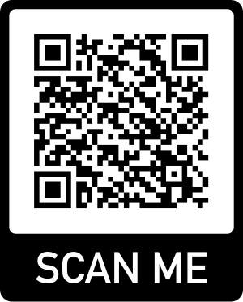
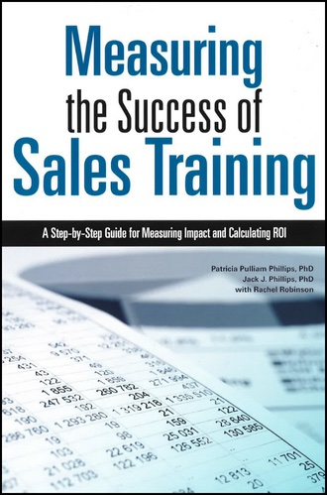

Resources

Slide 3

Objectives
After attending this session, participants should be able to:
  Identify the five levels of outcomes from any sales training program.
  Describe what ROI is and what it is not.
  Calculate the ROI for a sales training program.

Slide 4

Poll: How do you measure the success of your sales training? (Select all that apply.)
The number of people who complete the program on time
Participant perception of the program
Participant acquisition of knowledge, skills, information, and/or insight
Participant use of what they learn on the job
Improved performance in key business measures (e.g. sales, customer satisfaction) as a result of the program
The actual return on investment (ROI)
Other (add to chat)

Slide 5
Evaluation Framework
Levels of Evaluation | Measurement Focus | Typical Measures
0. Inputs | The input into the project in terms of scope, volume, efficiencies, costs | Participants, Hours, Costs, Timing
1. Reaction & Planned Action | Measures participant satisfaction and captures planned actions, if appropriate | Relevance, Importance, Usefulness, Appropriateness, Intent to use, Motivation to take action
2. Learning | Measures changes in knowledge, skills, and attitudes | Skills, Knowledge, Capacity, Competencies, Confidence, Contacts
3. Application | Measures changes in behavior or actions along with barriers and enablers | Extent of use, Task completion, Frequency of use, Actions completed, Success with use, Barriers to use, Enablers to use
4. Business Impact | Measures changes in business impact variables | Productivity, Revenue, Quality, Time, Efficiency, Customer Satisfaction, Employee Engagement
5. Return on Investment | Compares project benefits to the costs | Benefit-Cost Ratio (BCR), ROI%, Payback Period
5

Slide 6

What is ROI?
Project benefits
Project costs
BCR =
Project benefits – Project costs
Project costs
ROI =
x 100
6

Slide 7
Benefit-Cost Ratio and Return on Investment
$71,760
$32,984
BCR =
$71,760 - $32,984
$32,984
ROI =
x 100
7

Slide 8
Benefit-Cost Ratio and Return on Investment
$71,760
$32,984
BCR =
= 2.18
$71,760 - $32,984
$32,984
ROI =
x 100 = 118%
8

Slide 9
Try this one.
$425,000
BCR =
$425,000
ROI =
Increase store sales (1st year) $2,750,000
Gross profit on sales is 20%
Program Cost (25 participants) = $425,000
9

Slide 10
Try this one.
$2,750,000
$425,000
BCR =
= 6.47
$2,750,000 - $425,000
$425,000
ROI =
x 100 = 547%
Increase store sales (1st year) $2,750,000
Gross profit on sales is 20%
Program Cost (25 participants) = $425,000
10

Slide 11
Try this one.
$2,750,000
$425,000
BCR =
= 6.47
$2,750,000 - $425,000
$425,000
ROI =
x 100 = 547%
Increase store sales (1st year) $2,750,000
Gross profit on sales is 20%
Program Cost (25 participants) = $425,000
11

Slide 12
Try this one.
($2,750,000 x .20)
$425,000
BCR =
= 1.29
($2,750,000 x .20) - $425,000
$425,000
ROI =
x 100 = 29%
Increase store sales (1st year) $2,750,000
Gross profit on sales is 20%
Program Cost (25 participants) = $425,000
12

Slide 13

What can you do to ensure sales training
delivers business value?

Slide 14

The ROI Methodology Process Model
Designing for the Delivery of Business Results
PLAN THE EVALUATION
COLLECT DATA
ANALYZE DATA
Make it Credible:
Capture Costs of
Program
OPTIMIZE RESULTS
LEVEL 0: INPUT
LEVEL 1: REACTION AND PLANNED ACTION
LEVEL 3:
APPLICATION
Tell the Story:
Communicate
Results to Key
Stakeholders
Optimize
Results:
Use Black Box
Thinking to
Increase Funding
Start with Why:
Align Programs
With the
Business
Make it Feasible:
Select the Right
Solution
Expect
Success:
Plan for
Results
Make it Matter:
Design for Input,
Reaction and
Learning
Make it Stick:
Design for
Application
and Impact
Make it
Credible:
Isolate the
Effects of the
Program
Make it Credible:
Convert Data to
Monetary Value
Make it Credible:
Calculate ROI
LEVEL 5: ROI
LEVEL 2: LEARNING
LEVEL 4: IMPACT
Make it Credible:
Identify Intangible Measures
INTANGIBLE BENEFITS
©2023 ROI Institute Inc. All Rights Reserved.
14

Slide 15
The ROI Methodology Process Model
Designing for the Delivery of Business Results
PLAN THE EVALUATION
COLLECT DATA
ANALYZE DATA
Make it Credible:
Capture Costs of
Program
OPTIMIZE RESULTS
LEVEL 0: INPUT
LEVEL 1: REACTION AND PLANNED ACTION
LEVEL 3:
APPLICATION
Tell the Story:
Communicate
Results to Key
Stakeholders
Optimize
Results:
Use Black Box
Thinking to
Increase Funding
Start with Why:
Align Programs
With the
Business
Make it Feasible:
Select the Right
Solution
Expect
Success:
Plan for
Results
Make it Matter:
Design for Input,
Reaction and
Learning
Make it Stick:
Design for
Application
and Impact
Make it
Credible:
Isolate the
Effects of the
Program
Make it Credible:
Convert Data to
Monetary Value
Make it Credible:
Calculate ROI
LEVEL 5: ROI
LEVEL 2: LEARNING
LEVEL 4: IMPACT
Make it Credible:
Identify Intangible Measures
INTANGIBLE BENEFITS
©2023 ROI Institute Inc. All Rights Reserved.
15

Slide 16
The ROI Methodology Process Model
Designing for the Delivery of Business Results
PLAN THE EVALUATION
COLLECT DATA
ANALYZE DATA
Make it Credible:
Capture Costs of
Program
OPTIMIZE RESULTS
LEVEL 0: INPUT
LEVEL 1: REACTION AND PLANNED ACTION
LEVEL 3:
APPLICATION
Tell the Story:
Communicate
Results to Key
Stakeholders
Optimize
Results:
Use Black Box
Thinking to
Increase Funding
Start with Why:
Align Programs
With the
Business
Make it Feasible:
Select the Right
Solution
Expect
Success:
Plan for
Results
Make it Matter:
Design for Input,
Reaction and
Learning
Make it Stick:
Design for
Application
and Impact
Make it
Credible:
Isolate the
Effects of the
Program
Make it Credible:
Convert Data to
Monetary Value
Make it Credible:
Calculate ROI
LEVEL 5: ROI
LEVEL 2: LEARNING
LEVEL 4: IMPACT
Make it Credible:
Identify Intangible Measures
INTANGIBLE BENEFITS
©2023 ROI Institute Inc. All Rights Reserved.
16

Slide 17
The ROI Methodology Process Model
Designing for the Delivery of Business Results
PLAN THE EVALUATION
COLLECT DATA
ANALYZE DATA
Make it Credible:
Capture Costs of
Program
OPTIMIZE RESULTS
LEVEL 0: INPUT
LEVEL 1: REACTION AND PLANNED ACTION
LEVEL 3:
APPLICATION
Tell the Story:
Communicate
Results to Key
Stakeholders
Optimize
Results:
Use Black Box
Thinking to
Increase Funding
Start with Why:
Align Programs
With the
Business
Make it Feasible:
Select the Right
Solution
Expect
Success:
Plan for
Results
Make it Matter:
Design for Input,
Reaction and
Learning
Make it Stick:
Design for
Application
and Impact
Make it
Credible:
Isolate the
Effects of the
Program
Make it Credible:
Convert Data to
Monetary Value
Make it Credible:
Calculate ROI
LEVEL 5: ROI
LEVEL 2: LEARNING
LEVEL 4: IMPACT
Make it Credible:
Identify Intangible Measures
INTANGIBLE BENEFITS
©2023 ROI Institute Inc. All Rights Reserved.
17

Slide 18
The ROI Methodology Process Model
Designing for the Delivery of Business Results
PLAN THE EVALUATION
COLLECT DATA
ANALYZE DATA
Make it Credible:
Capture Costs of
Program
OPTIMIZE RESULTS
LEVEL 0: INPUT
LEVEL 1: REACTION AND PLANNED ACTION
LEVEL 3:
APPLICATION
Tell the Story:
Communicate
Results to Key
Stakeholders
Optimize
Results:
Use Black Box
Thinking to
Increase Funding
Start with Why:
Align Programs
With the
Business
Make it Feasible:
Select the Right
Solution
Expect
Success:
Plan for
Results
Make it Matter:
Design for Input,
Reaction and
Learning
Make it Stick:
Design for
Application
and Impact
Make it
Credible:
Isolate the
Effects of the
Program
Make it Credible:
Convert Data to
Monetary Value
Make it Credible:
Calculate ROI
LEVEL 5: ROI
LEVEL 2: LEARNING
LEVEL 4: IMPACT
Make it Credible:
Identify Intangible Measures
INTANGIBLE BENEFITS
©2023 ROI Institute Inc. All Rights Reserved.
18

Slide 19
Guiding Principles
When conducting a higher-level evaluation, collect data at lower levels.
When planning a higher-level evaluation, the previous level of evaluation is not required to be comprehensive.
When collecting and analyzing data, use only the most credible sources.
When analyzing data, select the most conservative alternative for calculations.
Use at least one method to isolate the effects of a project.
If no improvement data are available for a population or from a speciﬁc source, assume that little or no improvement has occurred.
Adjust estimates of improvement for potential errors of estimation.
Avoid use of extreme data items and unsupported claims when calculating ROI.
Use only the ﬁrst year of annual beneﬁts in ROI analysis of short-term solutions.
Fully load all costs of a solution, project, or program when analyzing ROI.
Intangible measures are deﬁned as measures that are purposely not converted to monetary values.
Communicate the results of ROI Methodology to all key stakeholders.
19

Slide 20
Characteristics
of Investments Suitable for Impact & ROI
Linkage of project to operational goals and issues
Importance of project to strategic objectives
Top executive interest in the evaluation
Cost of the project
Visibility of the project
Size of target audience
Investment of time required

Slide 21

Case Study:
Retail Merchandise

Slide 22

Start with Why
Large National chain of 420 stores located in most major US markets.
Sells small household items, gifts of all types, electronics, and jewelry as well as personal accessories.
Executives have been concerned about the slow sales growth and were experimenting with several programs to boost sales.
One concern focused on interaction with customers. Sales associates were not actively involved in the sales process, usually waiting for a customer to make a purchasing decision and then proceed with processing the sale.
Analysis, by store managers, revealed that the use of very simple techniques to probe and guide the customer to a purchase should boost sales.
Senior executives asked learning and development to experiment with a very simple customer interactive skills program for a small group of sales associates. Vendor-produce preferred to avoid the cost of development.

Slide 23

Make it Feasible
Title: Interactive Selling Skills
Target Group: Sales Associates in Electronics
Vendor Produced and Delivered
3 Days
  (2 Days Plus 1 Day)
Significant Use of Skill Practices
3 Groups Trained
  (48 Participants from 3 Stores)

Slide 24
Expect Success
Levels of Objectives | Broad Objective | Measures
Level 1 Reaction | Positive reaction Recommended improvements Acton items | Average rating of at least 4.0 on a 5.0 scale on quality, usefulness, and achievement 100% submission of planned action
Level 2 Learning | Acquisition of skills Selection of skills | Through role play scenarios, demonstration of appropriate selection and all five sales skills and customer influence steps
Level 3 Application | Use of skills Frequency of skill use Identify barriers | 100% of participants report use of skills 50% of participants report skills used with every customer Reported barriers to customer interaction and closing of sales
Leve 4 Business Impact | Sales increase | Weekly sales per sales person
Level 5 ROI | Target ROI of 25%

Slide 25
The ROI Methodology Process Model
Designing for the Delivery of Business Results
PLAN THE EVALUATION
COLLECT DATA
ANALYZE DATA
Make it Credible:
Capture Costs of
Program
OPTIMIZE RESULTS
LEVEL 0: INPUT
LEVEL 1: REACTION AND PLANNED ACTION
LEVEL 3:
APPLICATION
Tell the Story:
Communicate
Results to Key
Stakeholders
Optimize
Results:
Use Black Box
Thinking to
Increase Funding
Start with Why:
Align Programs
With the
Business
Make it Feasible:
Select the Right
Solution
Expect
Success:
Plan for
Results
Make it Matter:
Design for Input,
Reaction and
Learning
Make it Stick:
Design for
Application
and Impact
Make it
Credible:
Isolate the
Effects of the
Program
Make it Credible:
Convert Data to
Monetary Value
Make it Credible:
Calculate ROI
LEVEL 5: ROI
LEVEL 2: LEARNING
LEVEL 4: IMPACT
Make it Credible:
Identify Intangible Measures
INTANGIBLE BENEFITS
©2023 ROI Institute Inc. All Rights Reserved.
25

Slide 26
The ROI Methodology Process Model
Designing for the Delivery of Business Results
PLAN THE EVALUATION
COLLECT DATA
ANALYZE DATA
Make it Credible:
Capture Costs of
Program
OPTIMIZE RESULTS
LEVEL 0: INPUT
LEVEL 1: REACTION AND PLANNED ACTION
LEVEL 3:
APPLICATION
Tell the Story:
Communicate
Results to Key
Stakeholders
Optimize
Results:
Use Black Box
Thinking to
Increase Funding
Start with Why:
Align Programs
With the
Business
Make it Feasible:
Select the Right
Solution
Expect
Success:
Plan for
Results
Make it Matter:
Design for Input,
Reaction and
Learning
Make it Stick:
Design for
Application
and Impact
Make it
Credible:
Isolate the
Effects of the
Program
Make it Credible:
Convert Data to
Monetary Value
Make it Credible:
Calculate ROI
LEVEL 5: ROI
LEVEL 2: LEARNING
LEVEL 4: IMPACT
Make it Credible:
Identify Intangible Measures
INTANGIBLE BENEFITS
©2023 ROI Institute Inc. All Rights Reserved.
26

Slide 27
Selecting Data Collection Methods
Time required for participants
Time required for participant’s supervisor
Costs of method
Amount of disruption of normal activities
Accuracy
Utility
Culture / Philosophy
Workbook Page 4-10

Slide 28
Collect Data During and After the Program
Method | Level
 | 1 | 2 | 3 | 4
Surveys | ✔ | ✔ | ✔
Questionnaires | ✔ | ✔ | ✔ | ✔
Observation | ✔ | ✔ | ✔
Interviews | ✔ | ✔ | ✔
Focus Groups | ✔ | ✔ | ✔
Tests/Quizzes |  | ✔
Demonstrations |  | ✔
Simulations |  | ✔
Action planning/improvement plans |  |  | ✔ | ✔
Performance contracting |  |  | ✔ | ✔
Performance monitoring |  |  |  | ✔
28

Slide 29

Poll: How would you collect the Level 3 data for the Retail Merchandise case study? (Select all that apply.)
Questionnaire
Observation
Interviews
Focus groups
Demonstrations
Action plans
Other

Slide 30
Poll: How would you collect the Level 4 data for the Retail Merchandise case study? (Select all that apply.)
Questionnaire
Observation
Interviews
Focus groups
Demonstrations
Action plans
Other

Slide 31
Data Collection Methods
*Survey of Users, N = 246

Slide 32

Sources of Information
Participants
Supervisors of participants
Direct reports of participants
Peer group
Internal staff
External group
Organizational performance records

Slide 33

Timing of Follow-up
Availability of Data
Ideal Time for Application
(Level 3)
Ideal Time for Business Impact (Level 4)
Convenience of Collection
Constraints on Collection

Slide 34
ROI Analysis Profile
Data Collection
(L1) Reaction questionnaire –end of course
(L2) Facilitator assessment/demonstration – during course
(L3) Program follow-up session – 3 weeks
(L3) Questionnaire – 3 months
(L4) Performance Monitoring – 3 months
Isolation
Data Conversion

Slide 35
The ROI Methodology Process Model
Designing for the Delivery of Business Results
PLAN THE EVALUATION
COLLECT DATA
ANALYZE DATA
Make it Credible:
Capture Costs of
Program
OPTIMIZE RESULTS
LEVEL 0: INPUT
LEVEL 1: REACTION AND PLANNED ACTION
LEVEL 3:
APPLICATION
Tell the Story:
Communicate
Results to Key
Stakeholders
Optimize
Results:
Use Black Box
Thinking to
Increase Funding
Start with Why:
Align Programs
With the
Business
Make it Feasible:
Select the Right
Solution
Expect
Success:
Plan for
Results
Make it Matter:
Design for Input,
Reaction and
Learning
Make it Stick:
Design for
Application
and Impact
Make it
Credible:
Isolate the
Effects of the
Program
Make it Credible:
Convert Data to
Monetary Value
Make it Credible:
Calculate ROI
LEVEL 5: ROI
LEVEL 2: LEARNING
LEVEL 4: IMPACT
Make it Credible:
Identify Intangible Measures
INTANGIBLE BENEFITS
©2023 ROI Institute Inc. All Rights Reserved.
35

Slide 36
Isolate Program Effects
*Sample of selected users n = 246
36

Slide 37
Poll: How would you isolate the effects of the Interactive Selling Skills program? (Select all that apply.)
Participant estimates
Manager estimates
Senior Manager Estimates
Trendline Analysis
Customer Input
Expert Input
Control Group
Mathematical Modeling

Slide 38
ROI Analysis Profile
Data Collection
(L1) Reaction questionnaire –end of course
(L2) Facilitator assessment/demonstration – during course
(L3) Program follow-up session – 3 weeks
(L3) Questionnaire – 3 months
(L4) Performance Monitoring – 3 months
Isolation
Data Conversion
Control group arrangement
Store size
Store location
Customer traffic levels
Previous store performance
Participant estimates (back-up)

Slide 39
Convert Data to Money
*Sample of selected users n = 246
39

Slide 40

Rapid-Fire Chat
How are you going to convert weekly sales to money?

Slide 41
ROI Analysis Profile
Data Collection
(L1) Reaction questionnaire –end of course
(L2) Facilitator assessment/demonstration – during course
(L3) Program follow-up session – 3 weeks
(L3) Questionnaire – 3 months
(L4) Performance Monitoring – 3 months
Isolation
Data Conversion
Control group arrangement
Store size
Store location
Customer traffic levels
Previous store performance
Participant estimates (back-up)
Profit contribution (standard value)

Slide 42
The ROI Methodology Process Model
Designing for the Delivery of Business Results
PLAN THE EVALUATION
COLLECT DATA
ANALYZE DATA
Make it Credible:
Capture Costs of
Program
OPTIMIZE RESULTS
LEVEL 0: INPUT
LEVEL 1: REACTION AND PLANNED ACTION
LEVEL 3:
APPLICATION
Tell the Story:
Communicate
Results to Key
Stakeholders
Optimize
Results:
Use Black Box
Thinking to
Increase Funding
Start with Why:
Align Programs
With the
Business
Make it Feasible:
Select the Right
Solution
Expect
Success:
Plan for
Results
Make it Matter:
Design for Input,
Reaction and
Learning
Make it Stick:
Design for
Application
and Impact
Make it
Credible:
Isolate the
Effects of the
Program
Make it Credible:
Convert Data to
Monetary Value
Make it Credible:
Calculate ROI
LEVEL 5: ROI
LEVEL 2: LEARNING
LEVEL 4: IMPACT
Make it Credible:
Identify Intangible Measures
INTANGIBLE BENEFITS
©2023 ROI Institute Inc. All Rights Reserved.
42

Slide 43

The Results

Slide 44

Investment
Interactive Selling Skills
Target Group: Sales Associates in Electronics
Vendor Produced and Delivered
3 Days
  (2 Days Plus 1 Day)
Significant Use of Skill Practices
3 Groups Trained
  (48 Participants from 3 Stores)

Slide 45

Level 1 – Selected Data
Success with Objectives 4.3
Relevance of Material 4.4
Usefulness of Program 4.5
Exercises/Skill Practices 3.9
Overall Instructor Rating 4.1
Target 4.0 / 5.0

Slide 46

Level 2 – Selected Data
All participants demonstrated that they could use the skills successfully.

Slide 47
Level 3 – Selected Data
 | Strongly Agree | Agree | Neither Agree or Disagree | Disagree | Strongly Disagree
I utilize the skills taught in the program. | 78% | 22% | 0% | 0% | 0%
 | With Each Customer | Every Third Customer | Several Times Each Day | At Least Once Daily | At Least Once Weekly
Frequency of use of skills | 52% | 26% | 18% | 4% | 0%
Target:
100% of participants report use of skills
50% of participants report skills used with every customer

Slide 48
Level 4 – Average Weekly Sales
Weeks After Training | Trained Groups | Control Groups
1 | $9,723 | $9,698
2 | $9,978 | $9,720
3 | $10,424 | $9,812
13 | $13,960 | $11,572
14 | $11,491 | $9,683
15 | $11,044 | $10,092
Average for Weeks 13,14,15 | $12,075 | $10,449

Slide 49
Annualized Program Benefits
Average Weekly Sales per Employee Trained Groups
$12,075
Average Weekly Sales per Employee Untrained Groups
$10,449
Increase in sales $1,626
Profit Contribution is 2% of Store Sales ($1626 x .02) $32.50
Total Weekly Improvement ($32.50 x 46 participants) $1,495
Total Annual Benefits ($1,495 x 48 Weeks) $71,760

Slide 50
Cost Summary
Facilitation Fees: 3 courses @ $3750 $11,250
Program Materials: 48 @ $35/participant $1,680
Meals/Refreshments: 3 days @ $28/participant $4,032
Facilities: 9 days @ $120 $1,080
Participant Salaries Plus Benefits (35% factor) $12,442
Coordination/Evaluation $2,500
Total Costs $32,984

Slide 51
What is ROI?
Project benefits
Project costs
BCR =
Project benefits – Project costs
Project costs
ROI =
x 100
51

Slide 52
Benefit-Cost Ratio and Return on Investment
$71,760
$32,984
BCR =
$71,760 - $32,984
$32,984
ROI =
x 100
52

Slide 53
Benefit-Cost Ratio and Return on Investment
$71,760
$32,984
BCR =
= 2.18
$71,760 - $32,984
$32,984
ROI =
x 100 = 118%
Target: 25%
53

Slide 54

Summary of Follow-Up
Tabulating Program Costs
Tabulating Program Costs
$32,984
Isolating the Effects of the Program
Converting Data to Monetary Value
Calculating
the Return on Investment
Collecting Post Program Data
Follow-up Session
Questionnaire
Performance Monitoring
Control Groups
Participants’ Estimates
Standard Values
$71,760
118%
Identifying Intangible Benefits
Improvement in
Customer satisfaction
Job confidence

Slide 55

The Payoff
Justify/defend budgets.
Align projects to business needs.
Show contributions of selected projects.
Earn respect of senior management/administrators.
Build staff morale.
Improve support for projects.
Enhance design and implementation processes.
Identify inefficient projects to redesign or eliminate.
Identify successful projects to implement in other areas.
Earn a “seat at the table”.
55

Slide 56

Be Proactive
Remember, when it comes to delivering results:
  Hope is not a strategy.
  Luck is not a factor.
  Doing nothing is not an option.
Change is inevitable.
Progress is optional.
56

Slide 57

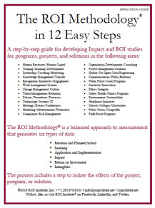


Scan the QR code or click the link below to access resources from today’s session.
https://roiinstitute.net/smm-mroi-in-sales-training/

Slide 58
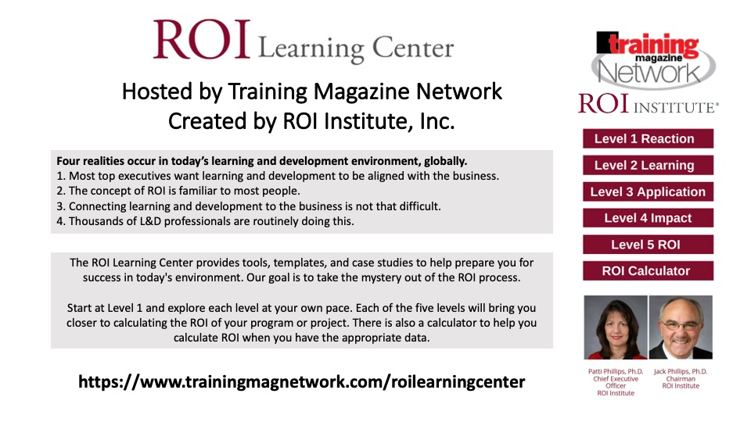


Patti Phillips, Ph.D.
CEO,
ROI Institute
Jack Phillips, Ph.D.
Chairman,
ROI Institute

Slide 59
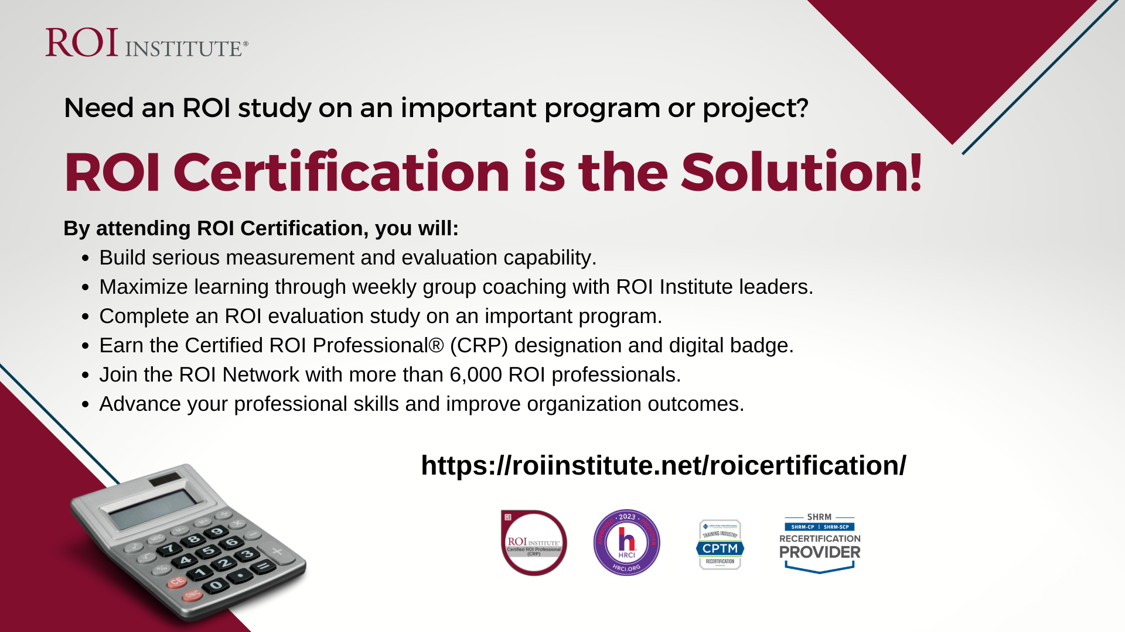
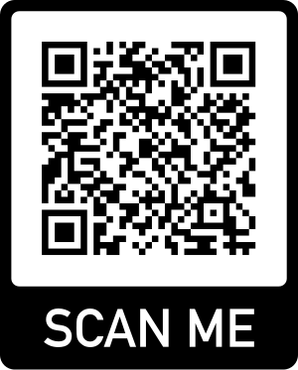

Slide 60


Slide 61

Let’s have a conversation.
Schedule a time that works for you.
https://calendly.com/pattiphillips/connect
patti@roiinstitute.net

