Slide 1

Return on Investment in HR
Patti P. Phillips, Ph.D., CEO, ROI Institute, Inc.

Slide 2
Objectives
Define ROI.
Determine when to use ROI.
Recognize the benefits of using ROI.

Slide 3

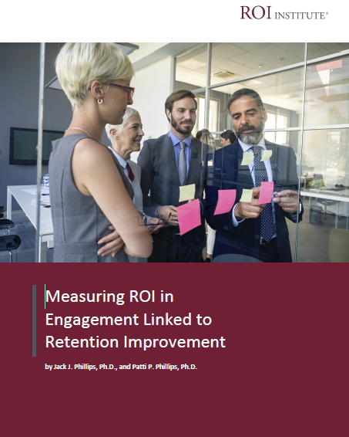
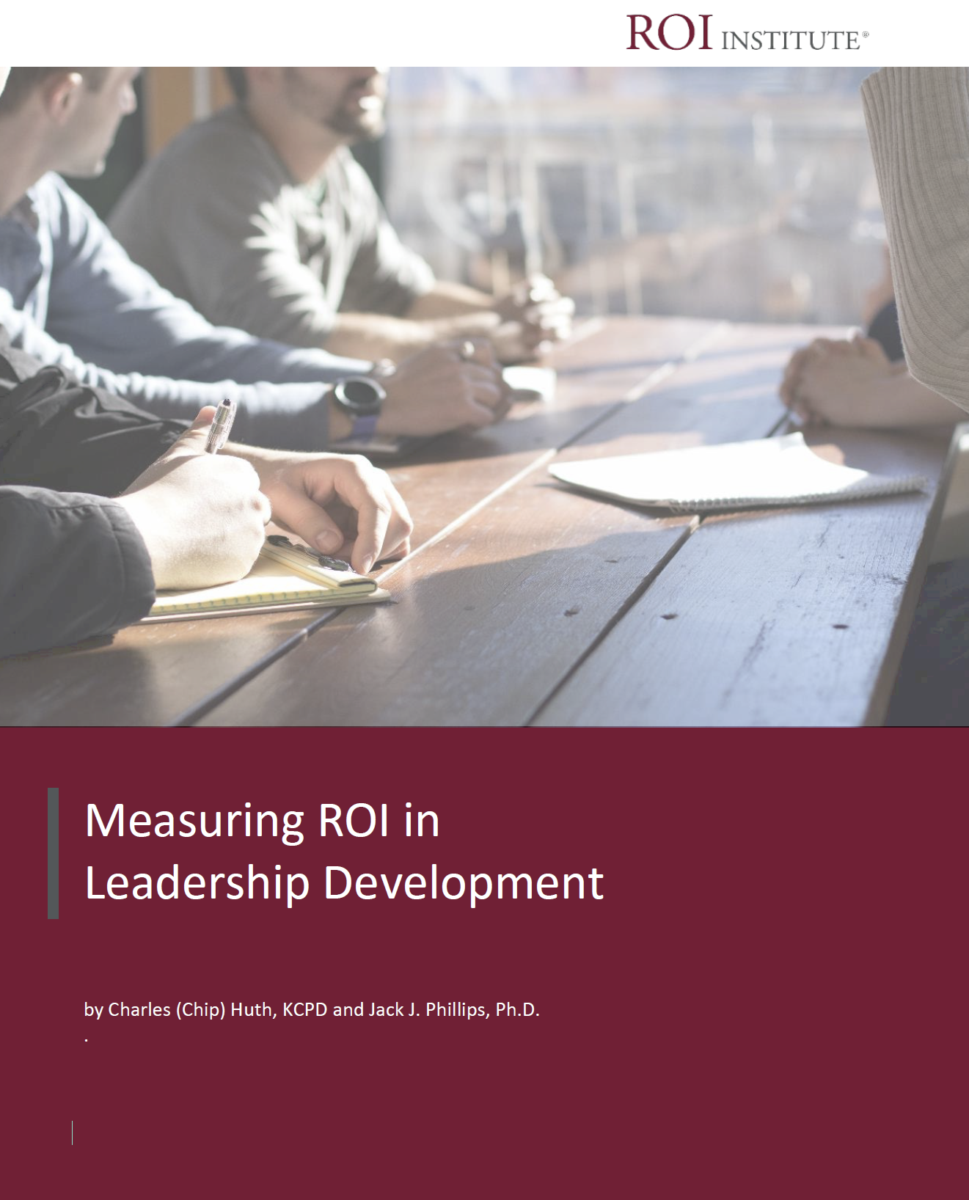
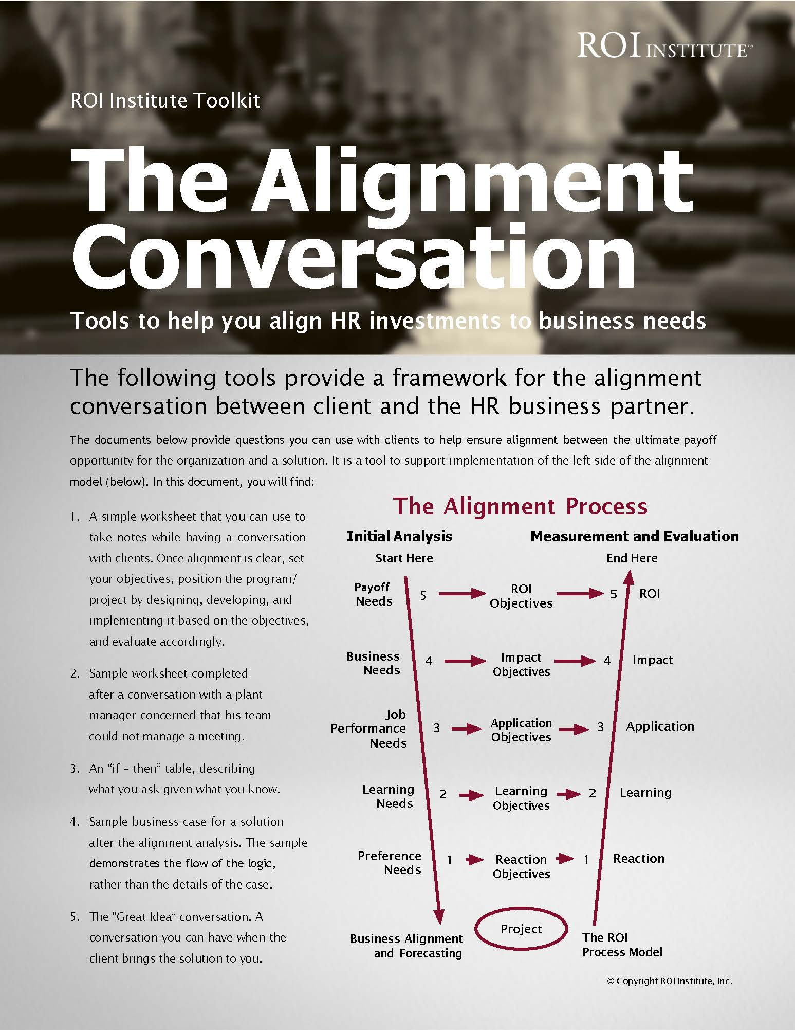
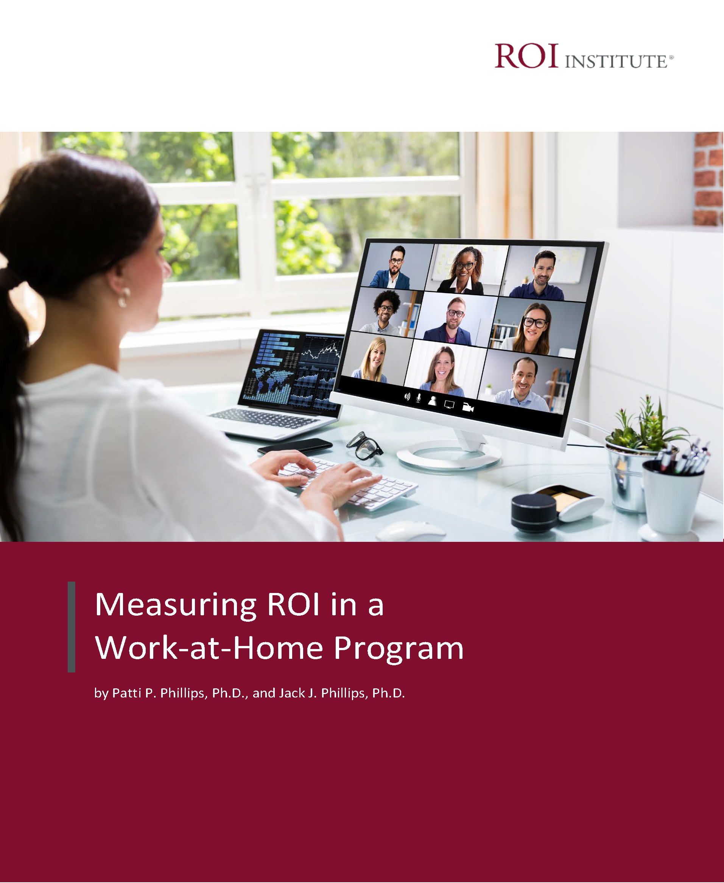
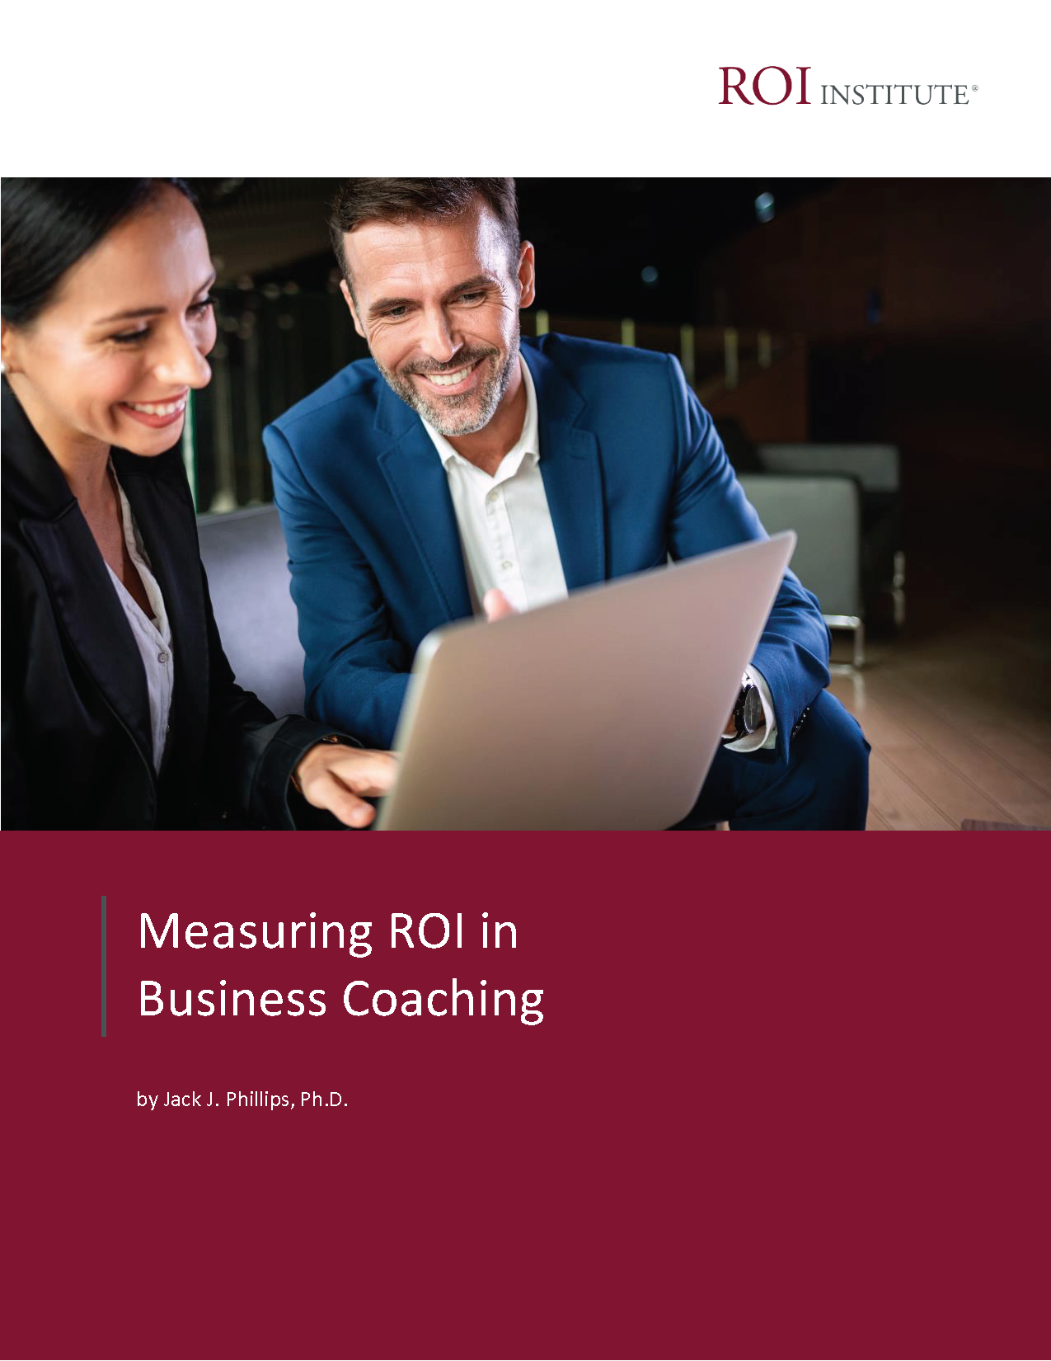
Resources

Slide 4

Rapid Fire Chat
How do you know your HR investments are delivering value?

Slide 5
Logic and Intuition
Macro Analysis
Micro Analysis
How do you know your HR investments are delivering value?

Slide 6
Evaluation Framework
Levels of Evaluation | Measurement Focus | Typical Measures
0. Inputs | The input into the project in terms of scope, volume, efficiencies, costs | Participants, Hours, Costs, Timing
1. Reaction & Planned Action | Measures participant satisfaction and captures planned actions, if appropriate | Relevance, Importance, Usefulness, Appropriateness, Intent to use, Motivation to act, Net Promoter Score
2. Learning | Measures changes in knowledge, skills, and attitudes | Skills, Knowledge, Capacity, Competencies, Confidence, Mindset, Contacts
3. Application & Implementation | Measures changes in behavior or actions | Extent of use, Task completion, Frequency of use, Actions completed, Behavior change, Success with use, Barriers to use, Enablers to use, Utility, Scrap
4. Impact | Measures changes in impact variables | Productivity, Revenue, Quality, Time, Efficiency, Customer satisfaction, Patient satisfaction, Employee engagement, Talent mobility, Innovation
5. Return on Investment | Compares project benefits to the costs | Benefit-Cost Ratio (BCR), ROI%, Payback period

Slide 7
What is ROI?
Program Benefits
Program Costs
BCR =
Benefits – Costs
Costs
ROI =
x 100

Slide 8
What is ROI?
$750,000
$425,000
BCR =
$750,000 - $425,000
$425,000
ROI =
x 100

Slide 9

The ROI Methodology Process Model
Designing for the Delivery of Business Results
PLAN THE EVALUATION
COLLECT DATA
ANALYZE DATA
Make it Credible:
Tabulate Costs of
Program
OPTIMIZE RESULTS
LEVEL 0: INPUT
LEVEL 1: REACTION AND PLANNED ACTION
LEVEL 3:
APPLICATION
Tell the Story:
Communicate
Results to Key
Stakeholders
Optimize
Results:
Use Black Box
Thinking to
Increase Funding
Start with Why:
Align Programs
With the
Business
Make it Feasible:
Select the Right
Solution
Expect
Success:
Plan for
Results
Make it Matter:
Design for Input,
Reaction and
Learning
Make it Stick:
Design for
Application
and Impact
Make it
Credible:
Isolate the
Effects
Make it Credible:
Convert Data to
Monetary Value
Make it Credible:
Calculate ROI
LEVEL 5: ROI
LEVEL 2: LEARNING
LEVEL 4: IMPACT
Make it Credible:
Identify Intangibles
INTANGIBLE BENEFITS
©2022 ROI Institute Inc. All rights reserved.
9

Slide 10
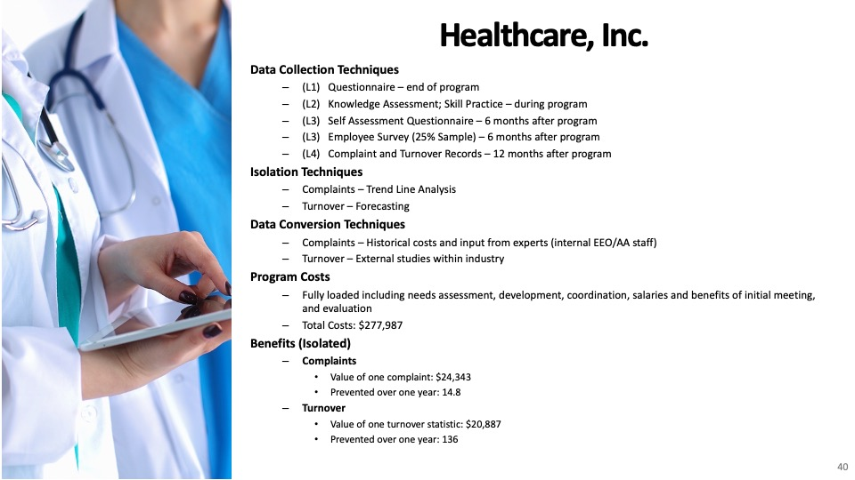

Slide 11
Use ROI selectively.
Considerations when identifying programs to evaluating to ROI?
  Cost of the program
  Linkage of program to operational goals and issues
  Importance of program to strategic objectives
  Top executive interest in the evaluation
  Visibility of the program
  Size of target audience
  Investment of time required

Slide 12
Measurement Targets
Level |  | Minimum % of Programs to Evaluate at Each Level | **Benchmarking %
0 | Input | 100% | 100%
1 | Reaction | 100% | 80%
2 | Learning | 80-90% | 70%
3 | Application | 30-50% | 49%
4 | Impact | 10-20% | 37%
5 | ROI | 5-10% | 18%
*Percent of programs evaluated at each level each year
**Benchmarking 2020

Slide 13

The Benefits of ROI
Justify/defend budgets.
Align projects to business needs.
Show project contributions.
Earn senior leaders’ respect.
Build staff morale.
Improve project support.
Enhance design and implementation processes.
Identify inefficient projects that need to be redesigned or eliminated.
Identify successful projects that can be implemented in other areas.
Earn a “seat at the table”.

Slide 14

Resources

Slide 15

Let’s have a conversation.
Schedule a time that works for you.
https://calendly.com/pattiphillips/connect
patti@roiinstitute.net

Slide 16
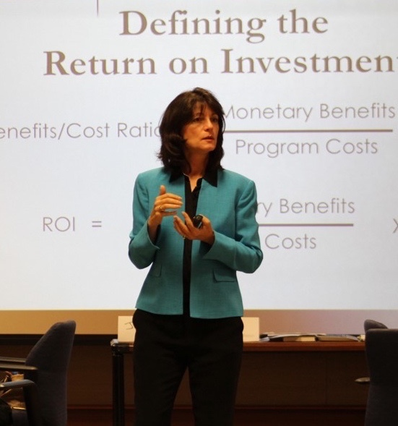
Patti P. Phillips, Ph.D.
CEO, ROI Institute, Inc.
Chair, i4cp People Analytics Board
Chair, Center for Talent Reporting Board
Senior Fellow, The Conference Board
Member, UN Institute for Training and Research Board of Trustees
Member, International Federation of Training and Development Board
Fellow, ATD Certified Professional in Talent Development
Author, Educator, Consultant, Coach

