Slide 1


Value for Money:
How the ROI Methodology Shows the Value for Money for All Types of Projects and Programs
Presented by Jack J. Phillips, Ph.D., Chairman, ROI Institute, Inc.

Slide 2

Objectives
After attending this session, participants should be able to:
Explain the need for an improved logic model.
Identify the key characteristics of the ROI Methodology.
List the advantages of using the ROI Methodology.
Describe different applications of the ROI Methodology.

Slide 3

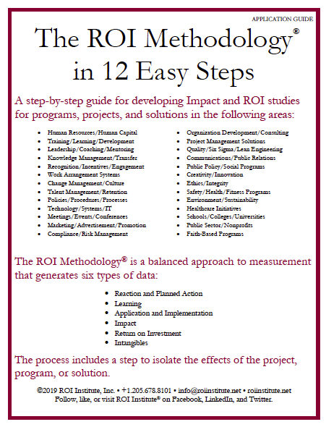

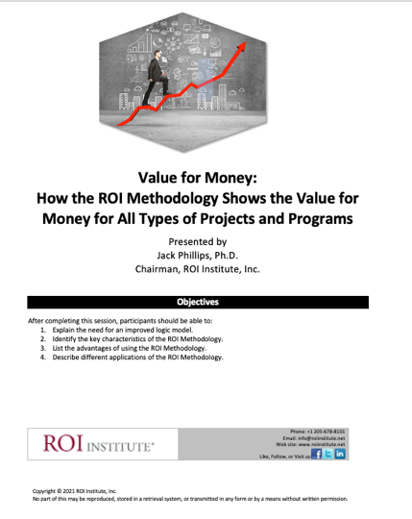
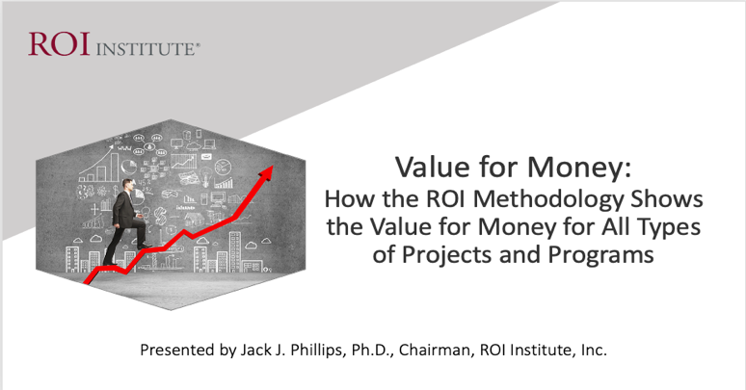
Resources

Slide 4

Pressures Facing the Public Sector Today
Budget constraints
Need to do more with less
Need process improvements (effectiveness and efficiency)
Need to show value of programs
Need for public accountability and transparency
4
4

Slide 5
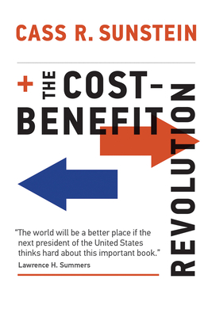
Issues — Real or Imagined?
No profits — no ROI? Lack of alignment Absence of hard data Too much politics Multiple ROI perspectives
5

Slide 6

What is ROI?
Program Benefits
Costs
BCR =
Benefits - Costs
Costs
ROI =
x 100
6

Slide 7
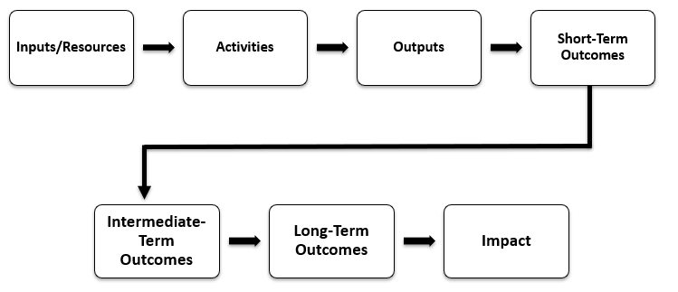
A Basic Program Logic Model
7
7

Slide 8

Concerns about Current Models
Lack of focus on benefit-cost analysis
Lack of emphasis on attribution
Inability to “show the money”
Not CEO- and CFO-friendly
Lack of focus on process improvement
The inability to influence investment
8

Slide 9

What is your experience with measuring ROI?
(Select all that apply.)
No experience with it.
It has been suggested, but no action has been taken.
I have attempted it.
I have successfully conducted an ROI study.
I have successfully conducted many ROI studies.
I wish ROI would go away.
9

Slide 10

Application of this Methodology
Publicly traded businesses
Privately held businesses
Governments (federal, state, and local)
Nongovernment organizations
Nonprofits
Universities
Community colleges and
technical institutes
K-12 school systems
Foundations
Charities
Healthcare organizations
Networks and alliances
Associations
Religious organizations
10
10

Slide 11

The ROI Methodology®
Most used evaluation system in the world
Endorsed by United Nations with a UN General Assembly resolution in 2008
Endorsed by 26 federal governments
Used by over 300 health care systems
Used by over 150 colleges and universities
Used by three-fourths of Fortune 500 organizations
Used by major foundations such as the Gates Foundation
11

Slide 12

What is Design Thinking?

Slide 13
Evaluation Framework
Levels of Evaluation | Measurement Focus | Typical Measures
0. Inputs & Indicators | The input into the project in terms of scope, volume, efficiencies, costs | Participants, Hours, Costs, Timing
1. Reaction & Planned Action | Measures participant satisfaction and captures planned actions, if appropriate | Relevance, Importance, Usefulness, Appropriateness, Intent to use, Motivation to take action
2. Learning & Confidence | Measures changes in knowledge, skills, and attitudes | Skills, Knowledge, Capacity, Competencies, Confidence, Contacts
3. Application & Implementation | Measures changes in behavior or actions | Extent of use, Task completion, Frequency of use, Actions completed, Success with use, Barriers to use, Enablers to use
4. Business Impact | Measures changes in business impact variables | Productivity, Revenue, Quality, Time, Efficiency, Customer satisfaction, Employee engagement
5. Return on Investment | Compares project benefits to the costs | Benefit-Cost Ratio (BCR), ROI%, Payback period
13

Slide 14

The ROI Methodology Process Model
Designing for the Delivery of Business Results
PLAN THE EVALUATION
COLLECT DATA
ANALYZE DATA
Make it Credible:
Tabulate Costs of
Program
OPTIMIZE RESULTS
LEVEL 0: INPUT
LEVEL 1: REACTION AND PLANNED ACTION
LEVEL 3:
APPLICATION
Tell the Story:
Communicate
Results to Key
Stakeholders
Optimize
Results:
Use Black Box
Thinking to
Increase Funding
Start with Why:
Align Programs
With the
Business
Make it Feasible:
Select the Right
Solution
Expect
Success:
Plan for
Results
Make it Matter:
Design for Input,
Reaction and
Learning
Make it Stick:
Design for
Application
and Impact
Make it
Credible:
Isolate the
Effects
Make it Credible:
Convert Data to
Monetary Value
Make it Credible:
Calculate ROI
LEVEL 5: ROI
LEVEL 2: LEARNING
LEVEL 4: IMPACT
Make it Credible:
Identify Intangibles
INTANGIBLE BENEFITS
©2022 ROI Institute Inc. All Rights Reserved.
14

Slide 15

Twelve Guiding Principles of ROI

Slide 16
Measurement Targets
Level |  | Recommended % of Programs | **Benchmarking %
0 | Input | 100% | 100%
1 | Reaction | 100% | 80%
2 | Learning | 80-90% | 70%
3 | Application | 30% | 49%
4 | Impact | 10% | 37%
5 | ROI | 5% | 18%
*Percentage of programs evaluated at each level each year
**Benchmarking 2020
What is your status?
16
Notes:
SALLY

Slide 17
Cost of the program
Linkage of program to operational goals and issues
Importance of program to strategic objectives
Top executive interest in the evaluation
Visibility of the program
Size of target audience
Investment of time required
Characteristics of Programs Suitable for Impact & ROI
17

Slide 18

Start with Why
Align Programs with the Business
Design Thinking Principle 1
A problem-solving approach to handle problems on a systems levels
Alignment is the key.
Is it a problem or opportunity?
Need specific business measures.
18

Slide 19

Make It Feasible
Select the Right Solution
Design Thinking Principle 2
A mind-set for curiosity and inquiry
  What are we doing (or not doing) that’s influencing the business measure?
  How can we achieve this performance?
19

Slide 20

Expect Success
Design for Results
Design Thinking Principle 3
A framework to balance needs and feasibility
  Set objectives at multiple levels
  Redefine success of program
  Expand responsibilities
20

Slide 21
Developing Objectives for Each Level
Levels of Objectives | Focus of Objectives
Level 1, Reaction | Defines specific measures of expected reaction to the program as it is revealed and communicated to the stakeholders
Level 2, Learning | Defines specific measures of improvement in knowledge, information, contacts, and skills as the participants and other stakeholders learn how to make the program successful
Level 3, Application | Defines specific measures of actions taken that define success with application and implementation of the program
Level 4, Impact | Defines the specific impact measures that will change or improve as a consequence of the program’s implementation
Level 5, ROI | Defines the minimum return on investment from the program, comparing program costs with monetary benefits from the program
21

Slide 22
After completing this program, participants should:
Matching Evaluation Levels with Objectives
1. | Decrease citizen complaints by 20% in one year.
2. | Use problem-solving skills to uncover causes of problems.
3. | Be able to demonstrate the five steps to determine if there is a food security issue.
4. | Rate the facilitator 4 out of 5 on presentation skills.
5. | Decrease the amount of time required to develop a proposal by 25%.
6. | Achieve a 20% ROI one year after program implementation.
7. | Perceive the Crime Prevention Program to be relevant to the community (4.5 out of 5).
8. | Decrease security breaches by 25% in six months.
9. | Conduct a proper investigation using the seven-step process in 95% of complaint situations.
10. | Score an average of 20 or better on AIDS Awareness quiz.
11. | Complete a conflict-of-interest questionnaire each year as part of the new ethics policy.
12. | Use all 10 negotiation skills in at least 50% of negotiation situations.
4
3
2
1
4
5
1
4
3
2
3
3
1 = Reaction 2 = Learning 3 = Application 4 = Impact 5 = ROI
22

Slide 23

Focus on the objectives
Think about the definition of success
Make it relevant
Make it important
Make it action-oriented
Make it Matter
Design for Input, Reaction,
and Learning
Design Thinking Principle 4
A way to take on design challenges by applying empathy

Slide 24

Make it Stick
Design for Application and Impact
Design Thinking Principle 5
A culture that fosters exploration
and experimentation
Collect data
Focus on objectives
Ensure transfer to the workplace
Design for application

Slide 25
Data Collection Methods
*Survey of Users, N = 246
25

Slide 26

Make it Credible
Measure Results and Calculate ROI
Design Thinking Principle 6
A fixed process and a tool kit
Isolating the effects of the program
Converting Impact data to money
Identifying intangible benefits
Tabulating cost of the program
Calculating ROI
26

Slide 27

Isolation Methods
*Survey of Users, N = 246

Slide 28
Data Conversion Methods
*Survey of Users, N = 246
28

Slide 29

Intangibles
Adaptability
Awards
Brand awareness
Career minded
Caring
Collaboration
Communication
Conflicts
Corporate social responsibility
Decisiveness
Engagement
Image
Innovation
Job satisfaction
Leadership
Networking
Organizational climate
Organizational commitment
Reputation
Stress
Talent
Teamwork
29

Slide 30


“When in doubt, put it in.”
Fully-Loaded Costs
The process should withstand even the closest scrutiny in terms of its credibility.
DIRECT
INDIRECT
Program materials
Instructor/facilitator
Facilities
Travel, lodging, meals
Needs assessment (Prorated)
Program development (Prorated)
Participant time (salaries & benefits)
Administrative/overhead
Evaluation
30

Slide 31

Example: Crime Prevention Program
Presented to Community: Designed to reduce burglaries
Unit of Measure: 1 burglary
V = $13,096 (RAND Corporation)
△P = 3 per month
A△P = 3 x 12 = 36
A△P x V = 36 x $13,096 = $471,456
Assume anticipated blended learning program cost: $239,700.
What is the ROI?
31
31

Slide 32
ROI Calculation
$471,456
$239,700
BCR =
=
1.97:1
$471,456 - $239,700
$239,700
=
ROI =
x 100
97%
32

Slide 33
Tell the Story
Communicate Results to Key Stakeholders
Design Thinking Principle 7
A storytelling process to inspire senior executives
Define audience
Identify why they need it
Select method
Move quickly
Consider one-page summary
33

Slide 34

Optimize Results
Use Black Box Thinking to Increase Funding
Design Thinking Principle 8
A new competitive logic of business strategy
EVALUATION
OPTIMIZATION
ALLOCATION
Measure
Improve
Fund
34

Slide 35

What are your concerns about measuring ROI?
(Select all that apply.)
It’s too difficult.
It takes took much time.
No one is asking for this.
It will kill my programs.
I wish it would go away.
35

Slide 36

The Payoff
Justify/defend budgets.
Align projects to business needs.
Show contributions of selected projects.
Earn senior leaders’ respect.
Build staff morale.
Improve project support.
Enhance design and implementation processes.
Identify inefficient projects that need to be redesigned or eliminated.
Identify successful projects that can be implemented in other areas.
Earn a “seat at the table”.

Slide 37

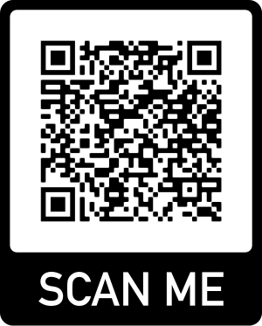
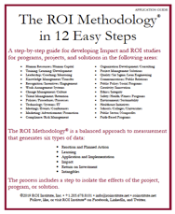


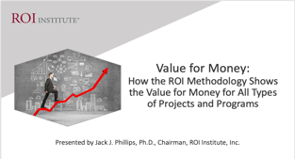
Click the link below or scan the QR code to access the resources from today’s session.
https://bit.ly/WAEvaluators

Slide 38

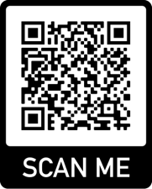

Slide 39
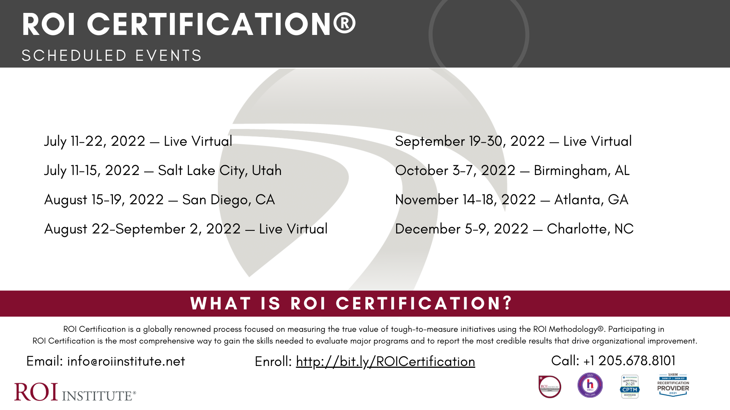

Slide 40




Questions?
Visit us online:
www.roiinstitute.net
Email:
Jack@roiinstitute.net
Connect with Us

