Slide 1


How to Ensure that Your Programs Deliver Impact and ROI
Jack J. Phillips, Ph.D.
Chairman, ROI Institute, Inc.

Slide 2

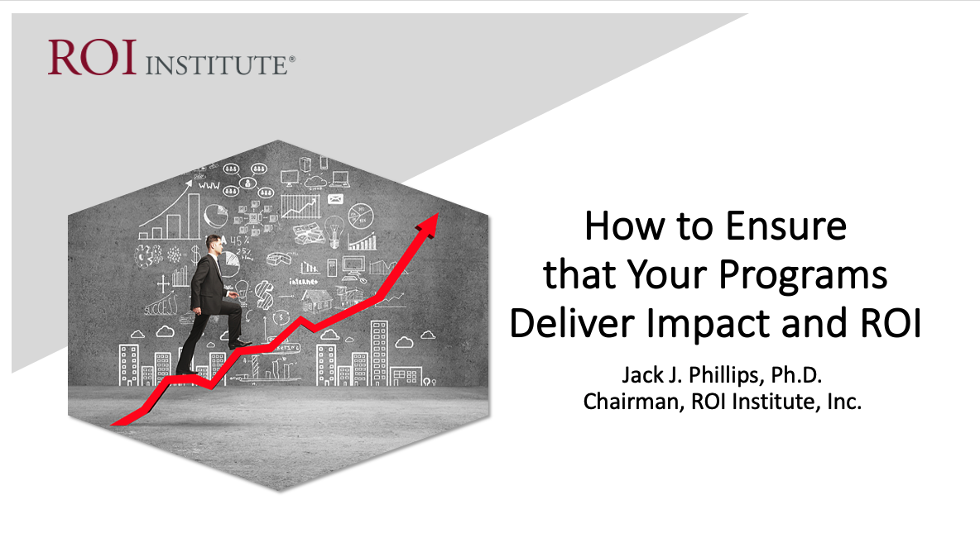
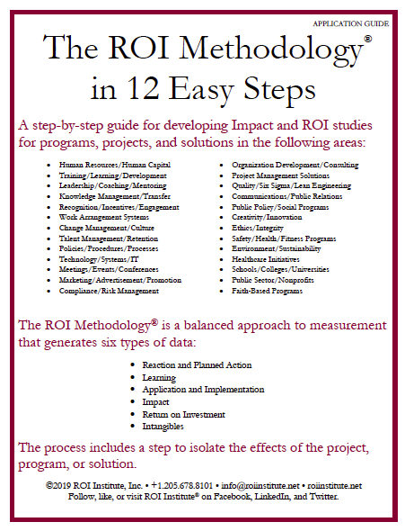

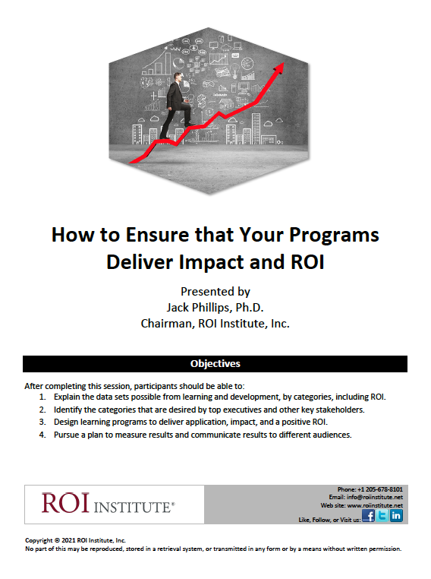
Resources

Slide 3

Session Objectives
After attending this session, participants should be able to:
Explain the data sets possible from learning and development, by categories, including ROI.
Identify the categories that are desired by top executives and other key stakeholders.
Design learning programs to deliver application, impact, and a positive ROI.
Pursue a plan to measure results and communicate results to different audiences.

Slide 4

Why Are You Interested in Measuring ROI Now?
Top executives are requiring this. I must pursue it.
I have pressure to justify my budget. I need to pursue this.
I know I will need to demonstrate more value in the future.
I want to show increased accountability for our expenditures.
I want to experiment with and explore new techniques to measure program success.
4

Slide 5

Serious Performance Challenges
Most learning and development is wasted (not used).
The learning outcome desired by executives in client organizations is rarely measured.
Most learning providers do not have data showing that they make a difference in the organization.
Most executives see learning as a cost and not an investment.
Most executives view hard skills more valuable than soft skills.
True
or
False?
5

Slide 6
Serious Performance Challenges
Most learning and development is wasted (not used).
The learning outcome desired by executives in client organizations is rarely measured.
Most learning providers do not have data showing that they make a difference in the organization.
Most executives see learning as a cost and not an investment.
Most executives view hard skills more valuable than soft skills.
True
or
False?
It’s much worse for virtual.
6

Slide 7
The Value Chain
 | LEVEL | ISSUE | MEASURES | TARGETS**
This is easy Always measured | 0 | Inputs | Volume, Hours, Convenience, Cost | 100%
This is easy Almost always measured | 1 | Reaction | *Relevance, Engaging, *Important, Useful, *New Content, *Intent to Use, *Recommend to Others | 100%
Not difficult Usually measured | 2 | Learning | Concepts, Trends, Facts, Contacts, Skills, Competencies | 90%
Possible Often measured | 3 | Application | Use of content, Frequency of Use, Success with Use, Barriers, Enablers | 30%
Not so difficult to connect Sometimes measured | 4 | Impact | Productivity, Time, Quality, Costs, Image, Reputation, Engagement, Compliance | 10%
Possible for many programs Rarely measured | 5 | ROI | Benefit Cost Ratio or Return on Investment, Expressed as a Percent | 5%
*Can predict
Must take a step to isolate the effects
Executives prefer
**Best Practice: Percent of programs evaluated at this level each year.
7

Slide 8

What CEOs Want
Measures | Currently Measure | Should Measure | Importance
Inputs and Indicators | 94% | 86% | 6
Efficiency | 78% | 82% | 7
Reaction | 53% | 22% | 8
Learning | 32% | 28% | 5
Application | 11% | 61% | 4
Impact | 8% | 96% | 1
ROI | 4% | 74% | 2
Awards | 40% | 44% | 3
ROI Institute and ATD research show that the data CEOs receive are not demonstrating what they want out of their talent investment. (N=96)
8

Slide 10

Scotland Yard

Slide 11
11

Slide 12
The ROI Methodology Process Model
Designing for the Delivery of Business Results
EVALUATION PLANNING
DATA COLLECTION
DATA ANALYSIS
Make it Credible:
Tabulate Costs of
Program
OPTIMIZE RESULTS
LEVEL 0: INPUT
LEVEL 1: REACTION AND PLANNED ACTION
LEVEL 3:
APPLICATION
Tell the Story:
Communicate
Results to Key
Stakeholders
Optimize
Results:
Use Black Box
Thinking to
Increase Funding
Start with Why:
Align Programs
With the
Business
Make it Feasible:
Select the Right
Solution
Expect
Success:
Plan for
Results
Make it Matter:
Design for Input,
Reaction and
Learning
Make it Stick:
Design for
Application
and Impact
Make it
Credible:
Isolate the
Effects
Make it Credible:
Convert Data to
Monetary Value
Make it Credible:
Calculate ROI
LEVEL 5: ROI
LEVEL 2: LEARNING
LEVEL 4: IMPACT
Make it Credible:
Identify Intangibles
INTANGIBLE BENEFITS
©2021 ROI Institute Inc. – No part of this document can be reproduced, stored in a retrieval system, or transmitted in any form without written permission from ROI Institute, Inc.
12

Slide 13

Start with Why
Align Programs with the Business
Design Thinking Principle 1
A problem-solving approach to handle problems on a systems levels
13

Slide 14

Alignment Model
Start Here
End Here
Payoff Needs
5
ROI Objectives
5
ROI
Why?
Business Needs
4
Impact Objectives
4
Impact
Performance Needs
3
Application Objectives
3
Application
Learning Needs
2
Learning Objectives
2
Learning
Initial
Analysis
Measurement and Evaluation
Preference Needs
1
Reaction Objectives
1
Reaction
Input Needs
0
Input Objectives
0
Input
Program Process Initiative
Alignment and Forecasting
The ROI Process Model
14

Slide 15

Make it Feasible
Select the Right Solution
Design Thinking Principle 2
A mind-set for curiosity and inquiry
15

Slide 16
Alignment Model
Start Here
End Here
Payoff Needs
5
ROI Objectives
5
ROI
Why?
Business Needs
4
Impact Objectives
4
Impact
Performance Needs
3
Application Objectives
3
Application
Feasible Solution
Learning Needs
2
Learning Objectives
2
Learning
Preference Needs
1
Reaction Objectives
1
Reaction
0
0
Program Process Initiative
Alignment and Forecasting
The ROI Process Model
16

Slide 17

Have a Discussion and Use Diagnostic Tools
Feasible solutions evolve through the understanding of context, empathizing with the target audience, and identifying performance gaps. The next step is to identify learning needs and how best to deliver relevant information. Forecasting outcomes based on inputs is sometimes helpful.
Statistical process control Brainstorming Problem analysis Cause-and-effect diagram Force-field analysis Mind mapping Affinity diagrams Simulations | Diagnostic instruments Focus groups Probing interviews Job satisfaction surveys Engagement surveys Exit interviews Exit surveys Nominal group technique
17

Slide 18

Expect Success
Design for Results
Design Thinking Principle 3
A framework to balance
needs and feasibility
18

Slide 19
Developing Objectives for Each Level
Levels | Focus
Level 1, Reaction | Defines specific measures of expected reaction to the program as it is revealed and communicated to the stakeholders
Level 2, Learning | Defines specific measures of improvement in knowledge, information, contacts, and skills as the participants and other stakeholders learn how to make the program successful
Level 3, Application | Defines specific measures of actions taken that define success with application and implementation of program
Level 4, Impact | Defines the specific impact measures that will change or improve as a consequence of the program’s implementation
Level 5, ROI | Defines the minimum return on investment from the program, comparing program costs with monetary benefits from the program
19

Slide 20

Rules for Objectives
Must be measurable and represent minimum acceptable performance.
Fewer objectives are better than many objectives.
Involve subject-matter experts and key stakeholders.
Keep them relevant to the situation, program, and key stakeholders.
Create stretch objectives, but make sure they are achievable.
Allow for the flexibility to change as conditions change.
Failure is OK; process improvement is the key.
Objectives are tools for progress, not weapons for performance review.
Most objectives should be time-bound.
Objectives provide the focus for design, development, implementation, and evaluation.
20

Slide 21
Evaluation Levels with Objectives
After completing this program or project, participants should be able to:
1. | Decrease citizen complaints by 20% in one year.
2. | Use problem-solving skills to uncover product defect causes.
3. | Be able to demonstrate the five steps to calm an upset customer.
4. | Perceive the content to be relevant their situation (4.5 out of 5).
5. | Decrease security breaches by 25% in six months.
6. | Achieve a 20% ROI one year after implementation of sales incentive system.
1 = Reaction 2 = Learning 3 = Application 4 = Impact 5 = ROI
21

Slide 22
Evaluation Levels with Objectives
After completing this program or project, participants should be able to:
1. | Decrease citizen complaints by 20% in one year.
2. | Use problem-solving skills to uncover product defect causes.
3. | Be able to demonstrate the five steps to calm an upset customer.
4. | Perceive the content to be relevant their situation (4.5 out of 5).
5. | Decrease security breaches by 25% in six months.
6. | Achieve a 20% ROI one year after implementation of sales incentive system.
4
3
2
1
4
5
1 = Reaction 2 = Learning 3 = Application 4 = Impact 5 = ROI
22

Slide 23
23

Slide 24

Make it Stick
Design for Application and Impact
Design Thinking Principle 5
A culture that fosters exploration
and experimentation
24

Slide 25
Thirty Techniques to Design Virtual Learning to Deliver Impact and a Positive ROI
25

Slide 26
Data Collection Methods
Method | Level
 | 1 | 2 | 3 | 4
Surveys | ✓ | ✓ | ✓
Questionnaires | ✓ | ✓ | ✓ | ✓
Observation | ✓ | ✓ | ✓
Interviews | ✓ | ✓ | ✓
Focus Groups | ✓ | ✓ | ✓
Tests/Quizzes |  | ✓
Demonstrations |  | ✓
Simulations |  | ✓
Action planning/improvement plans |  |  | ✓ | ✓
Performance contracting |  |  | ✓ | ✓
Performance monitoring |  |  |  | ✓
26

Slide 27

Make it Credible
Measure Results and Calculate ROI
Isolating the effects of the program
Converting Impact data to money
Identifying intangible benefits
Tabulating cost of the program
Calculating ROI
Design Thinking Principle 6
A fixed process and a tool kit
27

Slide 28
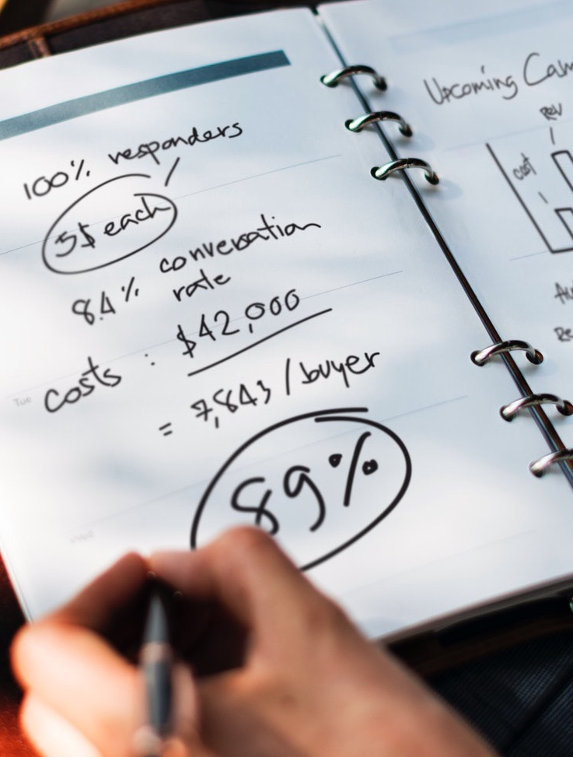
What percent of your programs are evaluated at the impact level per year?
None
About 5%
About 10%
About 15%
More than 20%
28

Slide 29
Measurement Targets
Level |  | Recommended % of Programs | **Benchmarking %
0 | Input | 100% | 100%
1 | Reaction | 100% | 80%
2 | Learning | 80-90% | 70%
3 | Application | 30% | 49%
4 | Impact | 10% | 37%
5 | ROI | 5% | 18%
*Percentage of programs evaluated at each level each year
**Benchmarking 2020
29
Notes:
SALLY

Slide 30

What is ROI?
Program Benefits
Program Costs
BCR =
Benefits - Costs
Program Costs
ROI =
X 100
30

Slide 31

ROI Calculation Example
Program: Inclusive Leadership
Program Benefits = $762,393
Program Costs = $387,708
*Data taken from an inclusive leadership case study.
31

Slide 32
What is ROI?
$762,393
$387,708
BCR =
=
1.97
$762,393 - $387,708
$387,708
ROI =
X 100 =
97%
32

Slide 33

Executives and chief financial officers need ROI data for major programs.
33

Slide 34
34

Slide 35

Optimize Results
Use Black Box Thinking to Increase Funding
Design Thinking Principle 8
A new competitive logic of business strategy
35

Slide 36

The Payoff
Justify/defend budgets.
Align projects to business needs.
Show contributions of selected projects.
Earn respect of senior management/administrators.
Build staff morale.
Improve support for projects.
Enhance design and implementation processes.
Identify inefficient projects that need to be redesigned or eliminated.
Identify successful projects that can be implemented in other areas.
Earn a “seat at the table”.
36

Slide 37

Be Proactive
Remember, when it comes to delivering results:
  Hope is not a strategy.
  Luck is not a factor.
  Doing nothing is not an option.
Change is inevitable.
Progress is optional.
37

Slide 38


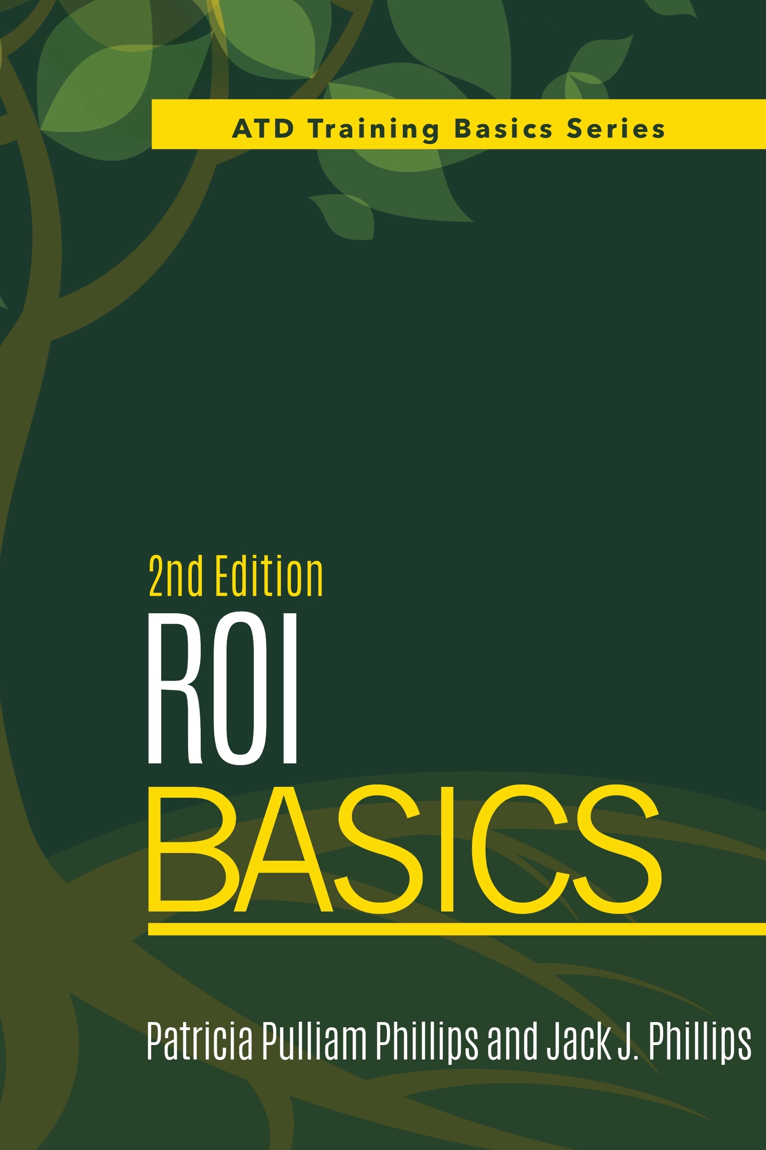
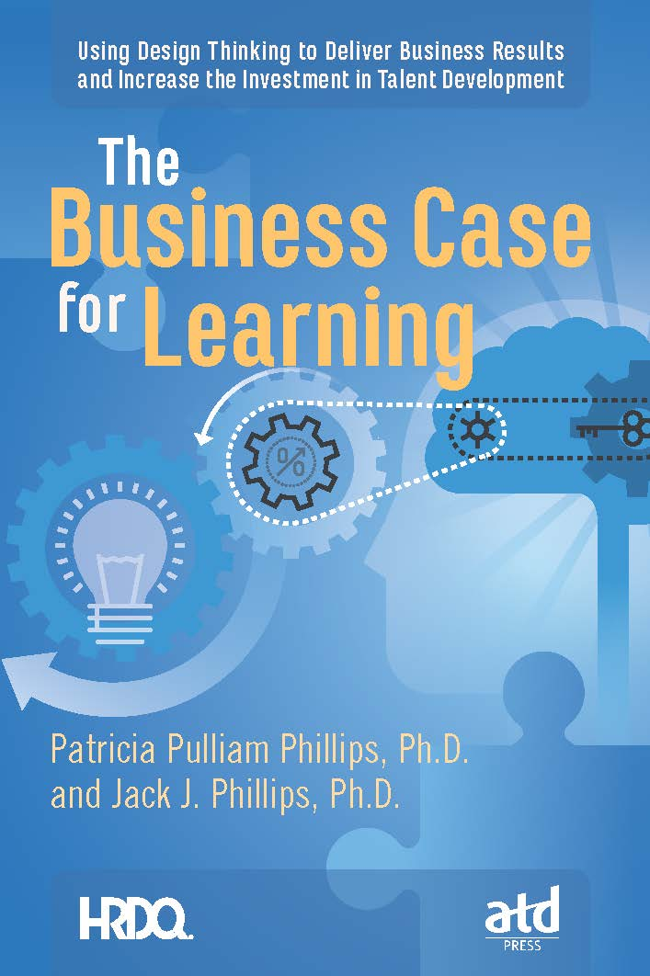
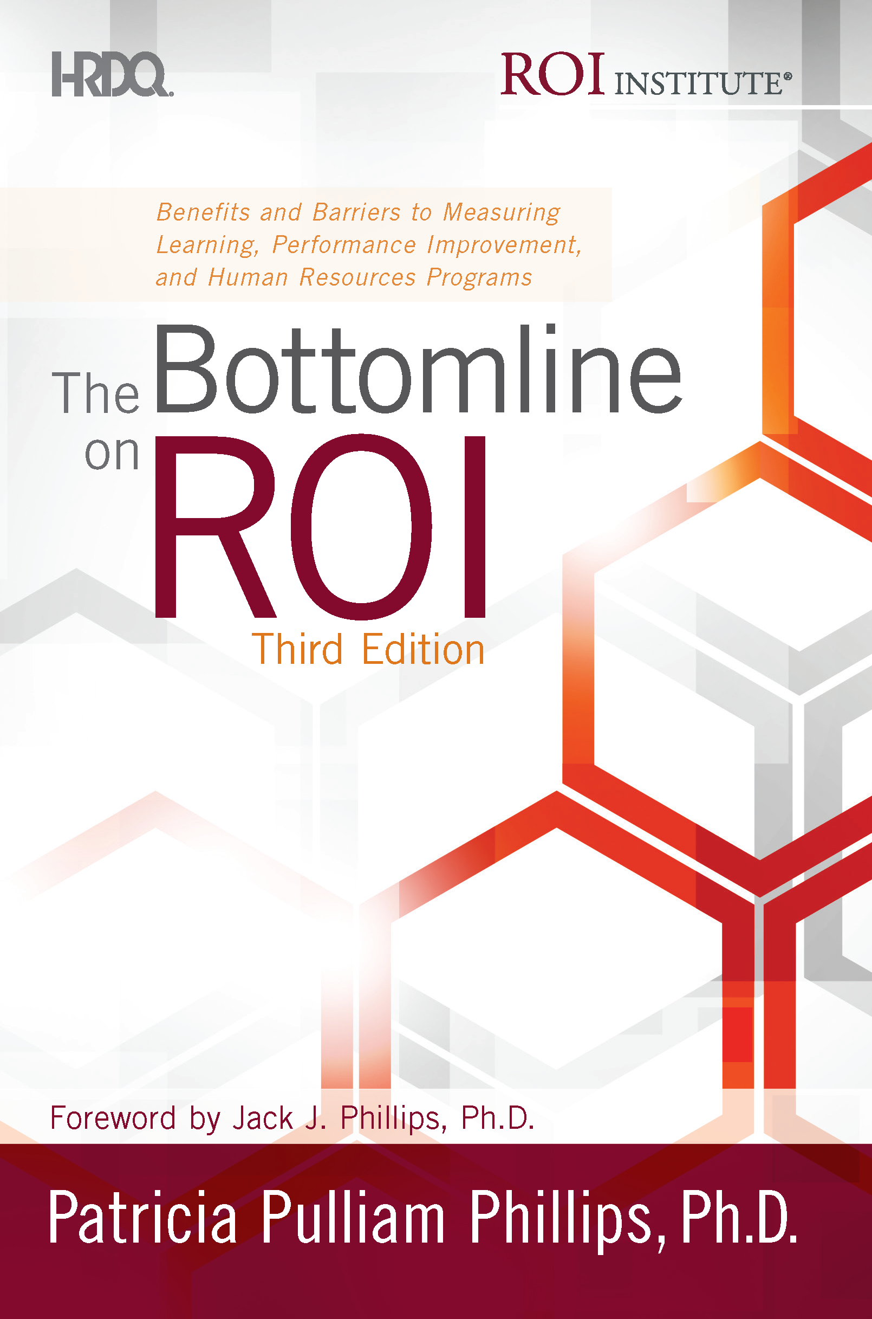

Congratulations!
Winners can choose a digital copy of one of these books.
Proving the Value of Soft Skills: Measuring Impact and Calculating ROI
ROI Basics, 2nd Edition
The Business Case for Learning
The Bottomline on ROI, Third Edition
38

Slide 39


Click the link below to access resources from today’s session.
https://roiinstitute.net/talsuccess-roi-training/

Slide 40


www.roiinstituteacademy.com
Join Level 0 Membership at no cost to gain access to resource materials, tools, and case studies.

Slide 41




Questions?
Visit us online:
www.roiinstitute.net
Email:
Jack@roiinstitute.net
Connect with us on:

