Slide 1





The Impact and ROI of Leadership Development
Nader Bechini, CRP
Director, ROI Institute MENA
@naderbechini

Slide 2

Why Now?
4 Reasons

Slide 3

Why Now?
Top 10 Challenges
Developing “Next Gen” leaders
64%
Reason 1:
Challenges facing C-level executives
Failure to attract/retain talent
60%
New competitors globally
48%
Cyber-security
28%
Slowing economics growth in emerging markets
25%
Labor relations
24%
Global recession
22%
Income inequality/disparity
21%
Oudated/insufficient national infrastructure
20%
Global political uncertainty
18%
Source: Global Leadership forecast 2018, DDI, The Conference Board, Ernst & Young
Notes:
More than 1,000 C-level executives worldwide identified the issues they expect to command their attention in the coming year. Of the 28 challenges from which they could choose, their biggest concerns weren’t headline-worthy global issues like political instability, climate change, terrorism, or a global recession. Rather, the top challenges vying for leaders’ action
focused on their own leaders. Developing “Next Gen” leaders and failure to attract/retain top talent were rated in the top five by 64 percent and 60 percent of respondents, respectively. Leaders clearly indicated that top talent and effective leaders will be needed to address the myriad current challenges and to position their organization for future success. The Top 10 Challenges are shown above.

Slide 4
Why Now?
Top 10 Challenges
Developing “Next Gen” leaders
64%
Reason 1:
Challenges facing C-level executives
Failure to attract/retain talent
60%
New competitors globally
48%
Cyber-security
28%
Slowing economics growth in emerging markets
25%
Labor relations
24%
Global recession
22%
Income inequality/disparity
21%
Oudated/insufficient national infrastructure
20%
Global political uncertainty
18%
Source: Global Leadership forecast 2018, DDI, The Conference Board, Ernst & Young
Notes:
More than 1,000 C-level executives worldwide identified the issues they expect to command their attention in the coming year. Of the 28 challenges from which they could choose, their biggest concerns weren’t headline-worthy global issues like political instability, climate change, terrorism, or a global recession. Rather, the top challenges vying for leaders’ action
focused on their own leaders. Developing “Next Gen” leaders and failure to attract/retain top talent were rated in the top five by 64 percent and 60 percent of respondents, respectively. Leaders clearly indicated that top talent and effective leaders will be needed to address the myriad current challenges and to position their organization for future success. The Top 10 Challenges are shown above.

Slide 5

Why Now?
Reason 2:
The “Cost of doing nothing”
The cost of being wrong
is less than the cost of
doing nothing.
Seth Godin

Slide 6

Why Now?
Reason 2:
The “Cost of doing nothing”
LOW EMPLOYEE RETENTION
Replacing an employee can cost between 50% to 60% of that employee’s salary
Source: SHRM
Notes:
Replacing an employee can cost between 50% -60% of that employee’s salary with overall costs ranging anywhere from 90%-200% replacement cost

Slide 7
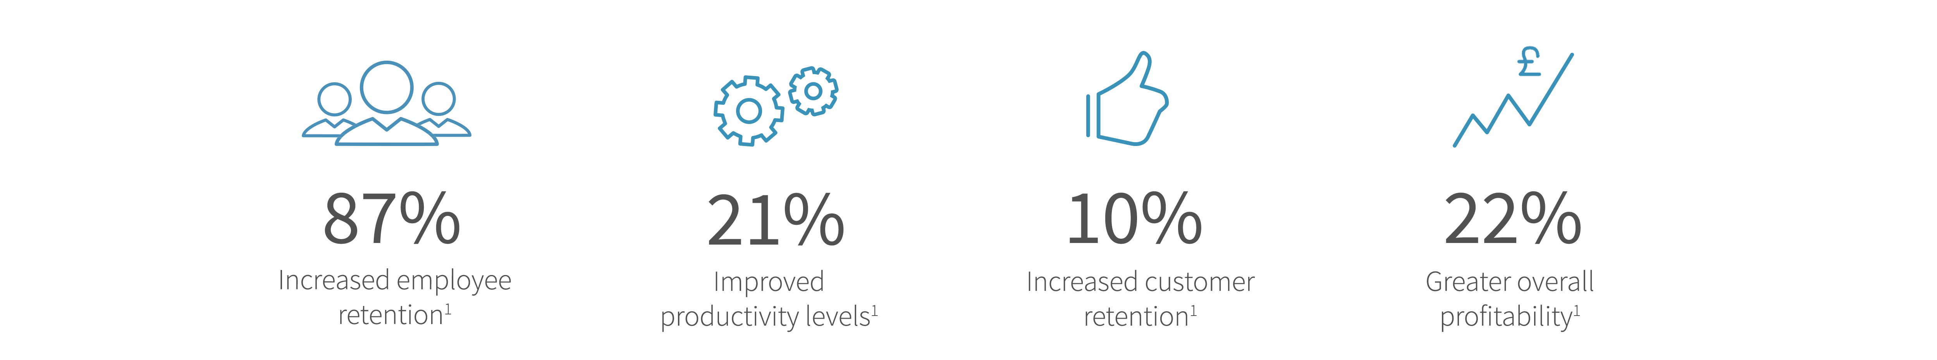
Why Now?
Benefits from Employees Engagement:
Reason 2:
The “Cost of doing nothing”
Source: Corporate Leadership Council
DISENGAGED EMPLOYEE
85% of employees worldwide are not engaged or are actively disengaged in their job.
Source: GALUP State of the Global Workplace 2017
Notes:
More than 1,000 C-level executives worldwide identified the issues they expect to command their attention in the coming
year. Of the 28 challenges from which they could choose, their biggest concerns weren’t headline-worthy global issues like
political instability, climate change, terrorism, or a global recession. Rather, the top challenges vying for leaders’ action
focused on their own leaders. Developing “Next Gen” leaders and failure to attract/retain top talent were rated in the
top five by 64 percent and 60 percent of respondents, respectively. Leaders clearly indicated that top talent and effective
leaders will be needed to address the myriad current challenges and to position their organization for future success. The
Top 10 Challenges are shown above.

Slide 8
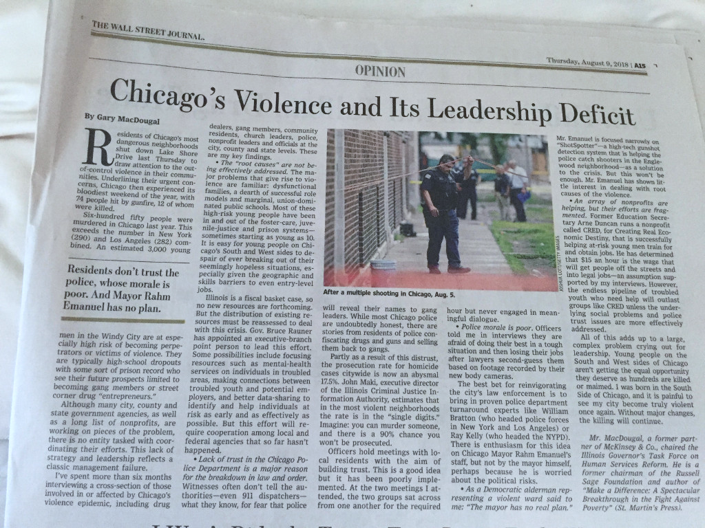
Why Now?
Reason 2:
The “Cost of doing nothing”
LOW PRODUCTIVITY
Notes:
The Wall Street Journal on August 9, 2018 indicates that the crime problem in Chicago is because of police leadership.

Slide 9
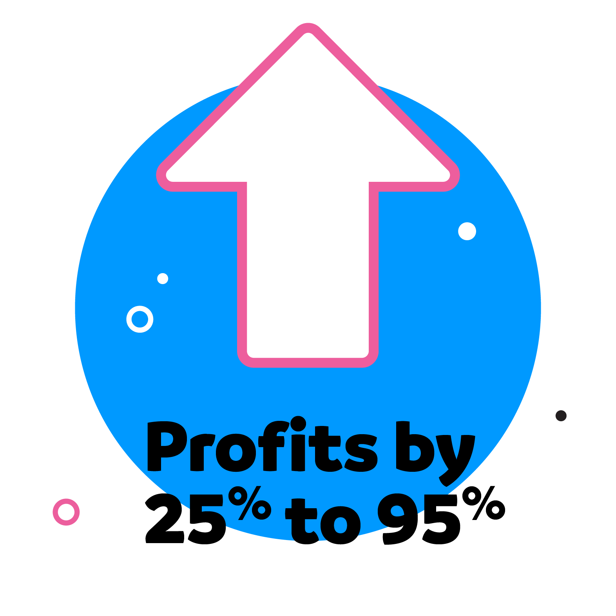

Why Now?
Increasing customer retention rates by 5% can increases profits by 25% to 95%
Reason 2:
The “Cost of doing nothing”
LOW CUSTOMER RETENTION
Source: Frederick Reichheld (the inventor of the net promoter score), Bain & Company
The Economics of E-Loyalty, Harvard Business School
Notes:
a 5% increase in customer retention produces from 25% to 95% increase in profit

Slide 10


Why Now?
Sponsors and Funders Want to see the Impact and Monetary Value
Reason 3:
Show Me The Money!

Slide 11
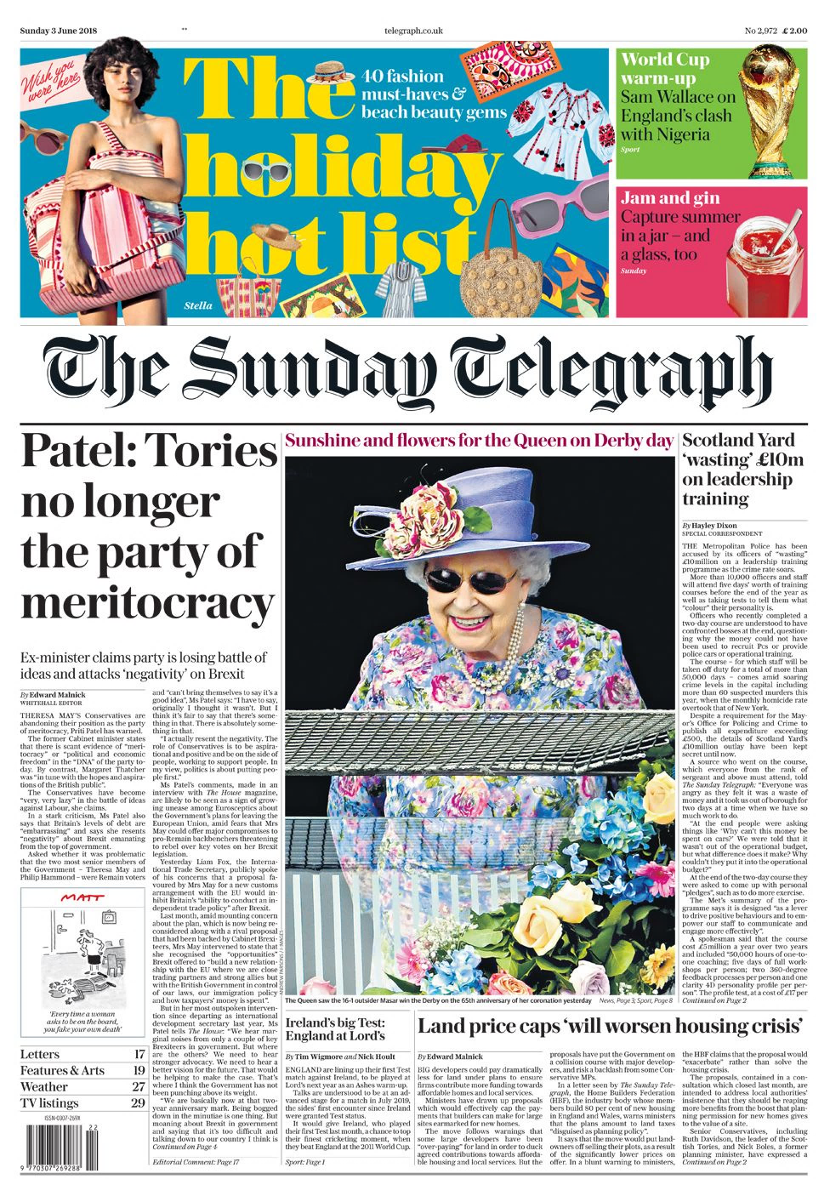
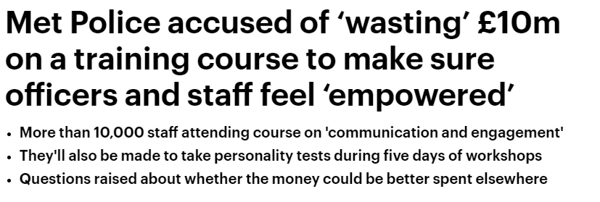
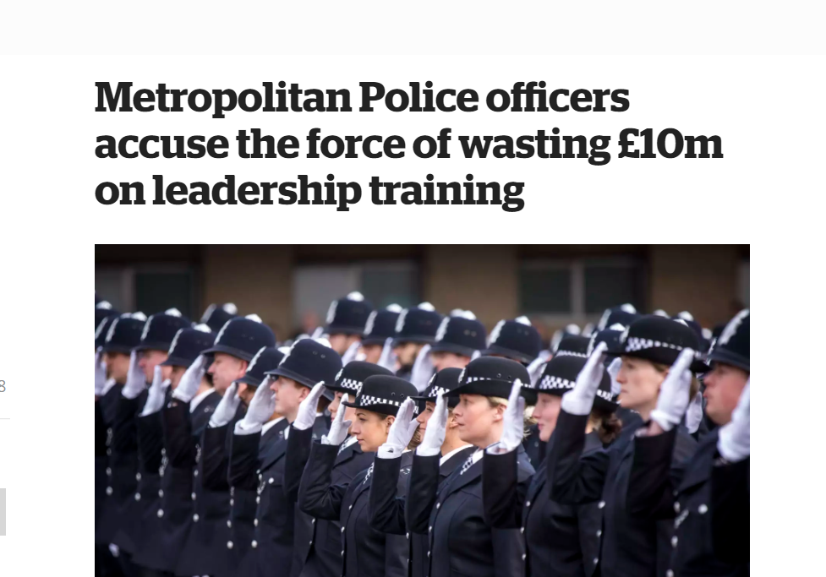

Why Now?
Reason 3:
Show Me The Money!
Notes:
In 3rd of June 2018, a major leadership development implementation at Scotland Yard in England brought headlines that said, “Met Police Accused of ‘Wasting’ £10 million on Leadership Training Programme as Crime Soars.”
Sunday Telegraph headline
More than 10,000 officers and staff (2 years)
4D personality profile
50,000 hours of one-to-one coaching
5 days training
Two ‘360-degree’ feedback sessions
Unfortunately, this program’s implementation came as the crime rate is at an all-time high in London and continues to increase, while the percentage of crimes solved is at an all-time low of five percent. Those are the key business measures that should be, and could be, connected to this leadership program. For some reason, they were not connected.
The detailed article probably left the impression with some people that leadership development is a waste.
why the money could not have been used to recruit PCs or provide police cars or operational training. The £10million budget, which is split over two years, would be enough to fund about 1000 police cars or the yearly salary of more than 400 PC’s.
Leadership development should start with why with very specific business measures. Major leadership efforts cannot be justified in today’s environment just on leader behavior changes, and that was the justification was for the Scotland Yard program. This program was open to all police supervisors, in the role of sergeant and above, including support staff managers. In reality, the key performance indicators of these leaders would be either directly related to these two crime-related categories (crime rate and crimes resolved), or they have impacts that support these measures.

Slide 12
Why Now?
96%
Reason 3:
Show Me The Money!
Business impact is No. 1 measure desired by CEOs
ROI is No. 2 measure desired by CEOs
74%
8%
4%
Only 8% of CEOs see a direct business impact from their company’s L&D programs.
Only 4% of CEOs currently see an ROI from their company’s L&D programs.
Source: ROI Institute, Inc
Notes:
Problem 4: According to one study, 96 percent of Fortune 500 CEOs want to see the business connection, yet only 8 percent see it. Also, 74 percent want to see ROI, yet only 4 percent see it.
Few learning and talent development professionals have data to show top executives that their programs make a difference in the organization. Design thinking keeps the hungry gorilla — in the form of a senior executive — fed so that he doesn’t come around demanding impact data.

Slide 13


Why Now?
According to ATD “State of the industry report” 2017
Benchmark Study Source: CEB 2014
45%
Reason 3:
Show Me The Money!
Avg per employee training expenditure
$1,273 X 45%= $573
= $1,273
Avg number of training hours consumed per employee
34.1 h X 45%= 15.3 h
= 34.1 h
Notes:
PROBLEM 5: People are not using learning (or they are learning what they don’t need to know).
Statistics show that over 50 percent of learning and development is wasted. People may be learning what you’re teaching, but it doesn’t necessarily apply to their day-to-day work, or, even if it does apply, for some reason they don’t use it. The wasted funds are bad, of course, but the wasted potential is even worse.
If a program is not delivering the desired results, the data generated by design thinking will show what caused the disappointment. Then you can adjust to improve the program, or others, in the future.

Slide 14






Why Now?
HR Role
Leaders Rating
HR Rating
Reactor
Sets and ensures compliance with policies
Responds to business needs
Installs basic initiatives to manage talent
41%
21%
Reason 4:
HR’s new role!
Partner
Works toward mutual goals with line managers
Shares information with the business about talent issue gaps
Provides HR solutions.
62%
48%
More than 2,500 HR professionals and 25,000-plus leaders completed the Global Leadership Forecast 2018 survey
Anticipator
Uses analytics to forecast talent needs
Provides insights and solutions to ensure high-quality supply of talent
Links talent planning to business planning.
11%
17%
Source: Global Leadership forecast 2018, DDI, The Conference Board, Ernst & Young
Notes:
Reactor: Sets and ensures compliance with policies; responds to business needs; installs basic initiatives to manage talent.
Partner: Works toward mutual goals with line managers; shares information with the business about talent issue gaps; provides HR solutions.
Anticipator: Uses analytics to forecast talent needs; provides insights and solutions to ensure high-quality supply of talent; links talent planning to business planning.

Slide 15

Why Now?
Reason 4:
HR’s new role!
HR
Notes:
Reactor: Sets and ensures compliance with policies; responds to business needs; installs basic initiatives to manage talent.
Partner: Works toward mutual goals with line managers; shares information with the business about talent issue gaps; provides HR solutions.
Anticipator: Uses analytics to forecast talent needs; provides insights and solutions to ensure high-quality supply of talent; links talent planning to business planning.

Slide 16

“If your actions inspire others to dream more, learn more, do more
and become more,
you are a leader.”
John Quincy Adams (6th U.S. President)

Slide 17
“If your actions inspire others to dream more, learn more, do more
and become more,
you are a leader.”
John Quincy Adams (6th U.S. President)

Slide 18

Levels of Evaluation
Measurement Focus
Impact data not converted to money
Compares leadership program monetary benefits to the costs
ROI
Level
5
Intangible
Measure changes in business impact measures
Business
Impact
Level 4
Measures changes in on-the-job behavior or actions
Application & Implementation
Level 3
Measures changes in knowledge, skills, and attitudes
Learning
Level 2
Measures participant satisfaction with the leadership program and captures planned action
Level 1
Reaction & Planned Action

Slide 19

How to measure the success
of Leadership Development?

Slide 20

Start with Why
1

Slide 21

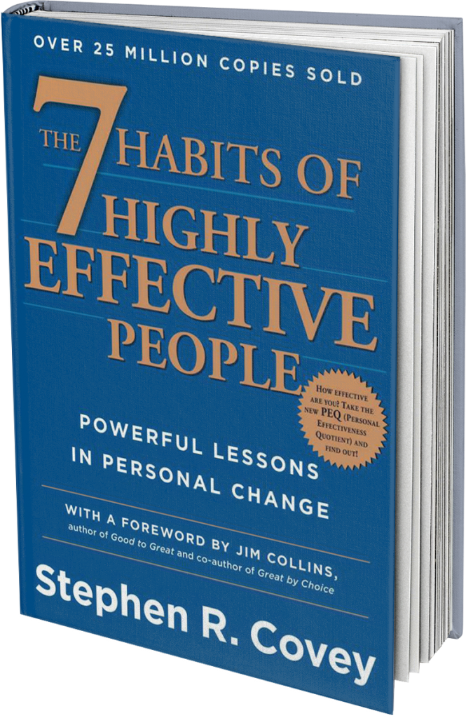

Start with Why
Align programs with the business
Opportunity
Problem
Problem to avoid

Slide 22










Start with Why
Align programs with the business
Hard Data
Soft Data
Typical Measures
Typical Measures
Output increases
Customer Satisfaction
Quality improvements
Employees Engagement
Cost savings
Creativity & Innovation
Time Savings
Work Habits
Notes:
Once the payoff need is addressed then the specific business measures that need to improve in order to address the payoff need are identified. These “Business needs” represent hard data, categorized as output, cost, and time; they may also represent soft data such as measures of customer satisfaction, employees satisfaction work habits, image, and creativity/innovation. Examples of business measures in need of improvement may be completion rate, inventory turnover, error rates, sales expense, overtime, brand awareness, employee complaints, and trademarks, copy-rights, and patents.

Slide 23

Make it Feasible
2

Slide 24

Make it Feasible
Select the Right Solution
1 What needs to change to influence the impact measure?
2 What can enable this change?
3 What is the best solution?

Slide 25

Expect Success
3

Slide 26



Expect the Success
Set objectives at multiple levels
Expect the Success
Start with why
Payoff Needs
5
ROI Objectives
5
Return on Investment
Business Needs
4
Impact Objectives
4
Impact
Make it Feasible
Performance Needs
Application Objectives
Application
3
3
Learning Needs
2
Learning Objectives
2
Learning
Preference Needs
1
Reaction Objectives
1
Reaction
Program
Notes:
Two decades ago, the definition of success was learning. We wanted to make sure they learned what was necessary to become a good leader. A decade ago, that success was defined as behavior, and we measured that with 360-degree feedback. Today, that success must be defined by impacts, or how the leader behavior is having an impact on the business.

Slide 27


Make it Matter
4

Slide 28
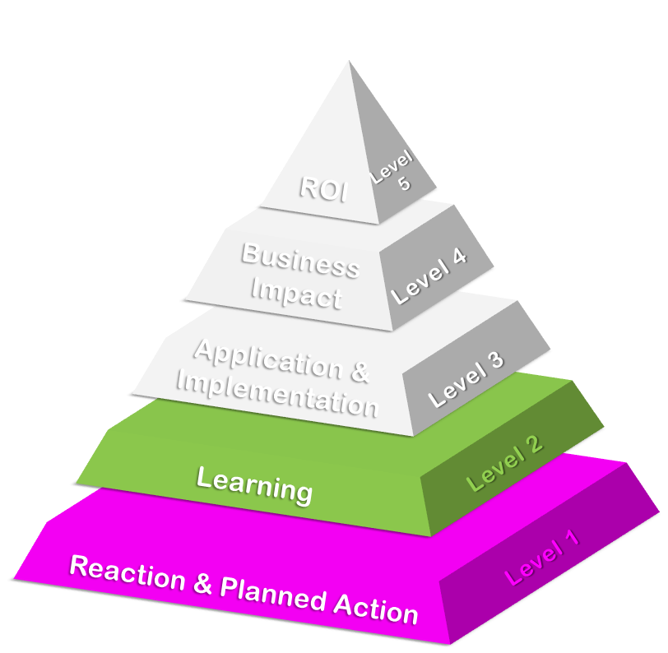
Make it Matter
Design for Input, Reaction and Learning
Main topics for REACTION
Relevance
Importance
Value-added
Facilitator / Mentor / Coach
Recommend to others
Data Collection Methods | Reaction | Learning
Questionnaires
Observations
Interviews
Focus Groups
Tests/Quizzes
Main topics for LEARNING
Skills
Knowledge
Attitude
Competency
Capacity
Demonstrations
Simulations

Slide 29

Make it Stick
5

Slide 30
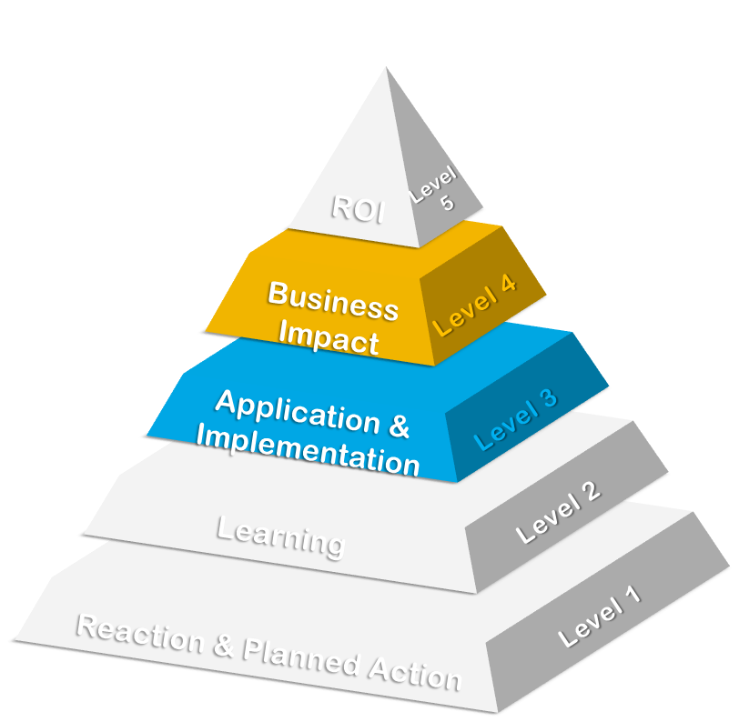
Make it Stick
Design for Application and Impact
Main topics for APPLICATION
Extent of use
Task completion
Frequency of use
Actions completed
Barriers and Enablers
Data Collection Methods | Application | Impact
Questionnaires
Observations
Interviews
Focus Groups
Tests/Quizzes
Main topics for IMPACT
Output
Quality
Cost
Time
Customer Satisfaction
Demonstrations
Simulations
Action planning
Performance contracts
Performance records

Slide 31

Make it Credible
6

Slide 32




Make it Credible
    STEP 1: ISOLATE THE EFFECTS OF PROGRAM
TOTAL IMPROVEMENT AFTER PROGRAM
Effect of Leadership Program on
Improvement
Leadership Program
External Factors
Incentives
Other factors are always present
They have their protective owners!
Without isolation there is no proof
Management
Attention
Systems/
Procedures
Changes

Slide 33














Make it Credible
FORECASTING
COACHEE/PARTICIPANT’S ESTIMATE (%)
TREND-LINE ANALYSIS
USE OF CUSTOMER INPUT
Isolating the Program Effects
CONTROL GROUP
EXPERT ESTIMATE/
PREVIOUS STUDIES
CALCULATING/ESTIMATING THE IMPACT OF OTHER FACTORS
MANAGEMENT’S ESTIMATE (%)
SUPERVISOR ESTIMATE (%)

Slide 34






Make it Credible
    STEP 2: CONVERT DATA TO MONEY
Notes:
1. STANDARD VALUE : Converting output to contribution; Converting the cost of quality; Converting employee’s time
2. RECORDS/REPORTS ANALYSIS: Using historical costs; Using internal and external experts
3. DATABASES : Using data from external databases; Linking with other measures
4. EXPERT ESTIMATION: Using participants’ estimates; Using supervisors’ and managers’ estimates; Using staff estimates; Using External expert estimation

Slide 35




Make it Credible
    STEP 2: CONVERT DATA TO MONEY
Standard Value
Databases
Records/Reports Analysis
Expert Estimation
Notes:
1. STANDARD VALUE : Converting output to contribution; Converting the cost of quality; Converting employee’s time
2. RECORDS/REPORTS ANALYSIS: Using historical costs; Using internal and external experts
3. DATABASES : Using data from external databases; Linking with other measures
4. EXPERT ESTIMATION: Using participants’ estimates; Using supervisors’ and managers’ estimates; Using staff estimates; Using External expert estimation

Slide 36



Make it Credible
    STEP 3: TABULATE COSTS OF PROGRAM
DIRECT
INDIRECT
Needs Assessment
Program Development
Participant Time
Administrative overhead
Evaluation
Program Fees
Program Materials
Facilities
Travel

Slide 37






Make it Credible
    STEP 4: CALCULATING ROI
ROI = | Benefits - Costs | X 100
 | Costs

Slide 38
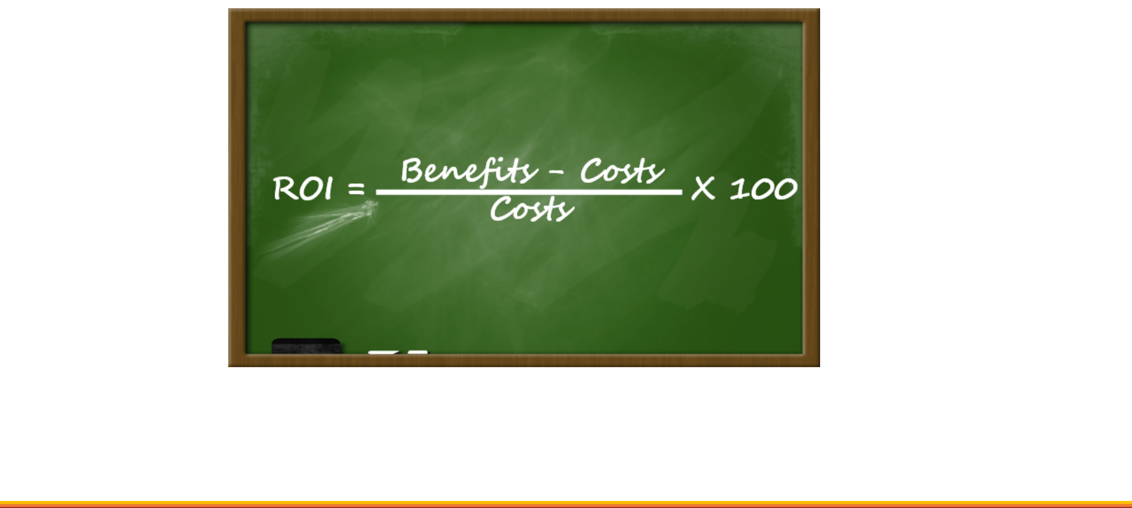
Make it Credible
    STEP 4: CALCULATING ROI

Slide 39
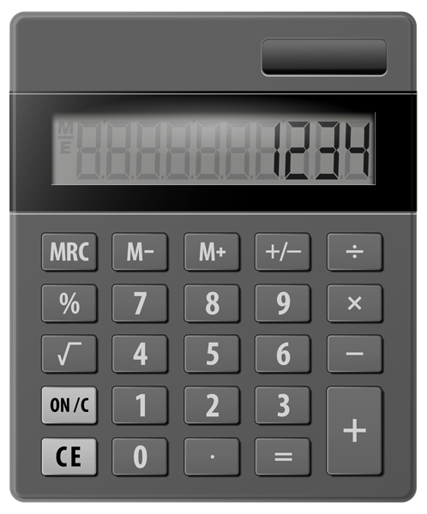
Make it Credible
    STEP 4: CALCULATING ROI
Program Costs = 60,000 SAR
Program Benefits (1st year) = 100,000 SAR
ROI = | 100,0000 – 60,000 | X 100
 | 60,000
= | 67%
ROI
INSTITUTE®

Slide 40

Make it Credible
    STEP 5: IDENTIFYING INTANGIBLES
Notes:
Intangibles are those measures that are not converted to money because they cannot be credibly converted using a minimum amount of resources A quantitative value can be assigned or developed for any intangible.
In some programs intangibles are more important than monetary measures
Intangibles are the invisible advantage
Knowledge sharing, Innovation, etc
We are entering the intangible economy
Technology and knowledge Age
Intangibles drive programs
Some learning & development programs are implemented because of the intangibles (e.g. Have greater collaboration, Partnering, Communication, Teamwork, reduce poverty, etc)
When linked to the learning or performance improvement program, intangible benefits are viewed as additional evidence of the program’s success and are presented as supportive qualitative data. Data is deemed as intangible when it cannot be converted to monetary values easily, the expense of the conversion is too great, or the data cannot be isolated effectively from other factors.
The range of intangible measures is practically limitless. Intangibles do not usually carry the weight of measures that are expressed in dollars and cents, but they are still a very important part of the overall evaluation. Most successful learning initiatives result in some intangible benefits. These should be captured and reported.
The intangibles listed in the table on the previous page are the more common ones resulting from studies. However, even though they may not be converted in one study, they may be converted in another study or another organization. In some situations, intangible measures, such as teamwork, job satisfaction, communications, and customer satisfaction, are more important than monetary measures. Therefore, it is very important to track these measures.

Slide 41

Tell the Story
7

Slide 42








Four Primary Audiences
Tell the story
Face to Face Meeting
Complete Study (Detailed)
Sponsor
Staff Team
One page Summary
Immediate
Managers
Participants
Executive Summary
Notes:
Client (who fund the program): Secure approval / Need to understand the project’s value to the organization
Immediate Managers: Obtain commitment/build credibility
Participants: Enhance reinforcement / who provide data to the evaluators
Staff Team: Show importance / need to understand how to study was developed

Slide 43


Optimize Results
8

Slide 44







Costs Vs. Investment Perception
Executives perception of LDP
1
EVALUATION
Make It better
COST
INVESTMENT
OPTIMIZATION
2
Improve Results
Control it
Reduce it
Eliminate it
Maintain it
Enhance it
Protect it
ALLOCATION
3
Get More Funding

Slide 45

Show the Value Now!

Slide 46

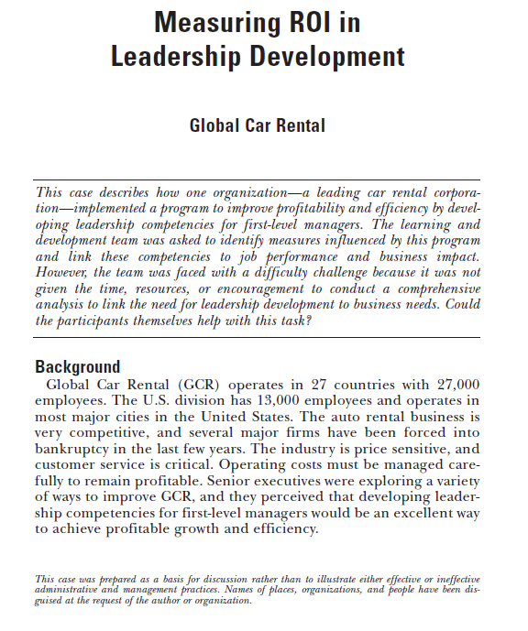


#ATDSaudiArabia
bit.ly/2SeiXyz
Nader Bechini
Director, ROI Institute MENA
nader@roiinstitute.net

Slide 47




Contact & Connect
Nader Bechini
Director, ROI Institute MENA
nader@roiinstitute.net
@naderbechini
+966500931328

