Slide 1




10 Steps for Proving the Value of Human Capital Investments
Nader Bechini, CRP
Director, ROI Institute MENA
@naderbechini

Slide 2


11th Oct 2018
Human
Capital
Index
Notes:
Without human capital, countries:
Cannot sustain economic growth,
Will not have a workforce that is prepared for the more highly-skilled jobs of the future, and
Will not compete effectively in the global economy.
The World Bank launched last week (11th Oct 2018) a new way to measure economic success. According to the bank the higher the investment in people through learning, skills and health the more productive and higher earning the workforce tends to be.

Slide 3

Why Now?
5 Reasons

Slide 4

Why Now?
Top 10 Challenges
Developing “Next Gen” leaders
64%
Reason 1:
Challenges facing C-level executives
Failure to attract/retain talent
60%
New competitors globally
48%
Cyber-security
28%
Slowing economics growth in emerging markets
25%
Labor relations
24%
Global recession
22%
Income inequality/disparity
21%
Oudated/insufficient national infrastructure
20%
Global political uncertainty
18%
Source: Global Leadership forecast 2018, DDI, The Conference Board, Ernst & Young
Notes:
More than 1,000 C-level executives worldwide identified the issues they expect to command their attention in the coming year. Of the 28 challenges from which they could choose, their biggest concerns weren’t headline-worthy global issues like political instability, climate change, terrorism, or a global recession. Rather, the top challenges vying for leaders’ action
focused on their own leaders. Developing “Next Gen” leaders and failure to attract/retain top talent were rated in the top five by 64 percent and 60 percent of respondents, respectively. Leaders clearly indicated that top talent and effective leaders will be needed to address the myriad current challenges and to position their organization for future success. The Top 10 Challenges are shown above.

Slide 5
Why Now?
Top 10 Challenges
Developing “Next Gen” leaders
64%
Reason 1:
Challenges facing C-level executives
Failure to attract/retain talent
60%
New competitors globally
48%
Cyber-security
28%
Slowing economics growth in emerging markets
25%
Labor relations
24%
Global recession
22%
Income inequality/disparity
21%
Oudated/insufficient national infrastructure
20%
Global political uncertainty
18%
Source: Global Leadership forecast 2018, DDI, The Conference Board, Ernst & Young
Notes:
More than 1,000 C-level executives worldwide identified the issues they expect to command their attention in the coming year. Of the 28 challenges from which they could choose, their biggest concerns weren’t headline-worthy global issues like political instability, climate change, terrorism, or a global recession. Rather, the top challenges vying for leaders’ action
focused on their own leaders. Developing “Next Gen” leaders and failure to attract/retain top talent were rated in the top five by 64 percent and 60 percent of respondents, respectively. Leaders clearly indicated that top talent and effective leaders will be needed to address the myriad current challenges and to position their organization for future success. The Top 10 Challenges are shown above.

Slide 6




Why Now?
Executives perception of HC
Reason 2:
Executives perception of Human Capital
COST
INVESTMENT
Control it
Reduce it
Eliminate it
Maintain it
Enhance it
Protect it

Slide 7

Why Now?
96%
Reason 3:
CEOs Expectations
Business impact is No. 1 measure desired by CEOs
ROI is No. 2 measure desired by CEOs
74%
8%
4%
Only 8% of CEOs see a direct business impact from their company’s L&D programs.
Only 4% of CEOs currently see an ROI from their company’s L&D programs.
Source: ROI Institute, Inc
Notes:
Problem 4: According to one study, 96 percent of Fortune 500 CEOs want to see the business connection, yet only 8 percent see it. Also, 74 percent want to see ROI, yet only 4 percent see it.
Few learning and talent development professionals have data to show top executives that their programs make a difference in the organization. Design thinking keeps the hungry gorilla — in the form of a senior executive — fed so that he doesn’t come around demanding impact data.

Slide 8


Why Now?
CFOs, Sponsors and Funders Want to see the Monetary Value
Reason 4:
Show Me The Money!

Slide 9

Why Now?
Warren Buffet
One of the most successful investors in the world and third-wealthiest person in the world
Reason 4:
Show Me The Money!

Slide 10
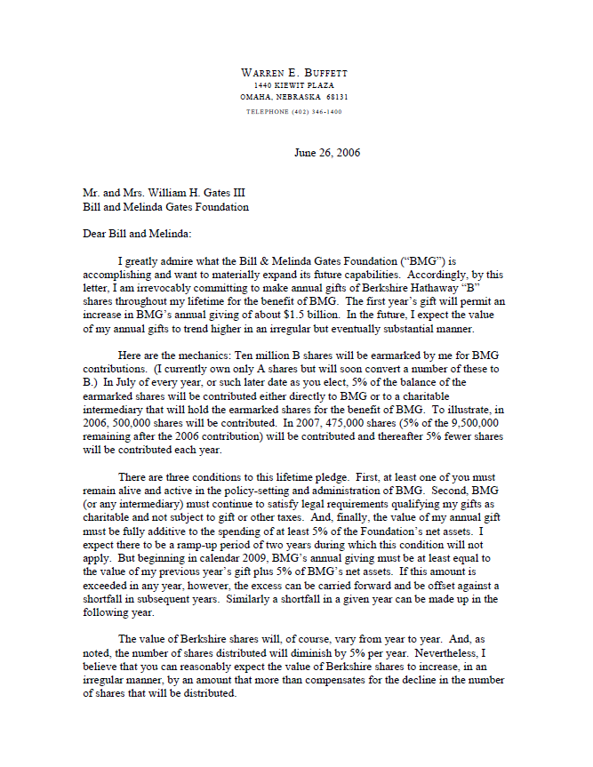
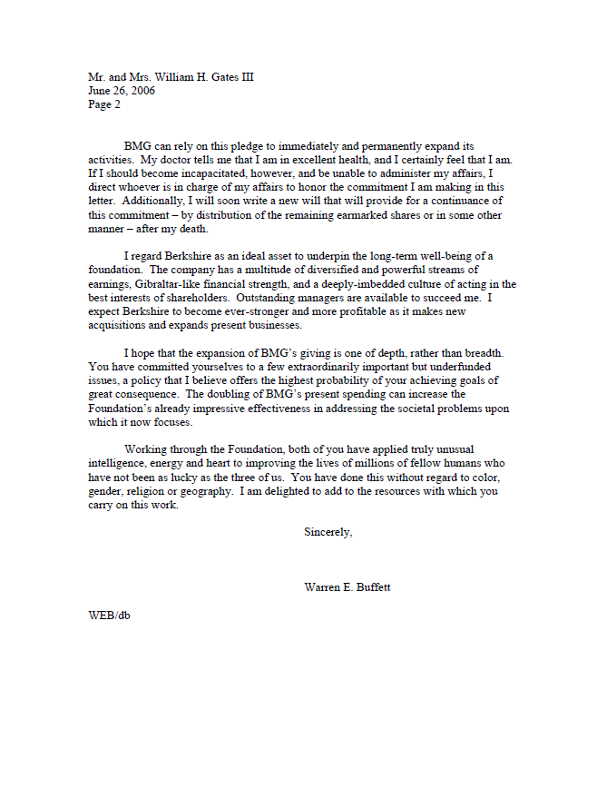

Why Now?
Reason 4:
Show Me The Money!
2006
Notes:
Problem 1: This is actually the big, ugly, overarching problem that spawns many other sub-problems.
When you’re seen as a cost, you’re seen as part of the problem, not part of the solution. And you’re at risk of not just having your budget cut but also of being left out of crucial organizational decisions. Design thinking helps you prove, every step of the way, that you are contributing to the bottom line of the company.

Slide 11
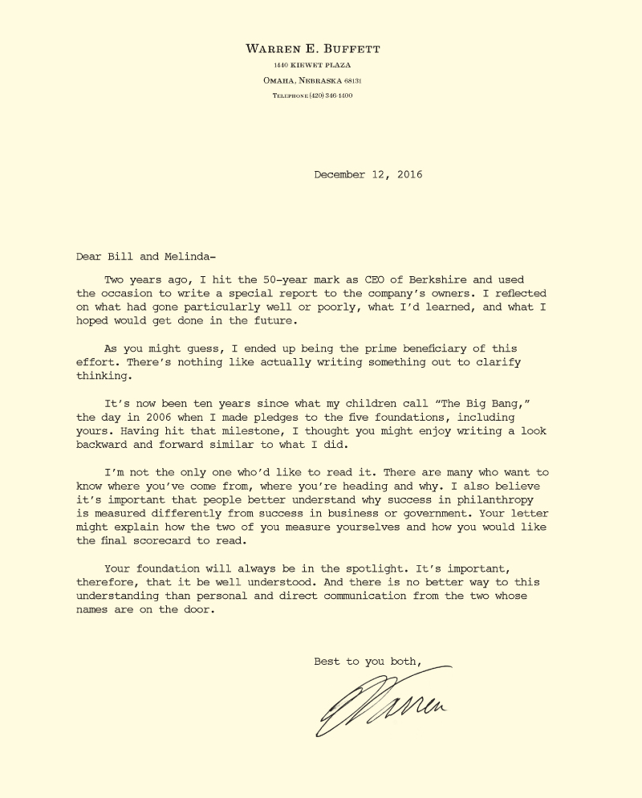

Why Now?
Reason 4:
Show Me The Money!
2016
Notes:
Problem 1: This is actually the big, ugly, overarching problem that spawns many other sub-problems.
When you’re seen as a cost, you’re seen as part of the problem, not part of the solution. And you’re at risk of not just having your budget cut but also of being left out of crucial organizational decisions. Design thinking helps you prove, every step of the way, that you are contributing to the bottom line of the company.

Slide 12

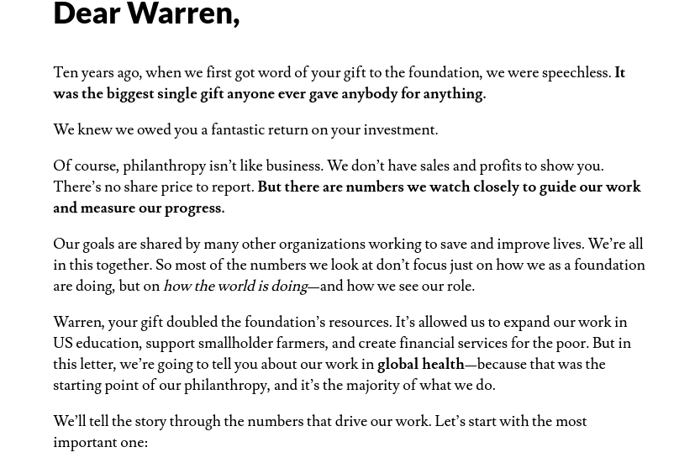
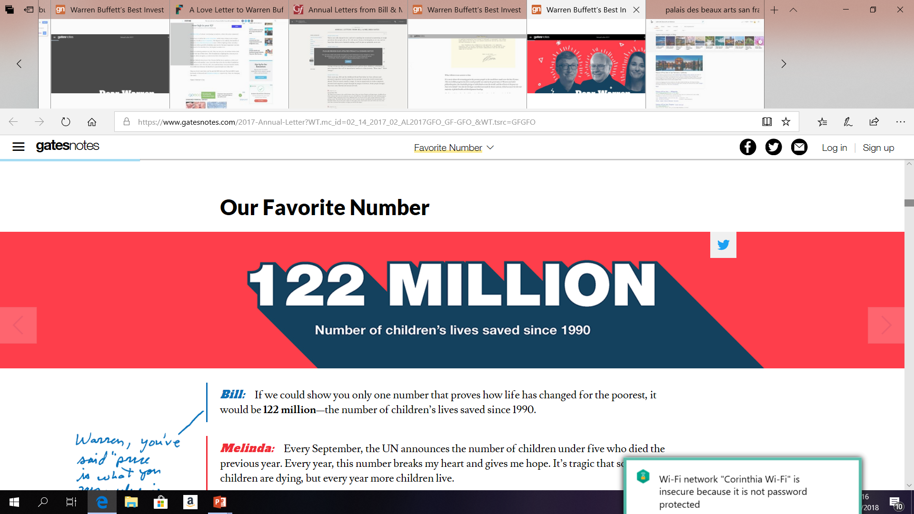
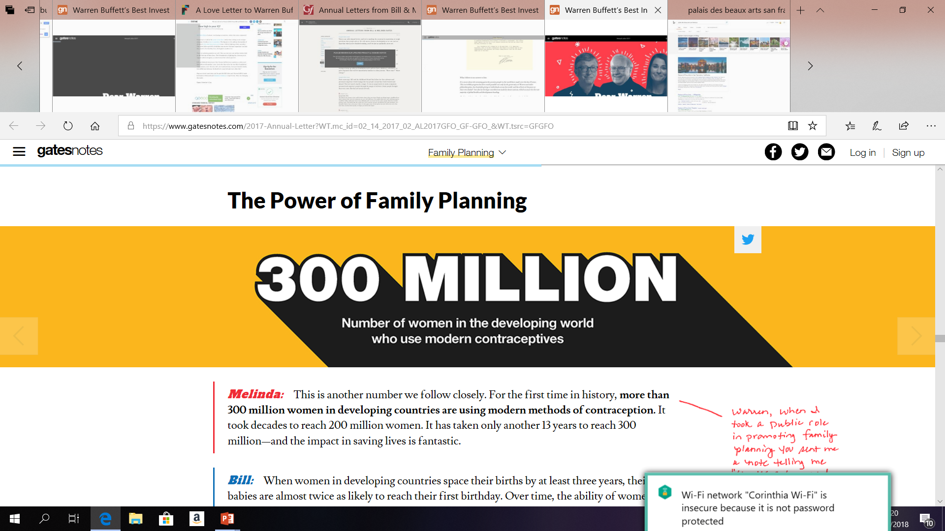
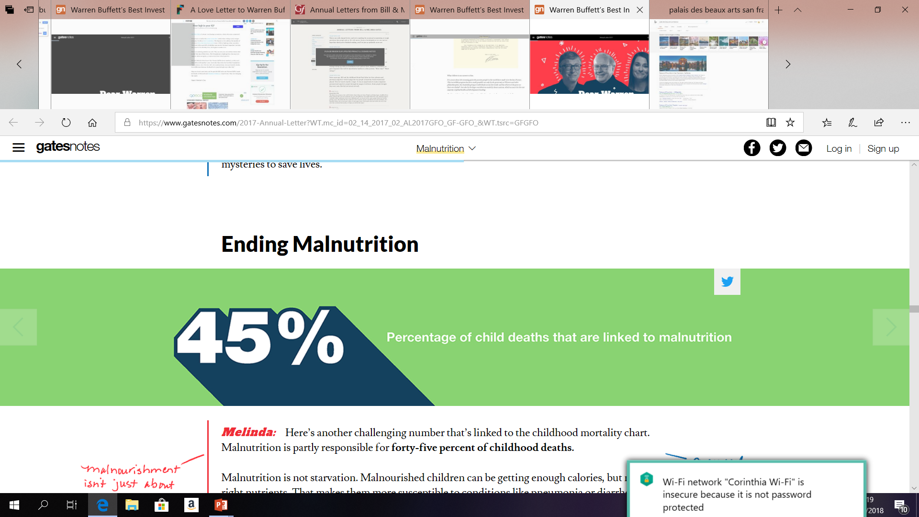
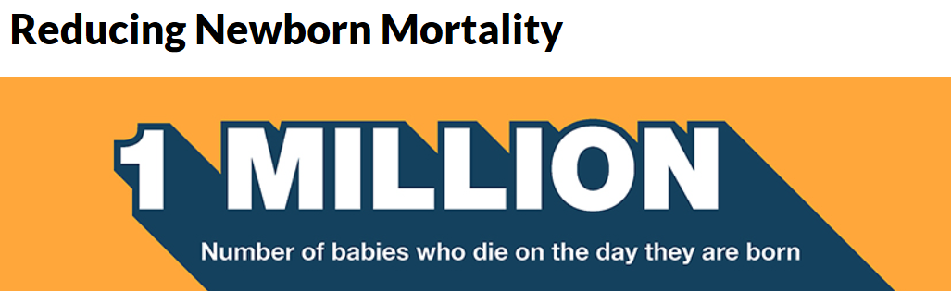
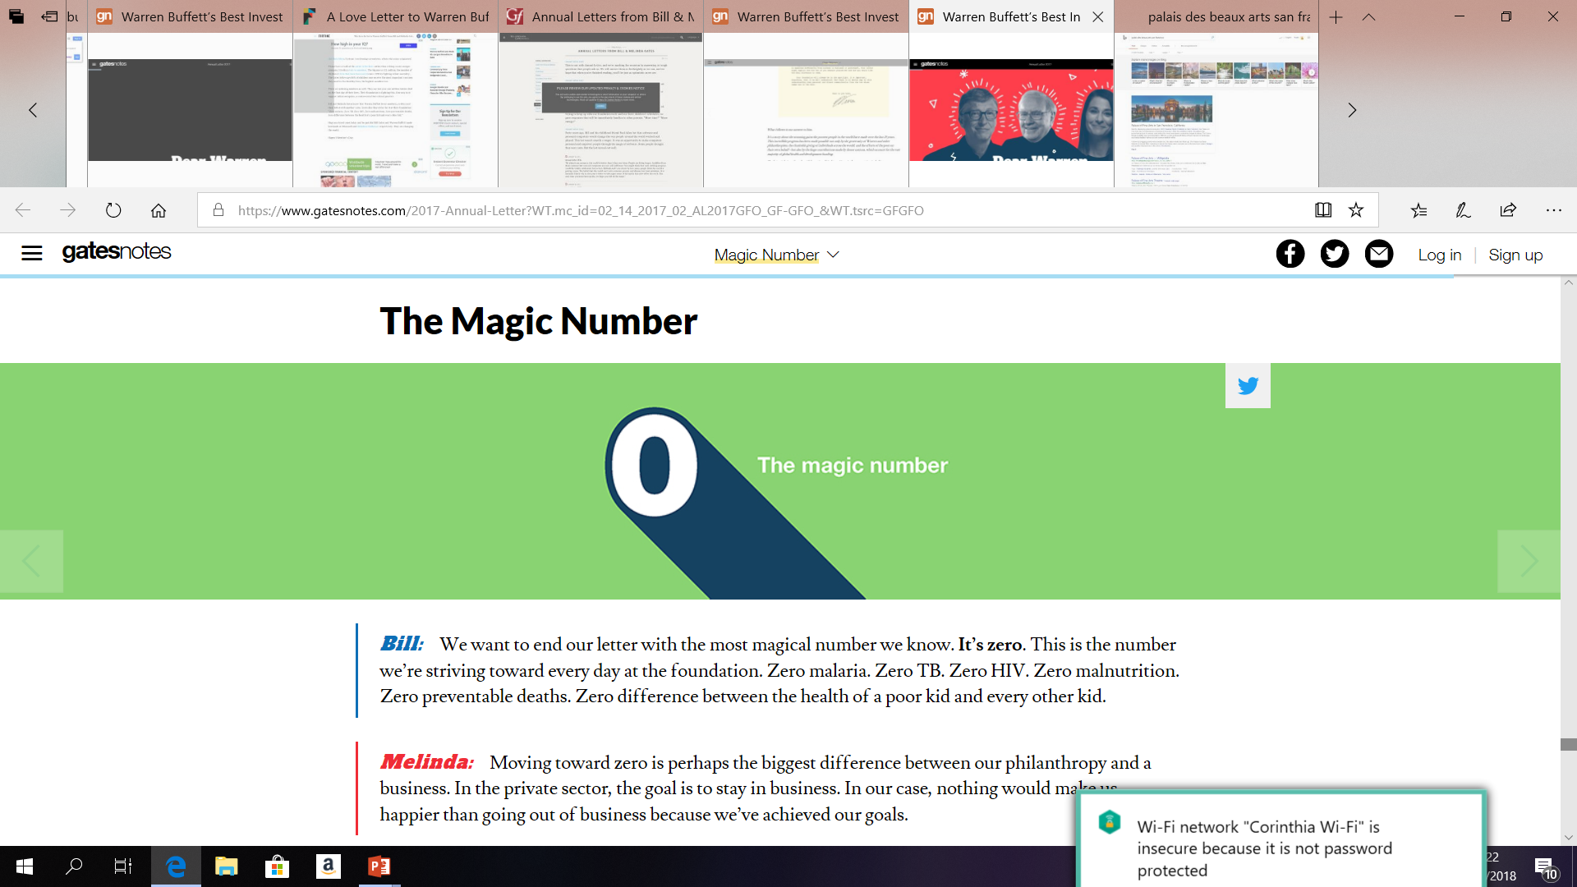
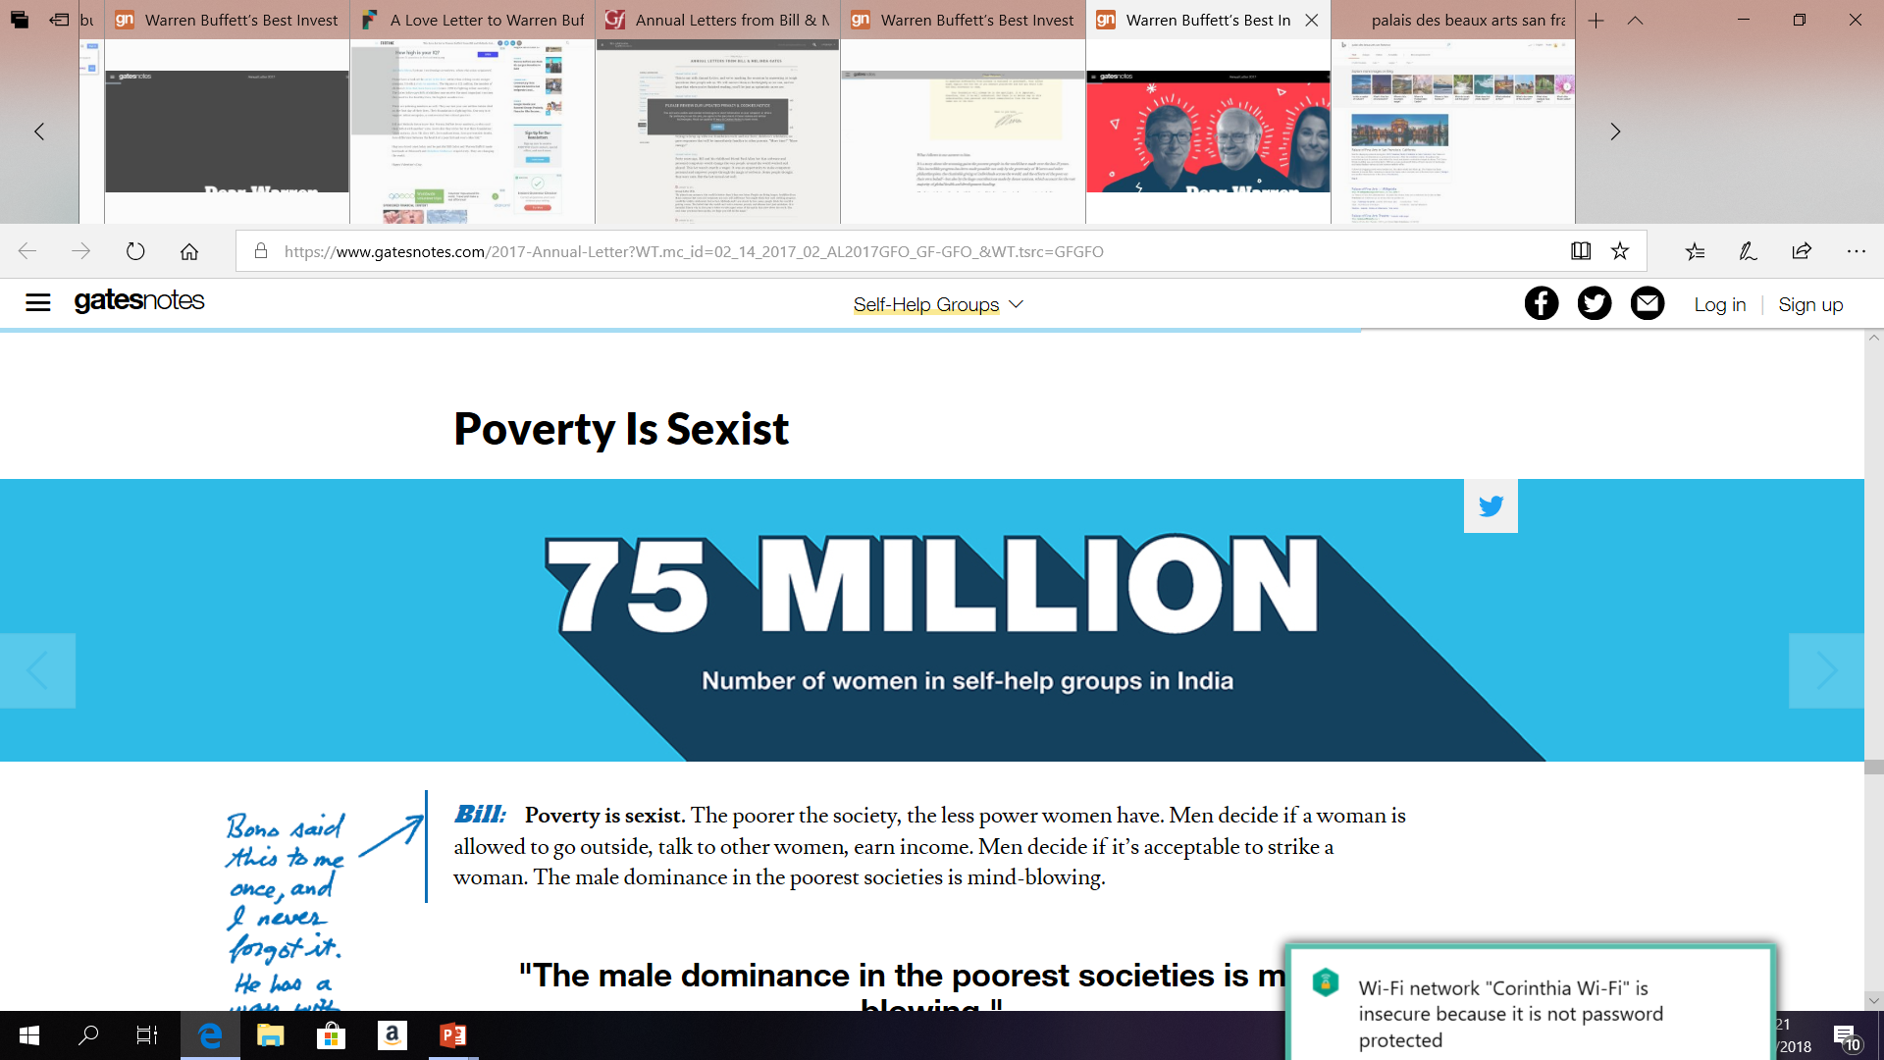
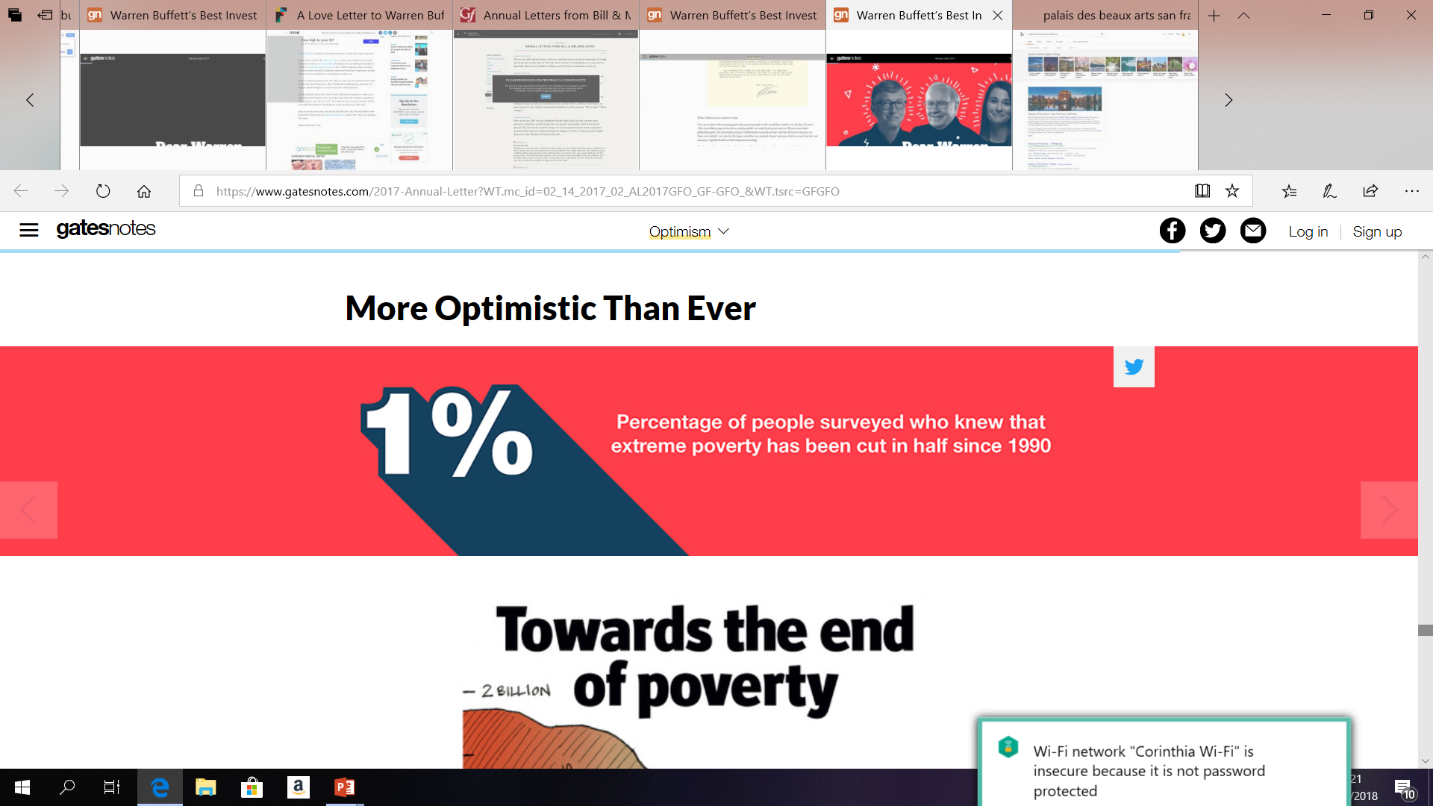
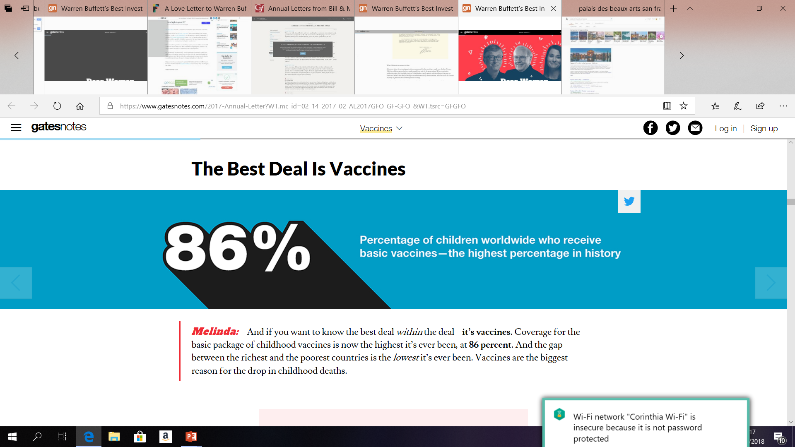
Notes:
122 million children under age five have been saved over the past 25 years. These are children who would have died if mortality rates had stayed where they were in 1990. diarrhea, pneumonia, and malaria; When a mother can choose how many children to have, her children are healthier, they’re better nourished, their mental capacities are higher—and parents have more time and money to spend on each child’s health and schooling. That’s how families and countries get out of poverty. This link between saving lives, a lower birthrate, and ending poverty was the most important early lesson Melinda and I learned about global health.
And for every dollar spent on childhood immunizations, you get $44 in economic benefits. That includes saving the money that families lose when a child is sick and a parent can’t work.
Polio is closest to reaching this magic number. You and I have talked about polio a lot. When you were growing up, you saw things kids never see today: children with polio on crutches and leg braces, photos of kids in iron lungs. By the late 1970s, with the help of vaccines, the United States eliminated polio, but it still raged around the world. In 1988, when the global campaign was launched to end polio, there were 350,000 new cases each year.
Last year, there were 37.

Slide 13
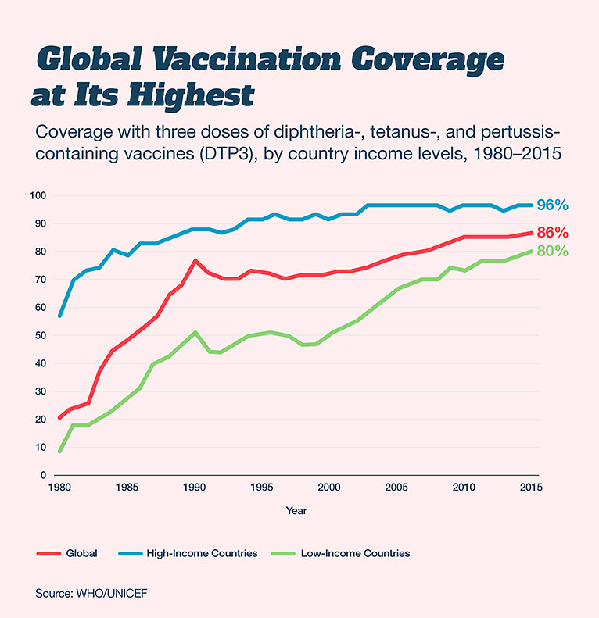
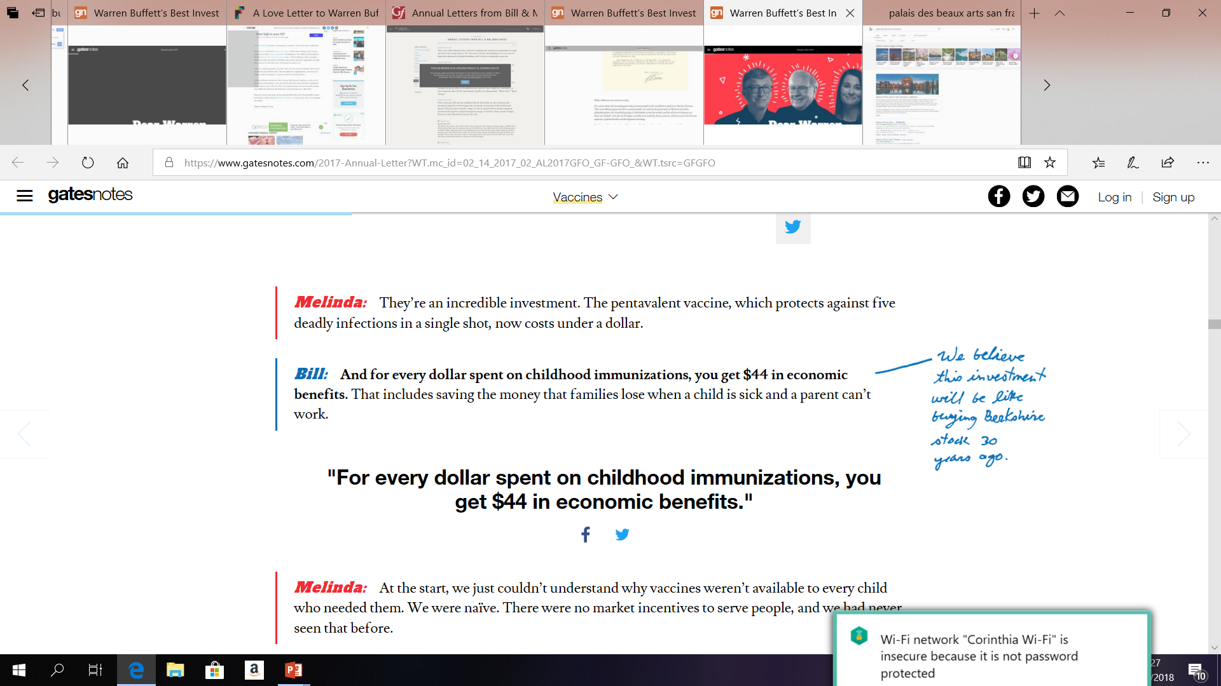
Notes:
122 million children under age five have been saved over the past 25 years. These are children who would have died if mortality rates had stayed where they were in 1990. diarrhea, pneumonia, and malaria; When a mother can choose how many children to have, her children are healthier, they’re better nourished, their mental capacities are higher—and parents have more time and money to spend on each child’s health and schooling. That’s how families and countries get out of poverty. This link between saving lives, a lower birthrate, and ending poverty was the most important early lesson Melinda and I learned about global health.
And for every dollar spent on childhood immunizations, you get $44 in economic benefits. That includes saving the money that families lose when a child is sick and a parent can’t work.
Polio is closest to reaching this magic number. You and I have talked about polio a lot. When you were growing up, you saw things kids never see today: children with polio on crutches and leg braces, photos of kids in iron lungs. By the late 1970s, with the help of vaccines, the United States eliminated polio, but it still raged around the world. In 1988, when the global campaign was launched to end polio, there were 350,000 new cases each year.
Last year, there were 37.

Slide 14
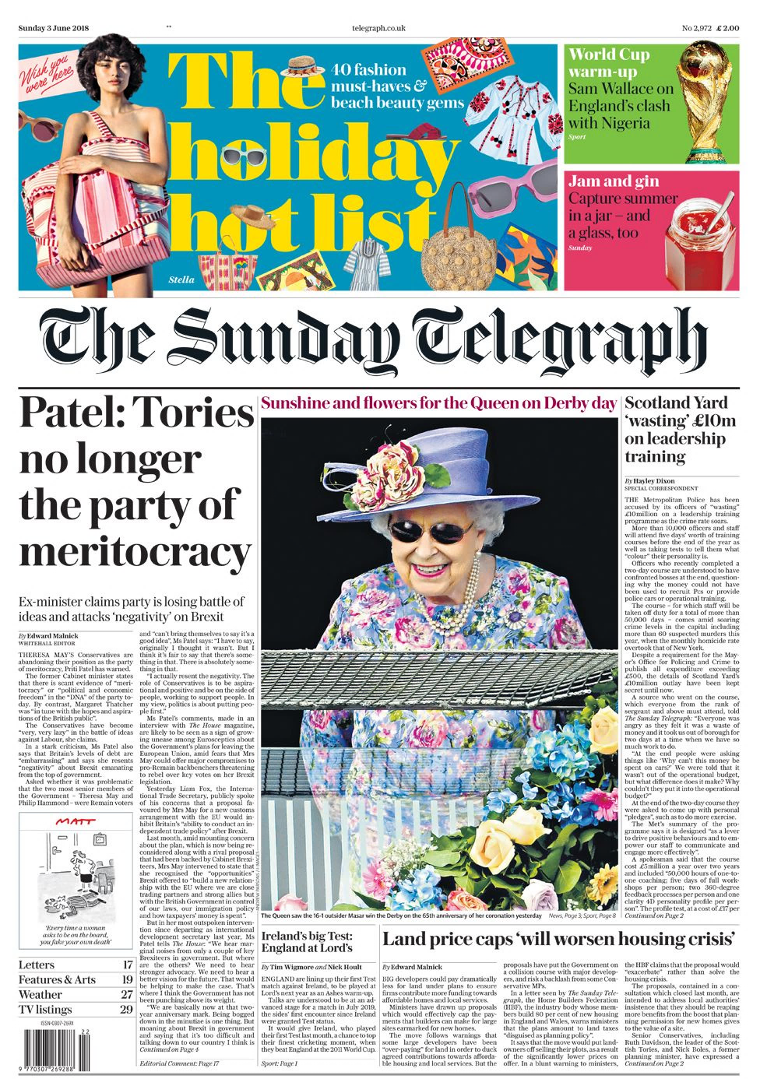
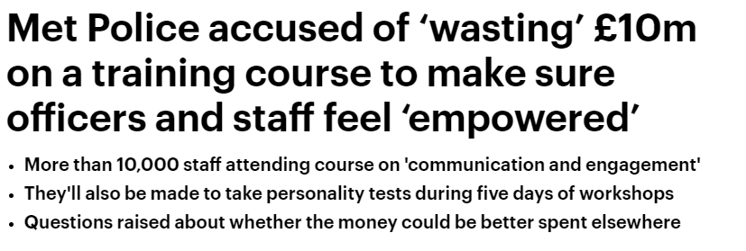
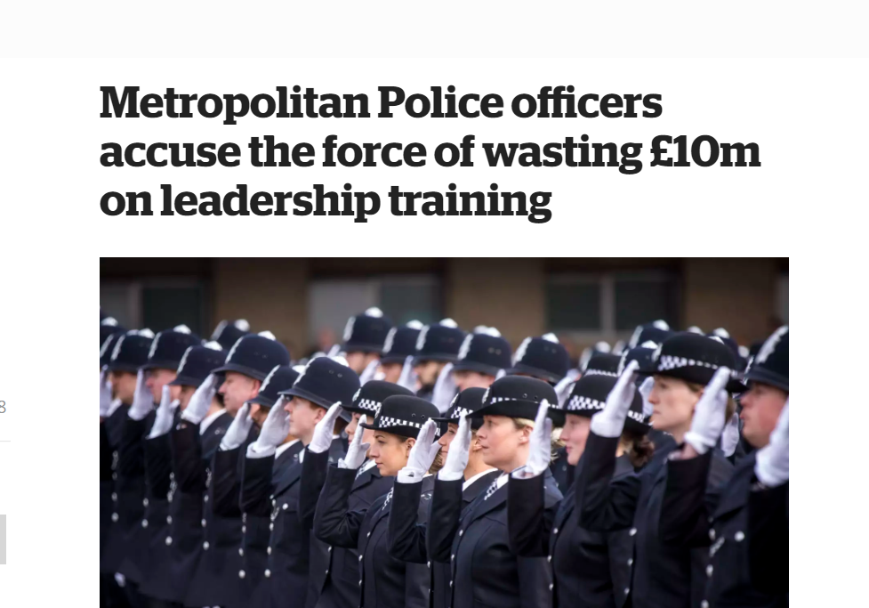

Why Now?
Reason 4:
Show Me The Money!
Notes:
The Program was a lever to drive positive behaviours and to empower our staff to communicate and engage more effectively.
More than 10,000 officers and staff (2 years)
4D personality profile
50,000 hours of one-to-one coaching
5 days training
Two ‘360-degree’ feedback sessions
The Met said the training was ‘a lever to drive positive behaviours and to empower our staff to communicate and engage more effectively’.
It includes 50,000 hours of one-to-one coaching and two so-called ‘360-degree’ feedback sessions. Participants also receive a ‘clarity 4D personality profile’ that attributes a colour to them from a choice of blue, red, green or yellow, according to the results of a character test. Yellows, for example, are said to be ‘talkative, expressive, light-hearted, sociable, flamboyant and enthusiastic’.
why the money could not have been used to recruit PCs or provide police cars or operational training. The £10million budget, which is split over two years, would be enough to fund about 1000 police cars or the yearly salary of more than 400 PC’s.
Staff will be taken off duty for a total of more than 50,000 days for the course, a move which comes as the number of murders in the capital topped 70 this year.
Unfortunately, this program’s implementation came as the crime rate is at an all-time high in London and continues to increase, while the percentage of crimes solved is at an all-time low of five percent. Those are the key business measures that should be, and could be, connected to this leadership program. For some reason, they were not connected. Essentially, the police department and the consulting company both described the success of the program in terms of anticipated leadership behaviors caused by the training, stating only, “We are confident this investment is worthwhile.”
Major leadership efforts cannot be justified in today’s environment just on leader behavior changes, and that was the justification was for the Scotland Yard program. This program was open to all police supervisors, in the role of sergeant and above, including support staff managers. In reality, the key performance indicators of these leaders would be either directly related to these two crime-related categories (crime rate and crimes resolved), or they have impacts that support these measures.

Slide 15






Why Now?
HR Role
Leaders Rating
HR Rating
Reactor
Sets and ensures compliance with policies
Responds to business needs
Installs basic initiatives to manage talent
41%
21%
Reason 5:
HR’s new role!
Partner
Works toward mutual goals with line managers
Shares information with the business about talent issue gaps
Provides HR solutions.
62%
48%
More than 2,500 HR professionals and 25,000-plus leaders completed the Global Leadership Forecast 2018 survey
Anticipator
Uses analytics to forecast talent needs
Provides insights and solutions to ensure high-quality supply of talent
Links talent planning to business planning.
11%
17%
Source: Global Leadership forecast 2018, DDI, The Conference Board, Ernst & Young
Notes:
Reactor: Sets and ensures compliance with policies; responds to business needs; installs basic initiatives to manage talent.
Partner: Works toward mutual goals with line managers; shares information with the business about talent issue gaps; provides HR solutions.
Anticipator: Uses analytics to forecast talent needs; provides insights and solutions to ensure high-quality supply of talent; links talent planning to business planning.

Slide 16

Why Now?
Reason 5:
HR’s new role!
HR
Notes:
Reactor: Sets and ensures compliance with policies; responds to business needs; installs basic initiatives to manage talent.
Partner: Works toward mutual goals with line managers; shares information with the business about talent issue gaps; provides HR solutions.
Anticipator: Uses analytics to forecast talent needs; provides insights and solutions to ensure high-quality supply of talent; links talent planning to business planning.

Slide 17

10 Steps for Unveiling the Value of Human Capital Investment

Slide 18


Develop Objectives
1

Slide 19


Develop Objectives
Align programs with the business
Opportunity
5
Payoff Needs
Problem
Problem to avoid
Program

Slide 20










Develop Objectives
Align programs with the business
Hard Data
Soft Data
5
Payoff Needs
4
Business Needs
Typical Measures
Typical Measures
Output increases
Customer Satisfaction
Quality improvements
Employees Engagement
Cost savings
Creativity & Innovation
Time Savings
Work Habits
Program
Notes:
Once the payoff need is addressed then the specific business measures that need to improve in order to address the payoff need are identified. These “Business needs” represent hard data, categorized as output, cost, and time; they may also represent soft data such as measures of customer satisfaction, employees satisfaction work habits, image, and creativity/innovation. Examples of business measures in need of improvement may be completion rate, inventory turnover, error rates, sales expense, overtime, brand awareness, employee complaints, and trademarks, copy-rights, and patents.

Slide 21

Develop Objectives
Align programs with the business
Objectives
Payoff Needs
5
ROI Objectives
5
Return on Investment
Business Needs
4
Impact Objectives
4
Impact
Performance Needs
3
Application Objectives
3
Application
Learning Needs
2
Learning Objectives
2
Learning
Preference Needs
1
Reaction Objectives
1
Reaction
Program
Notes:
Two decades ago, the definition of success was learning. We wanted to make sure they learned what was necessary to become a good leader. A decade ago, that success was defined as behavior, and we measured that with 360-degree feedback. Today, that success must be defined by impacts, or how the leader behavior is having an impact on the business.

Slide 22

Plan the Evaluation
2

Slide 23
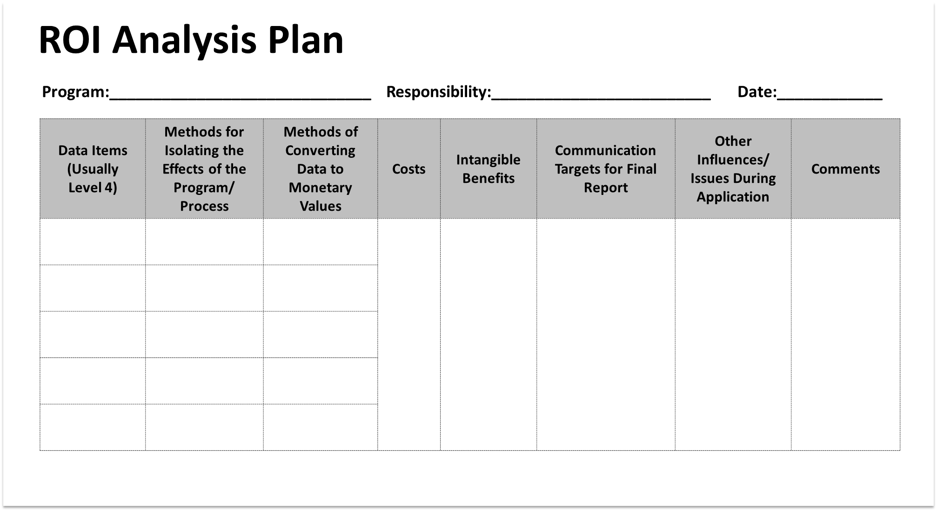
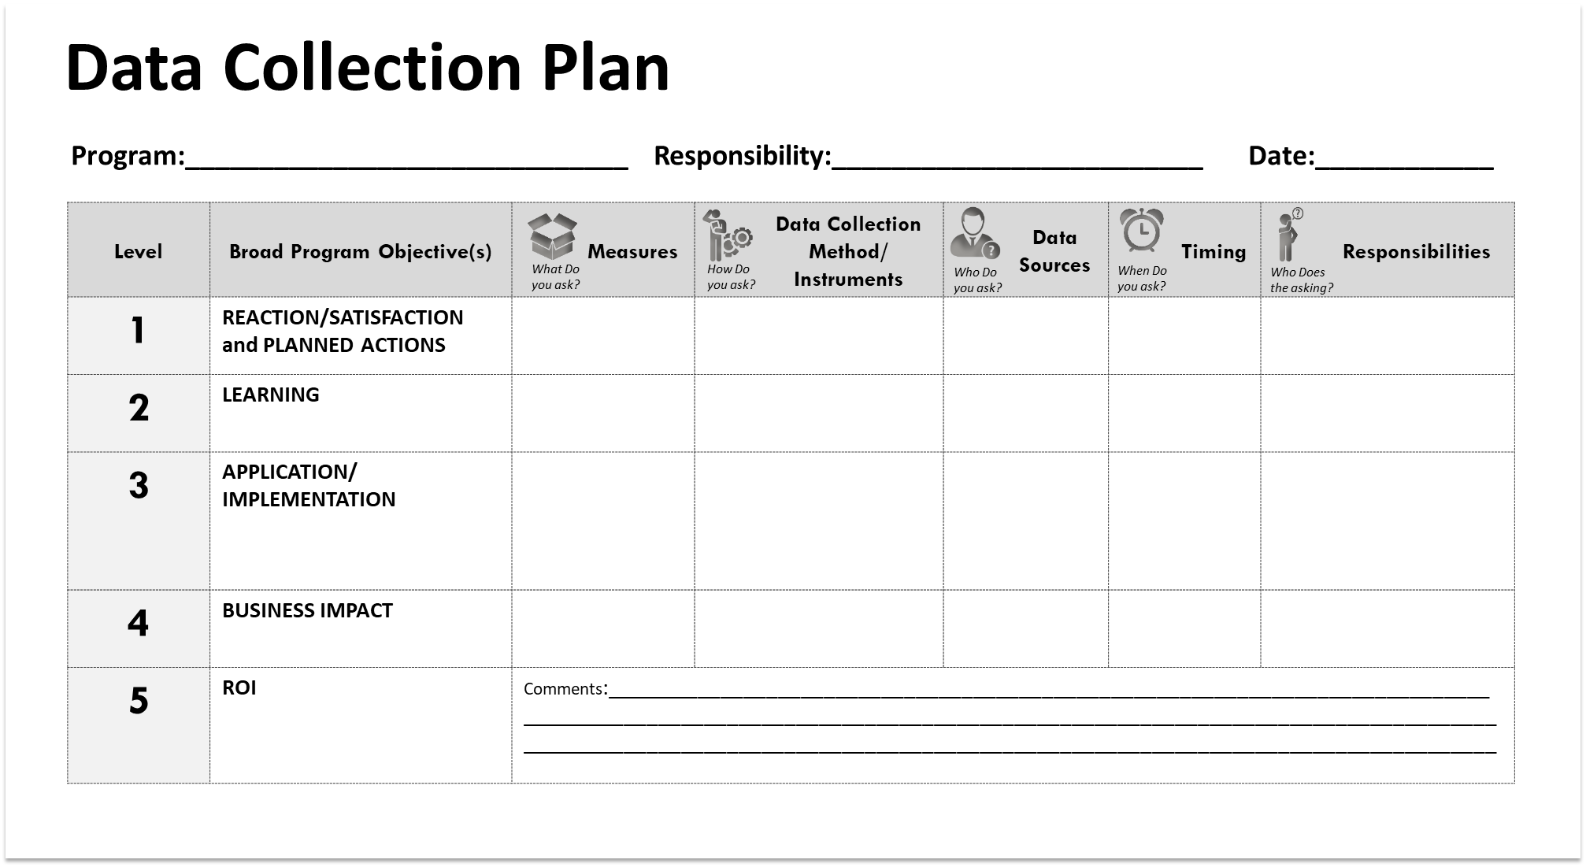

Evaluation Planning
Two documents form the basis of Human Capital program evaluation planning

Slide 24


Collect data during solution implementation
3

Slide 25
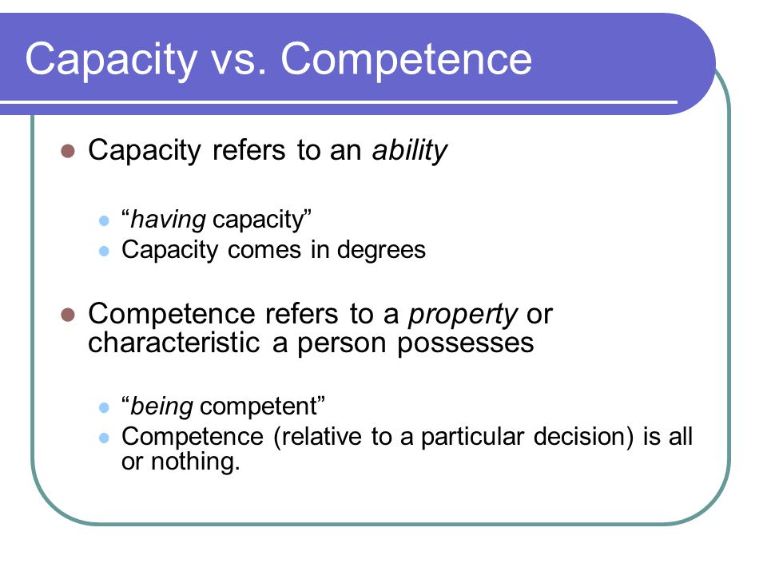
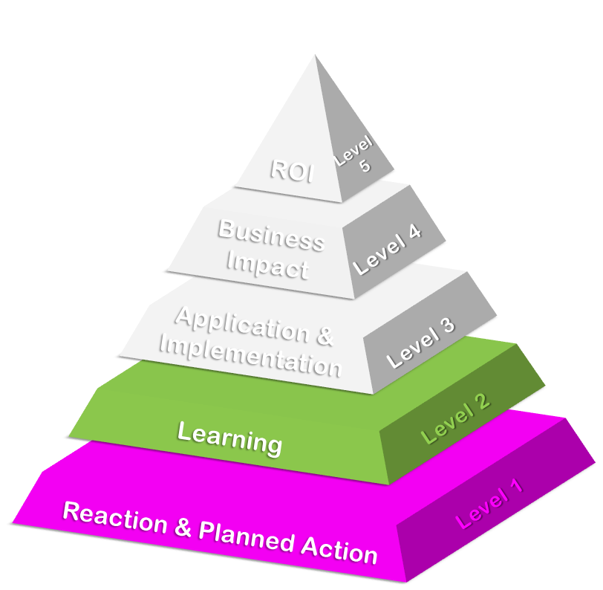
Collect data during implementation
Reaction and Learning
Main topics for REACTION
Relevance
Importance
Value-added
Facilitator / Mentor / Coach
Recommend to others
Data Collection Methods | Reaction | Learning
Questionnaires
Observations
Interviews
Focus Groups
Tests/Quizzes
Main topics for LEARNING
Skills
Knowledge
Attitude
Competency
Capacity
Demonstrations
Simulations

Slide 26

Collect data after solution implementation
4

Slide 27
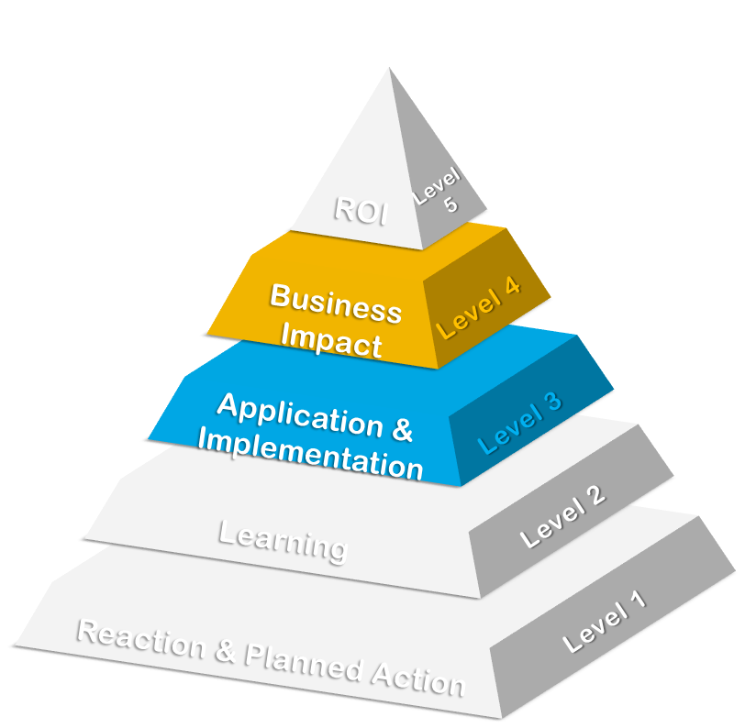
Collect data after implementation
Application and Impact
Main topics for APPLICATION
Extent of use
Task completion
Frequency of use
Actions completed
Barriers and Enablers
Data Collection Methods | Application | Impact
Questionnaires
Observations
Interviews
Focus Groups
Tests/Quizzes
Main topics for IMPACT
Output
Quality
Cost
Time
Customer Satisfaction
Demonstrations
Simulations
Action planning
Performance contracts
Performance records

Slide 28

ISOLATE THE SOLUTION EFFECTS
5

Slide 29




Isolate the solution effects
TOTAL IMPROVEMENT AFTER PROGRAM
Effect of HC Program on
Improvement
HC Program
Marketing
Other Factors
Other factors are always present
They have their protective owners!
Without isolation there is no proof
Management
Attention
Technology Impelementation

Slide 30














Isolate the solution effects
FORECASTING
PARTICIPANT’S ESTIMATE (%)
TREND-LINE ANALYSIS
USE OF CUSTOMER INPUT
Isolating the Solution Effects
CONTROL GROUP
EXPERT ESTIMATE/
PREVIOUS STUDIES
CALCULATING/ESTIMATING THE IMPACT OF OTHER FACTORS
MANAGEMENT’S ESTIMATE (%)
SUPERVISOR ESTIMATE (%)

Slide 31






CONVERT DATA TO MONEY
6
Notes:
1. STANDARD VALUE : Converting output to contribution; Converting the cost of quality; Converting employee’s time
2. RECORDS/REPORTS ANALYSIS: Using historical costs; Using internal and external experts
3. DATABASES : Using data from external databases; Linking with other measures
4. EXPERT ESTIMATION: Using participants’ estimates; Using supervisors’ and managers’ estimates; Using staff estimates; Using External expert estimation

Slide 32




Convert data to Money
Standard Value
Databases
Records/Reports Analysis
Expert Estimation
Notes:
1. STANDARD VALUE : Converting output to contribution; Converting the cost of quality; Converting employee’s time
2. RECORDS/REPORTS ANALYSIS: Using historical costs; Using internal and external experts
3. DATABASES : Using data from external databases; Linking with other measures
4. EXPERT ESTIMATION: Using participants’ estimates; Using supervisors’ and managers’ estimates; Using staff estimates; Using External expert estimation

Slide 33



Tabulate the costs
7
DIRECT
INDIRECT
Needs Assessment
Program Development
Participant Time
Administrative overhead
Evaluation
Program Fees
Program Materials
Facilities
Travel

Slide 34






CALCULATE ROI
8
ROI = | Benefits - Costs | X 100
 | Costs

Slide 35
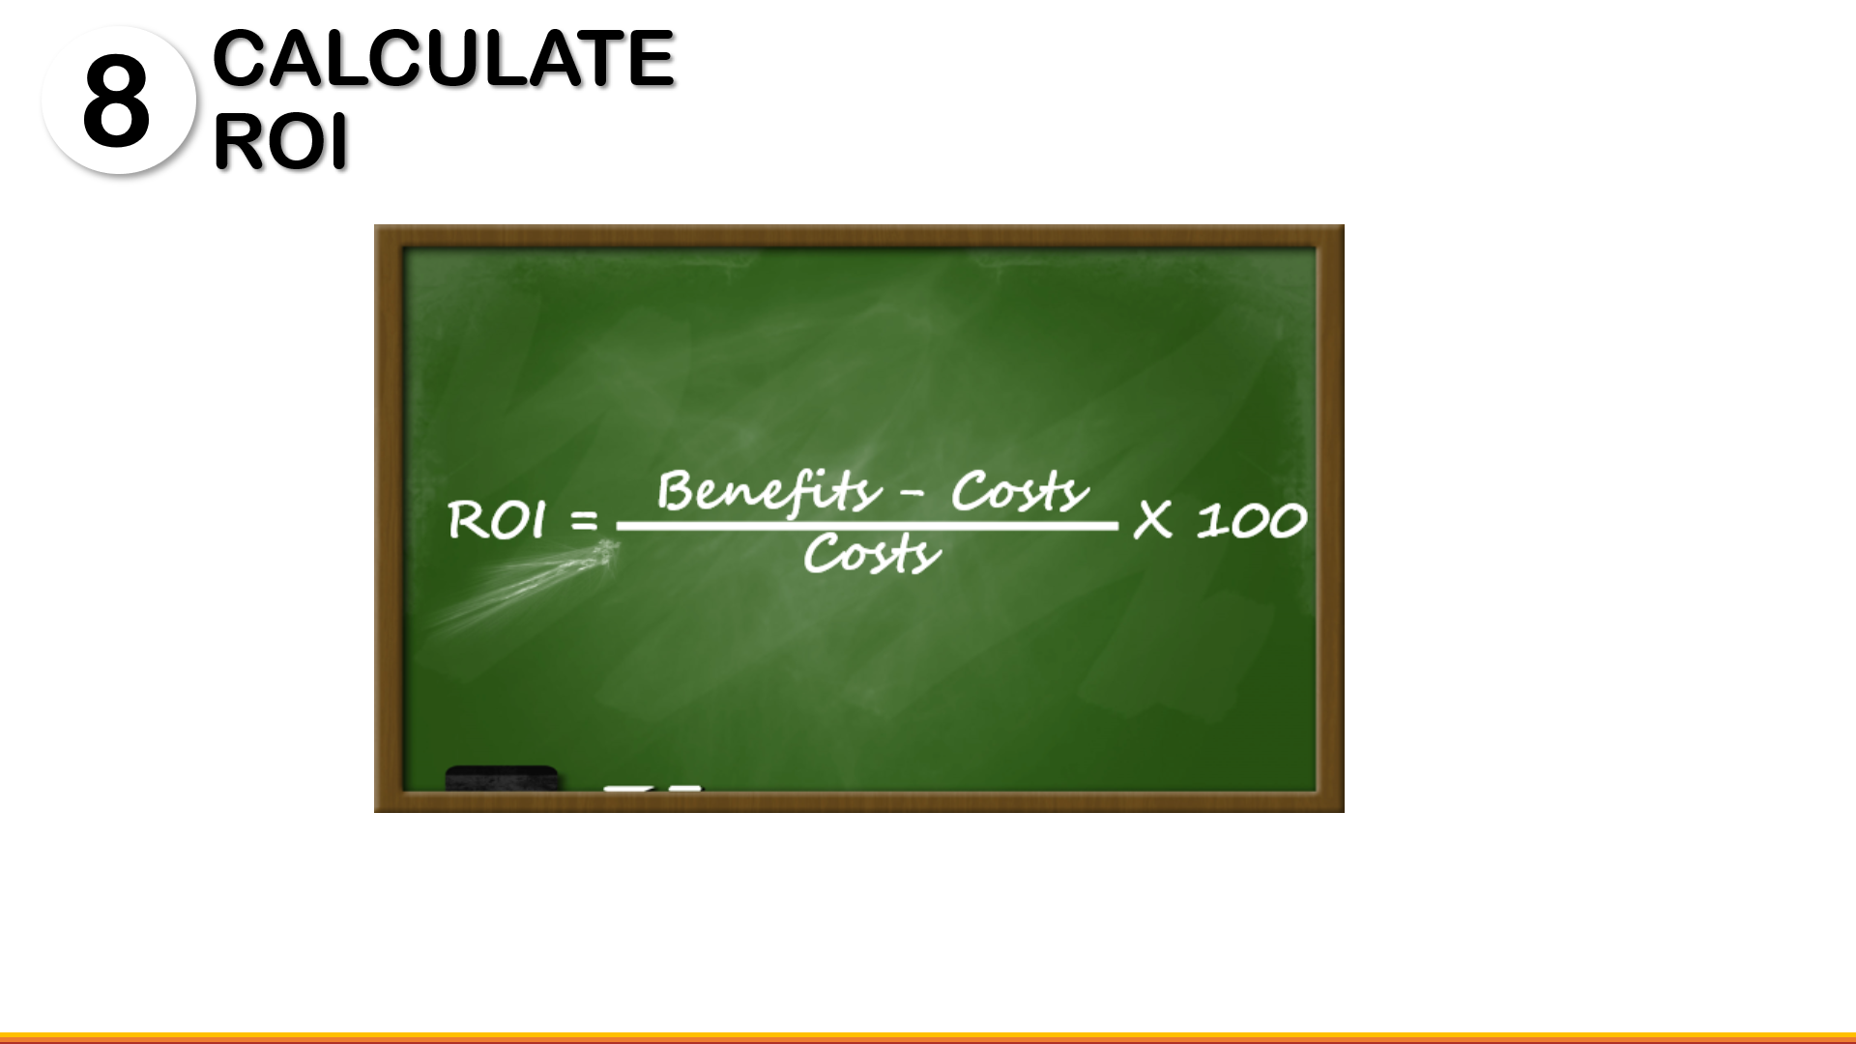

Slide 36
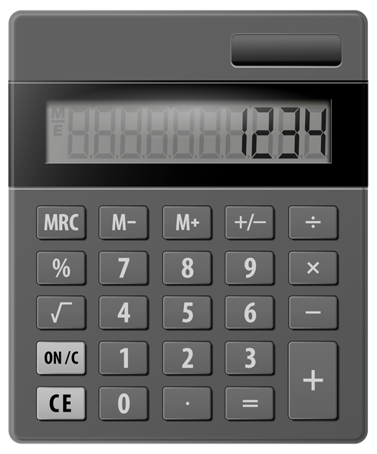
Program Costs = 60,000 SAR
Program Benefits (1st year) = 100,000 SAR
ROI = | 100,0000 – 60,000 | X 100
 | 60,000
= | 67%
ROI
INSTITUTE®

Slide 37

IDENTIFY INTANGIBLES
9
Notes:
Intangibles are those measures that are not converted to money because they cannot be credibly converted using a minimum amount of resources A quantitative value can be assigned or developed for any intangible.
In some programs intangibles are more important than monetary measures
Intangibles are the invisible advantage
Knowledge sharing, Innovation, etc
We are entering the intangible economy
Technology and knowledge Age
Intangibles drive programs
Some learning & development programs are implemented because of the intangibles (e.g. Have greater collaboration, Partnering, Communication, Teamwork, reduce poverty, etc)
When linked to the learning or performance improvement program, intangible benefits are viewed as additional evidence of the program’s success and are presented as supportive qualitative data. Data is deemed as intangible when it cannot be converted to monetary values easily, the expense of the conversion is too great, or the data cannot be isolated effectively from other factors.
The range of intangible measures is practically limitless. Intangibles do not usually carry the weight of measures that are expressed in dollars and cents, but they are still a very important part of the overall evaluation. Most successful learning initiatives result in some intangible benefits. These should be captured and reported.
The intangibles listed in the table on the previous page are the more common ones resulting from studies. However, even though they may not be converted in one study, they may be converted in another study or another organization. In some situations, intangible measures, such as teamwork, job satisfaction, communications, and customer satisfaction, are more important than monetary measures. Therefore, it is very important to track these measures.

Slide 38

COMMUNICATE RESULTS
10

Slide 39








Four Primary Audiences
Tell the story
Face to Face Meeting
Complete Study (Detailed)
Sponsor
Staff Team
Executive Summary
Immediate
Managers
Participants
One page Summary
Notes:
Client (who fund the program): Secure approval / Need to understand the project’s value to the organization
Immediate Managers: Obtain commitment/build credibility
Participants: Enhance reinforcement / who provide data to the evaluators
Staff Team: Show importance / need to understand how to study was developed

Slide 40

10 Steps for Proving the Value of Human Capital Investments
Notes:
PROBLEM 5: People are not using learning (or they are learning what they don’t need to know).
Statistics show that over 50 percent of learning and development is wasted. People may be learning what you’re teaching, but it doesn’t necessarily apply to their day-to-day work, or, even if it does apply, for some reason they don’t use it. The wasted funds are bad, of course, but the wasted potential is even worse.
If a program is not delivering the desired results, the data generated by design thinking will show what caused the disappointment. Then you can adjust to improve the program, or others, in the future.

Slide 41










10 Steps for Proving the Value of Human Capital Investments
EVALUATION PLANNING
DATA COLLECTION
DATA ANALYSIS
Tabulate Costs of Solution
REPORTING
Generate Impact study
Develop solution Objectives
Develop Evaluation Plans & Baseline Data
Collect Data During solution implementation
Collect Data After solution implementation
Isolate the Effects
Convert Data to Monetary Value
Calculate ROI
LEVEL 5 ROI
LEVEL 0 INPUT/INDICATORS
LEVEL 1 REACTION, SATISFACTION, & PLANNED ACTIONS
LEVEL 3
APPLICATION
Identify Intangible
LEVEL 2 LEARNING
LEVEL 4
BUSINESS IMPACT
INTANGIBLE BENEFITS
Notes:
PROBLEM 5: People are not using learning (or they are learning what they don’t need to know).
Statistics show that over 50 percent of learning and development is wasted. People may be learning what you’re teaching, but it doesn’t necessarily apply to their day-to-day work, or, even if it does apply, for some reason they don’t use it. The wasted funds are bad, of course, but the wasted potential is even worse.
If a program is not delivering the desired results, the data generated by design thinking will show what caused the disappointment. Then you can adjust to improve the program, or others, in the future.

Slide 42

Show the Value Now!
“
Every story has an end, but in life, every ending is just a new beginning
”
Dakota Fanning Uptown Girls

Slide 43

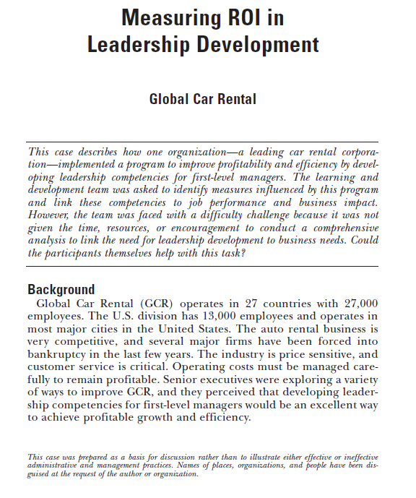


#ATDSaudiArabia
bit.ly/2SeiXyz
Nader Bechini
Director, ROI Institute MENA
nader@roiinstitute.net
@naderbechini

Slide 44




Contact & Connect
Nader Bechini
Director, ROI Institute MENA
nader@roiinstitute.net
@naderbechini
+966500931328

Slide 45

I’M SPEAKING AT
10 Steps for Proving the Value of Human Capital Investments
Wed 5 December 2018 at 12:45 pm
Nader Bechini, CRP
Director, ROI Institute MENA
@naderbechini
Burj Rafal Hotel Kempinski Riyadh, Saudi Arabia
#ATDSaudiArabia

