Slide 1
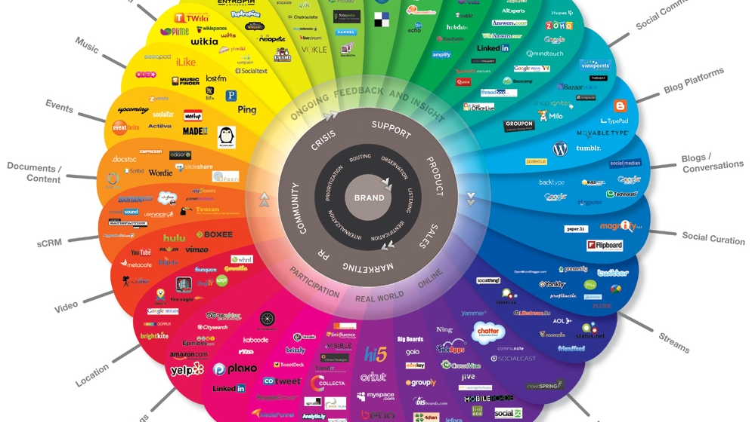
Social media for Business

Slide 2

Why Social Media?
There are now more than 3 billion people using social networks across the globe.

Slide 3

Just Remember R.I.C.E

Slide 4
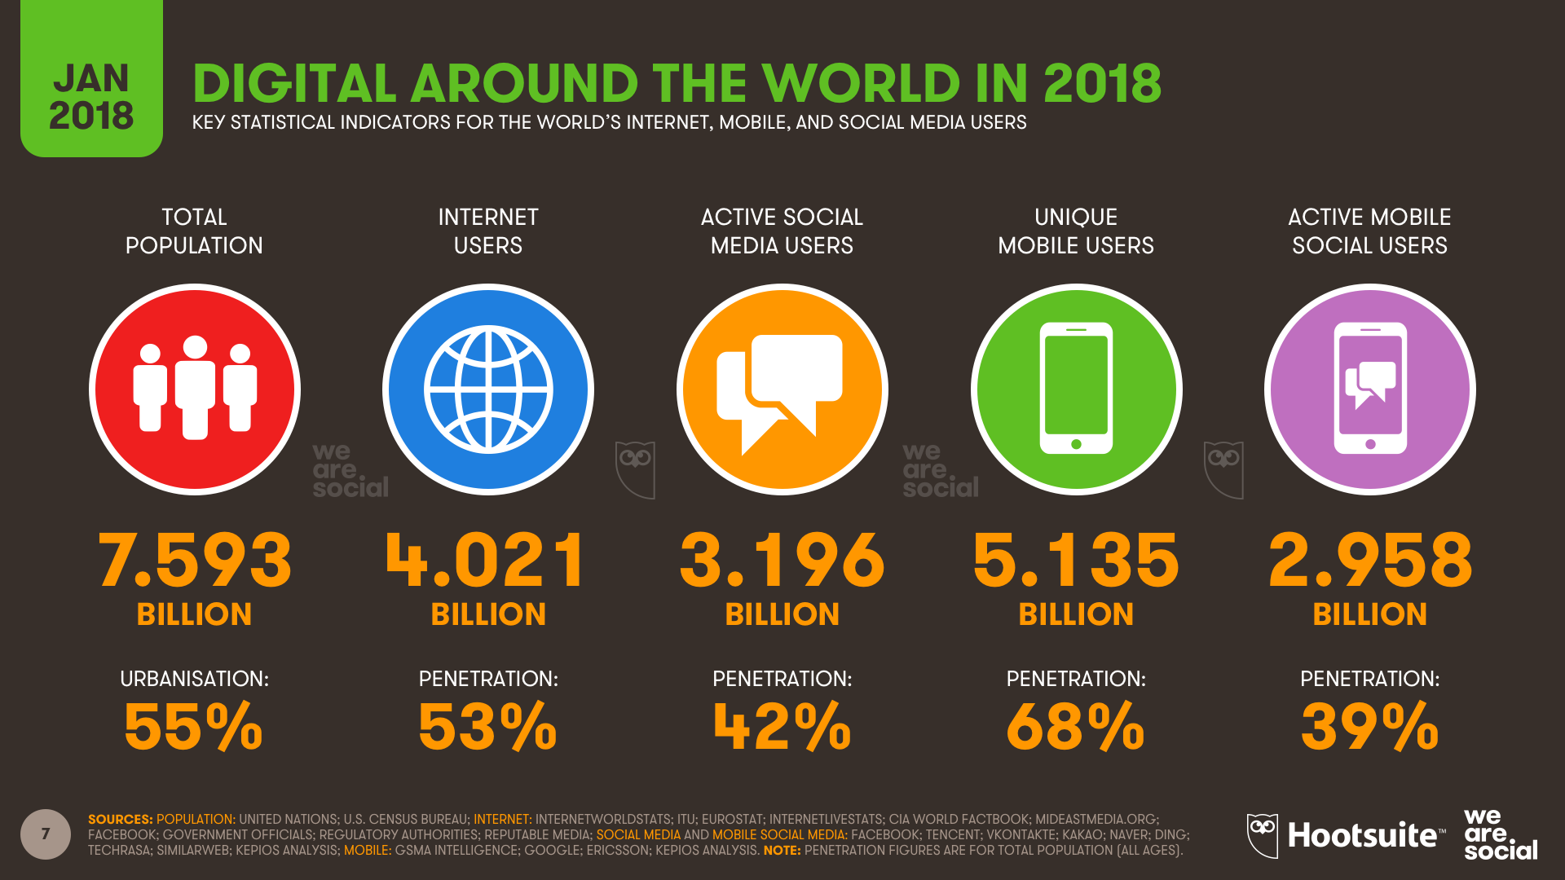
Notes:
Consider talking about:
Mobile social media

Slide 5
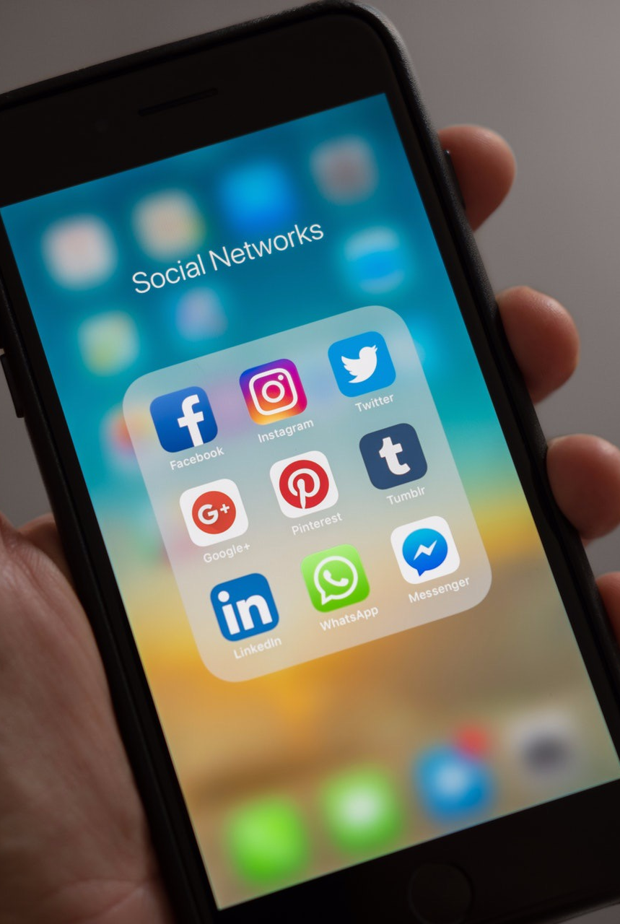
Facebook
Twitter
Instagram
Snapchat
WhatsApp
YouTube
LinkedIn
Tumblr
Pinterest

Slide 6
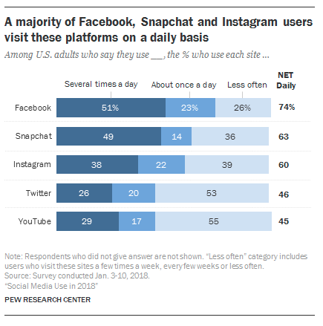
Capitalize on Trends
With nearly half of the world’s population using social media platforms, they’re a natural place to reach new and highly targeted potential customers.

Slide 7

Crowdsourcing
Source ideas: Ask your followers what they want, or engage in social listening, to come up with ideas for content you can create yourself. Put simply: Give people what they’re asking for. It’s a sure way to create content that people will want to read and share.
Source material for posts: Create a contest or use a #hashtag to source user-generated content you can share. Getting your followers involved can build excitement about your brand while also providing you with a library of social posts to share over time.

Slide 8
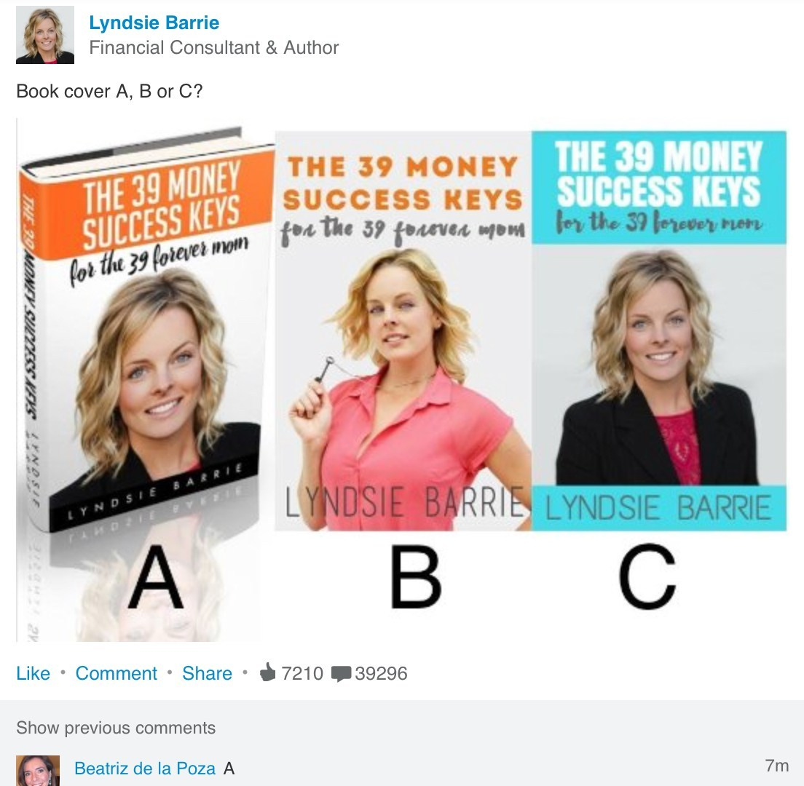
Here’s a wonderful example of how to turn a simple research question into a viral marketing campaign.
Meet Lyndsie Barrie, Financial Consultant and author of The 39 Money Success Keys.
She posted images of three possible book covers for her upcoming book into LinkedIn and ask viewers to choose between A, B or C.
Notes:
Consider talking about:
Most popular social networks
Usage

Slide 9

What question could you ask today that could lead to both helpful market intelligence as well as doubling-up as marketing promotion?
Notes:
Consider talking about:
Use by businesses
Social media mining
In politics
Use in hiring
Use in school admissions
Use by law enforcement agencies
Use in court cases
Social media marketing
Use in science

Slide 10

Increase website traffic
Social media posts and ads are key ways to drive traffic to your website.
Sharing great content from your blog or website to your social channels is a great way to get readers as soon as you publish a new post.
Notes:
Consider talking about:
Trustworthiness and reliability
Critique of activism
Ownership of content
Privacy
Criticism of commercialization
Debate over addiction
Debate over use in academic settings
Censorship

Slide 11

Be human
More than half of adults do not trust a brand until they see “real-world proof” that the brand is keeping its promises.
To connect with customers—and potential customers—you’ve got to show the human side of your brand.
How are you embracing your brand values? (Do you even have brand values?)
How are you looking out for the best interests of your customers and employees? Does your product really work?
Notes:
Consider talking about:
Disparity
Political polarization
Stereotyping
Cognition and memory
Physical and mental health
Effects on youth communication

Slide 12
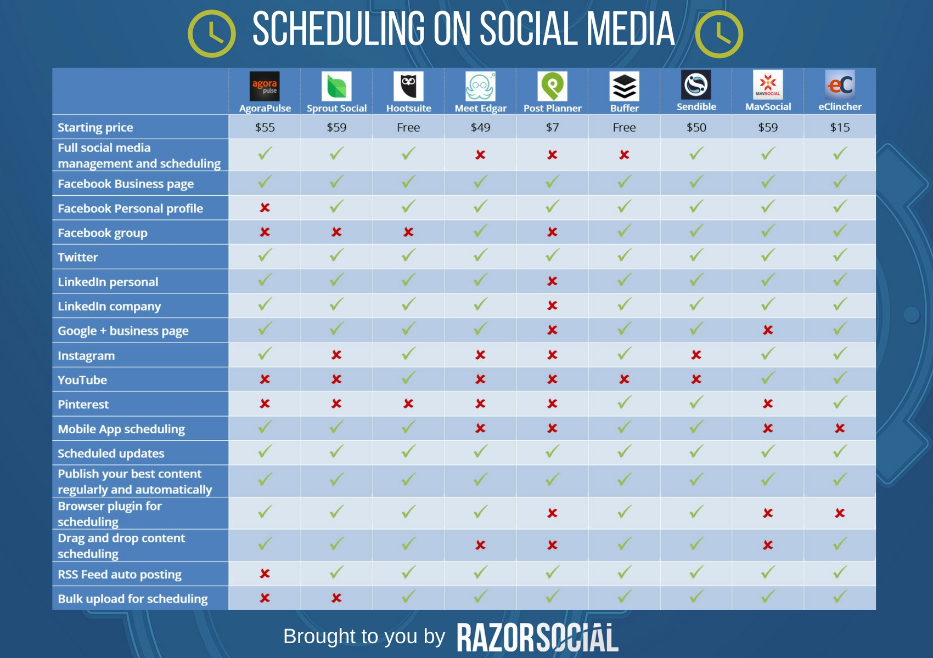
Social media scheduling
Scheduling content on social media is critical to your success.
Plan ahead. Be proactive.
Don’t be caught off guard…(Boss calls an impromptu staff meeting and you haven’t sent out the morning tweet.)
Notes:
Consider talking about:
As a news source
Interpersonal relationships
Self-presentation
Health improvement

Slide 13
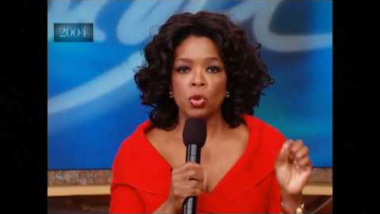
Give the people what they want

Slide 14
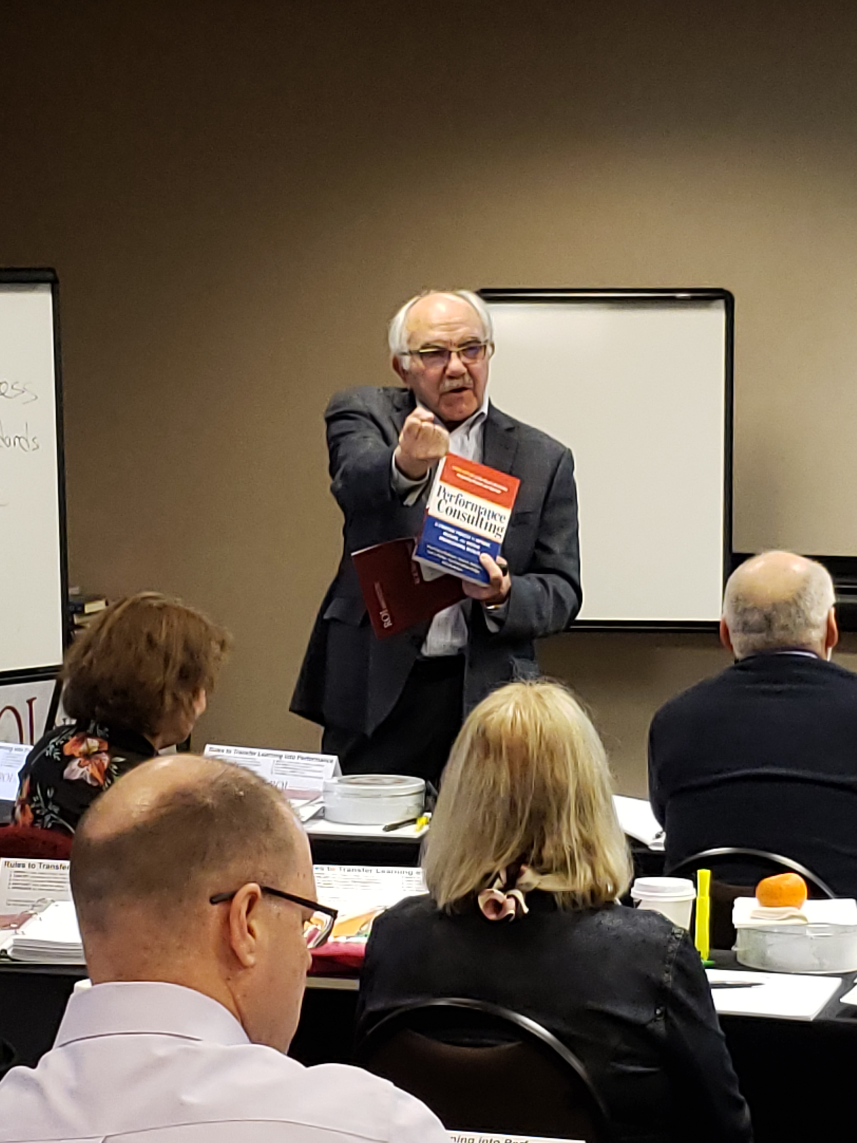
Jack is passionate about books. He gives one (or a lot) to everyone he meets.
Notes:
Consider talking about:
Disparity
Political polarization
Stereotyping
Cognition and memory
Physical and mental health
Effects on youth communication

Slide 15

Be like Jack.
Notes:
Consider talking about:
Disparity
Political polarization
Stereotyping
Cognition and memory
Physical and mental health
Effects on youth communication

Slide 16




Thank you!
Melissa@roiinstitute.net

