Slide 1

Delivering Results Executives Love

Slide 2
Objectives
Participants should be able to answer:
Why ROI?
What’s the value of ROI?
How does the ROI Certification process work?

Slide 3
Which of these are true?
Most of learning and development is wasted (not used).
The learning outcome desired by executives in client organizations is rarely measured.
Most learning providers do not have data showing that they make a difference in the organization.
Most executives see learning as a cost and not an investment.
Most executives view hard skills more valuable than soft skills.

Slide 4
What CEOs Want
ROI Institute and ATD research show that the data CEOs receive are not demonstrating what they want out of their talent investment. (N=96)
Measures | Currently Measure | Should Measure | Importance
Inputs and Indicators | 94% | 86% | 6
Efficiency | 78% | 82% | 7
Reaction | 53% | 22% | 8
Learning | 32% | 28% | 5
Application | 11% | 61% | 4
Impact | 8% | 96% | 1
ROI | 4% | 74% | 2
Awards | 40% | 44% | 3
Notes:
Efficiency measures are not enough. They are important set of measures in the management of value, but offer little insight into the creation of value. This is where effectiveness measures come in.

Slide 5
CLOs Use or Plan to Use ROI
35.6% |  | Use business data to demonstrate the impact of the training organization on the broader enterprise.
21.6% |  | Use ROI for that purpose.
22.6 % |  | Plan to implement ROI within 12 months.
9.7% |  | Plan implementation in 12 to 24 months.
17.3% |  | Plan implementation with no time frame.
(N=335)
71.2%
*2015 Measurement and Metrics Study by CLO Magazine

Slide 6
Ultimately, the success of any program is based on whether it improves business results.”
—Training Top 10 Hall of Fame, May 2017

Slide 7
Changing Paradigms for Learning
 | Traditional | Emerging
 | Job Training | Talent Development
 | Scale and Scope | Speed and Adaptability
✓ | Input Focus | Outcome Focus
✓ | Cost | Investment
 | Necessity | Value Driver
 | Standardization | Customization
 | Fixed Setting and Time | Agile and Flexible
✓ | Science of Learning | Learning Analytics
 | Command and Control | Empowerment
✓ | Needs Assessment | Performance Consulting
✓ | Reaction and Learning | Impact and ROI
7

Slide 8
Why Measure ROI?
Align projects to business needs
Show contributions of selected projects
Earn respect of senior management/administrators
Build staff morale
Justify/defend budgets
Improve support for projects
Enhance design and implementation processes
Identify inefficient projects that need to be redesigned or eliminated
Identify successful projects that can be implemented in other areas
Earn a “seat at the table”

Slide 9

What is Value?

Slide 10
What is Value?
 | LEVEL | ISSUE | MEASURES | TARGETS
This is easy Always measured | 0 | Inputs | Volume, Hours, Convenience, Cost | 100%
This is easy Almost always measured | 1 | Reaction | *Relevance, Engaging, *Important, Useful, *New Content, *Intent to Use, *Recommend to Others | 100%
Not difficult Usually measured | 2 | Learning | Concepts, Trends, Facts, Contacts, Skills, Competencies | 90%
Possible Often measured | 3 | Application | Use of content, Frequency of Use, Success with Use, Barriers, Enablers | 30%
Not so difficult to connect Sometimes measured | 4 | Impact | Productivity, Time, Quality, Costs, Image, Reputation, Engagement, Compliance | 10%
Possible for many programs Rarely measured | 5 | ROI | Benefit Cost Ratio or Return on Investment, Expressed as a Percent | 5%
*Can predict
Must take a step to Isolate the Effects
Executives prefer
*Best Practice: Percent of Programs Evaluated at this level each year.
Copyright © 2017 ROI Institute, Inc. No part of this may be reproduced, stored in a retrieval system, or transmitted in any form or by a means without written permission.

Slide 11
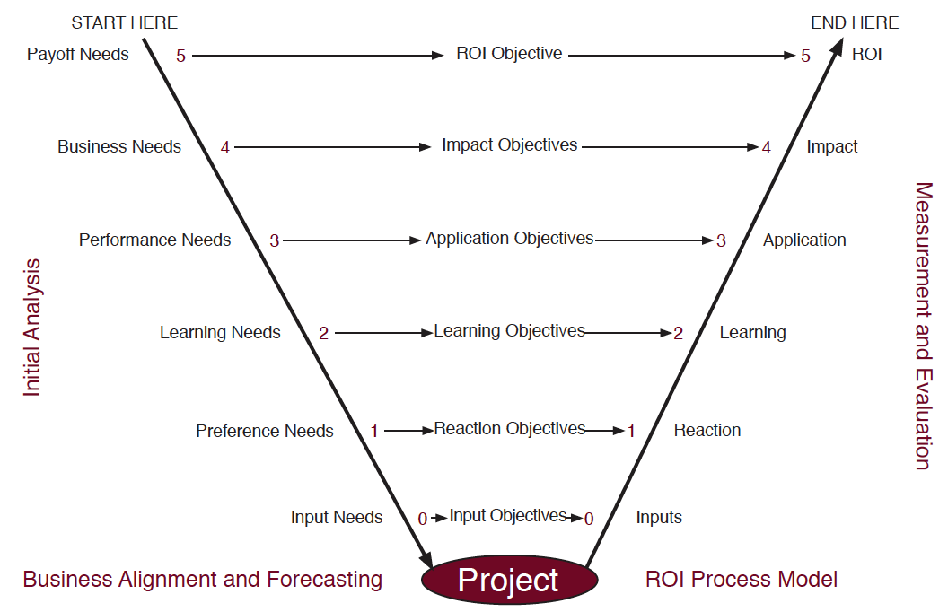
The V-Model provides alignment, connecting needs assessment with evaluation using five levels of data:

Slide 12
ROI Methodology®
LEVEL 0: INPUT
12

Slide 13
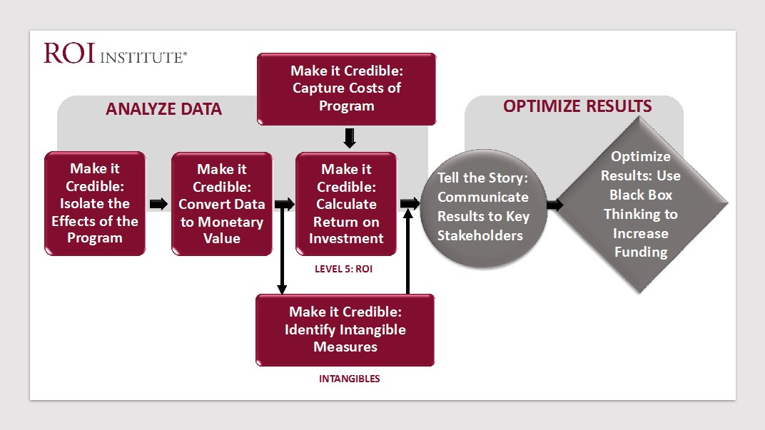
13

Slide 14
Measurement Targets
Level |  | % of Programs
0 | Input | 100%
1 | Reaction | 100%
2 | Learning | 80-90%
3 | Application | 30%
4 | Impact | 10%
5 | ROI | 5%

Slide 15

What percent of your programs are evaluated at Level 4 per year?

Slide 16

Bean Counters Need Beans to Count

Slide 17
Optimize Results
Using black box thinking to increase funding
EVALUATION
OPTIMIZATION
ALLOCATION
Measure
Improve
Fund
17

Slide 18
Certification Components
Prework
Workshop
Workbook and Materials
Virtual Assistance
Right to Use Materials at Work
Certified ROI Professional (CRP) Designation

Slide 19
Selecting a Project for Certification
Importance of program
Linkage of program to problems or opportunities
Linkage to strategic objectives
Management interest in the evaluations
Visibility of the program
Size of the target audience
Life cycle of the program

Slide 20
Be Proactive
Remember, when it comes to delivering results:
Hope is not a strategy.
Luck is not a factor.
Doing nothing is not an option.
Change is inevitable. Progress is optional.
20

