Slide 1

Onsite Workshop 2/4
© 2016 FGCU Institute for Entrepreneurship

Slide 2
Business Model Canvas
A written, visual depiction of a company’s business model that helps:
make logical connections
be agile AND comprehensive
state testable hypotheses (guesses)
© 2016 FGCU Institute for Entrepreneurship
Notes:
The idea behind the BMC is to:
make logical connections between ideas
quickly, but also comprehensively sketch out how the business will work
state assumptions that can be tested - this is where most people get uncomfortable…
we’ll talk more about this in a minute

Slide 3
The Business Model Canvas
Key Partners
Key Activities
Unique Value Proposition
Customer
Relationships
Customer Segments
Key Resources
Channels
Costs
Revenue Streams
© 2016 FGCU Institute for Entrepreneurship
Notes:
Value Proposition: It is not about an idea or product, it is about solving a migraine problem or need.
Customer Segment: Customers do not exist to buy, you exist to help them solve a problem or need.
Channels: How does your Value Proposition get to your Customer Segment?
Customer Relationships: How do you get, keep, and grow customers?
Revenue Streams: How do you get money from the combination of your Value Proposition and Customer Segment?
Key Resources: What are the most important assets required to make the Business Model work?
Key Partnerships: Who are the key partners and suppliers needed to make the Business Model work?
Key Activities: What are the most important things the company must do to make the Business Model work?
Cost Structure: What costs (not just obvious costs) must you incur to make the Business Model work?

Slide 4
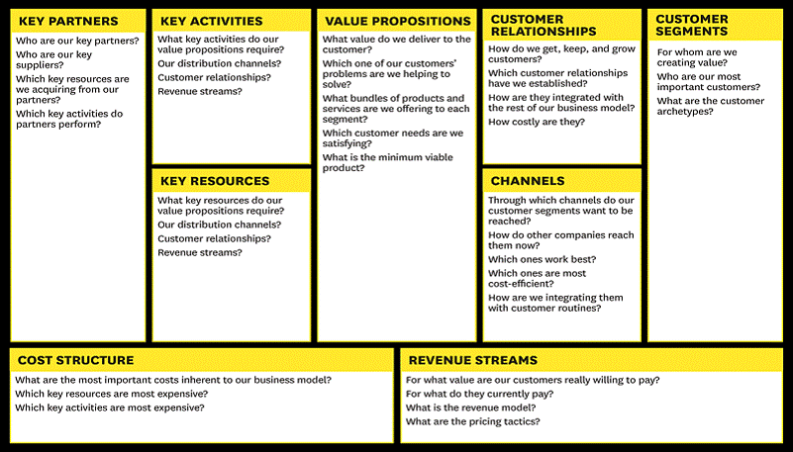
Business Model Canvas
© 2016 FGCU Institute for Entrepreneurship
Notes:
Of the business model canvas, we will mainly focus on the right side when developing the business model. This provides a birds eye view of the business venture, and then allows facilitators and mentors to work with the participants to develop the left side of the BMC while they are building their full Launch Plan.

Slide 5
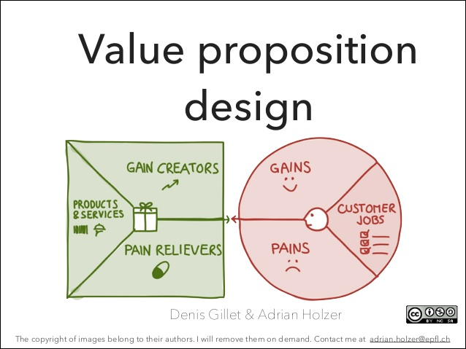
© 2016 FGCU Institute for Entrepreneurship
Notes:
Value Map (left) should Connect to the Customer Profile (Right)
Value Proposition: Product and Services a value proposition is built on. Pain Relievers describe how your products and services alleviate customer pains. Gain Creators describe how your products and services create customer gains. Help students get their business started and gain: more students showing success in starting businesses.
Customer Side: Gains describe the outcomes customers want to achieve or the concrete benefits they are seeking. Pains describe bad outcomes, risks, and obstacles related to customer jobs. Customer Jobs describe what customers are trying to get done in their work and in their lives, as expressed in their words.
When your product and services produce pain relievers and gain creators that match one or more of the jobs, pains, and gains that are important to your customer. Functional Jobs- mow the lawn, eat healthy, write a report. Social jobs, wants to look good. How they want to be perceived by others. Personal Emotional jobs: Feel Good or secure, seeking peace of minds on their investment.

Slide 6
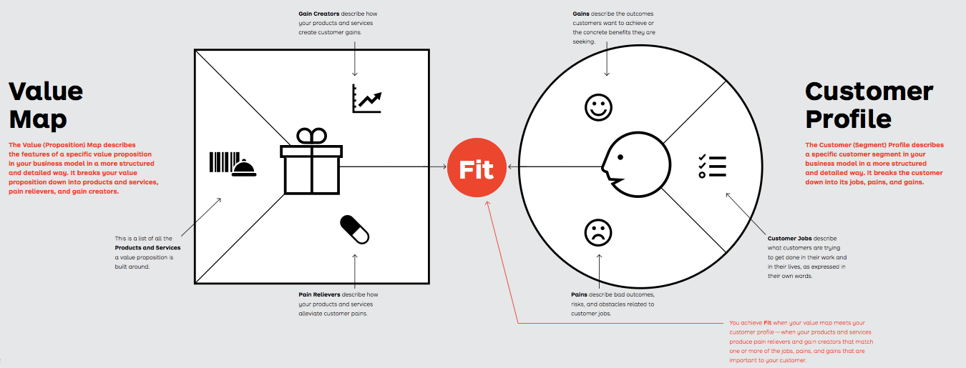
Begin with the Customer in Mind
Gains:
What outcomes do customers want to achieve?
What benefit are they seeking?
Pains:
What bad outcomes, risks, and obstacles related to job?
Customer Jobs:
What are customers trying to do in their work and lives
© 2016 FGCU Institute for Entrepreneurship

Slide 7
Value Map
Product & Services: What is the list of Products and Services a value proposition is built on?
Pain Relievers: How does your products and services create customer gains?
Gain Creators: How does your product and services create customer gains?
© 2016 FGCU Institute for Entrepreneurship

Slide 8
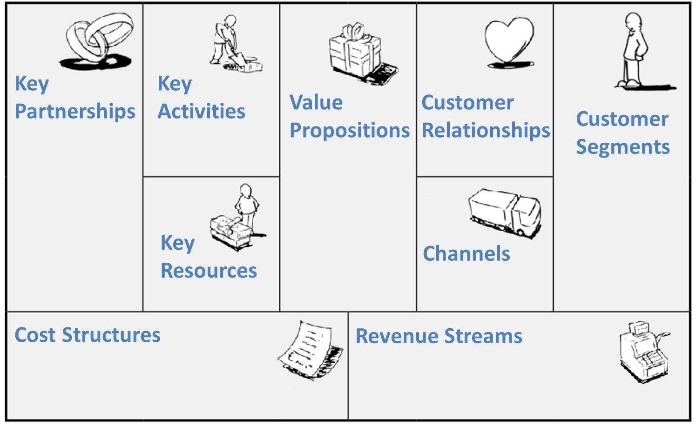


Logical Connections
Female
Married
2+ children
Exercises
Female
Organic everything
Shops locally
Does not like traveling
© 2016 FGCU Institute for Entrepreneurship
© 2016 FGCU Institute for Entrepreneurship
Notes:
Logical connections
Consider if there are multiple customer segments…
or… multiple revenue streams that influence the rest of the model
e.g. a subscription service to complement a traditional (per unit) model
if your drawing this out on paper, USE multiple colors or “stickies” to represent like-minded ideas … or use a coding scheme to keep organized
CS-A , for customer segment A
assess whether your key activities are relevant to the stated customer segments… do you ACTUALLY DO what you need to do in order to satisfy THEIR NEEDS.. how so?
Consider if there are multiple customer segments…
or… multiple revenue streams that influence the rest of the model
e.g. a subscription service to complement a traditional (per unit) model
if your drawing this out on paper, USE multiple colors or “stickies” to represent like-minded ideas … or use a coding scheme to keep organized
CS-A , for customer segment A
assess whether your key activities are relevant to the stated customer segments… do you ACTUALLY DO what you need to do in order to satisfy THEIR NEEDS.. how so?

Slide 9
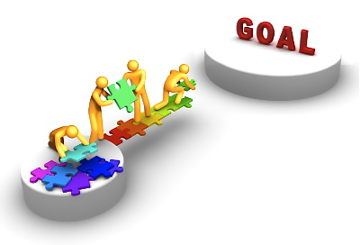
Goal
MINIMUM VIABLE PRODUCT/SERVICE
  Find Successful Business Model
  Grow it
© 2016 FGCU Institute for Entrepreneurship

Slide 10

How bad of a problem is it?
© 2016 FGCU Institute for Entrepreneurship
Notes:
IS IT A LITTLE PROBLEM THAT WE CAN JUST TAKE TWO ASPIRINS AND IT WILL GO AWAY. OR IS IT A MAJOR MIGRAINE.

Slide 11

Is it a Migraine?
© 2016 FGCU Institute for Entrepreneurship

Slide 12
Agile & Comprehensive
Female
Married
2+ children
Exercises
Female
Organic everything
Shops locally
Does not like traveling
© 2016 FGCU Institute for Entrepreneurship
© 2016 FGCU Institute for Entrepreneurship
Notes:
Agile
Do not fall trap to the escalation of commitment (sunk costs)
the idea with the BMC is to be in SEARCH OF a good business model
GETTING NEGATIVE FEEDBACK and using it is harder said than done?
This group may know better than anyone else… improving is the only option
facing the reality that we’re not always right is a PART OF THE LIFE
Comprehensive
Don’t forget to assess what you have around you by way of resources
in what ways can these resources help you achieve your objectives?
MAP THEM OUT on the BMC… this is a comprehensive tool, that forces you to think about each element of the business

Slide 13

Business Model vs. Plan
Model
Plan
© 2016 FGCU Institute for Entrepreneurship
Notes:
Introductory comments on business modeling
Much more realistic view of how businesses actually get started
“Everyone has a plan… until they get punched in the mouth”
We needed better tools to work with than a business plan
research clearly indicated that plans were not being written, or if they were, not being used
perhaps they’re too rigid for a process that is generally chaotic

