Slide 1
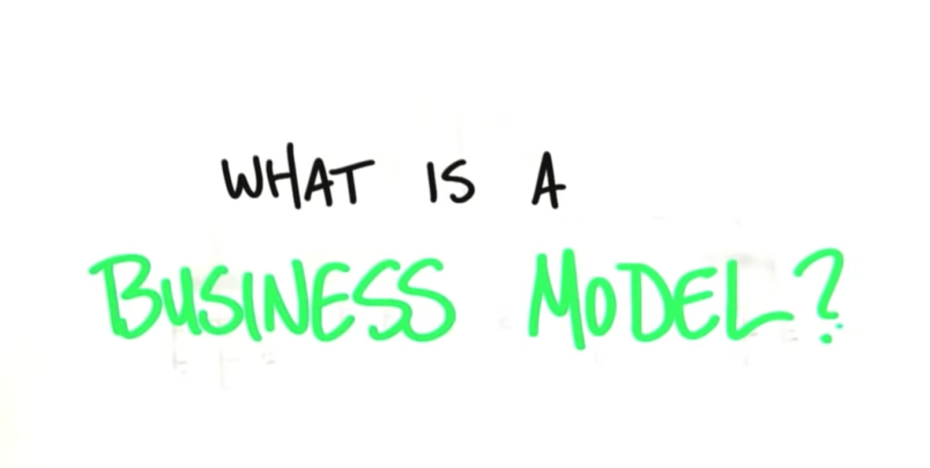
By : Marcela Leon
marcelaleon@innovazzone.com

Slide 2
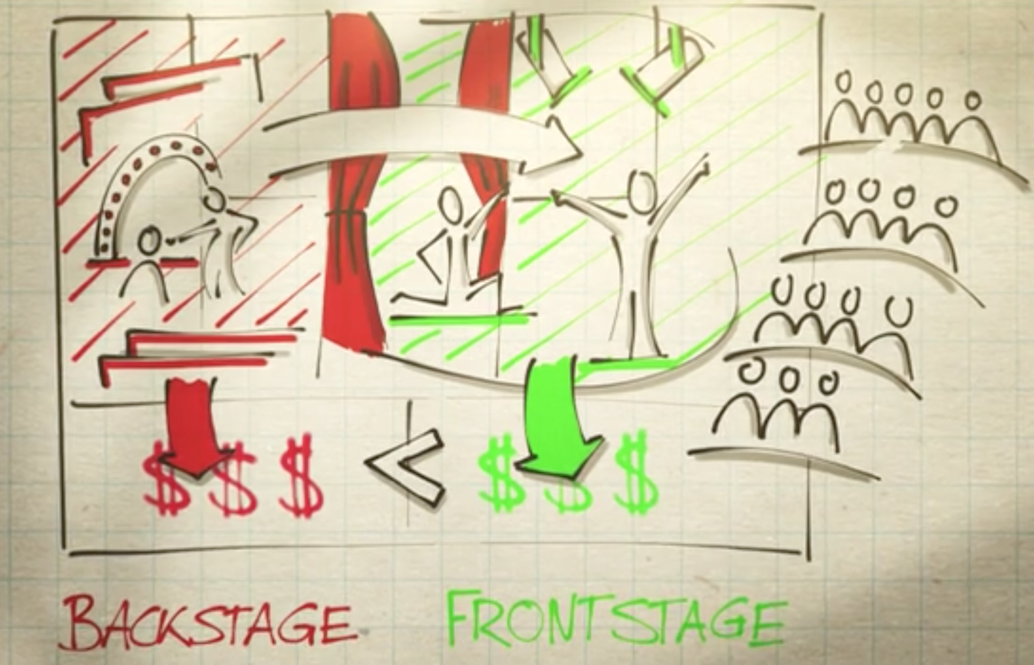
Source: https://www.youtube.com/watch?v=LLKqthJOdN8

Slide 3
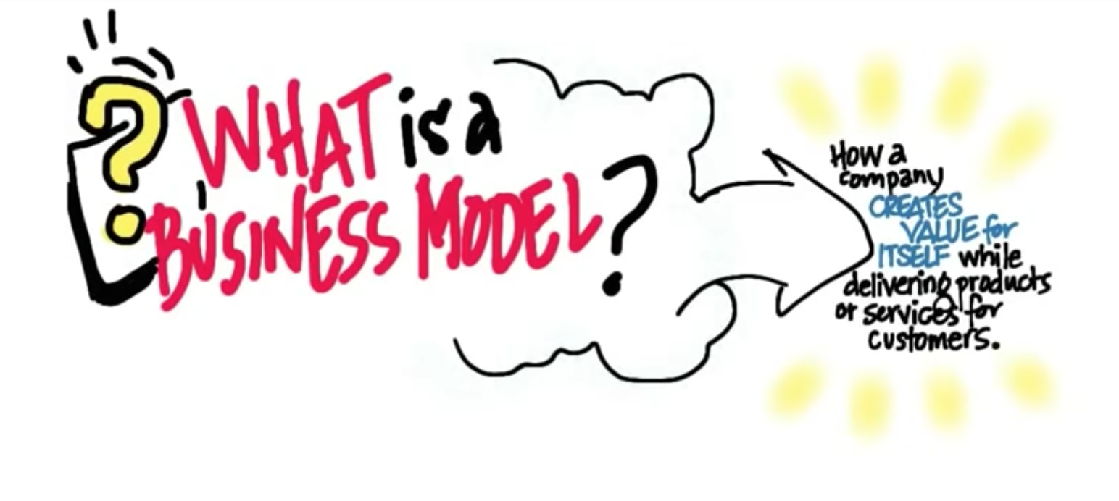
Source : https://www.youtube.com/watch?v=IP0cUBWTgpY

Slide 4









Key
Partnerships
Key
Activities
Value
Proposition
Customer
Relationships
Customer
Segments
Key
Resources
Channels
Cost Structure
Revenue Streams

Slide 5
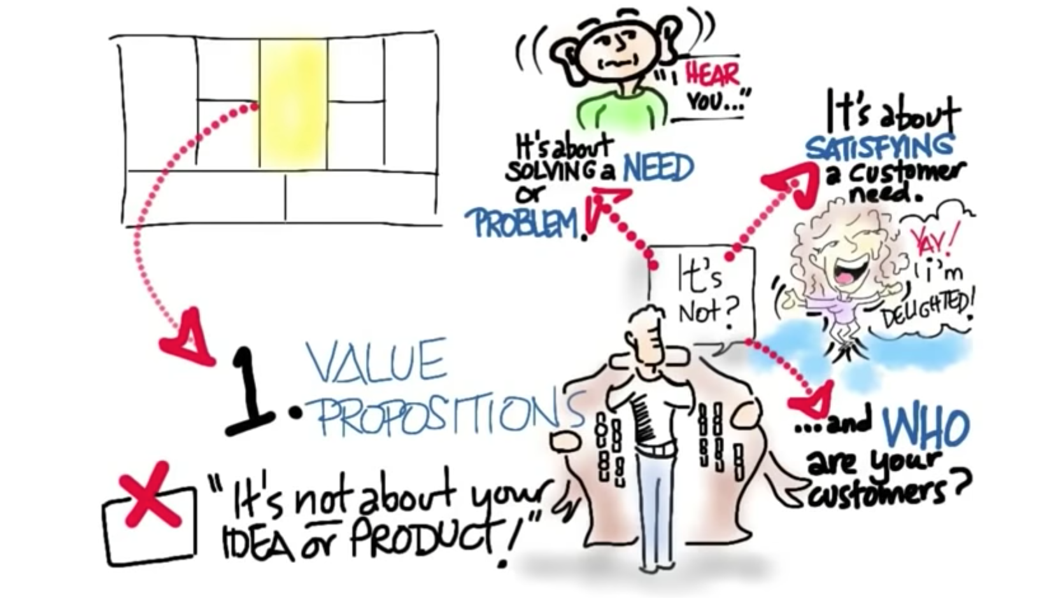
Source : https://www.youtube.com/watch?v=IP0cUBWTgpY

Slide 6
Key
Partnerships
Key
Activities
Value
Proposition
Customer
Relationships
Customer
Segments
Key
Resources
Channels
Cost Structure
Revenue Streams

Slide 7
Value
Proposition
Pain : Organizations not able to demonstrate Return
Board of Directors
Management
HR
Marketing
Solution :
They might be able to get sponsorship.
As consultant firm we will differentiate from others
PAIN OR NEED : Organizations deal with no opportunity to demonstrate if the investment on a HR or Marketing program or solution will have impact in the business and will have return.
This is a requirement of the Board of Directors, Management, Human Resources and Marketing.
With ROI Methodology HR & Marketing might be able to get sponsorship for investments on their solutions.
As consultant firm we would differentiate from other consultants significantly. No other firms can really do that.

Slide 8
Key
Partnerships
Key
Activities
Value
Proposition
Pain : Organizations not able to demonstrate Return
Board of Directors
Management
HR
Marketing
Solution :
They might be able to get sponsorship.
As consultant firm we will differentiate from others significantly.
Customer
Relationships
Customer
Segments
Key
Resources
Channels
Cost Structure
Revenue Streams

Slide 9
Key
Partnerships
Key
Activities
Value
Proposition
Customer
Relationships
Customer
Segments
Key
Resources
Channels
Cost Structure
Revenue Streams

Slide 10
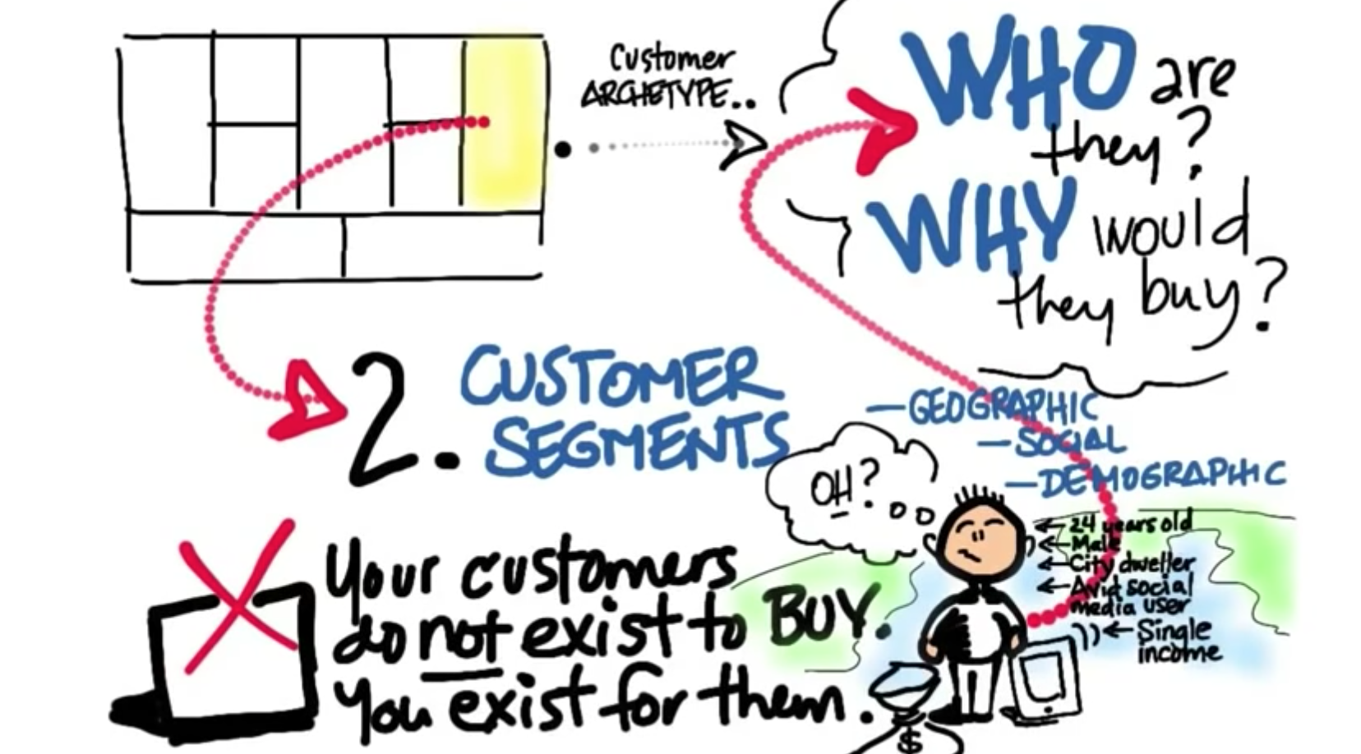
Source : https://www.youtube.com/watch?v=IP0cUBWTgpY

Slide 11
Customer
Segments
Large and Medium companies would be able to invest in ROI (1000 top Peruvian largest organizations)
Within orgs:
Board of Directors
GM’s
Head of HR
For certification:
HR Directors to invite their experts.
Our solutions are directed to all organizations in Peru. Although very likely only large and medium companies would have significant investments that would require ROI analysis.
So our market objective for CONSULTANT WORK would be first to go to the 1000 largest organizations which we have identified. We will explore or network.
Within organizations there our target clients for Consulting solutions are:
  Board of Directors
  General Managers
  Head of HR
Target market for CERTIFICATION AND WORKSHOPS: HR Directors in organizations.

Slide 12
Customer
Segments
Key
Partnerships
Key
Activities
Value
Proposition
Customer
Relationships
Large and Medium companies would be able to invest in ROI (1000 top Peruvian largest organizations)
Within orgs:
Board of Directors
GM’s
Head of HR
For certification:
HR Directors to invite their experts.
Key
Resources
Channels
Cost Structure
Revenue Streams

Slide 13
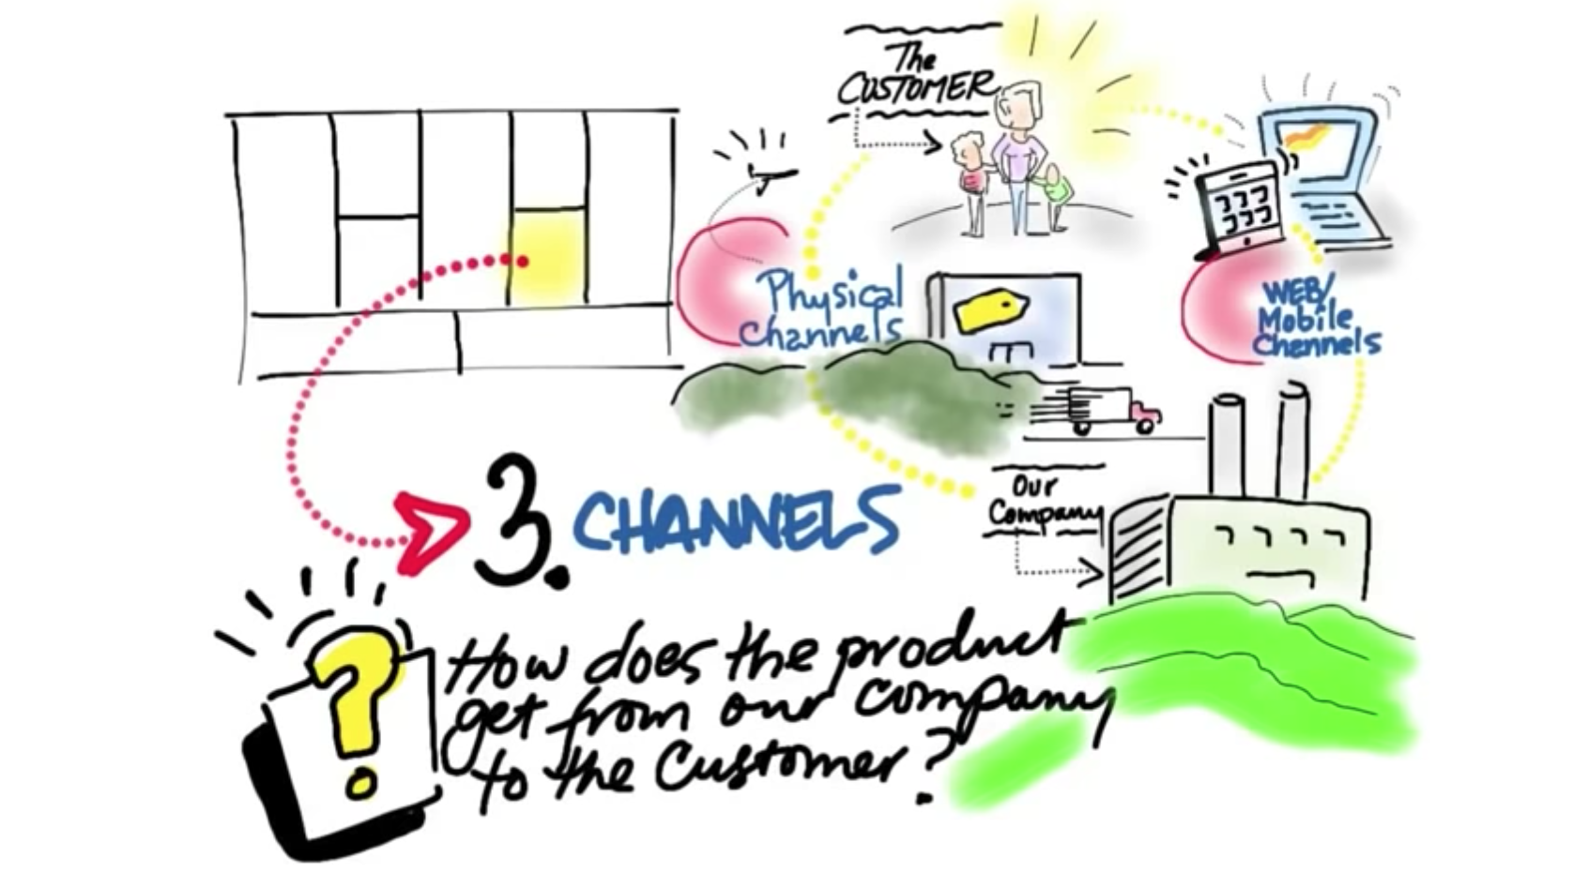
Source : https://www.youtube.com/watch?v=IP0cUBWTgpY

Slide 14
Key
Partnerships
Key
Activities
Value
Proposition
Customer
Relationships
Customer
Segments
Key
Resources
Channels
Cost Structure
Revenue Streams

Slide 15
Delivery/Touchpoint Channels:
Consulting with ROI – F2F, Web, mailing
Teaching ROI – workshops, certification. Centrum, Seminarium, APERHU, AMCHAM HR Committee
Writing ROI : Magazines - Gestión, web, Social Media, LINKEDIN strategy.
Speaking on ROI – APERHU y AMCHAM Congresses / Seminars.
Researching – Universities (business cases), Presentation of Survey Research made by Instituto ROI – renewed, Government initiative about Institutes.
Channels
Consulting – F2F, Web, mailing
Teaching – Centrum workshops. APERHU
Writing : Gestion , web,LINKEDIN Strategy
Speaking – APERHU & AMCHAM Congresses
Researching – Renewed research (Rodrigo), Government Institutes

Slide 16
Key
Partnerships
Key
Activities
Value
Proposition
Customer
Relationships
Customer
Segments
Key
Resources
Channels
Consulting – F2F, Web, mailing
Teaching – Centrum workshops. APERHU
Writing : Gestion , web,,LINKEDIN Strategy
Speaking – APERHU & AMCHAM Congresses
Researching – Renewed research (Rodrigo), Government Institutes
Cost Structure
Revenue Streams

Slide 17
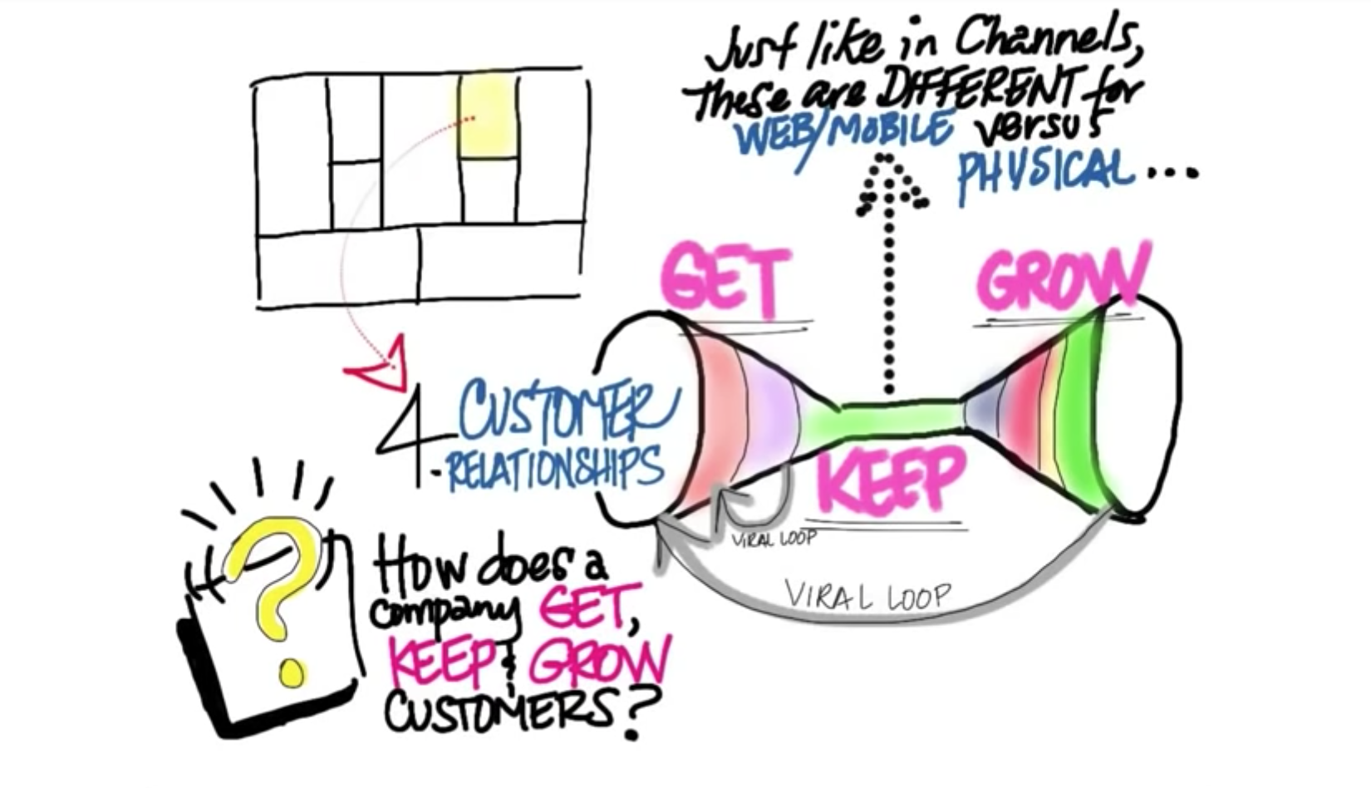
Source : https://www.youtube.com/watch?v=IP0cUBWTgpY

Slide 18
Key
Partnerships
Key
Activities
Value
Proposition
Customer
Relationships
Customer
Segments
Key
Resources
Channels
Cost Structure
Revenue Streams

Slide 19
New Customers : Landpage, HR Orgs. Network, Social Media Publications, Mailing.
Retained Customers:
Linkedin, Best Practices network, Subscription landpage, Outsorced Value Creator.
Customer
Relationships
Customer Relationships
GET customers :
Consulting : Landpage, APERHU & AMCHAM Seminars, Marketing, Mailing, Current Customers.
Certification/Workshops : Centrum Network
Social Media : Publications, Mailing Ads.
RETAIN Customers:
Certified/Workshop Network in Linkedin Group
Best Practices – Network
Landpage with suscription – notification updates on research and papers.
Outsourced Value Creator – for a fixed amount continuous support

Slide 20
Key
Partnerships
Key
Activities
Value
Proposition
New Customers : Landpage, HR Orgs. Network, Social Media Publications, Mailing.
Retained Customers:
Linkedin, Best Practices network, Subscription landpage, Outsourced Value Creator.
Customer
Segments
Customer
Relationships
Key
Resources
Channels
Cost Structure
Revenue Streams

Slide 21
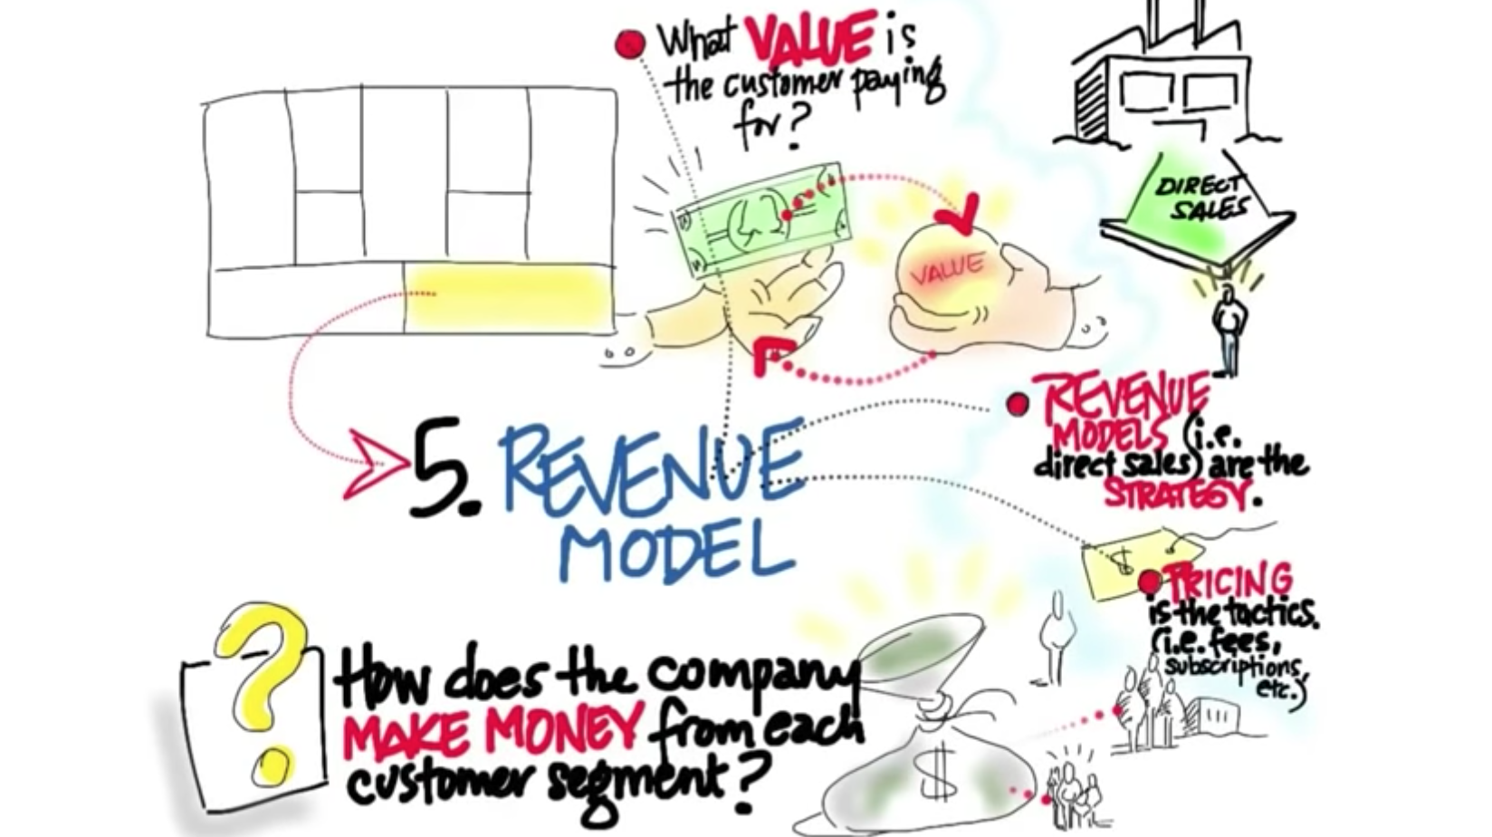
Source : https://www.youtube.com/watch?v=IP0cUBWTgpY

Slide 22
Key
Partnerships
Key
Activities
Value
Proposition
Customer
Relationships
Customer
Segments
Key
Resources
Channels
Cost Structure
Revenue Streams

Slide 23
Revenue Streams:
Consulting with ROI – Price according to scope, workload, resources involved & know-how transfer.
Blended Consulting + Teaching – Continuous income. (Engagement and Employee Experience Initiatives).
Teaching ROI (certification) – benchmark with other classes, resources involved, workload. Review Centrum pricing terms.
Payment – Invoice 30% before delivery, 70% to be paid 15-30 after each deliverable. Direct payment to bank account.
APERHU discount.
Revenue Streams
Consulting with ROI – Price according to scope, workload, resources involved & know-how transfer, daily price.
Blended Consulting + Teaching – Continous income.
Teaching ROI (certification) – benchmark with other classes, resources involved, workload. Review Centrum pricing terms.
Blended Cons. + Teaching – Engagement & Empl. Experience Payment –30% before, 70% t15-30 after, Aperhu discount

Slide 24
Key
Partnerships
Key
Activities
Value
Proposition
Customer
Relationships
Customer
Segments
Key
Resources
Channels
Cost Structure
Revenue Streams
Consulting with ROI – Price according to scope, workload, resources involved & know-how transfer, daily price.
Teaching ROI (certification) – benchmark with other classes, resources involved, workload. Review Centrum pricing terms.
Blended Cons. + Teaching – Engagement & Empl. Experience projects.
Payment –30% before, 70% t15-30 after, Aperhu discount

Slide 25
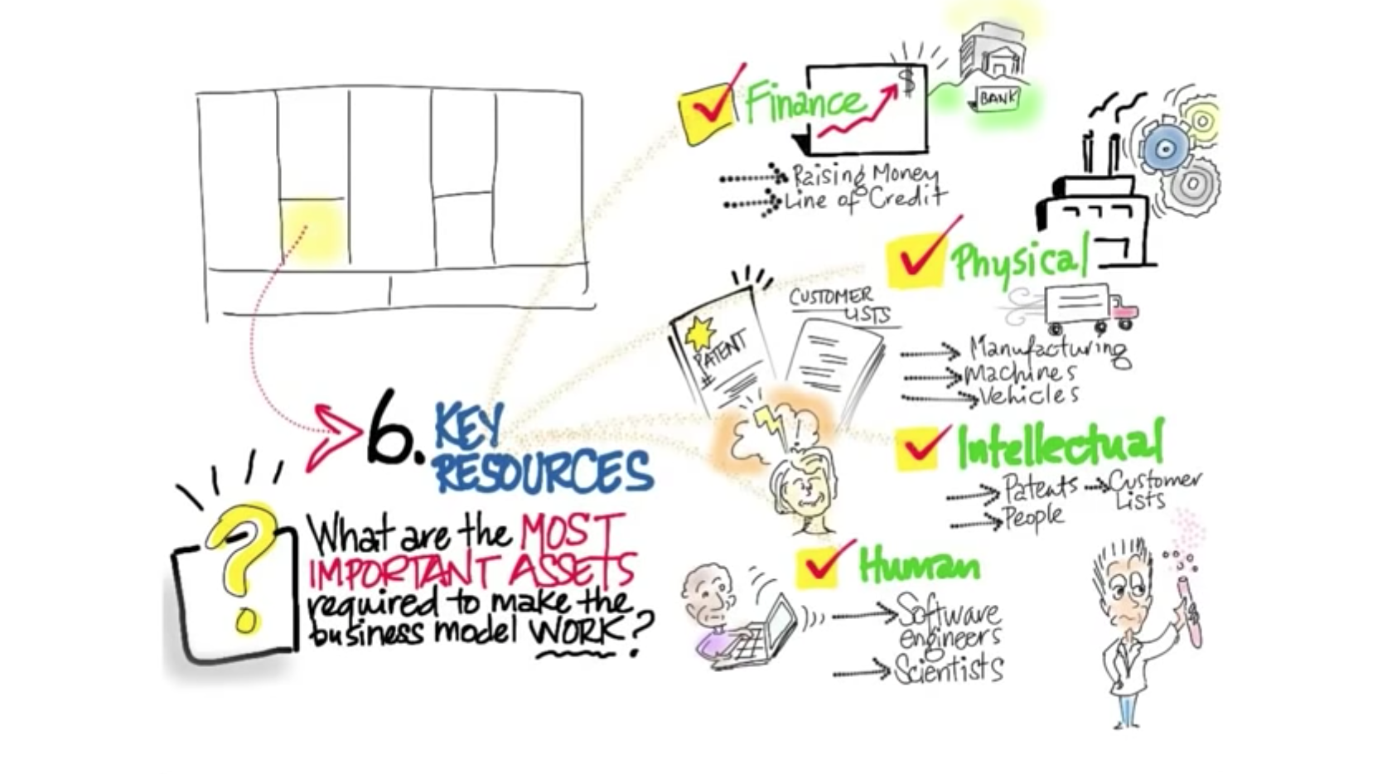
Source : https://www.youtube.com/watch?v=IP0cUBWTgpY

Slide 26
Key
Partnerships
Key
Activities
Value
Proposition
Customer
Relationships
Customer
Segments
Key
Resources
Channels
Cost Structure
Revenue Streams

Slide 27
Key Resources
New Website/ Landpage / Hosting
Resource : 1 employee dedication
Social Media Positioning & Ad Strategy
Office (Regus additional office)
Accounting & Administration (Erich’s team)
Brochures design
On-Demand Consultants (MA, MPP, RM, LT, Woman on Work)
Key
Resources
New Website
Resource : 1 employee Social Media Positioning & Ads.
Office (Regus add. Office)
Accounting& Admin. Brochures Design
OnDemand Cosnuttants

Slide 28
Key
Partnerships
Key
Activities
Value
Proposition
Customer
Relationships
Customer
Segments
Key
Resources
Channels
New Website
Resource : 1 employee Social Media Positioning & Ads.
Office
Accounting& Administrtion
Brochures Design
On-Demand Consultants
Cost Structure
Revenue Streams

Slide 29
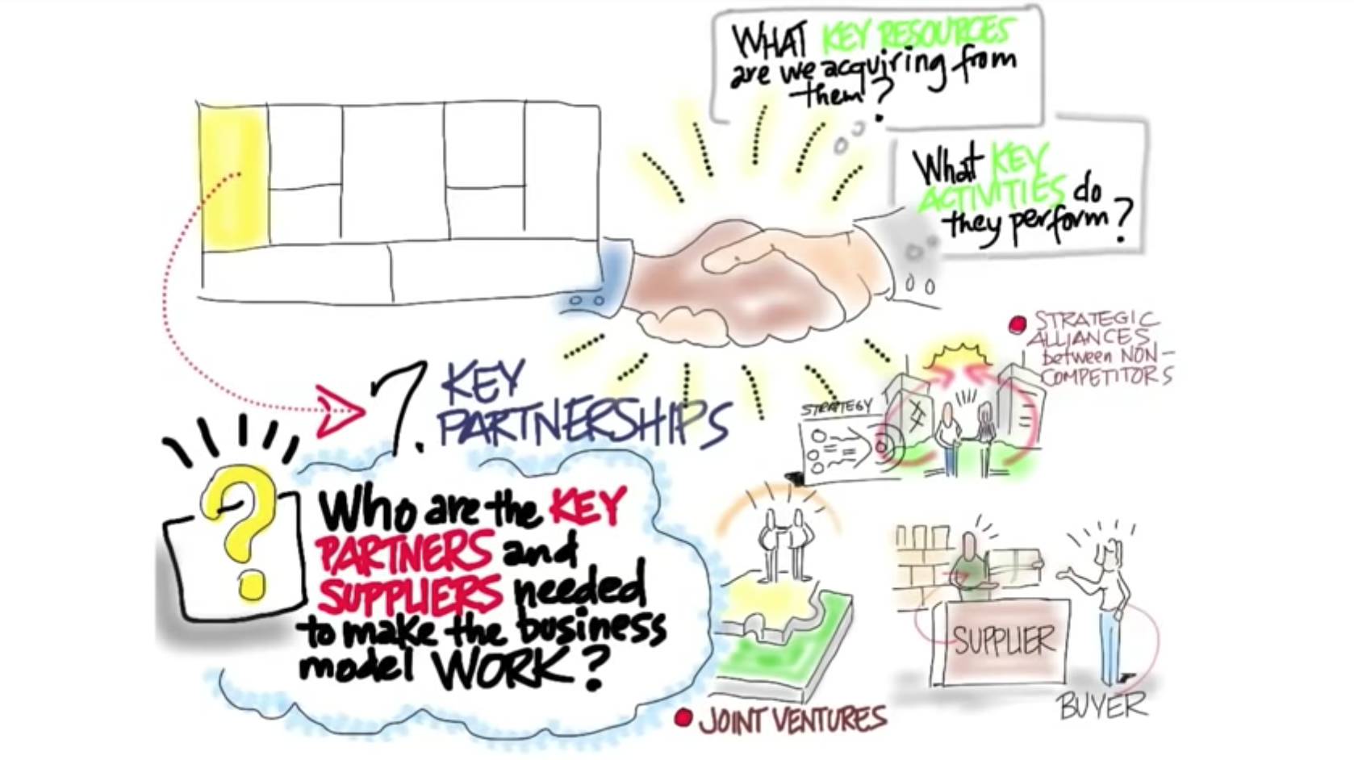
Source : https://www.youtube.com/watch?v=IP0cUBWTgpY

Slide 30
Key
Partnerships
Key
Activities
Value
Proposition
Customer
Relationships
Customer
Segments
Key
Resources
Channels
Cost Structure
Revenue Streams

Slide 31
ROI Institute Team
MAS Consultores
Centrum
APERHU Association
AMCHAM RH Committee
Gestión
Perspektiva
Universities
Government
Key
Partnerships
Key Partnerships
ROI Institute Team
MAS Consultores
Centrum
APERHU Association
AMCHAM RH Committee
Gestión
Perspektiva
Universities
Government

Slide 32
Key
Partnerships
Key
Activities
Value
Proposition
Customer
Relationships
Customer
Segments
ROI Institute Team
MAS Consultores
Centrum
APERHU Association
AMCHAM RH Committee
PR : Gestión
Perspektiva
Universities
Government
Key
Resources
Channels
Cost Structure
Revenue Streams

Slide 33
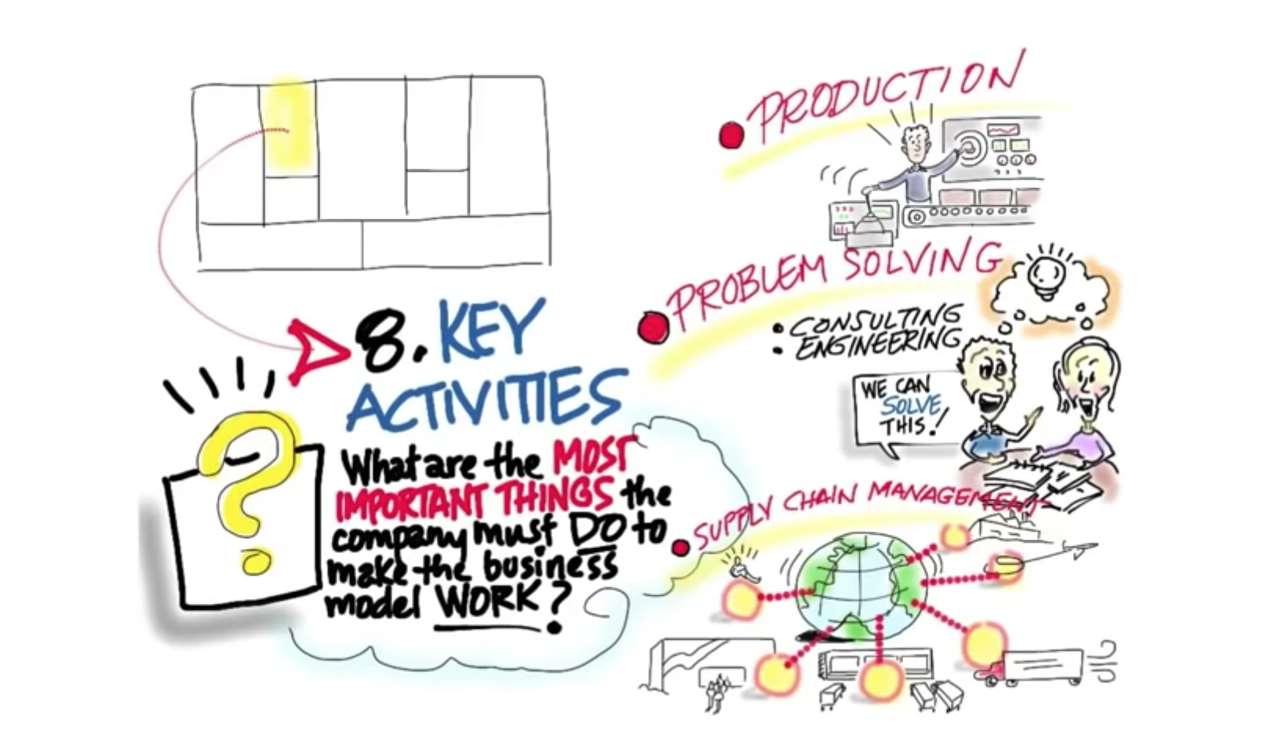
Source : https://www.youtube.com/watch?v=IP0cUBWTgpY

Slide 34
Key
Partnerships
Key
Activities
Value
Proposition
Customer
Relationships
Customer
Segments
Key
Resources
Channels
Cost Structure
Revenue Streams

Slide 35
Key
Activities
Consulting Business –ROI studies,. Formal 30-60-90 strategy.
Teaching ROI – wkshps coord, announce & fac.
Blended - Enagement and Empl. Exp. Projs. Speeches–AMCHAM & APERHU. Research – Renewed research & Institutes Research
Key Activities
Consulting Business – Conducting ROI studies for organizations. Management of formal announcement 30-60-90 strategy.
Teaching ROI – Workshops coordination and announcement
Blended Consulting + Teaching – Enagement and Employee Experience Projects.
Speeches – AMCHAM & APERHU.
Research – Renewed research & with action plans to present to AMCHAM for Congress, Institutes Research return for students & country.
Writing about ROI –blogs, articles, LINKEDIN
We require to start with Advertisement & Publications as well as getting 1 business case to publish.

Slide 36
Consulting Business –ROI studies,. Formal 30-60-90 strategy.
Teaching ROI – wkshps coord, announce & fac.
Blended - Enagement and Empl. Exp. Projs. Speeches–AMCHAM & APERHU. Research Resarch & Institutes research with AP’S
Value
Proposition
Customer
Segments
Key
Partnerships
Key
Activities
Customer
Relationships
Key
Resources
Channels
Cost Structure
Revenue Streams

Slide 37
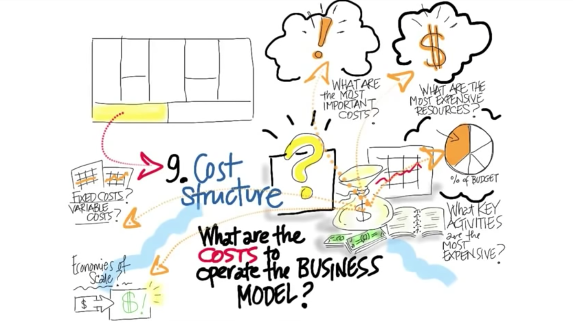
Source : https://www.youtube.com/watch?v=IP0cUBWTgpY

Slide 38
Key
Partnerships
Key
Activities
Value
Proposition
Customer
Relationships
Customer
Segments
Key
Resources
Channels
Cost Structure
Revenue Streams

Slide 39
Cost Structure
Fixed Costs :
Resources (employee & ML)
Social Media Positioning & Ad
Hosting
Taxes
Office
Variable Costs :
Partnership costs
Centrum costs
Instructor costs
New Website design
ML Costs
Cost Structure
Fixed Costs :
Resources (Empl & ML)
Social Media Ads
Hosting
Taxes
Office
Variable Costs :
Centrum costs
Instructor costs
New Website design
ML Costs

Slide 40
Key
Partnerships
Key
Activities
Value
Proposition
Customer
Relationships
Customer
Segments
Key
Resources
Channels
Cost Structure
Revenue Streams
Fixed Costs :
Resources (Empl & ML)
Social Media Ads
Hosting
Taxes
Office
Variable Costs :
Centrum costs
Instructor costs
New Website design
ML Costs

Slide 41
Pain : Organizations not able to demonstrate Return
Board of Directors
Management
HR
Marketing
Solution :
They might be able to get sponsorship.
As consultant firm we will differentiate from others significantly.
Landpage, HR Orgs. Network, Social Media Publications, Mailing.
Retained Customers:
Linkedin, Best Practices network, Subscription landpage, Outsourced Value Creator.
Customer
Segments
Key
Partnerships
Key
Activities
Value
Proposition
Customer
Relationships
Large and Medium companies would be able to invest in ROI (1000 top Peruvian largest organizations)
Within orgs:
Board of Directors
GM’s
Head of HR
For certification:
HR Directors to invite their experts.
ROI studies for orgs-
ROI Coaching to orgs. Certification/Workshop
Speeches – HR Orgs
Research – Business Cases/Institutes
Writing–blogs, articles
Ads & Pubs. (bus. case)
ROI Institute Team
MAS Consultores
Centrum
APERHU Association
AMCHAM RH Committee
PR : Gestion
Perspektiva
Universities
Government
Key
Resources
Channels
New Website
1 employee
Social Media Positioning & Ads.
Office
Accounting & Admin
Brochures Design
On-Demand Consultants
Consulting – F2F, Web, mailing
Teaching – Centrum workisops. APERHU
Writing : Gestion , web,,LINKEDIN Strategy
Speaking – APERHU & AMCHAM Congresses
Researching – Renewd research (Rodrigo), Government Institutes
Cost Structure
Revenue Streams
Fixed Costs :
Resources (Empl & ML)
Social Media Ads
Hosting
Taxes
Office
Variable Costs :
ROI Payment
Centrum costs
Instructor costs
New Website design
ML Costs
Consulting with ROI – Price according to scope, workload, resources involved & know-how transference.
Teaching ROI (certification) – benchmark with other classes, resources involved, workload. Review Centrum pricing terms.
Payment – Invoice 30% before delivery, 70% to be paid 15-30 after delivery. Direct payment to bank account.
APERHU discount.

Slide 42
Good Videos :
Business Model Theather : https://www.youtube.com/watch?v=LLKqthJOdN8
Explanation about the Model : https://www.youtube.com/watch?v=IP0cUBWTgpY
(I used this last video using screenshots to create the explanation)
Wikipedia :
https://en.wikipedia.org/wiki/Business_Model_Canvas
It is distributed under a Creative Commons license^{[7]} from Strategyzer AG and can be used without any restrictions for modeling businesses.
But, The Business Model Canvas was initially proposed by Alexander Osterwalder^{[4]} based on his earlier work on Business Model Ontology.^{[5]} Since the release of Osterwalder's work in 2008, new canvases for specific niches have appeared.

