Slide 1
2019 ROI Institute Partners Workshop
Welcome!

Slide 2

ROI Methodology® A well-documented, recognized and protected process that works.
2019 Partner Meeting
Patti P. Phillips, Ph.D. President & CEO
Ann Akins
Vice President & CFO
ROI Institute, Inc.

Slide 3
3

Slide 4
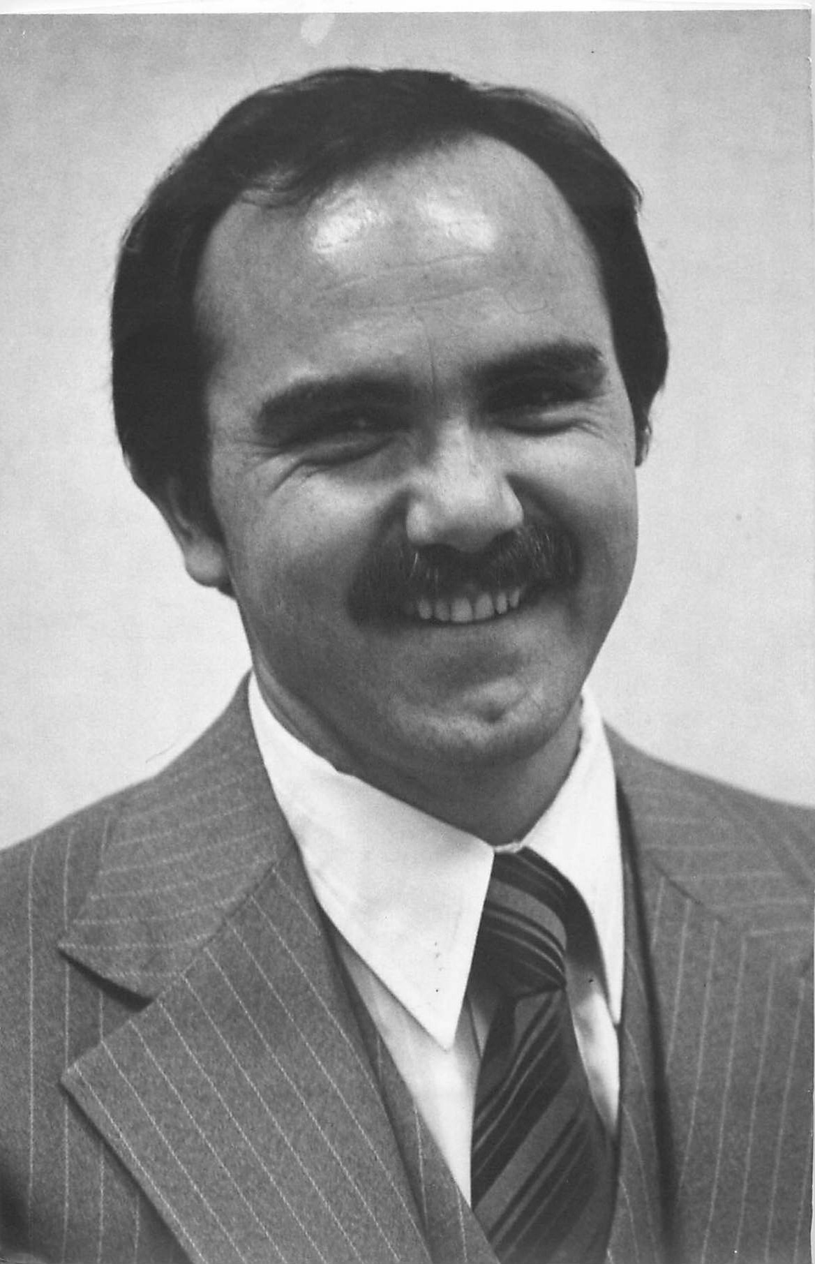
1973
4

Slide 5
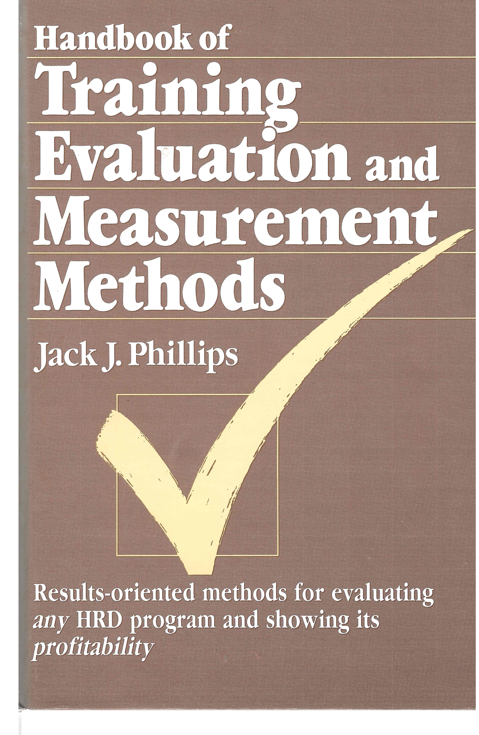
1983
1973
5

Slide 6
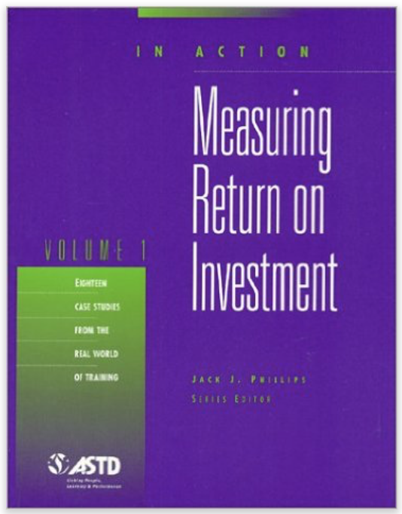
1983
1973
1994
6

Slide 7

1983
1995
1973
1994
7

Slide 8
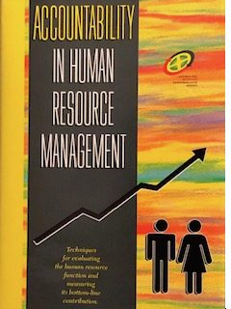
1983
1995
1973
1994
1996
8

Slide 9
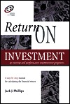
1983
1995
1997
1973
1994
1996
9

Slide 10
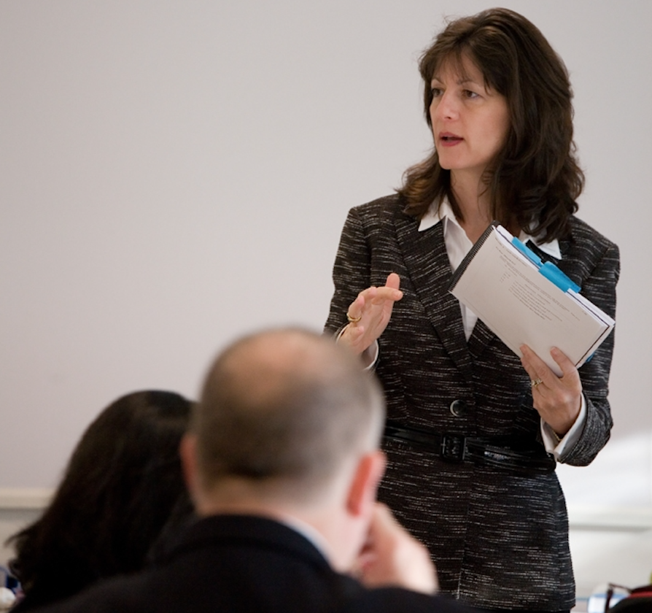
1983
1995
1997
1973
1994
1996
10

Slide 11
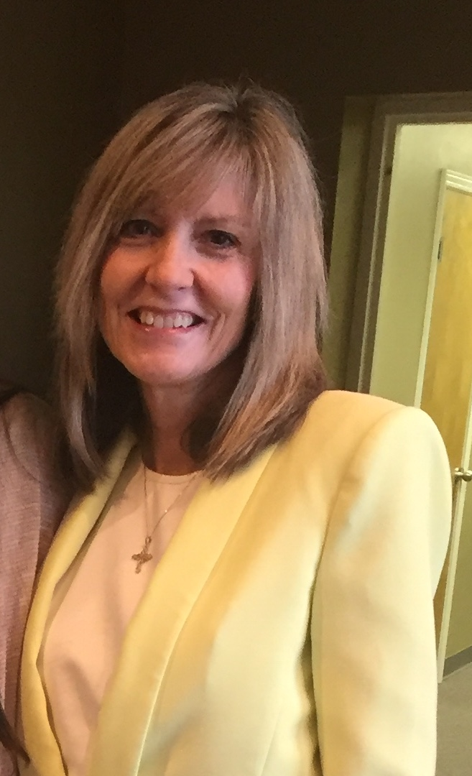
1983
1995
1997
1973
1994
1996
1998
11

Slide 12
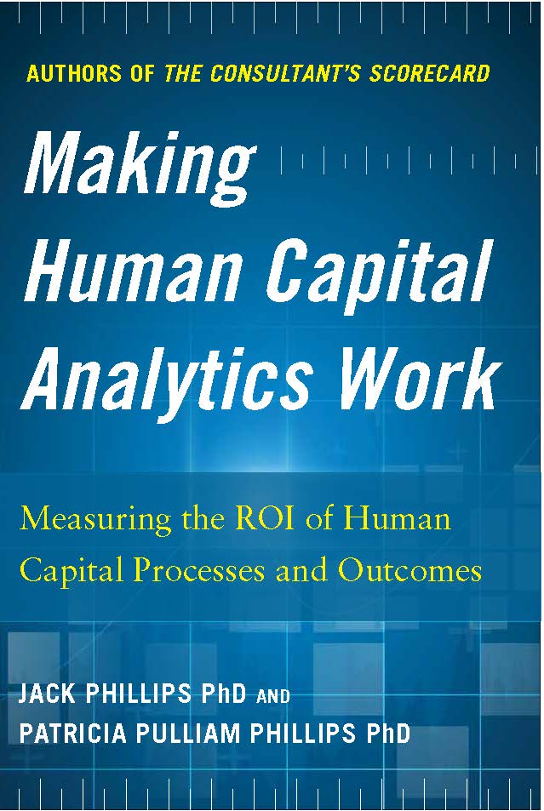
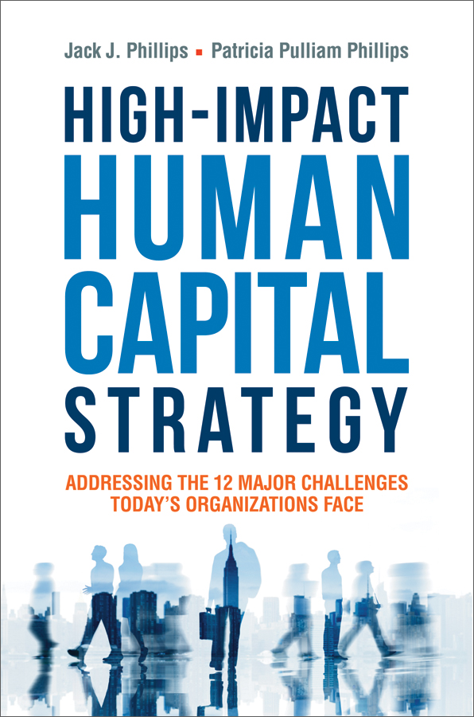
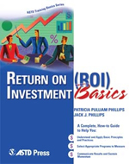
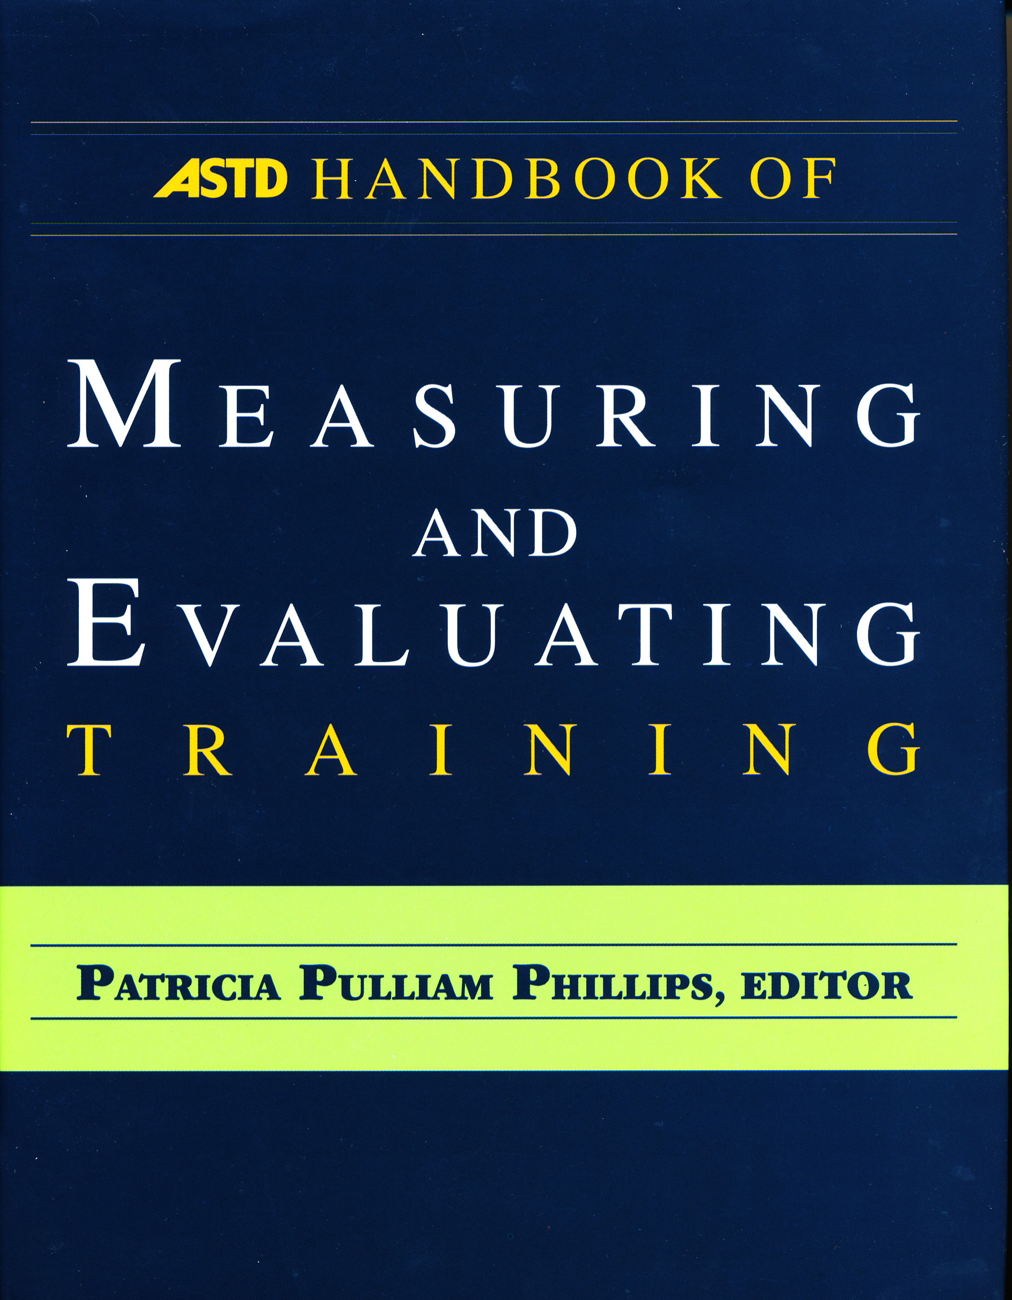
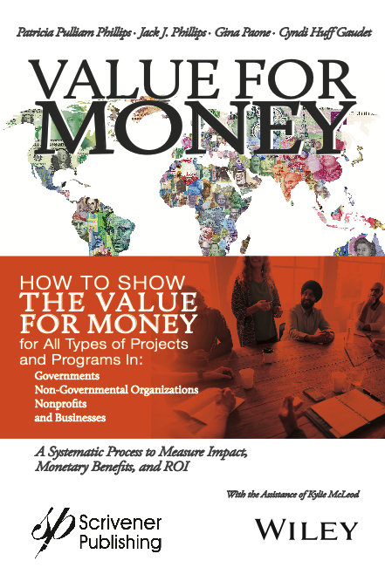
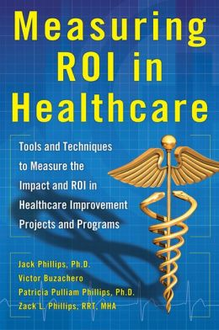
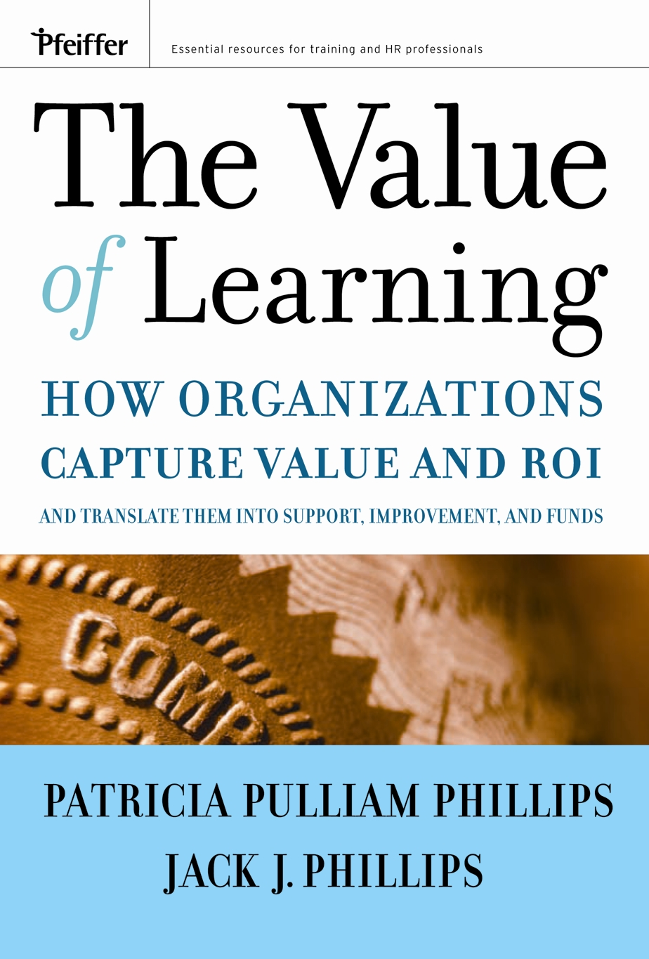
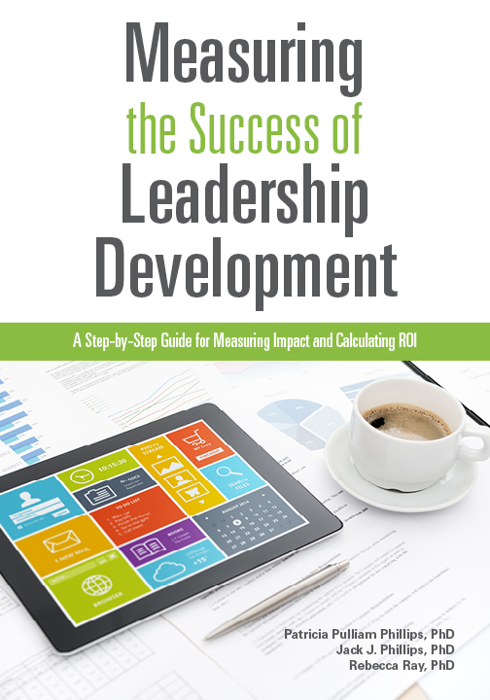
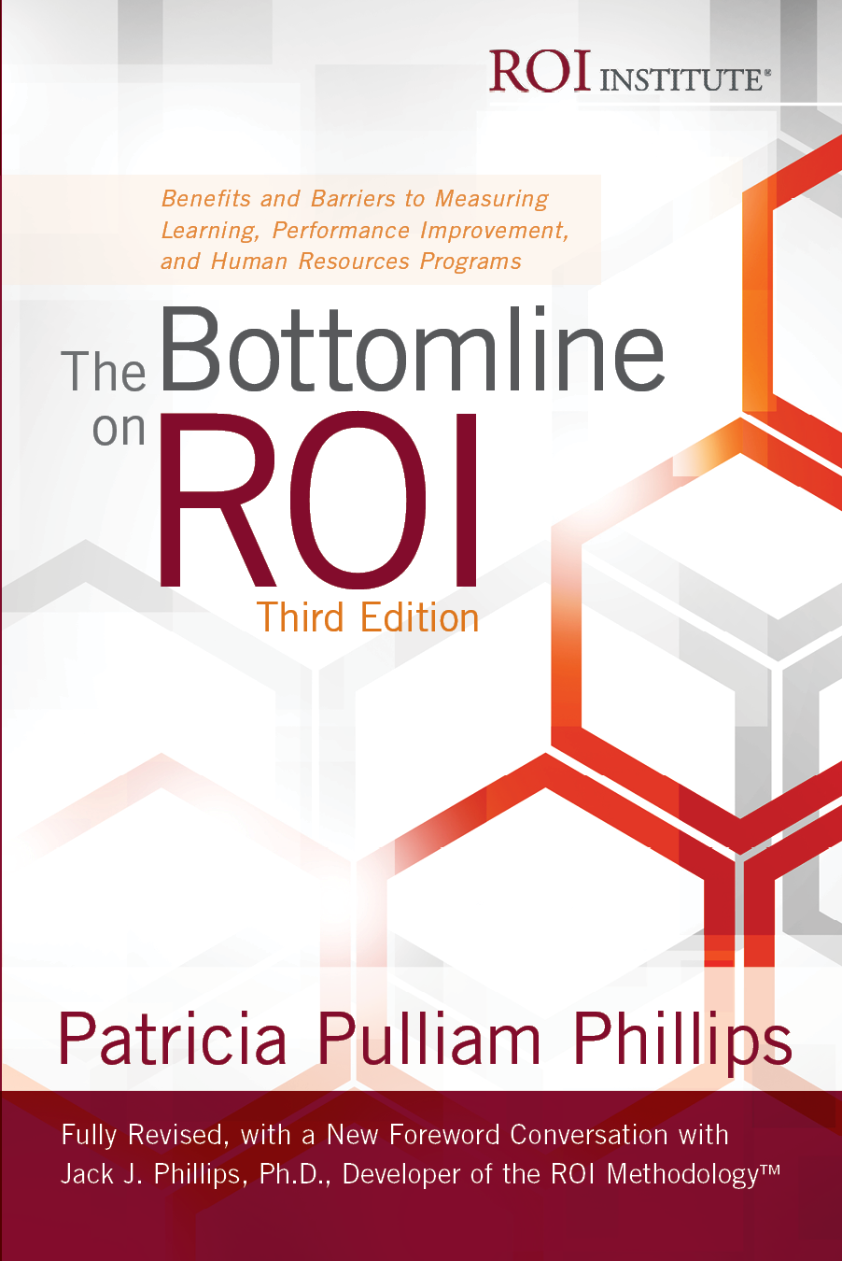
1983
1995
1997
2019
1973
1994
1996
1998
12

Slide 13
New Applications
Human Resources/Human Capital Training/Learning/Development Leadership/Coaching/Mentoring Knowledge Management/Transfer Recognition/Incentives/Engagement Work Arrangement Systems Change Management/Culture Talent Management/Retention Policies/Procedures/Processes Technology/Systems/IT Meetings/Events/Conferences Marketing/Advertisement/Promotion Compliance/Risk Management | Organization Development/Consulting Project Management Solutions Quality/Six Sigma/Lean Engineering Communications/Public Relations Public Policy/Social Programs Creativity/Innovation Ethics/Integrity Safety/Health/Fitness Programs Environment/Sustainability Healthcare Initiatives Schools/Colleges/Universities Public Sector/Nonprofits Faith-Based Programs
Fact

Slide 14
New Organizations
Governments (All levels — 26 countries have endorsed)
Nongovernmental Organizations (e.g. UN)
Nonprofits (e.g. American Cancer Society)
Foundations (e.g. Princess Alanood Foundation)
Religious Organizations (e.g. The United Methodist Church)
School Systems (e.g. elementary, middle, high Schools)
Higher Education (150 community colleges, universities)
Hospitals (Over 200)
Fact

Slide 15
Seventy Countries Including:
Fact
Australia
Brazil
Canada
China
Chile
Colombia
Ecuador
Egypt
France
Germany
India
Jordan
Kenya
Lebanon
Malaysia
Mexico
Netherlands
New Zealand
Nigeria
Oman
Peru
Philippines
Poland
Saudi Arabia
Singapore
South Africa
South Korea
Spain
Turkey
United Arab Emirates
United Kingdom
The ROI Methodology has been implemented in 70 countries through partners.

Slide 16
Why the continuing success? ROI is Fundamental to Resource Management
Investment A
X Not Sustainable
X
Optimal
X Inefficient
Vilfredo Pareto 1848 – 1923 Italian engineer, sociologist, economist 80-20 Rule
Pareto Optimality (aka Pareto efficiency)
Investment B
“When it is useful to them, men can believe a theory of which they know nothing more than its name.”

Slide 17
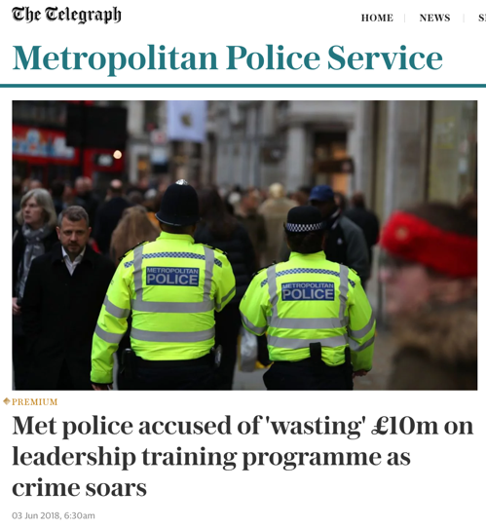
We keep reading the same story!

Slide 18
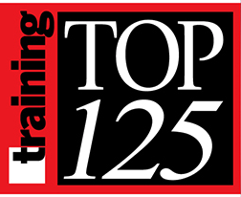
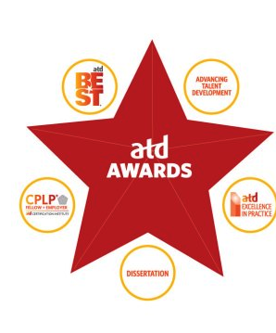
Association award programs are beginning to require it.

Slide 19

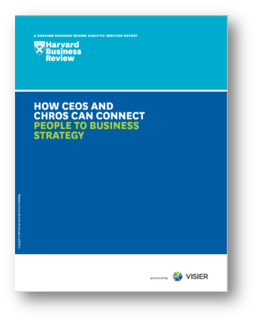
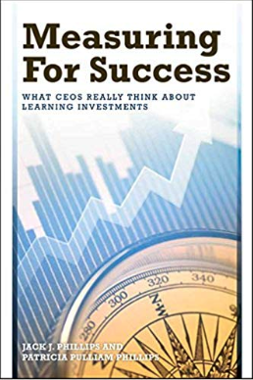
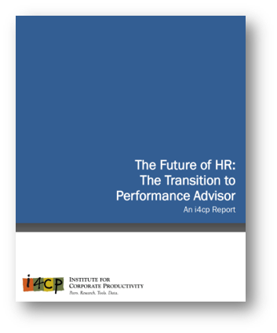
Senior leaders want it.
67% of CEOs say they get a least a basic set of human capital metrics from HR – but only 24% of survey respondents said HR also provides analytics that connect their people metrics to business metrics.
Really, the question isn’t about relevance of the (HR) function or a ‘seat at the table;” rather, it is what impact has HR made on the business.
74% of CEOs report that they want ROI, but only 4% are getting it. Next to business impact data, ROI is the most important metric in their decision making making.

Slide 20

ROI Methodology has more credibility than any other measurement process.
Systematic, step-by-step process
Conservative standards
Design Thinking approach
Always isolate the effects of programs
Client focused/Executive supported
CFO involvement

Slide 21
ROI Institute® Business Model
Research
Publication
Education
Consultation
Presentation
ROI Certification®
Began in 1995
14,000 people participating
5,000 people awarded Certified ROI Professional® designation
Certification offerings include
Live, face-to-face learning
Online learning
Blended learning with coaching
Self-study

Slide 22

Trademarks and copyrights protect the use of proprietary process and content available to partners and associates in good standing.
The following phrases are protected in US and non-US countries.
ROI Institute®
ROI Methodology®
ROI Certification®
Certified ROI Professional®
…. more in process
All content associated with the above phrases are covered under copyright rules and legislation worldwide.
Partners and associates in good standing license the use of all trademarks and copyrighted material. Trademarks and copyrighted materials are owned by ROI Institute, Inc.

Slide 23

Goals for 2019
Continued expansion in application
Accreditation by International Accreditation and Continuing Education and Training (IACET)
ROI Institute Academy, an online portal offering five levels of access on a subscription basis
Adopt more technologies to support ROI Methodology
Drive more research to support application of ROI Methodology
Create a coaching model that supports and enables partners, associates, and clients to be successful with the ROI Methodology
Streamline and formalize processes to enable partners and associates to drive business

Slide 24

All roads lead to ROI.

